Slide 1
API Service Development
Project : Student Course Management System O R Imon

Slide 2
Project Overview
The goal of the Student-Course Management System is to make managing student data and course enrollment more efficient. It offers a centralized platform that makes it easy to add courses, create students, and effectively manage the academic profiles of students.

Slide 3
Used Technologies & Challenges
Express.js: Utilized as the web application framework to handle HTTP requests and responses.
Sequelize (ORM): Integrated to interact with an SQLite database, allowing for the creation and management of students and courses.
SQLite: Employed as the database system for storing student and course information.

Slide 4
Challenges
Database Relationships: Establishing and managing the one-to-many relationship between students and courses.
GPA Calculation: Developing a reliable GPA calculation mechanism based on the enrolled course grades.
Error Handling: Implementing robust error handling to ensure smooth user interactions.

Slide 5
Solutions
Sequelize ORM: Leveraged Sequelize for seamless database interactions, simplifying the handling of relationships.
GPA Calculation Function: Developed a helper function to accurately calculate new GPAs based on enrolled course grades.

Slide 6
Timetable & Summary
Planning and Design: Hours 3-5
Backend Development: Hours 8-12
Testing and Debugging: Hours 5-7
Documentation and Finalization: Hours 5-6
The Student-Course Management System aims to enhance educational administration by providing a user-friendly platform for managing student information and course enrollments. The project focuses on efficiency, reliability, and scalability to adapt to future educational requirements.

Slide 7
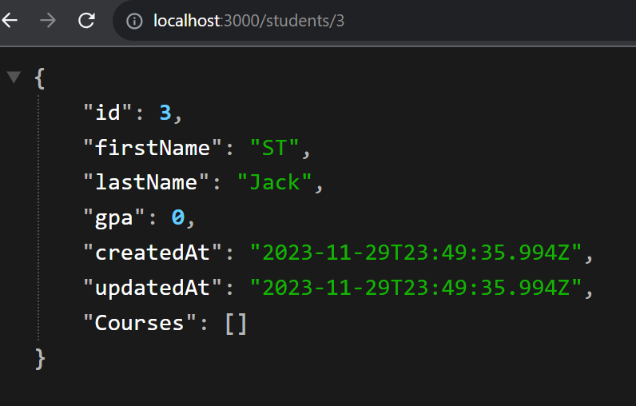
Demo
Create a new Student data
POST endpoint to create a new student
curl -X POST -H "Content-Type: application/json" -d '{"firstName": “ST", "lastName": “Jack"}' http://localhost:3000/students
GET endpoint to retrieve a student with all courses
http://localhost:3000/students/1
curl http://localhost:3000/students/<studentId

Slide 8
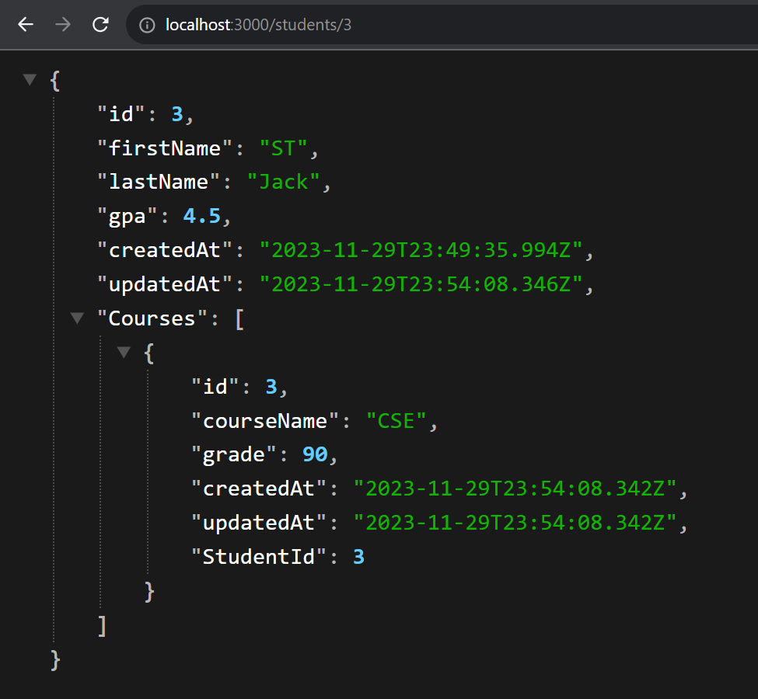
Demo
create a new course for a student
// POST endpoint to create a new course for a student
curl -X POST -H "Content-Type: application/json" -d '{"courseName": "CSE", "grade": 90}' http://localhost:3000/students/3/courses

Slide 9
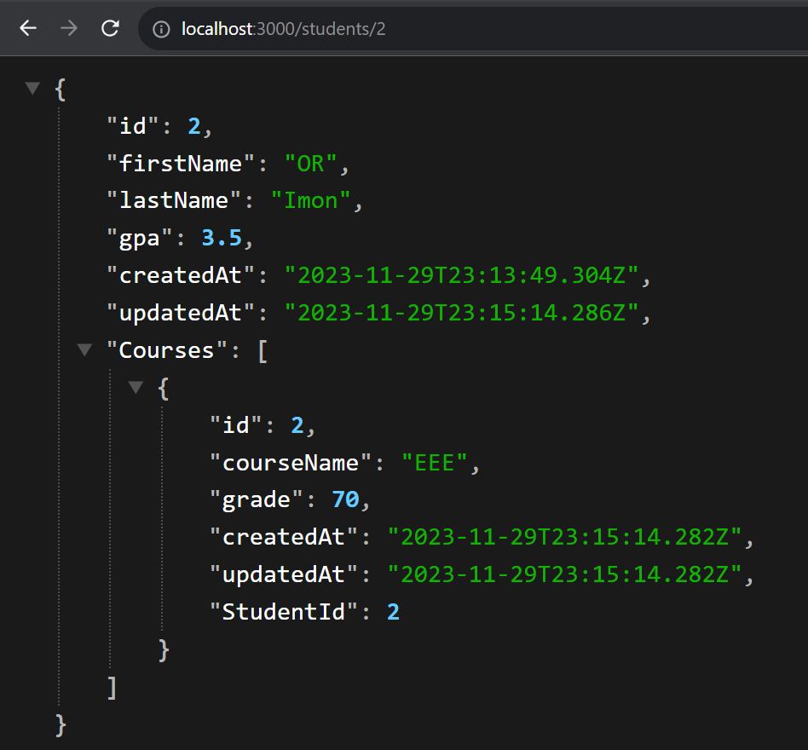
Demo
Update student & course data

Slide 10
Conclusion
The Student-Course Management System showcases the successful integration of technologies to create an efficient and reliable educational management solution. The project emphasizes the importance of database design, GPA calculations, and effective error handling for a robust system.

