Slide 1

Welcome To Our Presentation

Slide 2

OUR Project TOPIC
Smart Home System

Slide 3
Group Members

Slide 4
Hardware required
Arduino UNO
Sonar Sensor
Jumper wire
LED
LDR
Servo motor
Breadboard
DC Motor
TMP

Slide 5
INTRODUCTION
A smart home is a residence that uses internet-connected devices to enable the remote monitoring and management of appliances and systems, such as lighting and heating.
Those Sensor is compatible with Arduino UNO,Arduino mega2560, Arduino ADK etc.

Slide 6
Working Principle
Sonar Sensor measures the distance to an object and open the door.
LRD measures the light value and light will on/off with the condition.
TMP36 measures the temperature will on/off with the condition .

Slide 7
Features
Sensor has low power consumption, and high sensitivity. (Sensitivity should not be confused with accuracy)
Operates on low Voltage of 5v.
Operates on low current <20mA.

Slide 8
Advantages
Easier to Lock and Unlock the Doors
Save Energy
Know About Maintenance and Service
Customize as per your Convenience
It’s Smart
Increase Property Value

Slide 9
Disadvantages
Cost
Dependency on Professionals
Setup and Configuration
More Technical Security Threats

Slide 10
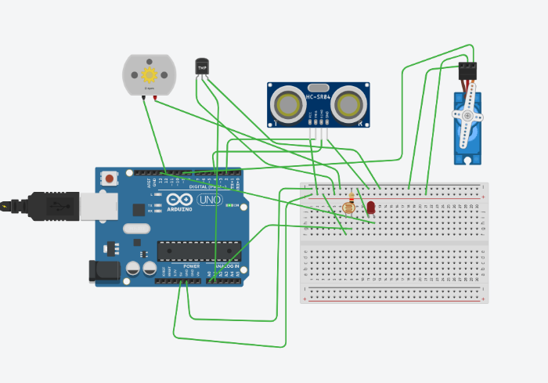
Pictographic Representation
connection to Arduino

Slide 11
REFERENCES
SL.No. | LINK
1. | https://www.instructables.com/id/Smart-home-with-arduino/
2. | https://www.hackster.io/amrmostaafaa/how-to-build-a-diy-arduino-based-smart-home-hub-with-1sheeld-79d405
3. | https://create.arduino.cc/projecthub/uiki-technologies/smart-home-automation-system-a35478

Slide 12

Any Question

Slide 13
Thank You ☺

