Slide 1
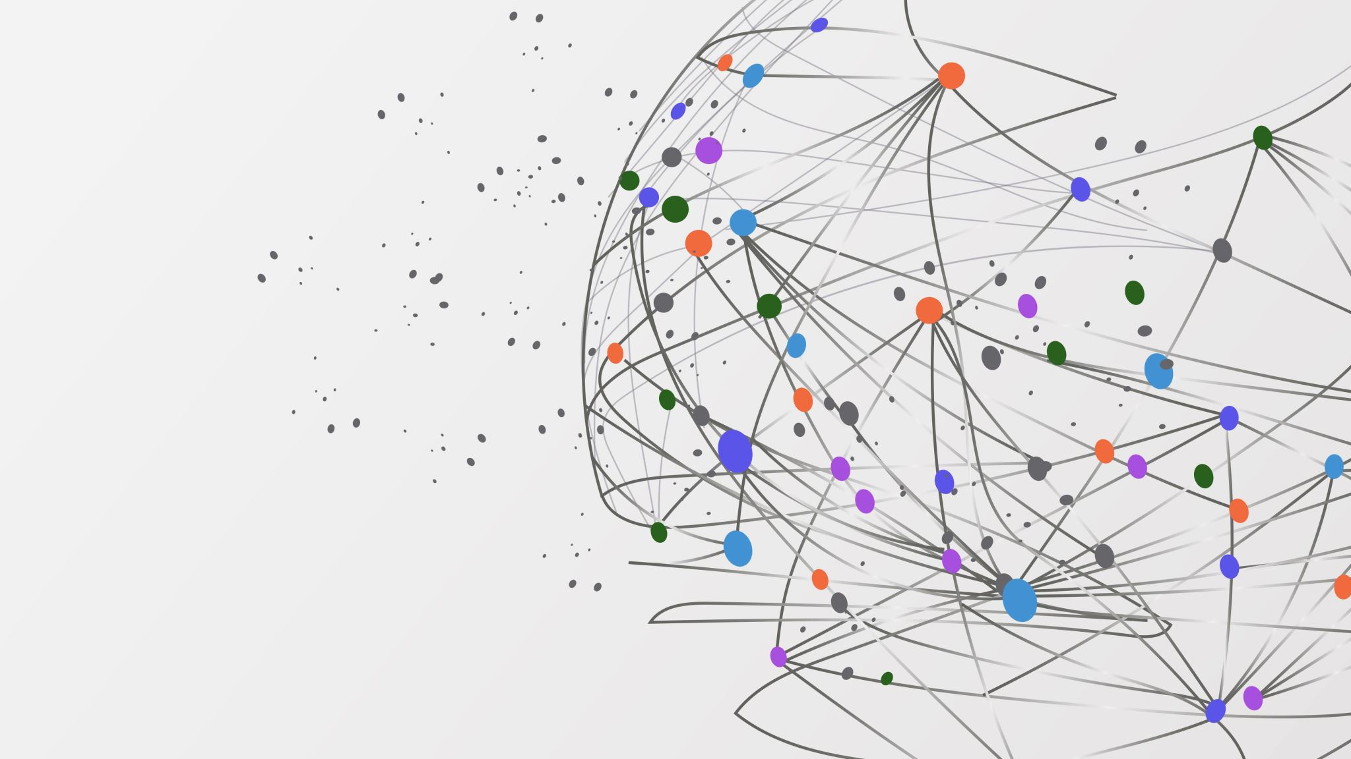
Particle in a box with a single barrier
Imma moncusí Laso

Slide 2
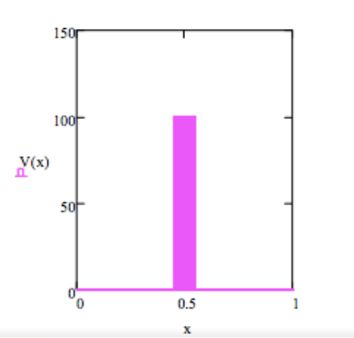
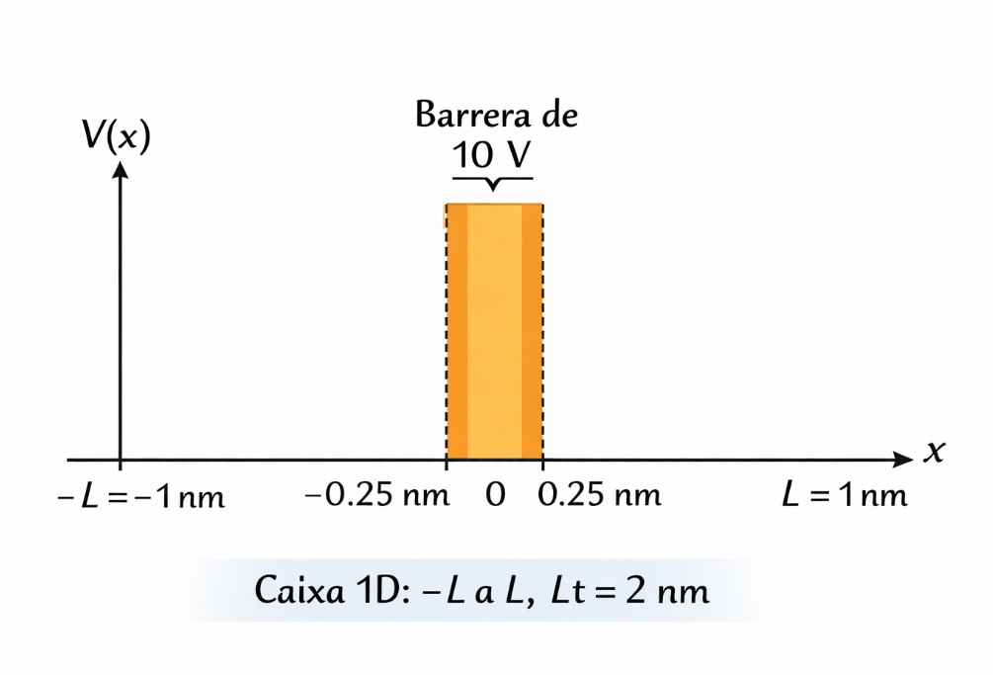
Initial conditions
Reference:
V=100
L=1
Lbarrier= 0.1
P1:
V=10
L=2
Lbarrier= 0.5

Slide 3
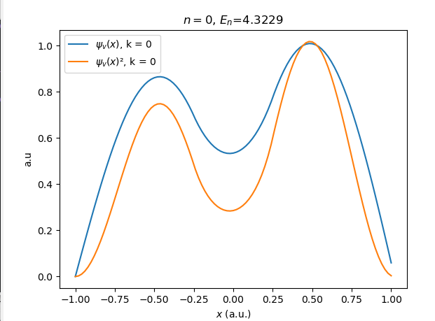
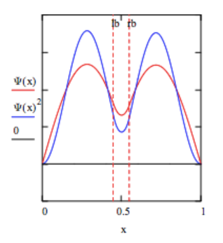
Reference vs result
Reference
h=0.02

Slide 4
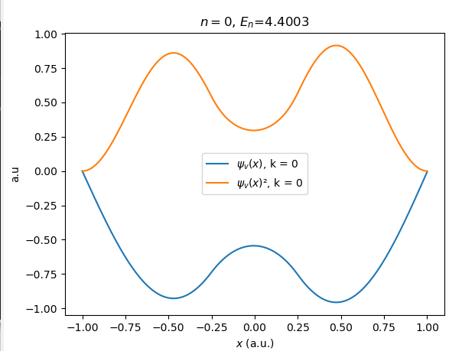
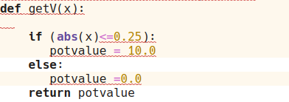
Reference vs result
Something happened, maybe this?
The probability makes sense, but psi is like it is multiplied by "-1"
h=0.002

Slide 5
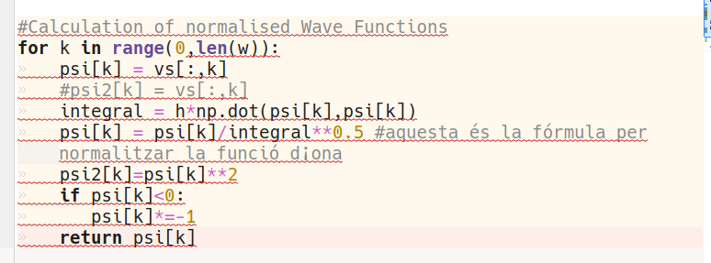

Solution intentSolution intent

