Slide 1
Software Engineering Laboratory
CSE-3104
BD Voting System
Presented By:
Farhan Mehmud Polock (ID:20232037010)
Jannatul Ferdous (ID:20232020010)
Ikaramul Islam Imon (ID;20232034010)
Supervised By:
Zahrul Jannat Peya , Assistant Professor
Department Of Computer Science And Engineering
North Western University,Khulna

Slide 2
Introduction
BD Voting System is a web-based platform for secure and transparent online elections.
It allows voters to register, login, and cast votes easily from anywhere.
Admins can manage elections, candidates, and monitor real-time results.
The project ensures data security, reliability, and transparency in the voting process.

Slide 3
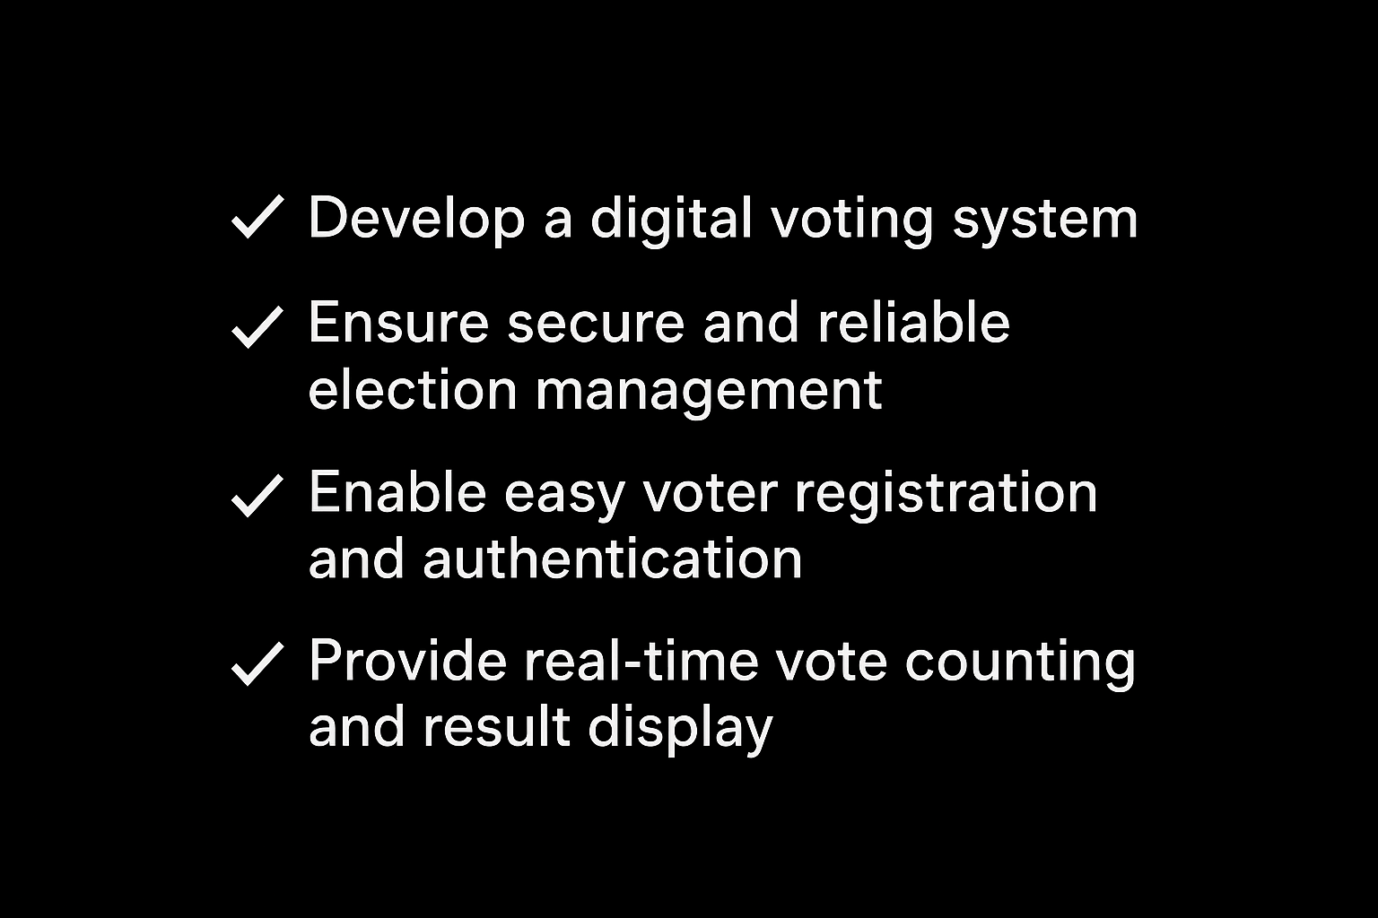
Objectives

Slide 4
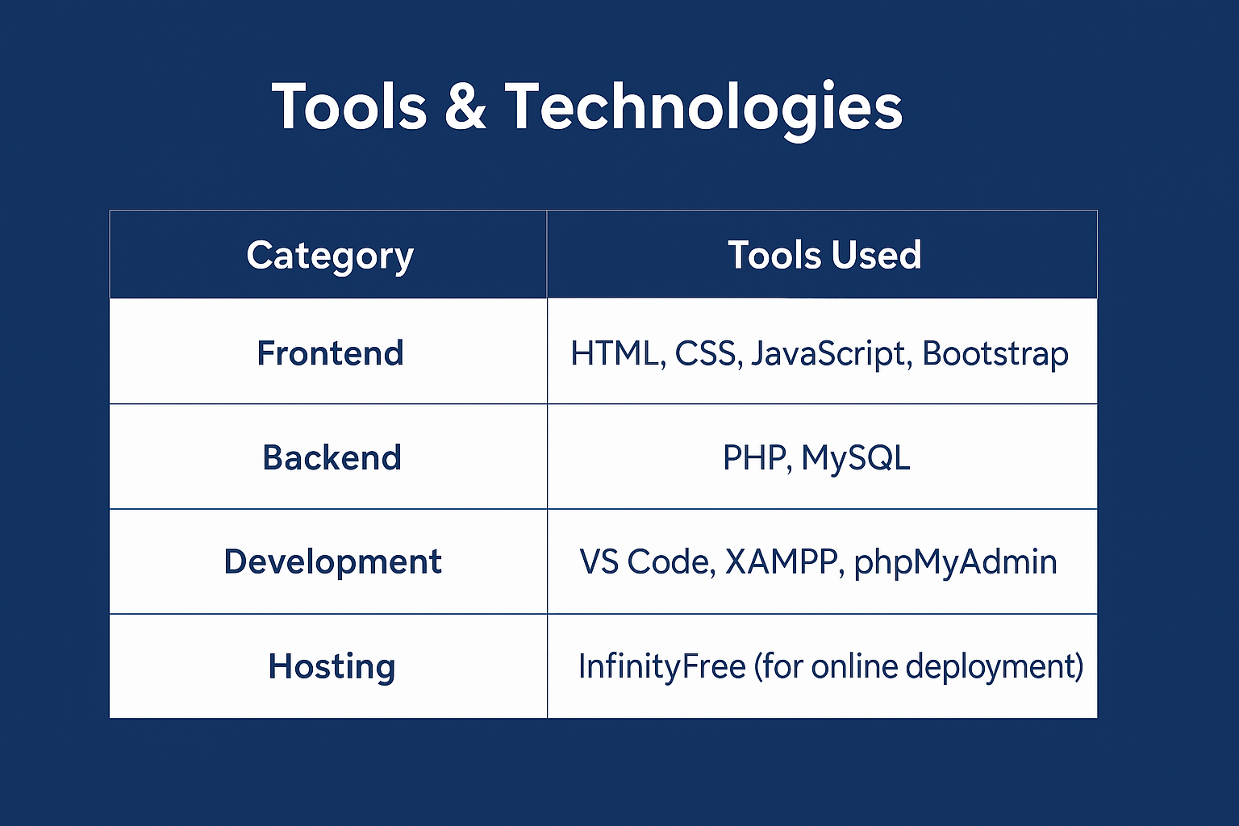

Slide 5
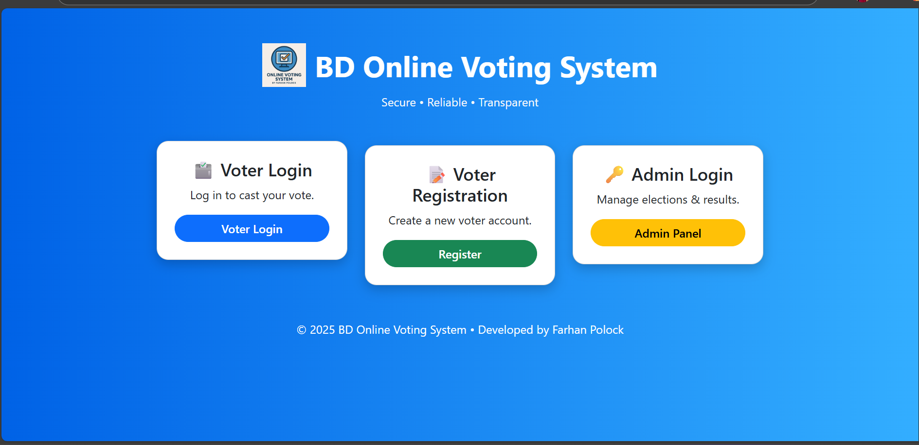
System overview
Home Page

Slide 6
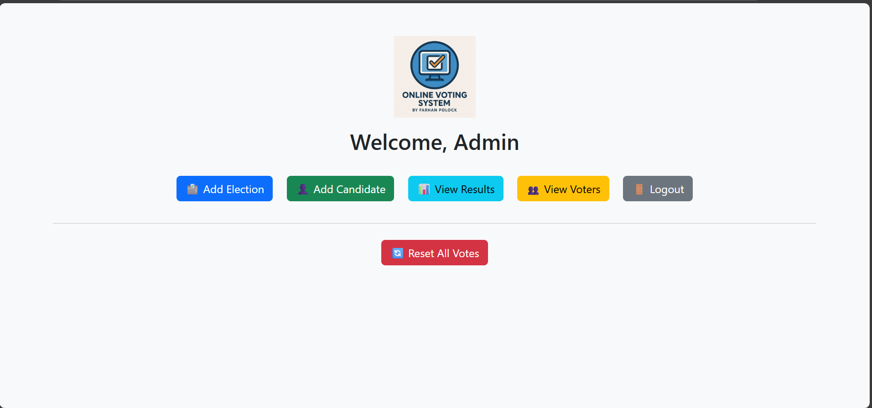
Admin Module
– Manages elections, candidates, and results.

Slide 7
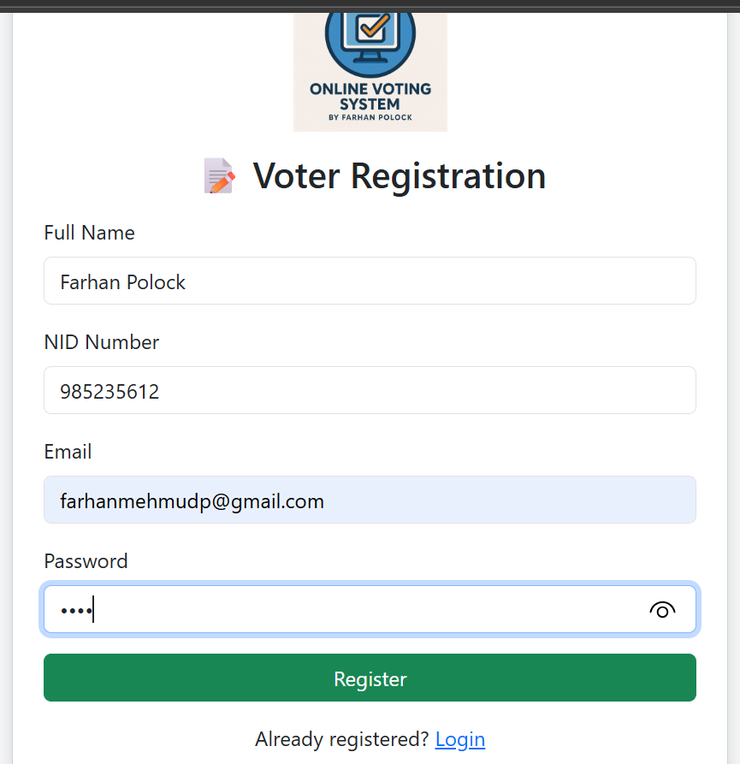
Voter Registration & Authentication

Slide 8
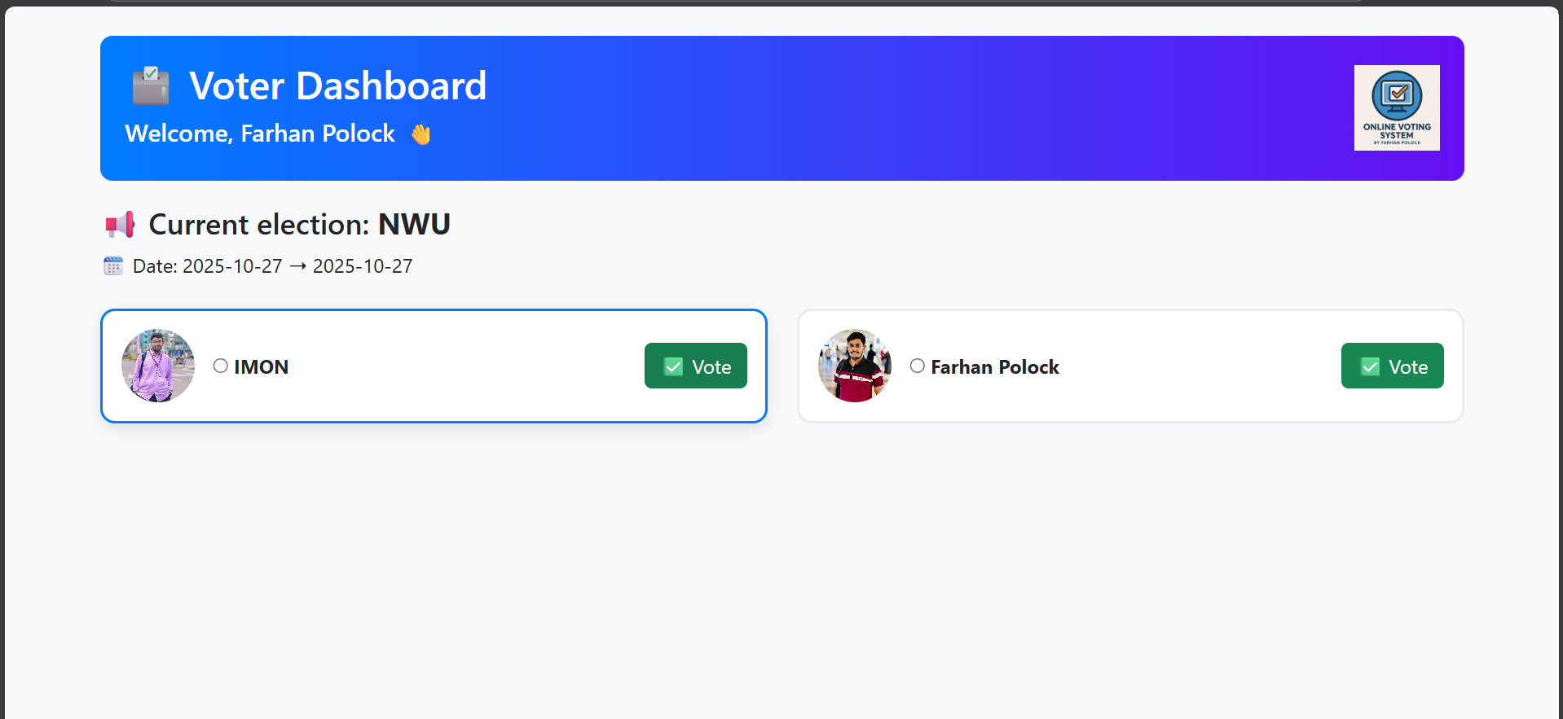
Voter Module
– Allows registration, login, and voting.

Slide 9
Conclusion
BD Voting System enhances transparency and trust in elections.
It reduces human error and simplifies the voting process.
This system can be further improved for national or institutional use.

Slide 10


