Slide 1
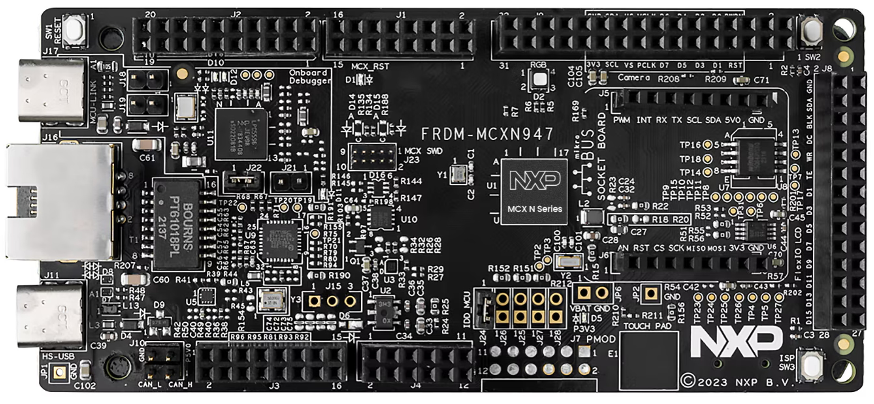
SW1
RST
J17
OPTIONAL
JLINK DEBUG
J11
HIGH SPEED USB
ROM ISP PROGRAMMING
CAMERA PREVIEW
SW3
ISP
RECOVERY

