Slide 1
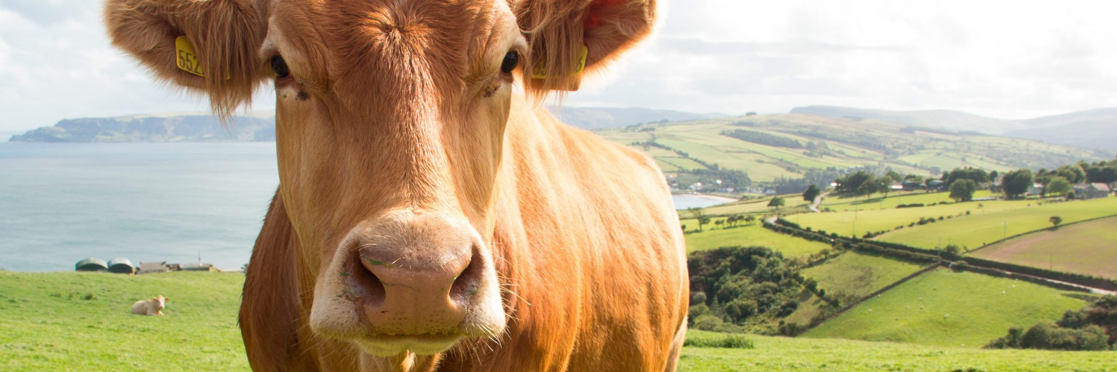

Compression algorithms to optimize battery
consumption in precision livestock farming.

Slide 2
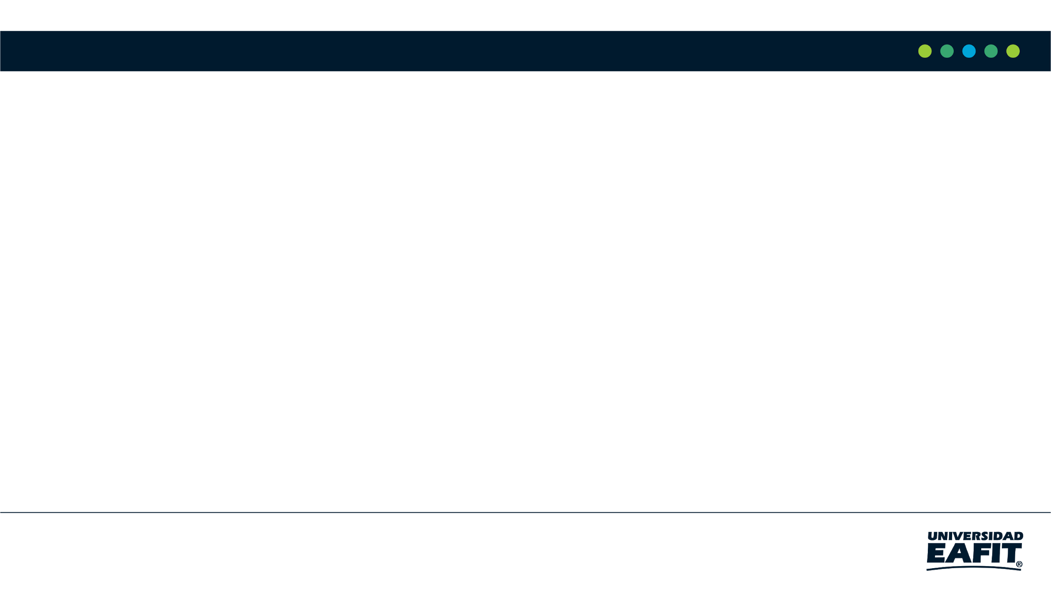




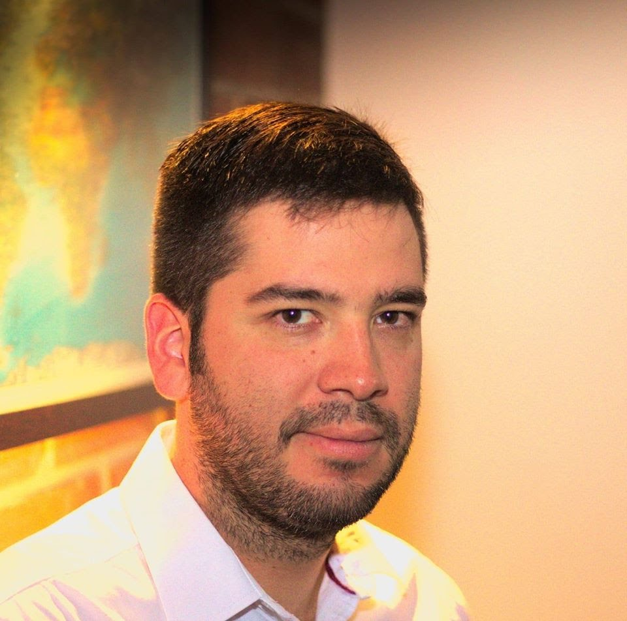

Team Presentation
Maria Isabel Arango
Isabella Montoya
Andrés
Agudelo
Simón Marín
Mauricio
Toro
https://github.com/imontoyah/ST0245-002/tree/master/proyecto

Slide 3
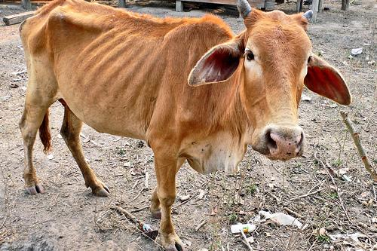
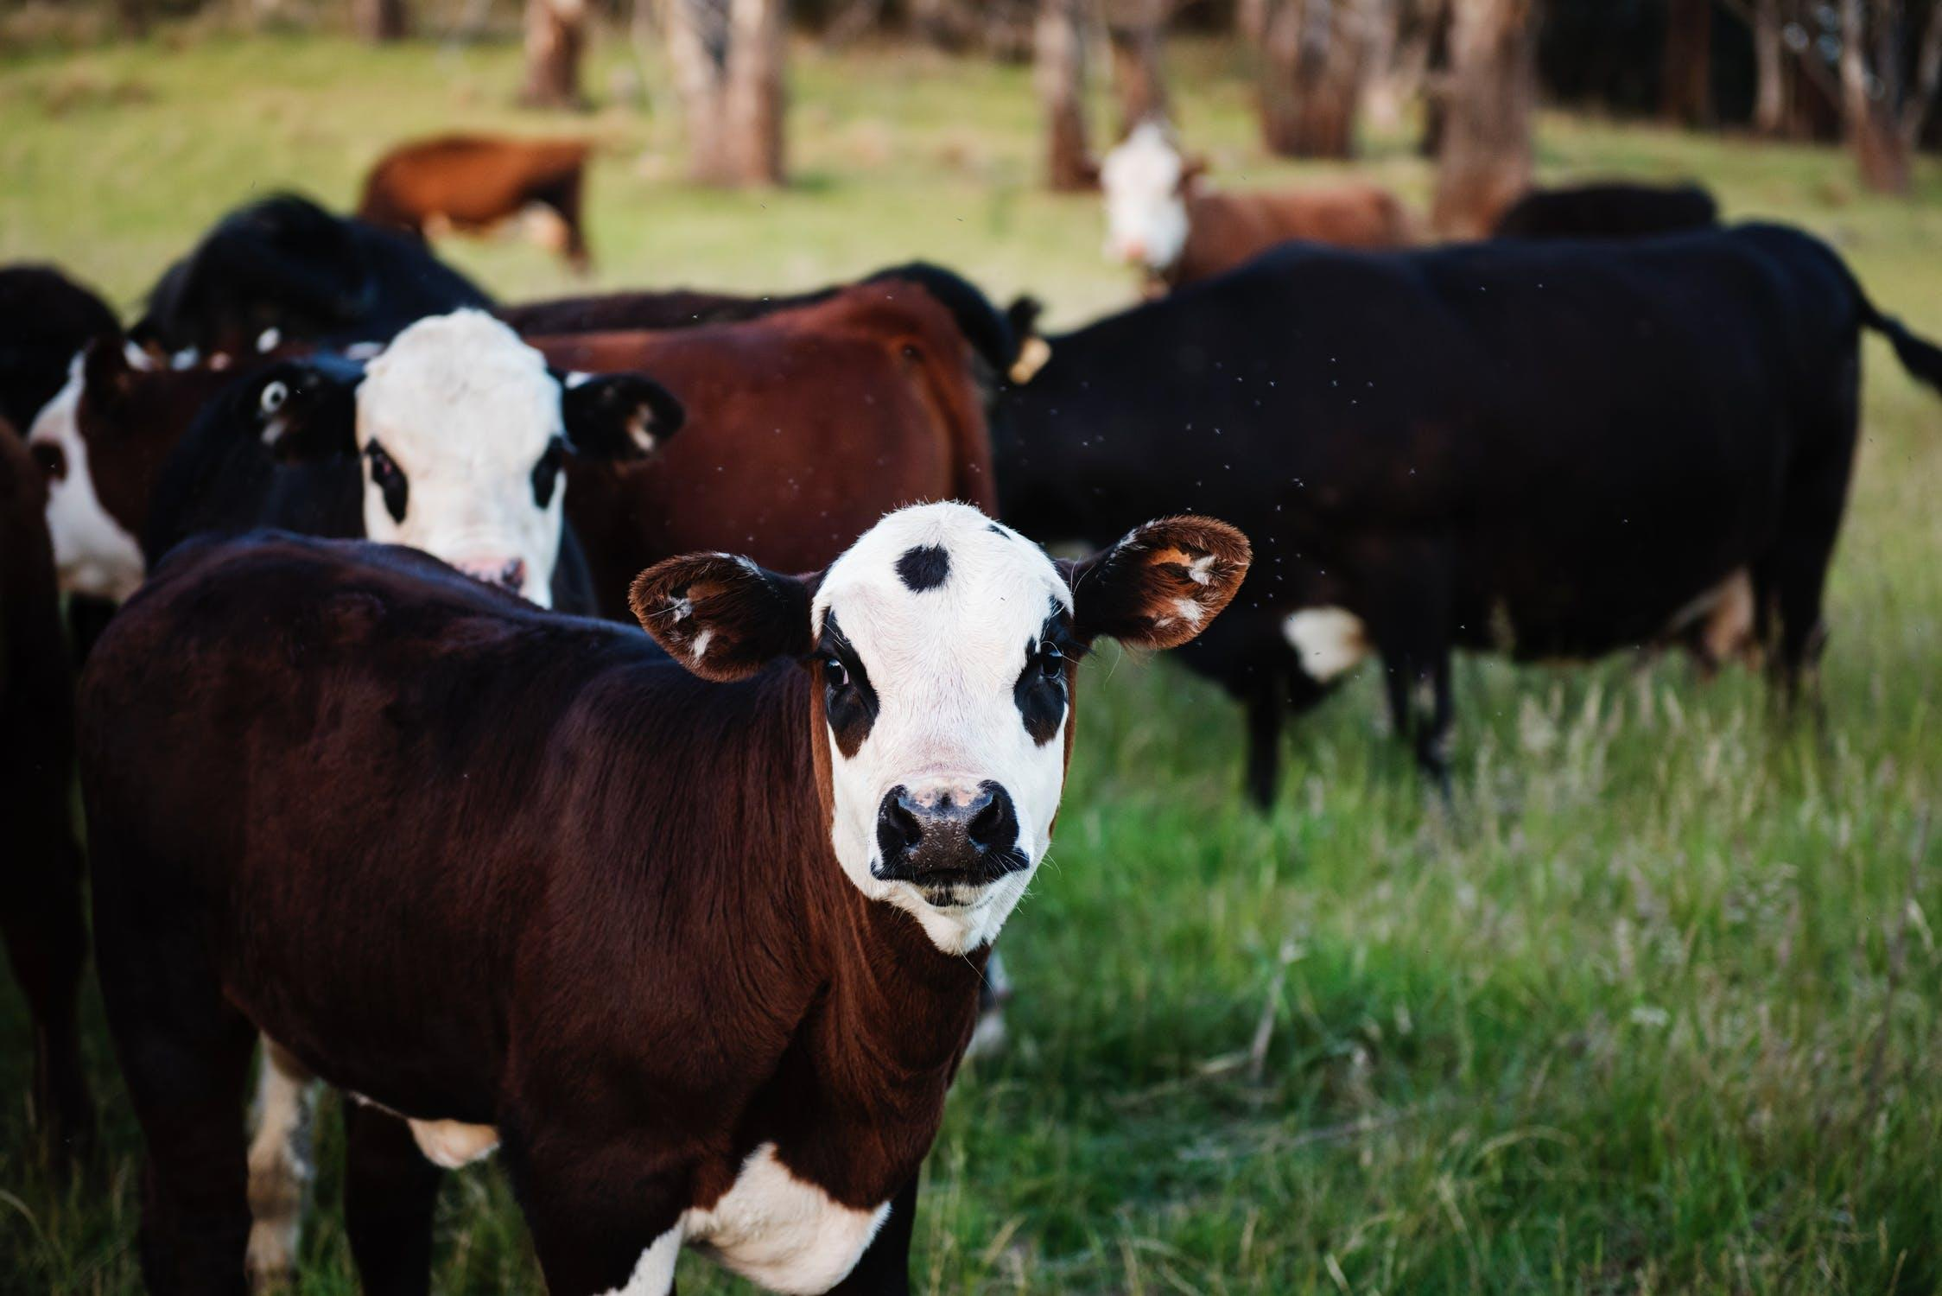
Training Process
Convolutional Neural Network
Sick-Cattle Images
Classification Algorithm
Classification Model
Healthy-Cattle Images

Slide 4
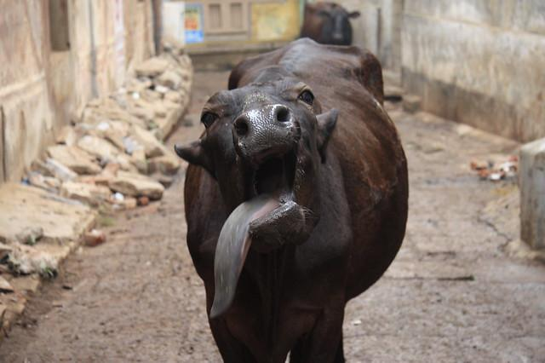
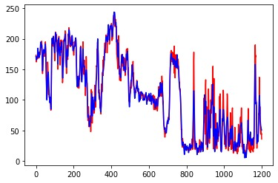
Testing Process
Is sick
Cattle Image
Fast Fourier
Transform
Classification Model
Output

Slide 5
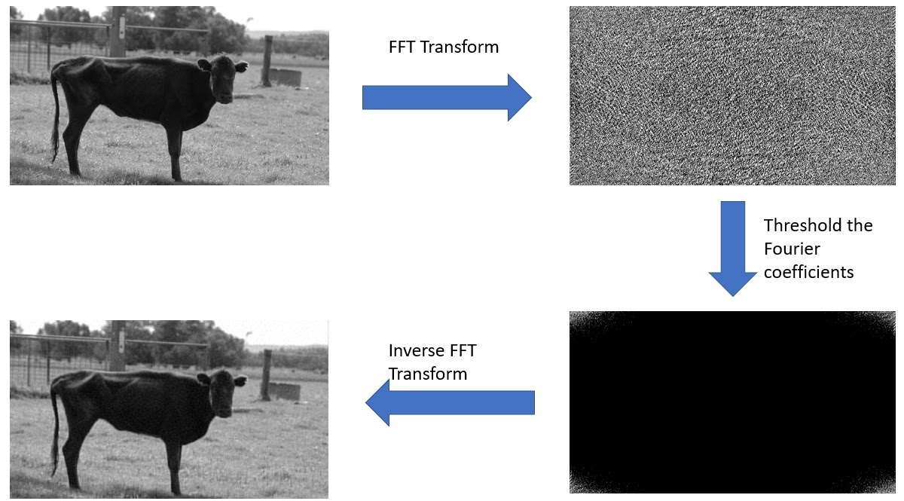
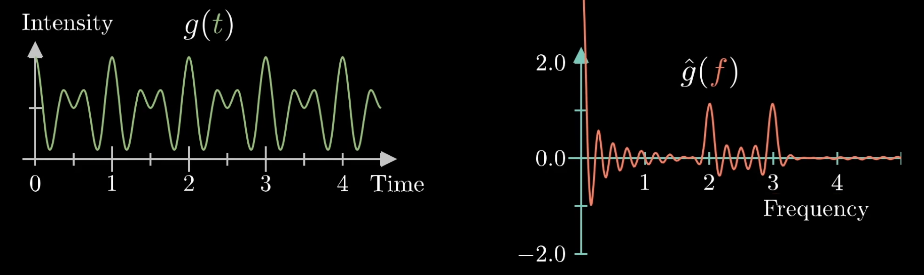
Compression Algorithm Design
FAST FOURIER TRANSFORM (FFT)
Fast Fourier transform is used to modify an image between the spatial and frequency domain. This algorithm transforms the image´s data into a set of frequencies in terms of sines and cosines, where we will only keep those frequencies with a high coefficient, reducing the size of the matrix.

Slide 6

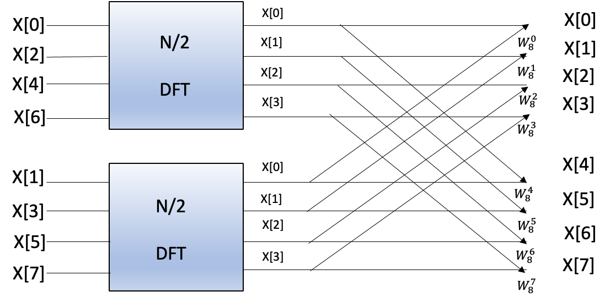
Compression Algorithm Design
Compression Algorithm Complexity
The order of complexity of DFT is O(n^2) while FFT is O(n. logn) hence, FFT is faster than DFT.
WHY?
FFT is based on divide the signal into two smaller signals (even and odds), compute the DFT of the two smaller signals and join them to get the DFT of the larger signal.

Slide 7
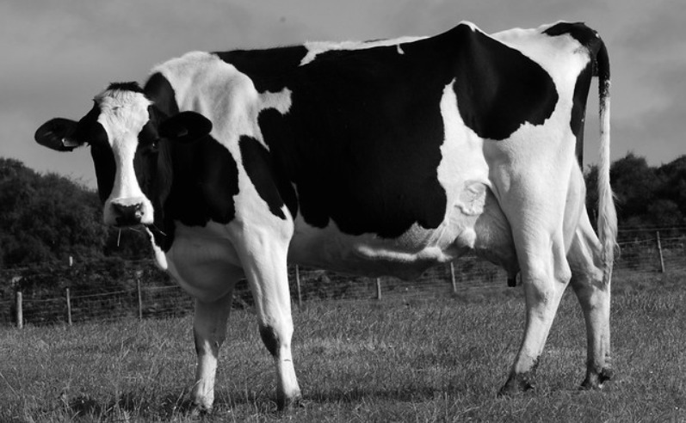
Tested Compression Algorithms
ORIGINAL IMAGE

Slide 8
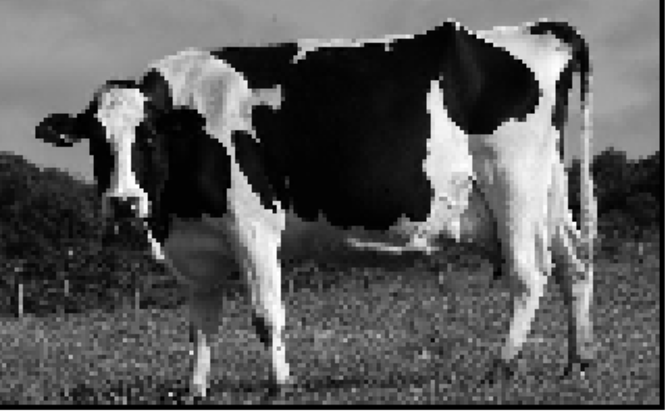

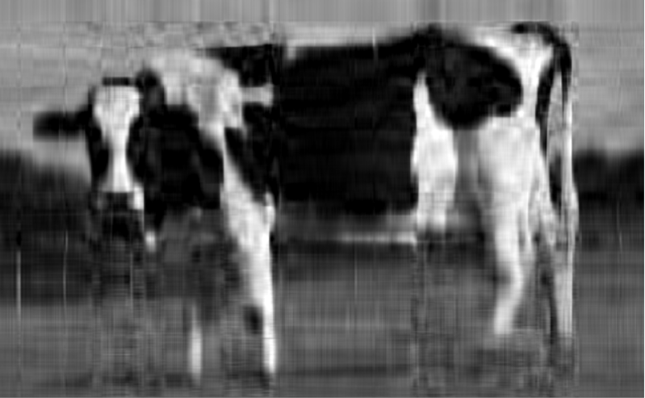
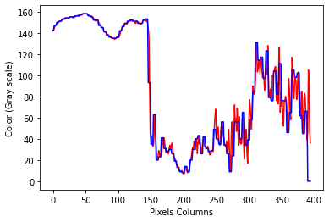
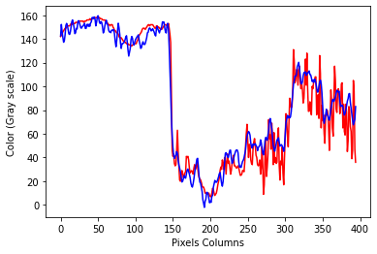
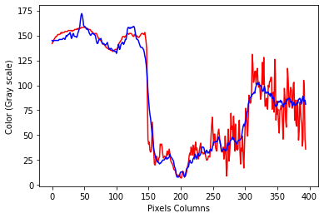
Tested Compression Algorithms
Nearest Neighbor
Fast Fourier Transform
Singular Value Decomposition
We compressed the image in a 95% using the three algorithms mentioned above.
Also, the graphics represent the relation between a specific column of the matrix and the values of the color it can takes being deep black the lowest and deep white the highest.

Slide 9
THANK YOU!.

