Slide 1
Packet Injection 101
Vivek Ramachandran

Slide 2
What is packet injection ?
Please go through the raw socket tutorial before going further.
Simply put packet injection is the technique by which a programmer can construct arbitrary packets in memory and inject them into the network.
By arbitrary i mean - full control over all the headers – Ethernet, IP, TCP, UDP … you name it we’ve got it !
Additionally, raw packet injection allows the programmer to design his own custom protocols, if he so desires.

Slide 3
Packet Injection – the whole nine yards – Approach 1
1. Create a raw socket
Raw
2. Create the Ethernet Header
Ethernet
3. Create the IP Header
IP
4. Create the TCP Header
TCP
Data
5. Create the data
6. Put everything together
Ethernet
IP
TCP
Data
7. Send the packet out
Ethernet
IP
TCP
Data
Raw

Slide 4
Packet Injection – the whole nine yards – Approach 2
1. Create a raw socket
Raw
2. Create a buffer for the packet
3. Create the Ethernet Header
Ethernet
4. Create the IP Header
Ethernet
IP
5. Create the TCP Header
Ethernet
IP
TCP
6. Create the data
Ethernet
IP
TCP
Data
7. Send the packet out
Ethernet
IP
TCP
Data
Raw

Slide 5

The Ethernet Header – Pictorial view

Slide 6
The Ethernet Header – Data structure view
Defined in linux/if_ether.h
Looks like this :
struct ethhdr
{
unsigned char h_dest[ETH_ALEN]; /* destination eth addr */
unsigned char h_source[ETH_ALEN]; /* source ether addr */
unsigned short h_proto; /* packet type ID field */
}
We will fill this structure up to create the Ethernet Header for our packet.

Slide 7
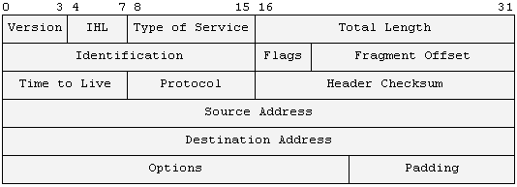
The IP Header – Pictorial View

Slide 8
The IP Header
Data Structure
View
struct iphdr {
#if defined(__LITTLE_ENDIAN_BITFIELD)
__u8 ihl:4,
version:4;
#elif defined (__BIG_ENDIAN_BITFIELD)
__u8 version:4,
ihl:4;
#else
#error "Please fix <asm/byteorder.h>"
#endif
__u8 tos;
__u16 tot_len;
__u16 id;
__u16 frag_off;
__u8 ttl;
__u8 protocol;
__u16 check;
__u32 saddr;
__u32 daddr;
/*The options start here. */
};
Define in linux/ip.h

Slide 9
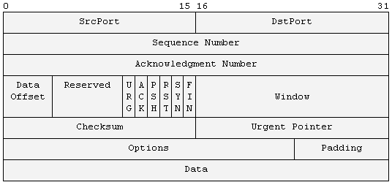
The TCP Header – Pictorial view

Slide 10
The TCP header
– Data Structures view
struct tcphdr {
__u16 source;
__u16 dest;
__u32 seq;
__u32 ack_seq;
__u16 doff:4,
res1:4,
cwr:1,
ece:1,
urg:1,
ack:1,
psh:1,
rst:1,
syn:1,
fin:1;
__u16 window;
__u16 check;
__u16 urg_ptr;
};
Define in linux/tcp.h

Slide 11
Let the games begin !

