Slide 1
Gam3ty
Final project

Slide 2
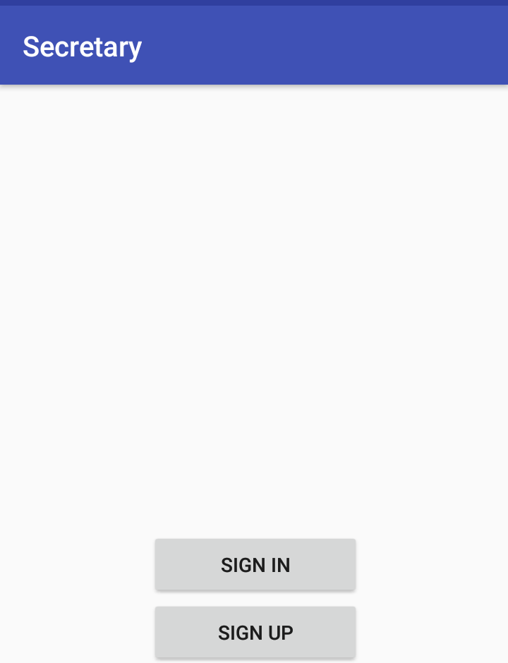
Sign on screen for secretary
if secretary have an account press sign in button to log into his account
Else press sign up to make an account

Slide 3
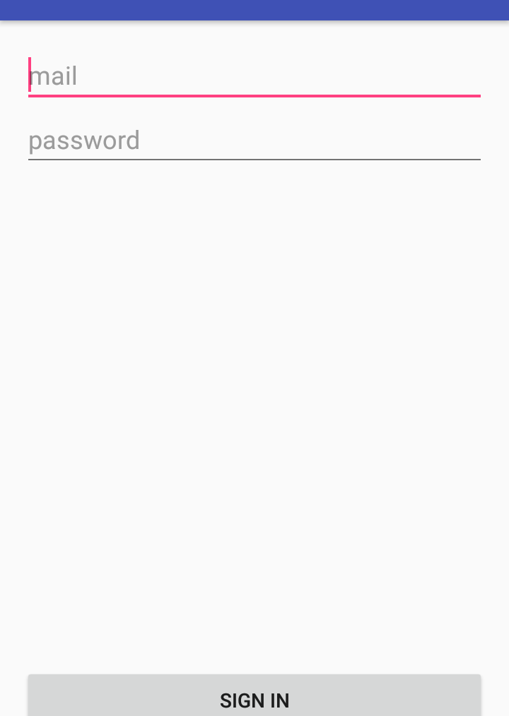
Sign in screen :
Here user type his mail and password then press sign in button to go to his profile

Slide 4
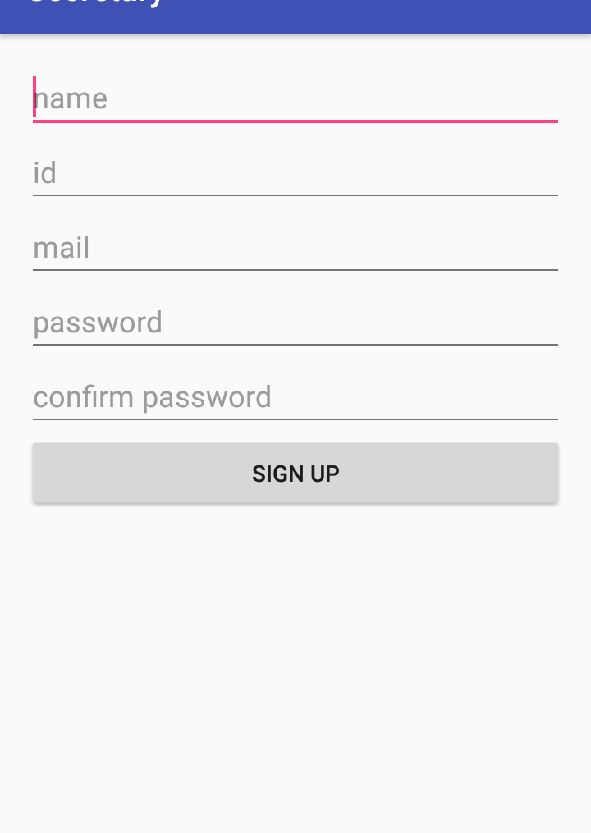
Sign up screen :
Here user fill in data to create an account

Slide 5
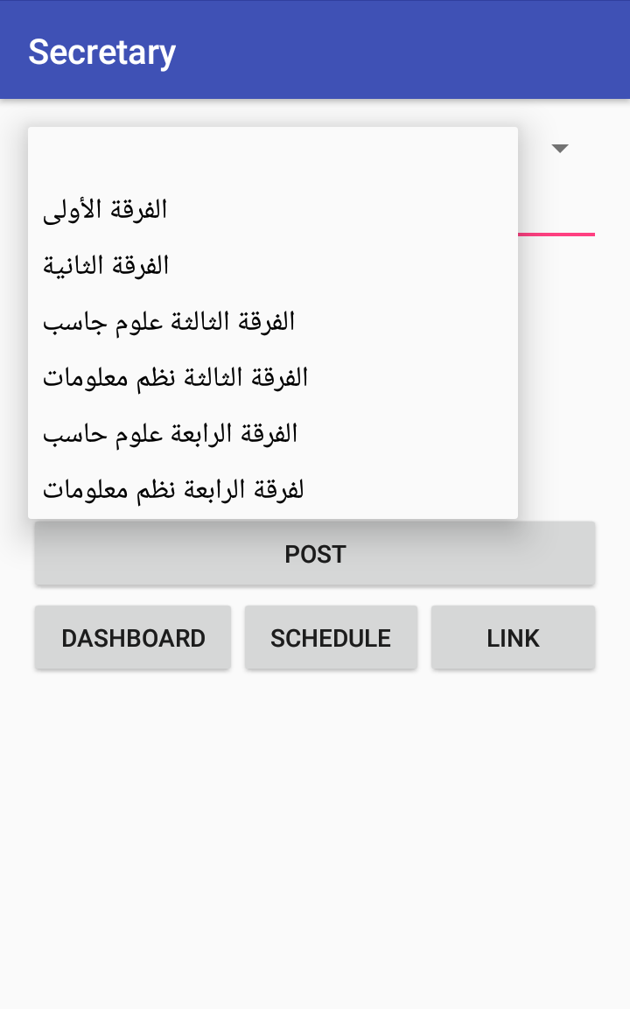
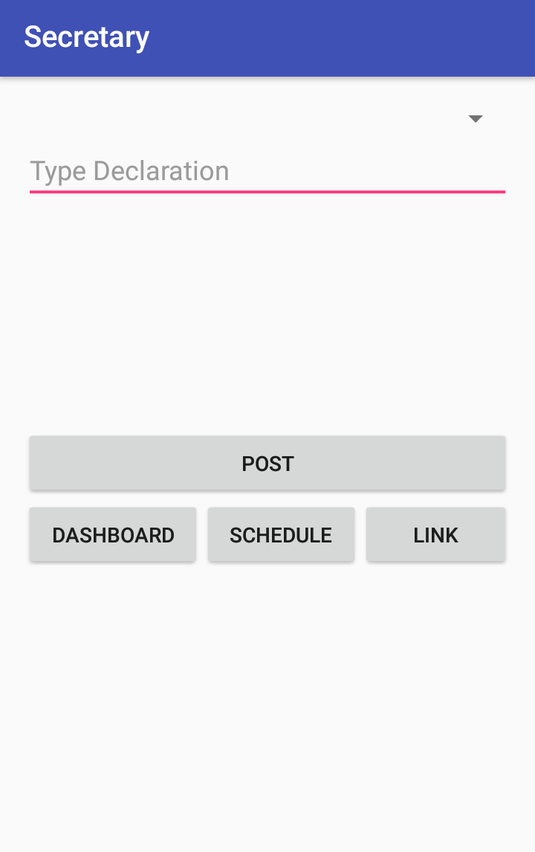
Dashboard screen : secretary choose the study group , then type declaration and press post button to post it in Bulletin board schedule button moves to schedules for all study groups link button moves to

Slide 6
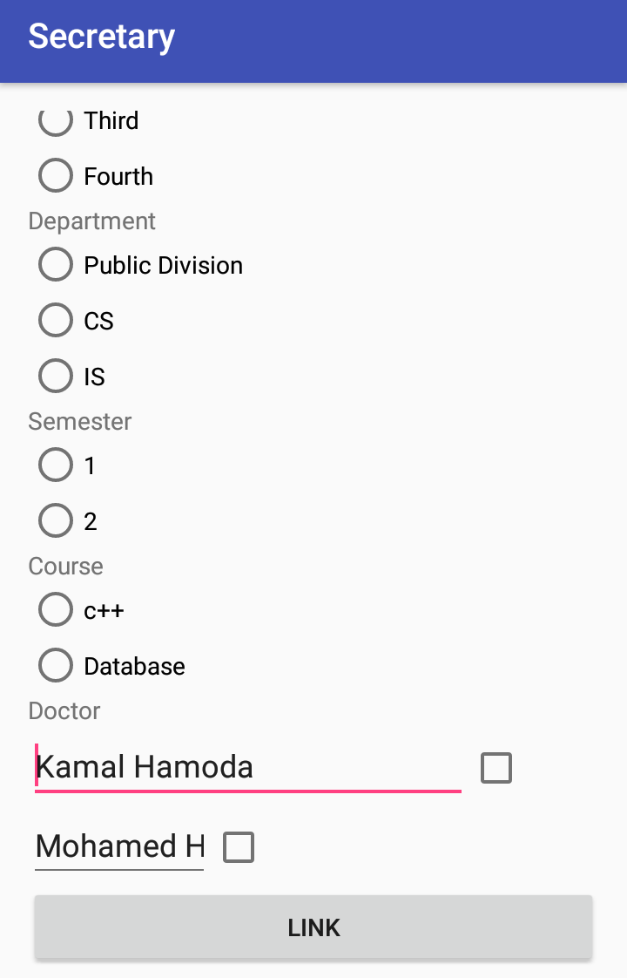
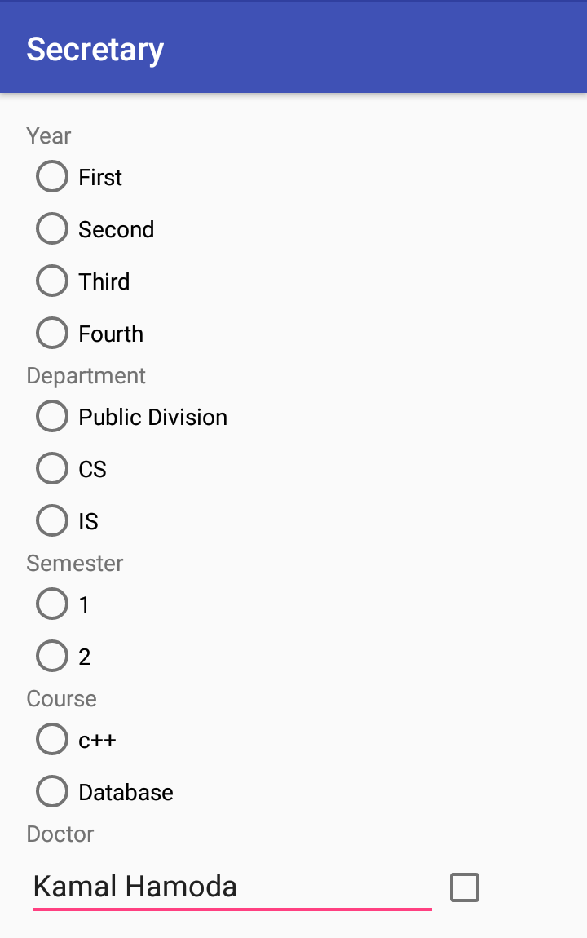
LINK SCREEN : HERE SECRETARY SELECT YEAR & DEPARTMENT & SEMESTER &COURSE AND DOCTOR TO

