Slide 1
Chapter 1 Introduction to Programs, and Java

Slide 2
Objectives
To understand, programs, and different types of them (§§1.2–1.4).
To describe the relationship between Java and the World Wide Web (§1.5).
To understand the meaning of Java language specification, API, JDK, and IDE (§1.6).
To write a simple Java program (§1.7).
To display output on the console (§1.7).
To explain the basic syntax of a Java program (§1.7).
To create, compile, and run Java programs (§1.8).
To use sound Java programming style and document programs properly (§1.9).
To explain the differences between syntax errors, runtime errors, and logic errors (§1.10).
To develop Java programs using NetBeans (§1.11).
To develop Java programs using Eclipse (§1.12).

Slide 3
Programs
Computer programs, known as software, are instructions to the computer.
You tell a computer what to do through programs. Without programs, a computer is an empty machine. Computers do not understand human languages, so you need to use computer languages to communicate with them.
Programs are written using programming languages.

Slide 4
Programming Languages
Machine Language Assembly Language High-Level Language
Machine language is a set of primitive instructions built into every computer. The instructions are in the form of binary code, so you have to enter binary codes for various instructions. Program with native machine language is a tedious process. Moreover the programs are highly difficult to read and modify. For example, to add two numbers, you might write an instruction in binary like this:
  1101101010011010

Slide 5
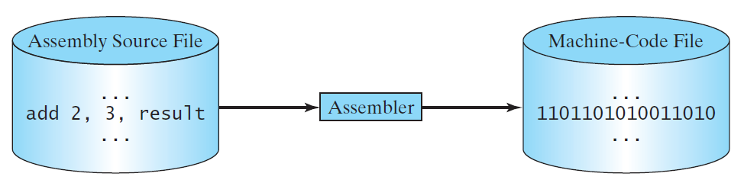
Programming Languages
Machine Language Assembly Language High-Level Language
Assembly languages were developed to make programming easy. Since the computer cannot understand assembly language, however, a program called assembler is used to convert assembly language programs into machine code. For example, to add two numbers, you might write an instruction in assembly code like this:
ADD R1, R2, R3

Slide 6
Programming Languages
Machine Language Assembly Language High-Level Language
The high-level languages are English-like and easy to learn and program. For example, the following is a high-level language statement that computes the area of a circle with radius 5:
area = 5 * 5 * 3.1415;

Slide 7
Interpreting/Compiling Source Code
A program written in a high-level language is called a source program or source code. Because a computer cannot understand a source program, a source program must be translated into machine code for execution. The translation can be done using another programming tool called an interpreter or a compiler.

Slide 8

Interpreting Source Code
An interpreter reads one statement from the source code, translates it to the machine code or virtual machine code, and then executes it right away, as shown in the following figure. Note that a statement from the source code may be translated into several machine instructions.

Slide 9

Compiling Source Code
A compiler translates the entire source code into a machine-code file, and the machine-code file is then executed, as shown in the following figure.

Slide 10
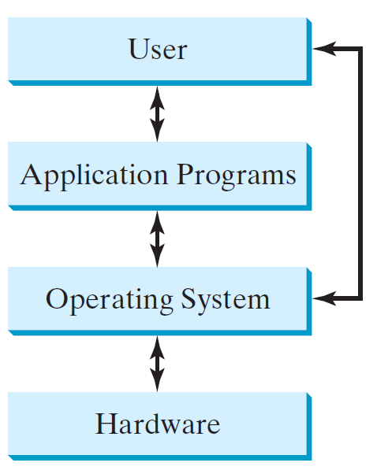
Operating Systems
The operating system (OS) is a program that manages and controls a computer’s activities. The popular operating systems for general-purpose computers are Microsoft Windows, Mac OS, and Linux. Application programs, such as a Web browser or a word processor, cannot run unless an operating system is installed and running on the computer.

Slide 11
Why Java?
The answer is that Java enables users to develop and deploy applications on the Internet for servers, desktop computers, and small hand-held devices.
The future of computing is being profoundly influenced by the Internet, and Java promises to remain a big part of that future. Java is the Internet programming language.
Java is a general purpose programming language.
Java is the Internet programming language.

Slide 12
Java, Web, and Beyond
Java can be used to develop standalone applications.
Java can be used to develop applications running from a browser.
Java can also be used to develop applications for hand-held devices.
Java can be used to develop applications for Web servers.

Slide 13
Java’s History
James Gosling, Mike Sheridan, and Patrick Naughton initiated the Java language project in June 1991 in Sun Microsystem
Java was originally designed for interactive television, but it was too advanced for the digital cable television industry at the time
The language was initially called Oak after an oak tree that stood outside Gosling's office
It went by the name Green later, and was later renamed Java, from Java coffee said to be consumed in large quantities by the language's creators
Public in Sun World: May 20, 1995
HotJava: The first Java-enabled Web browser

Slide 14
Characteristics of Java
Companion Website
Java Is Simple
Java Is Object-Oriented
Java Is Distributed
Java Is Interpreted
Java Is Robust
Java Is Secure
Java Is Architecture-Neutral
Java Is Portable
Java's Performance
Java Is Multithreaded
Java Is Dynamic
www.cs.armstrong.edu/liang/JavaCharacteristics.pdf

Slide 15
Characteristics of Java
Companion Website
Java Is Simple
Java Is Object-Oriented
Java Is Distributed
Java Is Interpreted
Java Is Robust
Java Is Secure
Java Is Architecture-Neutral
Java Is Portable
Java's Performance
Java Is Multithreaded
Java Is Dynamic
Java is partially modeled on C++, but greatly simplified and improved. Some people refer to Java as "C++--" because it is like C++ but with more functionality and fewer negative aspects Java garbage collection happens automatically but there is no automatic garbage collection in C++; all objects must be destroyed manually through the code. There are pretty high chances of a developer forgetting to delete all objects at the end. This leads to an increase in size and memory of the software, which can lead to an increase in costing..

Slide 16
Characteristics of Java
Companion Website
Java Is Simple
Java Is Object-Oriented
Java Is Distributed
Java Is Interpreted
Java Is Robust
Java Is Secure
Java Is Architecture-Neutral
Java Is Portable
Java's Performance
Java Is Multithreaded
Java Is Dynamic
Java is inherently object-oriented. Although many object-oriented languages began strictly as procedural languages, Java was designed from the start to be object-oriented. Object-oriented programming (OOP) is a popular programming approach that is replacing traditional procedural programming techniques.
One of the central issues in software development is how to reuse code. Object-oriented programming provides great flexibility, modularity, clarity, and reusability through encapsulation, inheritance, and polymorphism.

Slide 17
Characteristics of Java
Companion Website
Java Is Simple
Java Is Object-Oriented
Java Is Distributed
Java Is Interpreted
Java Is Robust
Java Is Secure
Java Is Architecture-Neutral
Java Is Portable
Java's Performance
Java Is Multithreaded
Java Is Dynamic
Distributed computing involves several computers working together on a network. Java is designed to make distributed computing easy. Since networking capability is inherently integrated into Java, writing network programs is like sending and receiving data to and from a file.

Slide 18
Characteristics of Java
Companion Website
Java Is Simple
Java Is Object-Oriented
Java Is Distributed
Java Is Interpreted
Java Is Robust
Java Is Secure
Java Is Architecture-Neutral
Java Is Portable
Java's Performance
Java Is Multithreaded
Java Is Dynamic
You need an interpreter to run Java programs. The programs are compiled into the Java Virtual Machine code called bytecode. The bytecode is machine-independent and can run on any machine that has a Java interpreter, which is part of the Java Virtual Machine (JVM).

Slide 19
Characteristics of Java
Companion Website
Java Is Simple
Java Is Object-Oriented
Java Is Distributed
Java Is Interpreted
Java Is Robust
Java Is Secure
Java Is Architecture-Neutral
Java Is Portable
Java's Performance
Java Is Multithreaded
Java Is Dynamic
Java compilers can detect many problems that would first show up at execution time in other languages.
Java has eliminated certain types of error-prone programming constructs found in other languages.
Java has a runtime exception-handling feature to provide programming support for robustness.

Slide 20
Characteristics of Java
Companion Website
Java Is Simple
Java Is Object-Oriented
Java Is Distributed
Java Is Interpreted
Java Is Robust
Java Is Secure
Java Is Architecture-Neutral
Java Is Portable
Java's Performance
Java Is Multithreaded
Java Is Dynamic
Java implements several security mechanisms to protect your system against harm caused by stray programs.

Slide 21
Characteristics of Java
Companion Website
Java Is Simple
Java Is Object-Oriented
Java Is Distributed
Java Is Interpreted
Java Is Robust
Java Is Secure
Java Is Architecture-Neutral
Java Is Portable
Java's Performance
Java Is Multithreaded
Java Is Dynamic
Write once, run anywhere
With a Java Virtual Machine (JVM), you can write one program that will run on any platform.

Slide 22
Characteristics of Java
Companion Website
Java Is Simple
Java Is Object-Oriented
Java Is Distributed
Java Is Interpreted
Java Is Robust
Java Is Secure
Java Is Architecture-Neutral
Java Is Portable
Java's Performance
Java Is Multithreaded
Java Is Dynamic
Because Java is architecture neutral, Java programs are portable. They can be run on any platform without being recompiled.

Slide 23
Characteristics of Java
Companion Website
Java Is Simple
Java Is Object-Oriented
Java Is Distributed
Java Is Interpreted
Java Is Robust
Java Is Secure
Java Is Architecture-Neutral
Java Is Portable
Java's Performance
Java Is Multithreaded
Java Is Dynamic
Java’s performance Because Java is architecture neutral, Java programs are portable. They can be run on any platform without being recompiled.

Slide 24
Characteristics of Java
Companion Website
Java Is Simple
Java Is Object-Oriented
Java Is Distributed
Java Is Interpreted
Java Is Robust
Java Is Secure
Java Is Architecture-Neutral
Java Is Portable
Java's Performance
Java Is Multithreaded
Java Is Dynamic
Multithread programming is smoothly integrated in Java, whereas in other languages you have to call procedures specific to the operating system to enable multithreading.

Slide 25
Characteristics of Java
Companion Website
Java Is Simple
Java Is Object-Oriented
Java Is Distributed
Java Is Interpreted
Java Is Robust
Java Is Secure
Java Is Architecture-Neutral
Java Is Portable
Java's Performance
Java Is Multithreaded
Java Is Dynamic
Java was designed to adapt to an evolving environment. New code can be loaded on the fly without recompilation. There is no need for developers to create, and for users to install, major new software versions. New features can be incorporated transparently as needed.

Slide 26
Python and Java
Python is a powerful easy-to-use scripting language that excels as a “glue” language because it connects system components, whereas Java is characterized as a low-level implementation language.
Speed: Python is interpreted language and is slow as compared to C/C++ or Java. Unlike C or C++ it's not closer to hardware because Python is a high-level language. Python's memory consumption is also high, due to the flexibility of the data types

Slide 27
JDK Versions
JDK 1.02 (1995)
JDK 1.1 (1996)
JDK 1.2 (1998)
JDK 1.3 (2000)
JDK 1.4 (2002)
JDK 1.5 (2004) a. k. a. JDK 5 or Java 5
JDK 1.6 (2006) a. k. a. JDK 6 or Java 6
JDK 1.7 (2011) a. k. a. JDK 7 or Java 7
JDK 1.8 (2014) a. k. a. JDK 8 or Java 8

Slide 28
JDK Editions
Java Standard Edition (J2SE)
  J2SE can be used to develop client-side standalone applications or applets.
Java Enterprise Edition (J2EE)
  J2EE can be used to develop server-side applications such as Java servlets, Java ServerPages, and Java ServerFaces.
Java Micro Edition (J2ME).
  J2ME can be used to develop applications for mobile devices such as cell phones.
This book uses J2SE to introduce Java programming.

Slide 29
Popular Java IDEs
NetBeans
Eclipse

Slide 30

A Simple Java Program
Listing 1.1
// This program prints Welcome to Java!
public class Welcome {
public static void main(String[] args) {
System.out.println("Welcome to Java!");
}
}
Animation
Welcome
IMPORTANT NOTE: If you cannot run the buttons, see www.cs.armstrong.edu/liang/javaslidenote.doc.
Run

Slide 31

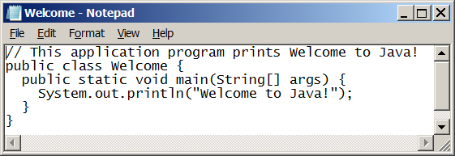
Creating and Editing Using NotePad
To use NotePad, type
  notepad Welcome.java
from the DOS prompt.

Slide 32

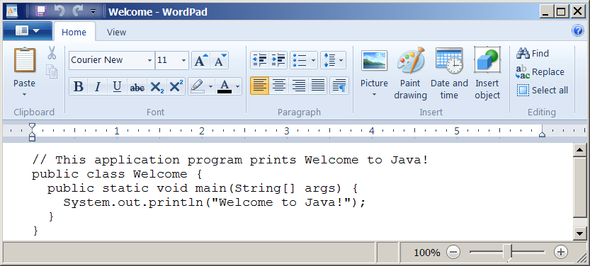
Creating and Editing Using WordPad
To use WordPad, type
  write Welcome.java
from the DOS prompt.

Slide 33
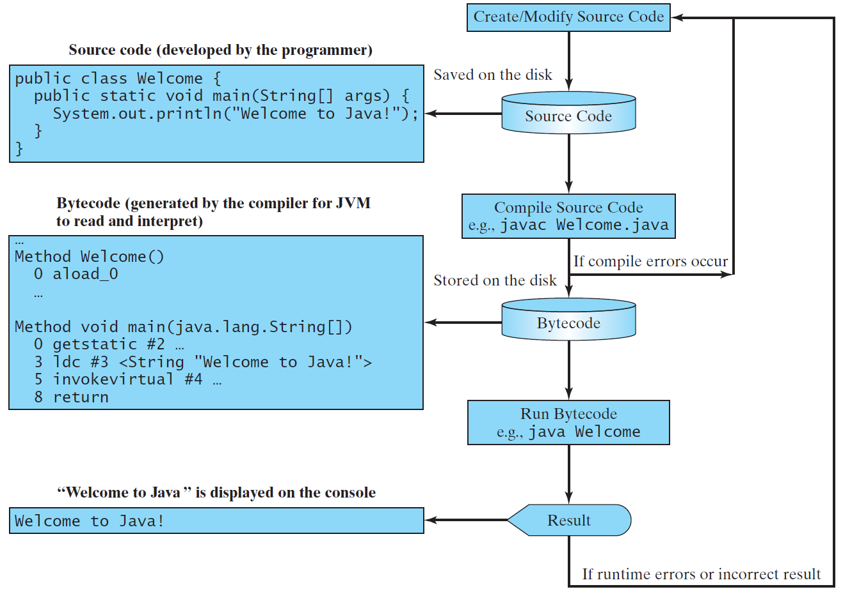
Creating, Compiling, and Running Programs

Slide 34
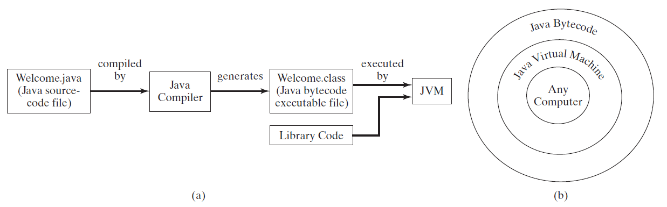
Compiling Java Source Code
You can port a source program to any machine with appropriate compilers. The source program must be recompiled, however, because the object program can only run on a specific machine. Nowadays computers are networked to work together. Java was designed to run object programs on any platform. With Java, you write the program once, and compile the source program into a special type of object code, known as bytecode. The bytecode can then run on any computer with a Java Virtual Machine, as shown below. Java Virtual Machine is a software that interprets Java bytecode.

Slide 35
Trace a Program Execution
animation
Enter main method
// This program prints Welcome to Java!
public class Welcome {
public static void main(String[] args) {
System.out.println("Welcome to Java!");
}
}

Slide 36
Trace a Program Execution
animation
Execute statement
// This program prints Welcome to Java!
public class Welcome {
public static void main(String[] args) {
System.out.println("Welcome to Java!");
}
}

Slide 37

Trace a Program Execution
animation
// This program prints Welcome to Java!
public class Welcome {
public static void main(String[] args) {
System.out.println("Welcome to Java!");
}
}
print a message to the console

Slide 38

Two More Simple Examples
Animation
WelcomeWithThreeMessages
Run
Animation
ComputeExpression
Run

Slide 39
Supplements on the Companion Website
Companion Website
See Supplement I.B for installing and configuring JDK
See Supplement I.C for compiling and running Java from the command window for details
www.cs.armstrong.edu/liang/intro10e

Slide 40

Compiling and Running Java from the Command Window
Companion Website
Set path to JDK bin directory
  set path=c:\Program Files\java\jdk1.8.0\bin
Set classpath to include the current directory
  set classpath=.
Compile
  javac Welcome.java
Run
  java Welcome

Slide 41

Compiling and Running Java from TextPad
Companion Website
See Supplement II.A on the Website for details

Slide 42
Anatomy of a Java Program
Class name
Main method
Statements
Statement terminator
Reserved words
Comments
Blocks

Slide 43
Class Name
Every Java program must have at least one class. Each class has a name. By convention, class names start with an uppercase letter. In this example, the class name is Welcome.
// This program prints Welcome to Java!
public class Welcome {
public static void main(String[] args) {
System.out.println("Welcome to Java!");
}
}

Slide 44
Main Method
Line 2 defines the main method. In order to run a class, the class must contain a method named main. The program is executed from the main method.
// This program prints Welcome to Java!
public class Welcome {
public static void main(String[] args) {
System.out.println("Welcome to Java!");
}
}

Slide 45
Statement
A statement represents an action or a sequence of actions. The statement System.out.println("Welcome to Java!") in the program in Listing 1.1 is a statement to display the greeting "Welcome to Java!“.
// This program prints Welcome to Java!
public class Welcome {
public static void main(String[] args) {
System.out.println("Welcome to Java!");
}
}

Slide 46
Statement Terminator
Every statement in Java ends with a semicolon (;).
// This program prints Welcome to Java!
public class Welcome {
public static void main(String[] args) {
System.out.println("Welcome to Java!");
}
}

Slide 47
Reserved words
Reserved words or keywords are words that have a specific meaning to the compiler and cannot be used for other purposes in the program. For example, when the compiler sees the word class, it understands that the word after class is the name for the class.
// This program prints Welcome to Java!
public class Welcome {
public static void main(String[] args) {
System.out.println("Welcome to Java!");
}
}

Slide 48

Blocks
A pair of braces in a program forms a block that groups components of a program.

Slide 49

Special Symbols

Slide 50
{ … }
// This program prints Welcome to Java!
public class Welcome {
public static void main(String[] args) {
System.out.println("Welcome to Java!");
}
}

Slide 51
( … )
// This program prints Welcome to Java!
public class Welcome {
public static void main(String[] args) {
System.out.println("Welcome to Java!");
}
}

Slide 52
;
// This program prints Welcome to Java!
public class Welcome {
public static void main(String[] args) {
System.out.println("Welcome to Java!");
}
}

Slide 53
// …
// This program prints Welcome to Java!
public class Welcome {
public static void main(String[] args) {
System.out.println("Welcome to Java!");
}
}

Slide 54
" … "
// This program prints Welcome to Java!
public class Welcome {
public static void main(String[] args) {
System.out.println("Welcome to Java!");
}
}

Slide 55
Programming Style and Documentation
Appropriate Comments
Naming Conventions
Proper Indentation and Spacing Lines
Block Styles

Slide 56
Appropriate Comments
Include a summary at the beginning of the program to explain what the program does, its key features, its supporting data structures, and any unique techniques it uses.
Include your name, class section, instructor, date, and a brief description at the beginning of the program.

Slide 57
Naming Conventions
Choose meaningful and descriptive names.
Class names:
  Capitalize the first letter of each word in the name. For example, the class name ComputeExpression.

Slide 58
Proper Indentation and Spacing
Indentation
  Indent two spaces.
Spacing
  Use blank line to separate segments of the code.

Slide 59

Block Styles
Use end-of-line style for braces.

Slide 60
Programming Errors
Syntax Errors
  Detected by the compiler
Runtime Errors
  Causes the program to abort
Logic Errors
  Produces incorrect result

Slide 61
Syntax Errors
public class ShowSyntaxErrors {
public static main(String[] args) {
System.out.println("Welcome to Java);
}
}
ShowSyntaxErrors
Run

Slide 62
Runtime Errors
public class ShowRuntimeErrors {
public static void main(String[] args) {
System.out.println(1 / 0);
}
}
ShowRuntimeErrors
Run

Slide 63
Logic Errors
public class ShowLogicErrors {
public static void main(String[] args) {
System.out.println("Celsius 35 is Fahrenheit degree ");
System.out.println((9 / 5) * 35 + 32);
}
}
ShowLogicErrors
Run

