Slide 1

Multiple Disease Predictor Using ML
Presented by Group #5 CSE 299
Instructor - Meem Tasfia Zaman
Lecturer
ECE Dept.
North-South University
Team Members -
MOSTAFIZUR RAHMAN 1912291042
Saiful Islam 1731604642
Sadia binte Sarowar 1811908642

Slide 2



DISEASE INDICATIONS BASED ON SYMPTOMS AND CAUSES FOR:
DIABETES
HEART DISEASE
PARKINSON’S DISEASE
Suggestions provided for predicted disease (If any medical support from doctors are required at the moment)

Slide 3
Type 1/2
Types
Diabetes
Gestational
Weight loss, thirst..
Symptoms
Blurred vision, fatigue…

Slide 4
Dataset info for diabetes prediction
Collected from Kaggle Datasets.
Features -
Supervised Categorical Problem.
Numerical | Categorical
Glucose, blood pressures, skin thickness, insulin, age. | Label/output

Slide 5
Heart Failure
CAD
Types
Heart Attack
Heart Disease
Arrhythmia
Symptoms
Chest discomfort, fatigue,etc
Dizziness, irregular heartbeat, etc

Slide 6
Dataset info for heart disease prediction
Collected from Kaggle Datasets.
Features -
Supervised Categorical Problem.
Numerical | Categorical
age, resting blood pressure, serum cholesterol, fasting blood sugar, maximum heart rate achieved, ST depression induced by exercise relative to rest, the slope of the peak of st segment | gender, chest pain type, resting electrocardiographic results, exercise induced angina, number of major vessels coloured by fluoroscopy, thal, label/output

Slide 7
Familial
Types
Early-onset
Parkinson’s Disease
Idiopathic
Average vocal fundamental frequency, signal factor
Symptoms
Maximum vocal fundamental frequency, health scaling

Slide 8
Dataset info for Parkinson’s disease prediction
Collected from Kaggle Datasets.
Features -
Supervised Categorical Problem.
Numerical | Categorical
Average vocal fundamental frequency(MDVP:Fo (Hz)),Maximum vocal fundamental frequency(MDVP:Fhi (Hz)),Five measures of variation in fundamental frequency(MDVP:Flo (Hz)) | Label/Output

Slide 9


SOFTWARE STACK & TECHNICALITIES
Python
Kaggle Dataset
Google Colab/ Jupyter notebook
Streamlit/ Django
Pickle
VS Code Editor

Slide 10
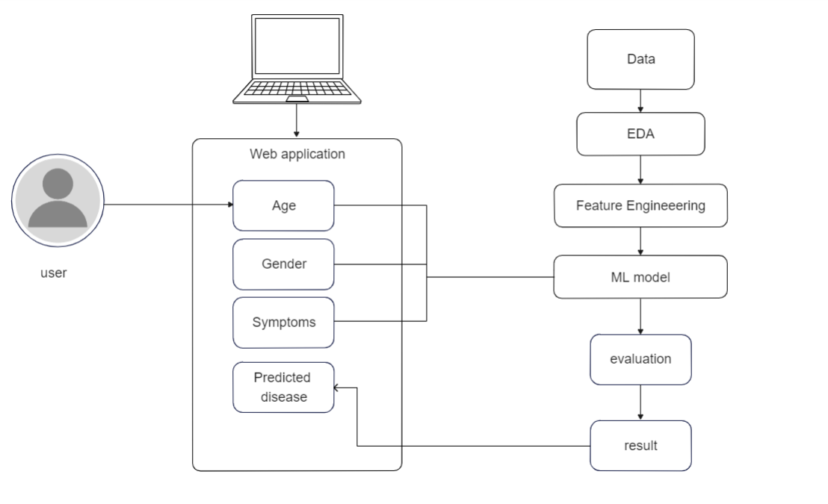
SOFTWARE ARCHITECTURE DIAGRAM

Slide 11
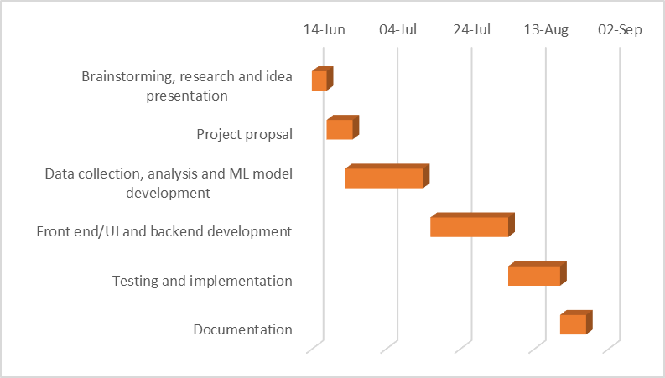
Project Timeline (Gantt Chart)

Slide 12

WORK DISTRIBUTION
Name | Tasks
Sadia | Research, Data Pre-Processing, ML models, Pickle.
Mostafizur Rahman | Research, Dataset collection, Model Tuning, Testing
Saiful | Research, EDA, Deployment, Streamlit/django
Teamwork!

Slide 13

Thank You!
Stay Happy and Healthy..

