Slide 1
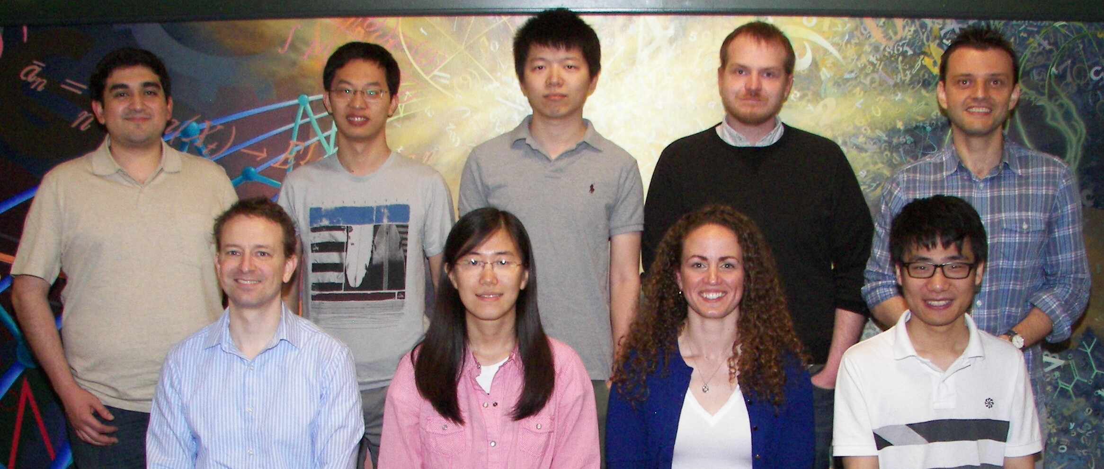
Team Uni_Iowa_State_1 Iowa State University Department of Statistics
DMC 2014
Solution
Presenters: Guillermo Basulto, Fan Cao, Cory Lanker, Xin Yin
Absent: Zoe Cheng, Marius Dragomiroiu, Jessica Hicks, Ian Mouzon, Lanfeng Pan

Slide 2
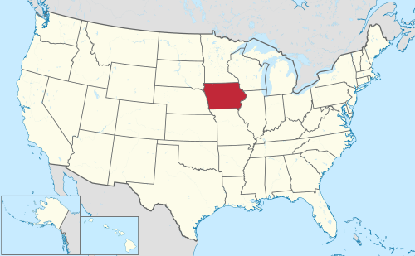
Iowa: “The Heartland of America”
reputation: corn and pigs
most spoken language other than English or Spanish: German

Slide 3
Team approach
data mining approach
data set exploration
feature matrix creation
statistical learning approach
likelihood ratio statistics
proper training and validation sets
classification methods
variety of methods
a single prediction from ensemble

Slide 4

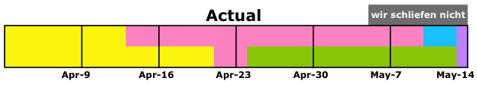
data mining approach
statistical learning approach
classification methods
schedule

Slide 5
data mining approach
statistical learning approach
classification methods
preliminary discoveries
delivery date missing
fashion seasons?
2 per year, based on shipping breaks
item IDs are chronological
delivery date = 31-Dec-1990 ?
error correction (e.g., birth date, size, color)

Slide 6
data mining approach
statistical learning approach
classification methods
feature matrix creation
very important
fully characterize information for all orders
order dependence
each customer visit has “batch” of orders
same customer can have multiple visits

Slide 7
data mining approach
statistical learning approach
classification methods
historical behavior
order history for same customer, item, color, etc.
all interactions
batch summary
number of orders, distinct sizes, distinct items
price trends, purchasing history
discount or sale price
“social network” information

Slide 8
data mining approach
statistical learning approach
classification methods
style category
clustering of items based on specific sizes
shoes, t-shirts, tops, bottoms, junior, unsized
universal size
unifies different size systems
reduces number of size levels

Slide 9
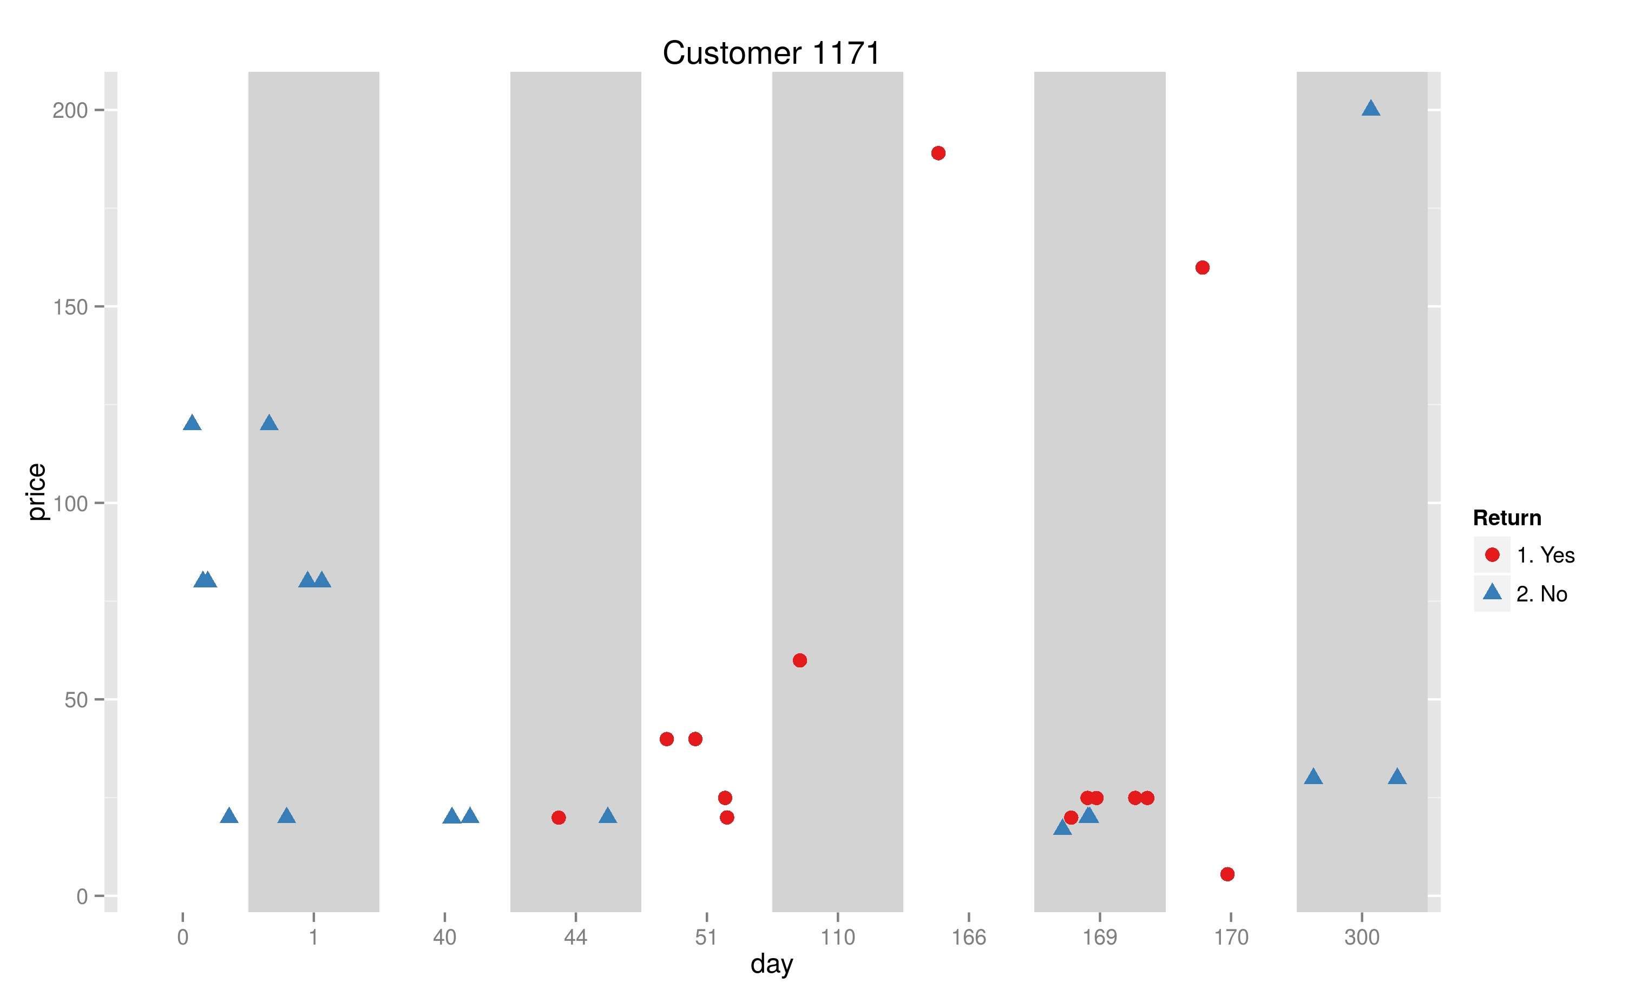
data mining approach
statistical learning approach
classification methods
all visits for Customer #1171
200 €
150 €
?
Return
price
100 €
yes
no
50 €
0 €
date of visit

Slide 10
data mining approach
statistical learning approach
classification methods
all visits for Customer #1171
200 €
150 €
none returned!
Return
price
100 €
yes
no
50 €
0 €
date of visit

Slide 11
data mining approach
statistical learning approach
classification methods
example: for each item, tabulate
number of returns for that item
number of non-returns for that item
summarizes all categories with a single feature
likelihood ratio statistics
where:
R = number of returns
NR = number of non-returns

Slide 12
data mining approach
statistical learning approach
classification methods
problem: model is
return leakage problem
ntree OOB 1 2 | Test 1 2
1: 28.46% 29.92% 27.13%| 49.12% 24.31% 70.37%
5: 27.88% 29.96% 25.98%| 46.64% 47.96% 45.51%
10: 25.71% 28.54% 23.15%| 46.30% 44.94% 47.46%
20: 23.47% 27.26% 20.03%| 45.44% 41.54% 48.79%
40: 22.02% 26.44% 18.01%| 43.85% 41.23% 46.10%
60: 21.55% 26.18% 17.35%| 43.48% 40.14% 46.33%
80: 21.32% 26.11% 16.97%| 43.27% 44.99% 41.80%
100: 21.16% 25.99% 16.77%| 42.98% 48.24% 38.47%

Slide 13
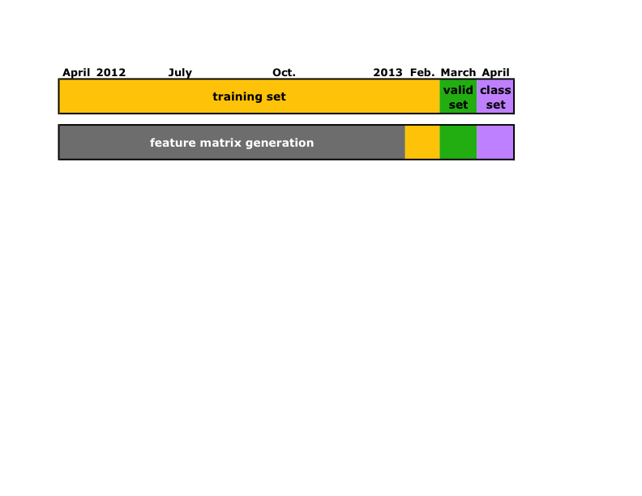
data mining approach
statistical learning approach
classification methods
do not train the model with orders used for feature matrix generation
ntree OOB 1 2| Test 1 2
50: 30.04% 34.99% 25.33%| 30.89% 37.30% 24.86%
100: 29.02% 34.63% 23.65%| 30.52% 37.82% 23.60%
150: 28.79% 34.70% 23.10%| 30.24% 37.58% 23.28%
200: 28.44% 34.57% 22.52%| 30.49% 37.84% 23.52%
before:
after:
much closer

Slide 14
data mining approach
statistical learning approach
classification methods
Method | Test error | Weight
C5.0 | 29.3% ± 1.8%
SVM−RBF | 29.7%
random forest | 29.9%
J48 | 31.1%
neural networks | 31.2%
LASSO logistic regression | 29.7%
adaBoost | 30.0%

Slide 15
data mining approach
statistical learning approach
classification methods
Method | Test error | Weight
C5.0 | 29.3% ± 1.8% | 66.00%
SVM−RBF | 29.7% | 33.00%
random forest | 29.9% | 0.33%
J48 | 31.1% | 0.33%
neural networks | 31.2% | 0.33%
LASSO logistic regression | 29.7% | 0
adaBoost | 30.0% | 0
combined classifier | 29.0%

Slide 16


Thank you for your attention!
Our team cordially thanks Prudsys for their invitation to present our solution at User Days.

