Slide 1
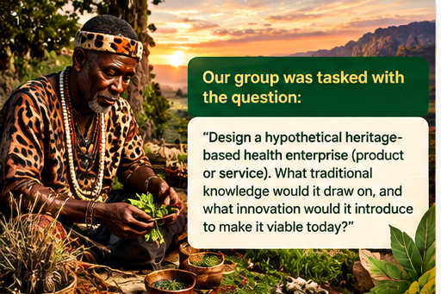
OUR GROUP WAS TASKED WITH THE QUESTION:
Design a hypothetical
heritage-based health enterprise.
What traditional knowledge would it draw on,
and what innovation would make it viable today?
GROUP 3'S ANSWER
MITILINK

Slide 2

THE INNOVATION OF GROUP 3
MITILINK
IT'S ABOUT TO GET HOT!
A digital bridge connecting Zimbabwean traditional health knowledge,
communities, practitioners and the diaspora.
CREATED BY GROUP 3

Slide 3
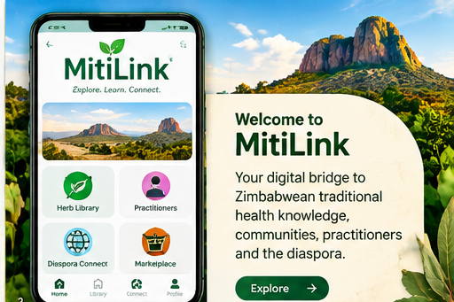
03 • SERVICE
03
Welcome to MitiLink
ONE APP. FOUR CORE FUNCTIONS.
🌿 HERB LIBRARY
Search local/common names, heritage context and safety notes.
👤 PRACTITIONER DIRECTORY
Profiles of participating practitioners with verification status.
🌍 DIASPORA CONNECT
Access Zimbabwean heritage and eligible services from abroad.
📦 TRACEABLE PRODUCTS
Approved products can include source, batch and safety information.

Slide 4
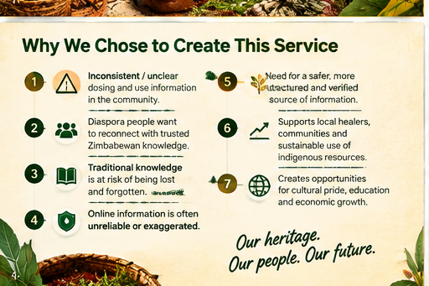
04 • WHY
04
Why did we choose to create this service?
01
UNCLEAR / INCONSISTENT USE
02
KNOWLEDGE IS SCATTERED
People may receive incomplete or conflicting information about preparation and use.
Important knowledge can sit with families, communities, books or informal sources.
03
ONLINE CLAIMS ARE HARD TO TRUST
04
DIASPORA ACCESS
Some herbal information online is exaggerated or unsupported.
Zimbabweans abroad can struggle to access trusted Zimbabwean heritage knowledge.
05
KNOWLEDGE PRESERVATION
06
SUPPORT KNOWLEDGE HOLDERS
Consent-based digital documentation can help keep cultural knowledge accessible.
Practitioners and elders can have a structured way to contribute and be recognised.
07
MODERN ACCESS
Mobile, low-data and offline features can make information easier to reach.

Slide 5
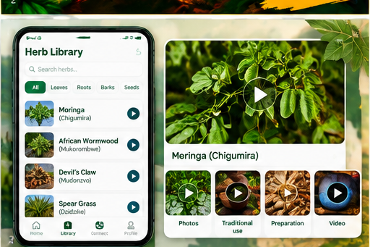
05 • HERB LIBRARY
05
Explore herbs with photos, videos & context
HERB PROFILE = 4 LAYERS
HERITAGE
Traditional name, story, preparation and community context.
EVIDENCE
Reliable research where available; uncertainty is shown.
SAFETY
Warnings, interactions, contamination risks and red flags.
SOURCE
Contributor, consent status and verification trail.
Optional multimedia: plant photos + short educational videos.

Slide 6
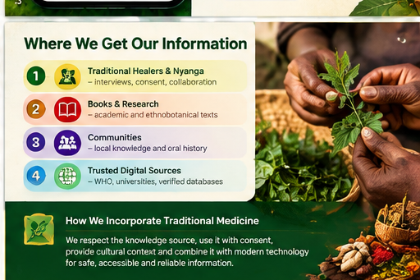
06 • TRADITIONAL KNOWLEDGE
06
Where do we get the information?
1 • KNOWLEDGE HOLDERS
Traditional healers, elders and other contributors — with consent.
2 • COMMUNITIES
Local knowledge, plant names, preparation traditions and cultural context.
3 • BOOKS + RESEARCH
Academic, ethnobotanical and other reliable reference material.
4 • TRUSTED DIGITAL SOURCES
WHO, universities and verified databases where appropriate.
HOW WE INCORPORATE TRADITIONAL MEDICINE
We preserve the knowledge source and cultural context, then add modern structure: search, verification, evidence labels, safety information and responsible access.

Slide 7
07 • USER JOURNEY
07
How MitiLink works
01
02
03
04
05
06
DISCOVER
LEARN
CHECK
CONNECT
ACCESS
FOLLOW UP
Search a herb, topic or practitioner.
→
See heritage, preparation traditions and safety.
→
See evidence level, warnings and verification.
→
Contact a verified knowledge holder.
→
Book or buy approved services/products where lawful.
→
Red flags guide users toward clinical care.
EDUCATION + CONNECTION — NOT DIAGNOSIS

Slide 8
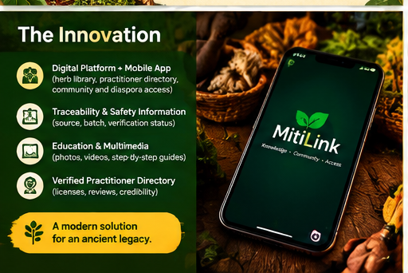
WHAT MAKES MITILINK INNOVATIVE?
•
DIGITAL HERB LIBRARY
Structured, searchable heritage knowledge.
•
VERIFICATION
Practitioner, contributor and source records.
•
EVIDENCE LABELS
Traditional use is separated from scientific evidence.
•
TRACEABILITY
Source/batch records for approved products.
•
LOW-DATA ACCESS
Offline reading and compressed content.
•
COMMUNITY REPORTING
Users can flag unsafe claims or suspicious products.

Slide 9
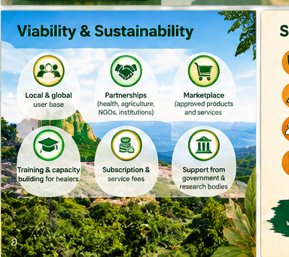
09 • VIABILITY
09
How can it become an enterprise?
CUSTOMERS
REVENUE
START SMALL
Zimbabwean users • diaspora • practitioners • researchers • ethical producers
Freemium tools • booking fees • approved marketplace • partnerships
One community/province network + curated library + verified directory
PROVE TRUST + USAGE → THEN SCALE

Slide 10
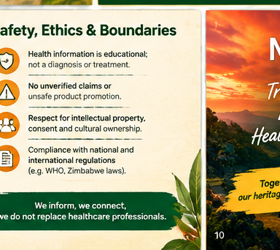
10 • SAFETY
10
Responsible traditional-health access
NO UNSUPPORTED CURE CLAIMS
Health information is educational; clinical claims need evidence and regulation.
CLEAR WARNINGS
Interactions, contraindications and red flags are highlighted.
CULTURAL OWNERSHIP
Consent, attribution and benefit sharing are built into the model.
LEGAL + DATA
Follow Zimbabwean and destination-country rules and protect user data.
PRODUCT CONTROLS
Marketplace products require appropriate regulatory checks.
TRUST IS THE REAL PRODUCT.

Slide 11
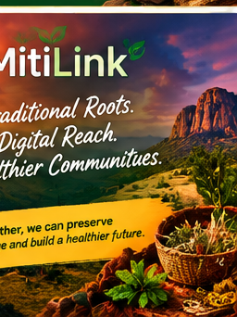
THE FINAL PITCH
“What if Zimbabwe’s traditional
health knowledge could travel
with its people?”
Preserve the heritage. Improve access. Label uncertainty. Protect people. Respect knowledge ownership.
MITILINK
TRADITIONAL ROOTS • DIGITAL REACH • GROUP 3

Slide 12
12 • REFERENCES
12
Sources & closing
Key sources used in the original proposal
1.
World Health Organization (2025), Global traditional medicine strategy 2025–2034.
2.
Zimbabwe (1981), Traditional Medical Practitioners Act [Chapter 27:14].
3.
Zimbabwe (2009), Environmental Management Regulations on genetic resources and indigenous knowledge.
4.
Group 3 original concept: MitiLink name, interface, service model and enterprise proposal.
QUESTIONS?

