Slide 1
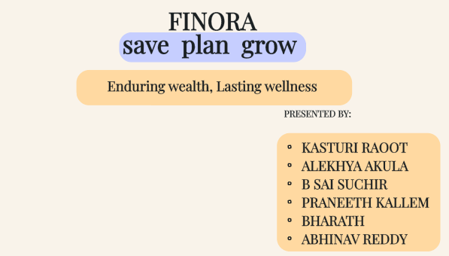
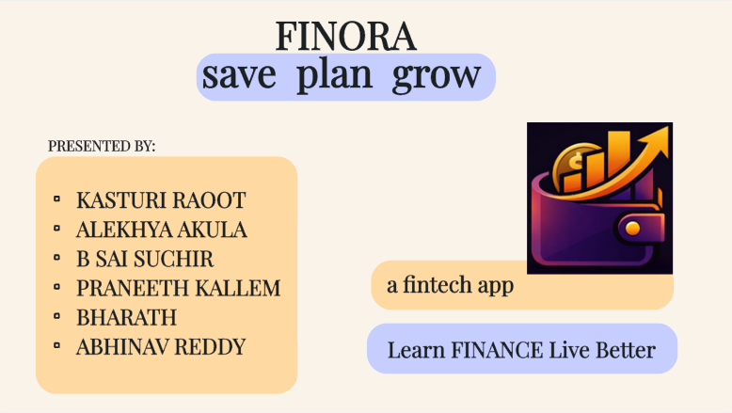


Slide 2
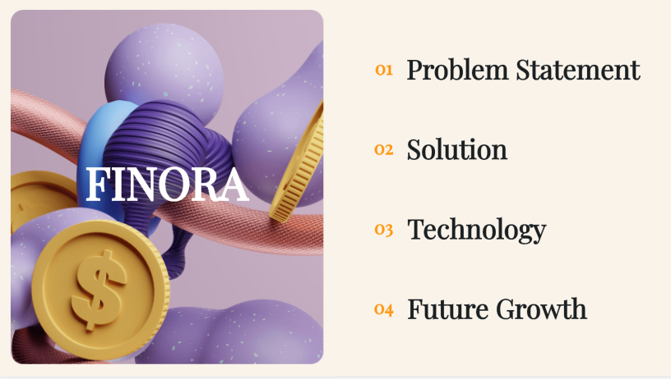


Slide 3
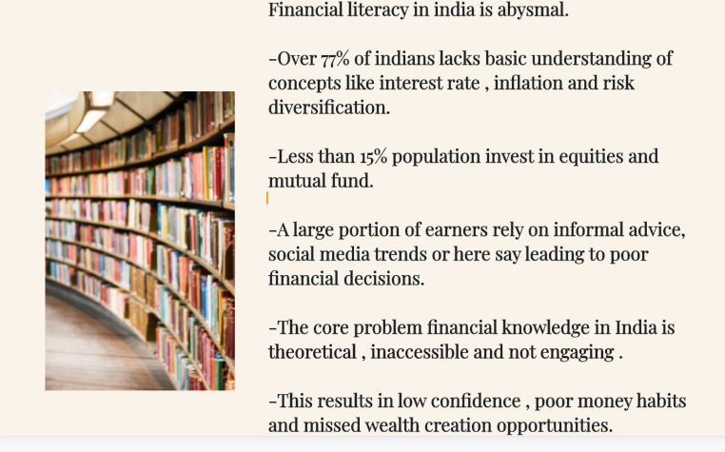

Slide 4
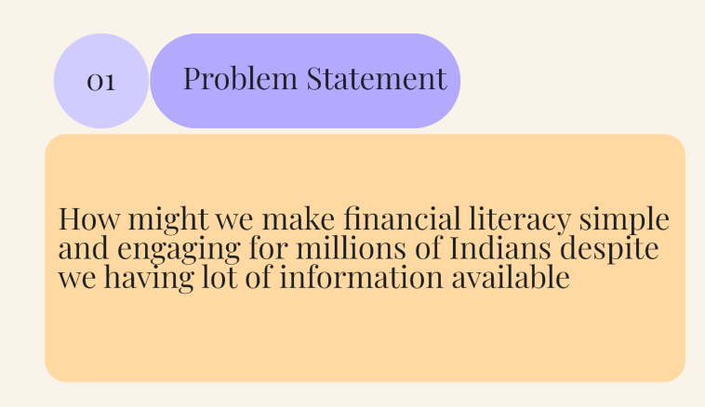

Slide 5
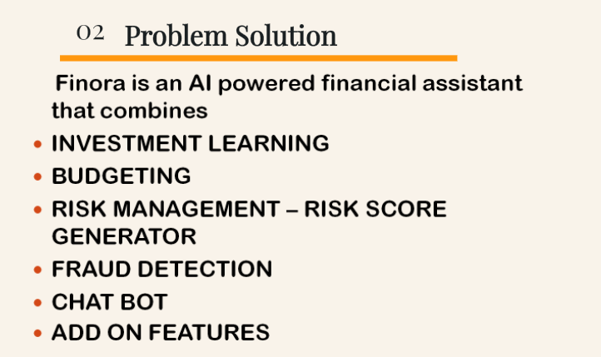

Slide 6
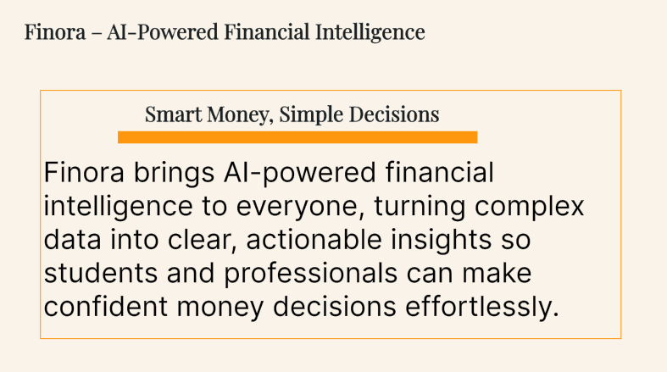

Slide 7
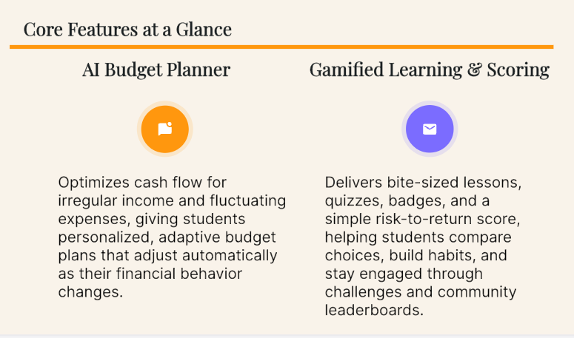

Slide 8
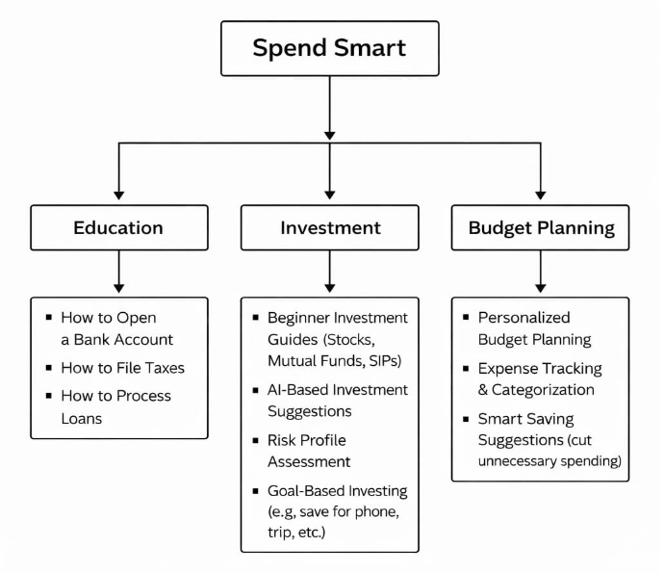
FINORA

Slide 9
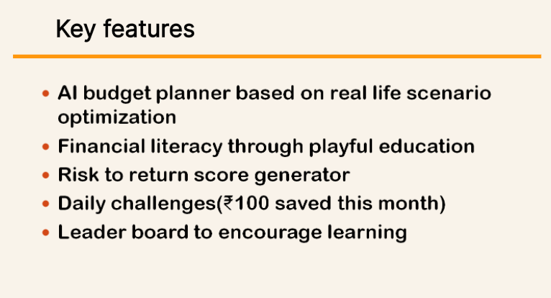

Slide 10

Tech stack
FRONTEND - Cross platform UI layer
React Native iOS + Android | Next.js Web App | Tailwind CSS (UI styling) | i18n/i10n Hindi,Telugu etc
BACKEND API Layer - Business logic, auth, routing
Node.js | REST + GraphQL (API Contracts) | JWT/Oauth2 Auth for DIGILOCKER | Redis (Catching Sessions)
AI/ML LAYER - Literacy Chatbot, Budget planner, personalization
LLM API GPT 4/Claude | Gamification Quizzes, badges | Budget Engine 50/30/20 Rules | Python ML Recommendations
DATA LAYER - Storage, Market Data, Analytics
PostgreSQL User data/budgets | MongoDB Lessons, contents | NSE/BSE API live data market | Firebase Push notifications
GEO SPECIFIC INTEGRATIONS - Payments, KYC, Investment, Fraud Reporting
UPI/RazorPay Payments | DIGILocker KYC User Verification | Zerodha/Groww Investment APIs | Cybercrime.gov.in Fraud Reporting
INFRA : AWS/GCP . Docker + Kubernetes. CI/CD (GitHub Actions). Sentry (App perf monitoring)

Slide 11
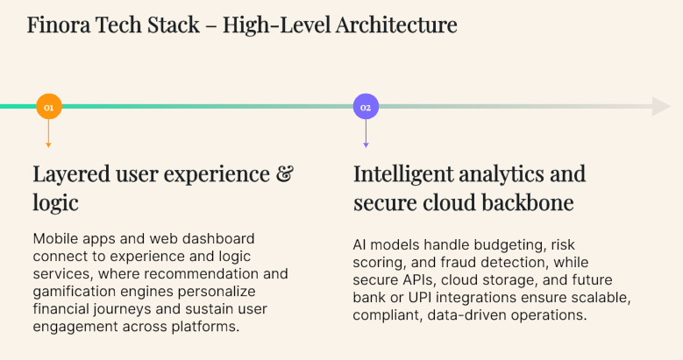

Slide 12
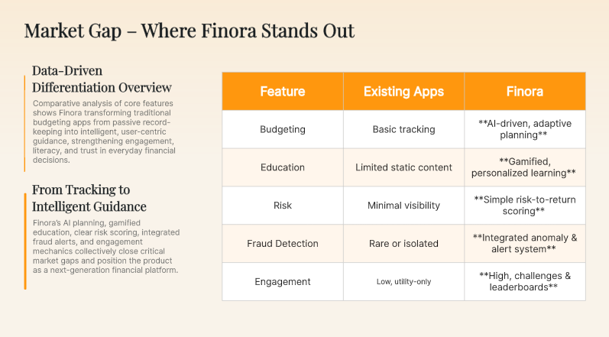

Slide 13
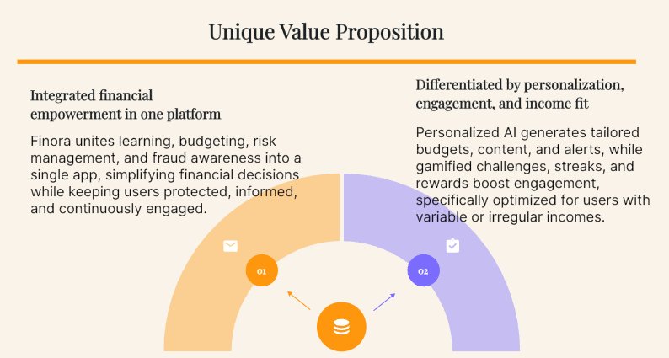

Slide 14


Slide 15
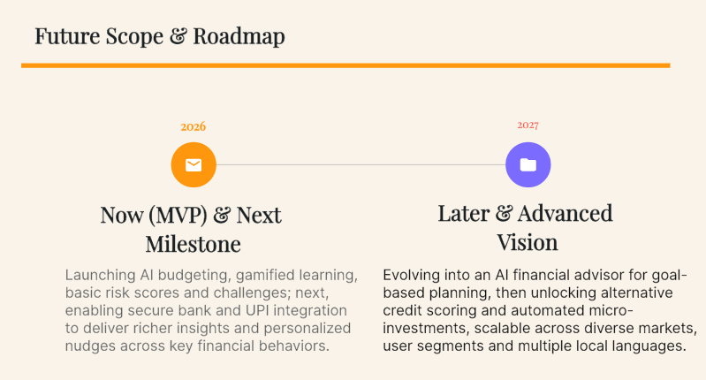

Slide 16
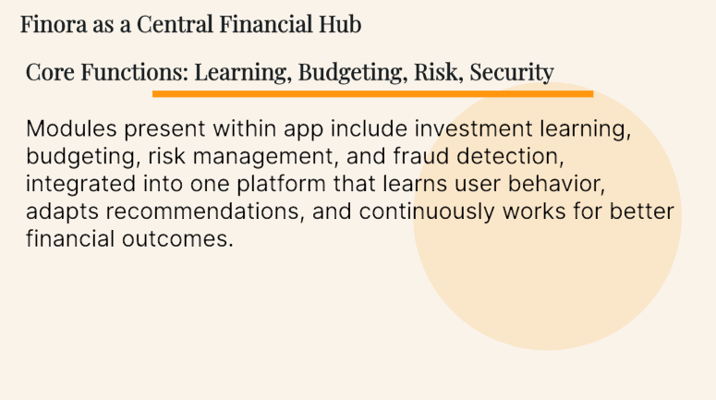
Conclusion:

Slide 17
THANK YOU!

