Slide 1
The Effect of Age and Bullying on the Likelihood of Teen Marijuana Use
Tim Baker
Northern Illinois University

Slide 2
Data Set and Research Questions
Data Source
Centers for Disease Control 2013 Youth Risk Behavior Surveillance Survey
Nationally representative sample of 148 high schools with 13,583 useable survey questionnaires.
68% total response ratio
I used a 5% SPSS randomly selected sample of cases from this survey. This was due to the extremely large number of cases and the limitations of HLM.
Research Questions
RQ 1 - Controlling for age, being bullied at school and being bullied online, what is the likelihood of teen marijuana use.
RQ 2 – Controlling for age and being bullied online, what is the relationship between being bullied on school grounds and the likelihood of teen marijuana use.
RQ 3 - Controlling for age and being bullied on school grounds, what is the relationship between being bullied online and the likelihood of teen marijuana use.
RQ 4 – What is the effect of age on the relationship between being bullied at school or online and the likelihood of teen marijuana use.
RQ 5 - What is the effect of age on the relationship between being bullied at school and the likelihood of teen marijuana use.
RQ 6 - What is the effect of age on the relationship between being bullied online and the likelihood of teen marijuana use.

Slide 3
Literature Review
Around 30% of students are involved in bullying in the United States as either a bully or being bullied in school(Hall, 2006).
Between the genders there is a difference in bullying patterns as well. Boys seem to prefer a physical approach to bullying in a manner to possibly express their masculinity. While girls prefer to use relational aggression bullying by spreading rumors or ostracizing (Leung & To, 2009).
The most common reason for bullying found in a study conducted by the West Virginia State Board of Education in 2015 was physical appearance followed by gender, sexual orientation, disability, and race (2015).
Over two-fifths of all 12th graders reported having used marijuana in their lifetimes. 35% had done so in the past year and 21% had done so in the past month (Johnston, O’Malley, Bachman & Schulenberg, 2011).
During the 2008-2009 school year 28% of students that were surveyed by US Department of Education had been bullied online (2011).
A longitudinal study of marijuana use from 1990-1999 showed that marijuana trials of marijuana amongst African American teens had decreased during the time period, but had remained steady for white and Hispanic teens (Delaney, 2002)

Slide 4
Variables
Cluster Variable = PSU (Primary Sampling Unit)
Dependent Variable = During your life, how many times have you used marijuana?
A. 0 times
B. 1 or 2 times
C. 3 to 9 times
D. 10 to 19 times
E. 20 to 39 times
F. 40 to 99 times
G. 100 or more times
Recoded to 1 = 1 or more time have smoked marijuana and 0 = never smoked marijuana.
Independent Variables:
I did not center these variables
Level 1 = During the past 12 months, have you ever been bullied on school property?
Coded 0 = Yes
Coded 1 = No
Level 1 = During the past 12 months, have you ever been electronically bullied? (Include being bullied through e-mail, chat rooms, instant messaging, Web sites, or texting.)
Coded 0 = Yes
Coded 1 = No

Slide 5
Variables Cont’d
Level 2 = How old are you?
Coded 1 = 12 years old or younger
Coded 2 = 13 years old
Coded 3 = 14 years old
Coded 4 = 15 years old
Coded 5 = 16 years old
Coded 6 = 17 years old
Coded 7 = 18 years old or older
I then aggregated the PSU (Primary Sampling Unit) by the age of the respondents to get an average age per PSU to use as the level 2 variable.
I did not center this variable

Slide 6
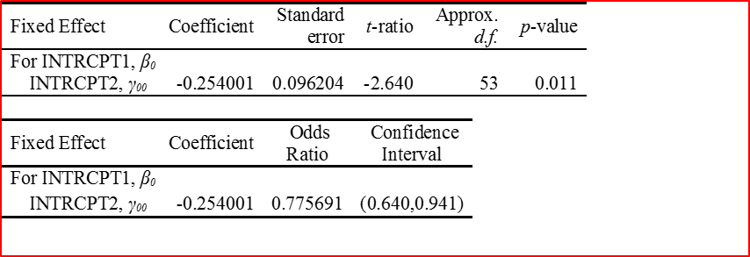

Null Model
Level 1: $η_{ij}=β_{0j}$
Level 2: $β_{0j}=γ_{00}+μ_{0j}$
$η_{ij}=$ Student Marijuana Use
Y00= -.254 = average log-odds of marijuana use among primary sampling units. This is statistically significant with a p=.011
Odds of marijuana use is .77. Confidence interval does not contain 1.
There is a statistically significant variance in the primary sampling units of the odds of marijuana use p= .014.

Slide 7
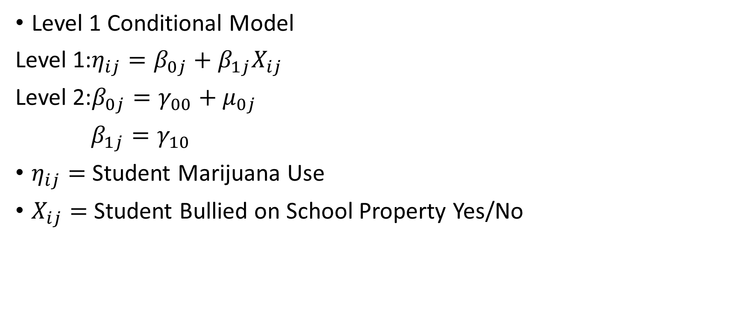
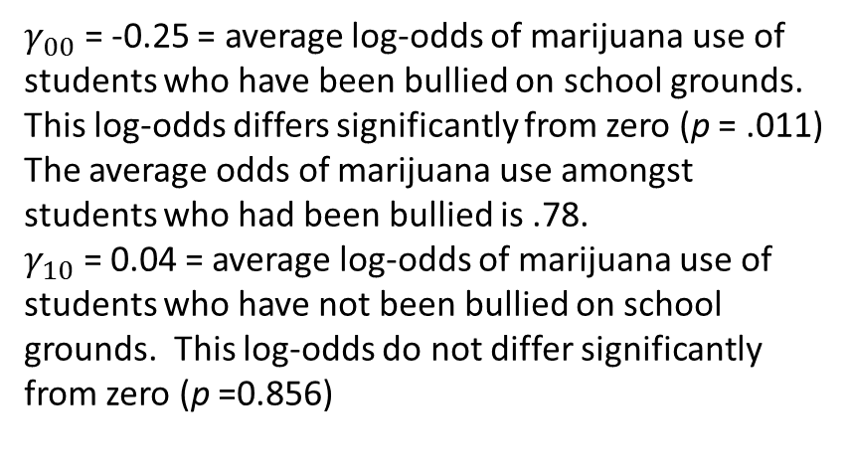
Models
Level 1 Conditional Model
Level 1:$η_{ij}=β_{0j}+β_{1j}X_{ij}$
Level 2:$β_{0j}=γ_{00}+μ_{0j}$
$β_{1j}=γ_{10}$
$η_{ij}=$ Student Marijuana Use
$X_{ij}=$ Student Bullied on School Property Yes/No
$γ_{00}$ = -0.25 = average log-odds of marijuana use of students who have been bullied on school grounds. This log-odds differs significantly from zero (p = .011)
The average odds of marijuana use amongst students who had been bullied is .78.
$γ_{10}$ = 0.04 = average log-odds of marijuana use of students who have not been bullied on school grounds. This log-odds do not differ significantly from zero (p =0.856)

Slide 8
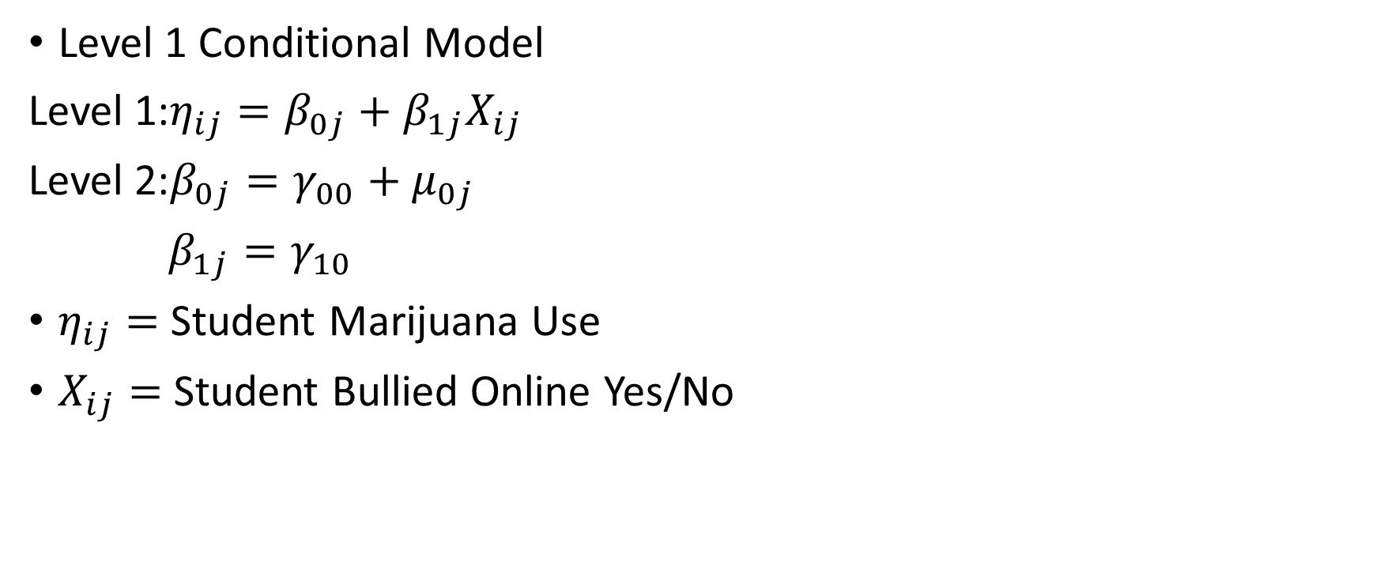
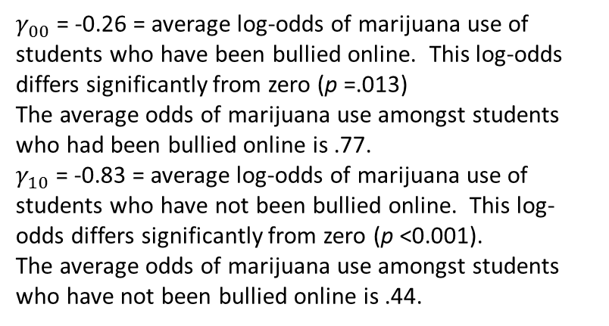
Models
Level 1 Conditional Model
Level 1:$η_{ij}=β_{0j}+β_{1j}X_{ij}$
Level 2:$β_{0j}=γ_{00}+μ_{0j}$
$β_{1j}=γ_{10}$
$η_{ij}=$ Student Marijuana Use
$X_{ij}=$ Student Bullied Online Yes/No
$γ_{00}$ = -0.26 = average log-odds of marijuana use of students who have been bullied online. This log-odds differs significantly from zero (p =.013)
The average odds of marijuana use amongst students who had been bullied online is .77.
$γ_{10}$ = -0.83 = average log-odds of marijuana use of students who have not been bullied online. This log-odds differs significantly from zero (p <0.001).
The average odds of marijuana use amongst students who have not been bullied online is .44.

Slide 9
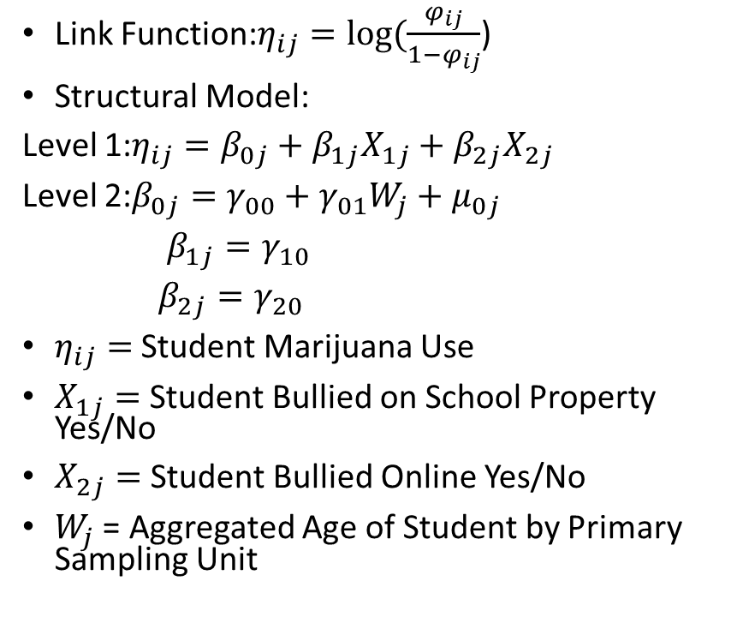
Intercept as Outcomes Model
Link Function:$η_{ij}=log⁡(\frac{φ_{ij}}{1−φ_{ij}}$)
Structural Model:
Level 1:$η_{ij}=β_{0j}+β_{1j}X_{1j}+β_{2j}X_{2j}$
Level 2:$β_{0j}=γ_{00}+γ_{01}W_{j}+μ_{0j}$
$β_{1j}=γ_{10}$
$β_{2j}=γ_{20}$
$η_{ij}=$ Student Marijuana Use
$X_{1j}=$ Student Bullied on School Property Yes/No
$X_{2j}=$ Student Bullied Online Yes/No
$W_{j}$ = Aggregated Age of Student by Primary Sampling Unit
Age of the respondent significantly increases the log-odds of marijuana use among students who have been bullied in school and online (p = .027)
For each increase in age there is a corresponding increase in the odds of marijuana use.

Slide 10
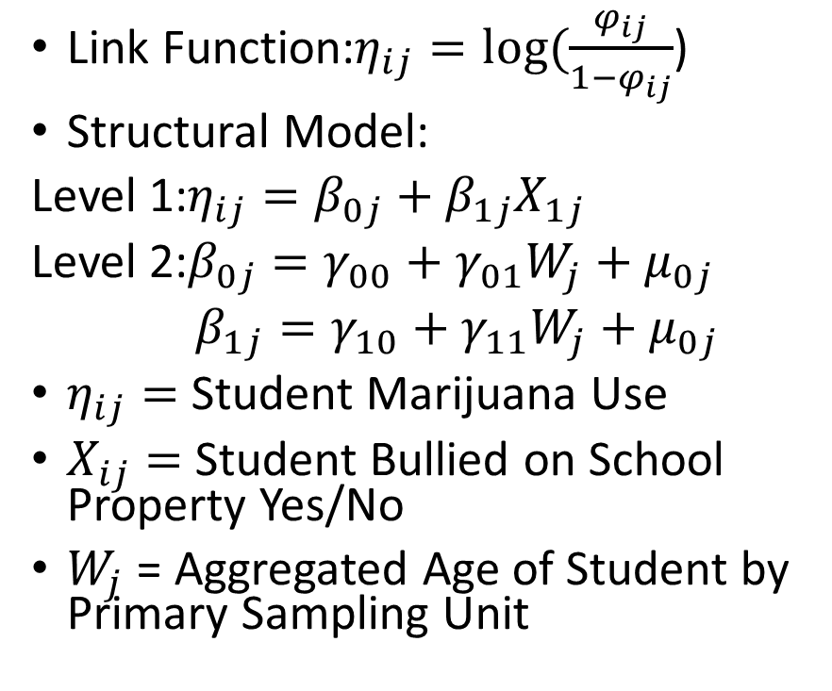
Intercept and Slopes as Outcomes Models
Link Function:$η_{ij}=log⁡(\frac{φ_{ij}}{1−φ_{ij}}$)
Structural Model:
Level 1:$η_{ij}=β_{0j}+β_{1j}X_{1j}$
Level 2:$β_{0j}=γ_{00}+γ_{01}W_{j}+μ_{0j}$
$β_{1j}=γ_{10}+γ_{11}W_{j}+μ_{0j}$
$η_{ij}=$ Student Marijuana Use
$X_{ij}=$ Student Bullied on School Property Yes/No
$W_{j}$ = Aggregated Age of Student by Primary Sampling Unit
At the sample level, increases in mean age lead to decreases in the effect of being having been bullied on teen marijuana use.
Each unit increase in mean age increases the log-odds from -4.57 to -3.67 (-4.57 + -.89).
However, this effect is not statistically significant with p= .285.
The confidence levels for this odds-ratio include 1.

Slide 11
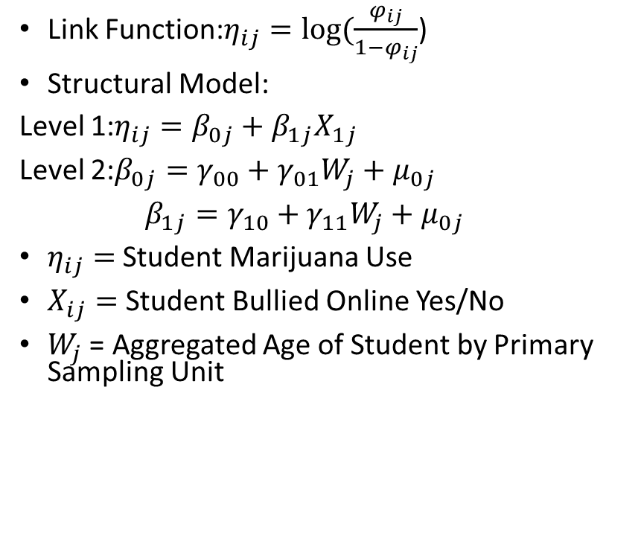
Intercept and Slopes as Outcomes Models
Link Function:$η_{ij}=log⁡(\frac{φ_{ij}}{1−φ_{ij}}$)
Structural Model:
Level 1:$η_{ij}=β_{0j}+β_{1j}X_{1j}$
Level 2:$β_{0j}=γ_{00}+γ_{01}W_{j}+μ_{0j}$
$β_{1j}=γ_{10}+γ_{11}W_{j}+μ_{0j}$
$η_{ij}=$ Student Marijuana Use
$X_{ij}=$ Student Bullied Online Yes/No
$W_{j}$ = Aggregated Age of Student by Primary Sampling Unit
At the sample level, increases in mean age lead to decreases in the effect of being having been bullied online on teen marijuana use.
Each unit increase in mean age increases the log-odds from 10.00 to 7.88 (10.00+ -2.12).
However, this effect is not statistically significant with p= .056. It is close however.
The confidence levels show that it is close to being statistically significant because for this odds-ratio barely includes 1.

Slide 12
Bibliography
Delaney, B. (n.d.). Teens: Ethnic and Racial Trends Spring 2002 (pp. 3-24, Rep. No. 143). Partnership for a Drug Free America.
DeVoe, J., & Murphy, C. (2011). Student Reports of Bullying and Cyber-Bullying: Results From the 2009 School Crime Supplement to the National Crime Victimization Survey (pp. 1-G-8, Rep.). Washington, DC: National Center for Education Statistics.
Hall, K. R. (2006). Solving Problems Together: A Psychoeducational Group Model for Victims of Bullies. The Journal for Specialists in Group Work, 31(3), 201-217. doi:10.1080/01933920600777790
Johnston, L., O'Malley, P., Bachman, J., & Schulenberg, J. (2011). MONITORING THE FUTURE NATIONAL SURVEY RESULTS ON DRUG USE, 1975–2010 (Vol. 1, pp. 1-725, Publication). Ann Arbor, MI: The University of Michigan.
Leung, C., & To, H. (2009). The Relationship Between Stress and Bullying Among Secondary School Students. New Horizons in Education, 57(1), 33-42.
Whisman, A. (2015). A Descriptive Analysis of Harassment, Intimidation, or Bullying Student Behaviors 2014-2015 (pp. Iii-8, Publication). Charleston, WV: West Virginia Department of Education.

