Slide 1

Interest in the Use of Video Games in History Education
Tim Baker

Slide 2
Purpose of study and research questions
To assess the affect on students’ interest in using video game learning in high school history education.
RQ1- Does the previous performance of students in history education affect students’ interest in using video games in the classroom?
RQ2- Does the assigned teacher have an affect on students’ interest in using video games in history education.

Slide 3

Web link to survey
https://niu.az1.qualtrics.com/SE/?SID=SV_0iWutvMGLDUVXwx

Slide 4
Primary variables: Alignment to survey items
Primary variables | Associated survey items
Students’ interest towards the use of video games in history education | 6-item Likert scale (see subsequent slide)
Previous performance in history education | Single item: “What do you normally receive for a grade in your previous history classes?” (5 categorical options)
Assigned teacher | Single item: “Who is your teacher for World History?” (3 categorical options)

Slide 5
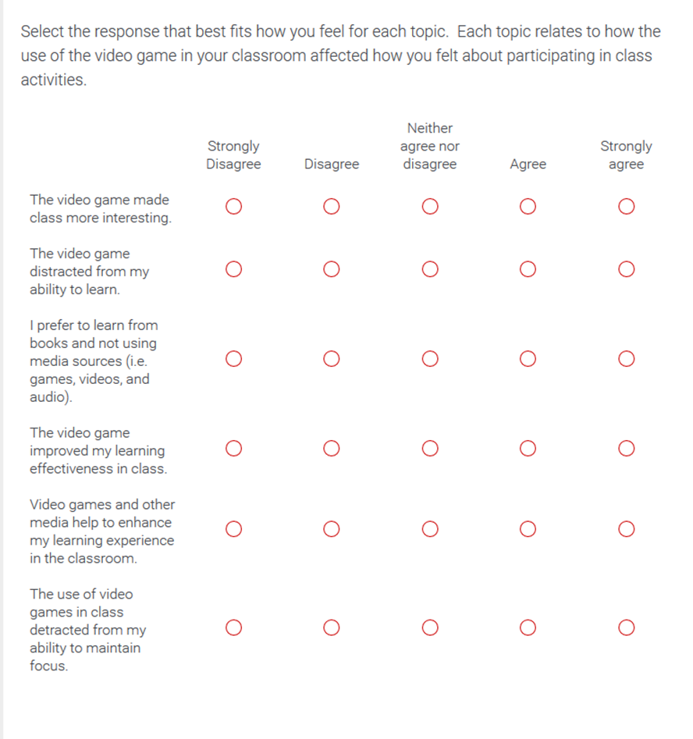
Student Attitudes Toward the Use of Video Games in the Classroom
Item responses coded 1 = SD to 5 = SA
Composite score computed as the sum of the item scores
Reverse-coded

Slide 6
Auxiliary variables: Alignment to survey items
Auxiliary variables | Associated survey items
Gender | Single item: “What is your gender?” (Male/Female)
Grade level | Single item: “What is your grade level?” (4 options: Freshman, Sophomore, Junior or Senior)
Race | Single item: “What is your racial/ethnic background?” (6 options: Hispanic, Non-Hispanic (Caucasian), African American, Asian, Middle Eastern, or Other/Mixed)
Class period World History taken | Three items: “What class period do you have *teachers name*?” (3 options for each item with the options being specific to the teachers class schedule)

Slide 7
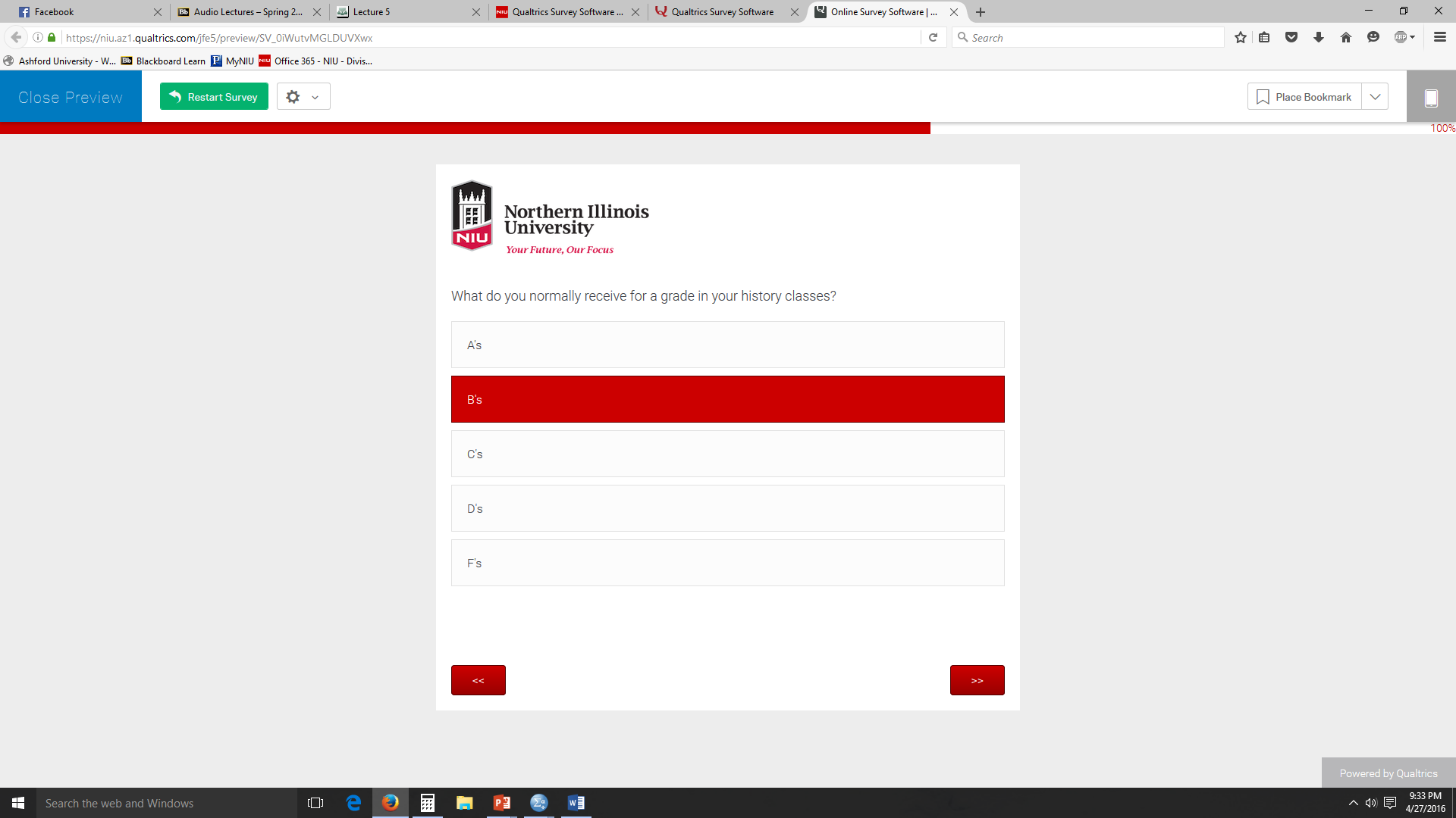
Sample page illustrating survey layout

Slide 8

Sample
9th-12th grade history students from a rural Midwestern high school in the U.S.
Convenience sampling was used
Students were enrolled in history classes at the time
N = 31 students responded

Slide 9
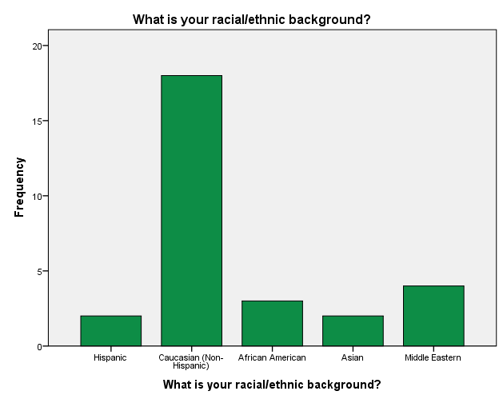
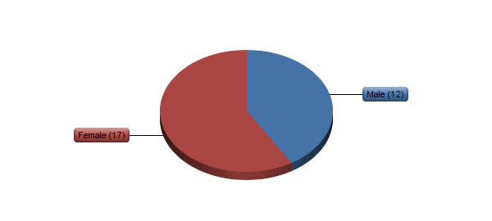
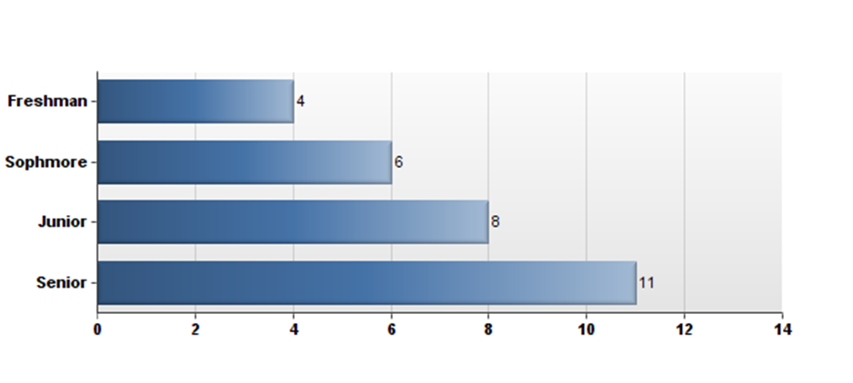
Demographic characteristics of sample
Gender distribution
What is your grade level?
What is your racial/ethnic background?

Slide 10
Results from coding of open-response item: In no more than 2 sentences, how would you describe the affect the use of a video game in your World History class helped or hurt your achievement?
Response | Percent of respondents
Enjoyed | 10%
Kept interesting and engaged | 19%
Learned more | 10%
Reinforced learning | 3%
To challenging | 3%
Disliked | 16%
Non-response | 35%

Slide 11

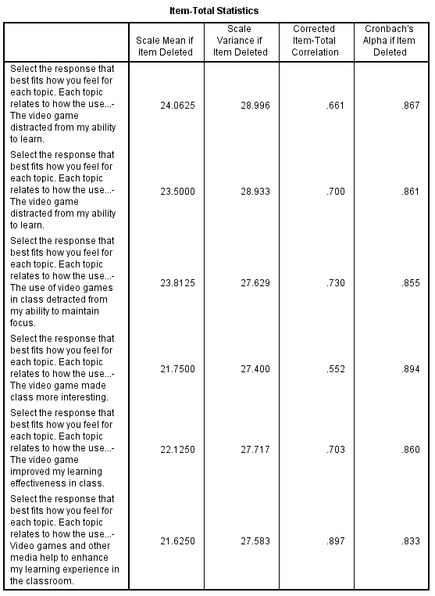
Reliability information for Interest in the Use of Video Games in the History Classroom scale
Cronbach’s alpha becomes only slightly higher if 1 out of the 6 items are removed, if 5 out of the 6 items are removed it becomes slightly lower. One item could be removed, but removing it would not have a large effect.
Reliability of scores is good (greater than .70 criterion)
4 of out 6 items correlate strong with the composite score, indicating good mostly good items

Slide 12
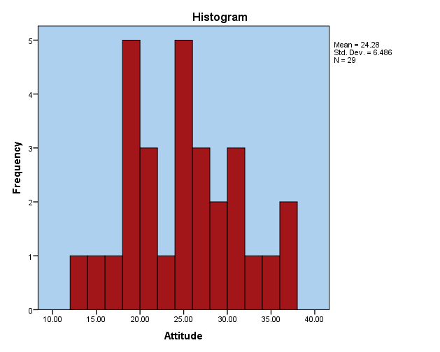
Distribution of composite for Interest in the Use of Video Games in the History Classroom scale scores

Slide 13
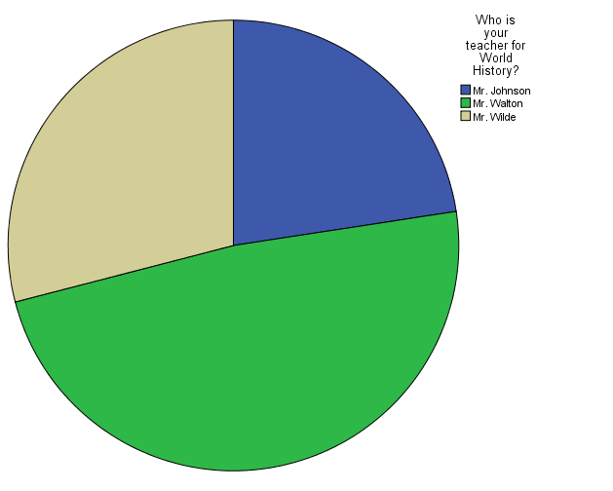
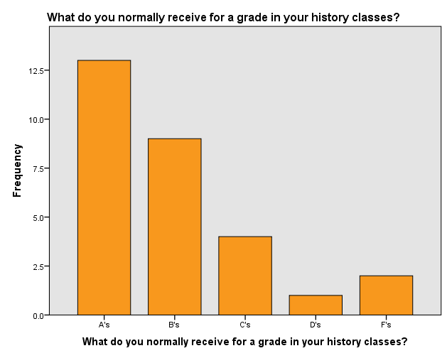
Distribution of other primary variables in survey

Slide 14

Analysis plan
RQ1- Does the previous performance of students in history education affect students’ interest in using video games in the classroom?
Analysis: Logistic regression to relate the students’ previous performance in history education classes to their interest in the use of video games in history education.
RQ2- Does the assigned teacher have an affect on students’ interest in using video games in history education.
Analysis: Chi-squared test to compare the teacher that the student had towards their interest in the use of video games in the history classroom.

