Slide 1
Assessment Framework
Leo Deng

Slide 2
Funtionailities
User Input box for problem and AI solution
User Input box for adding a new aspect for assessing
Dropdown menu for user to choose which aspect to be assessed
Auto-assessment using benchmark provided on Github and returns feedback in both the program as well as a CSV file

Slide 3
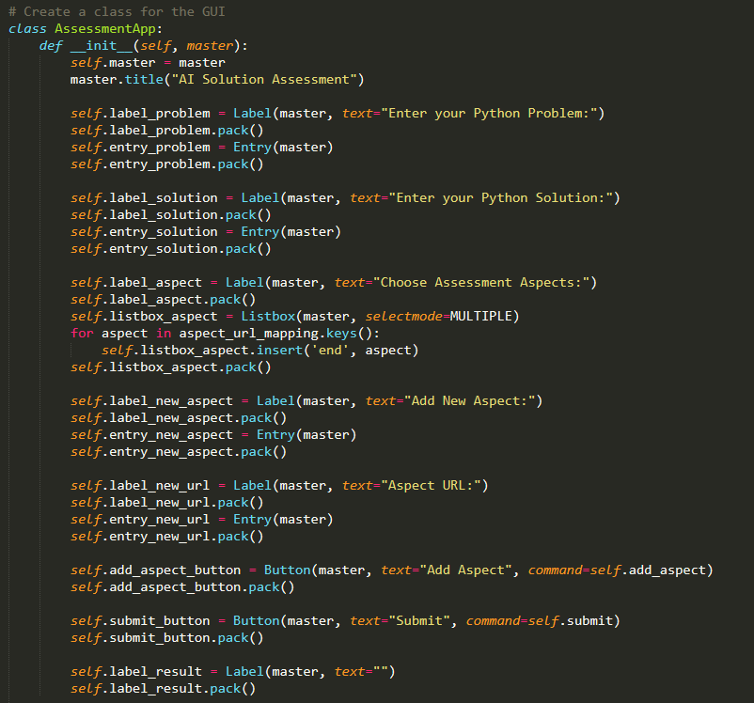
Creating GUI

Slide 4
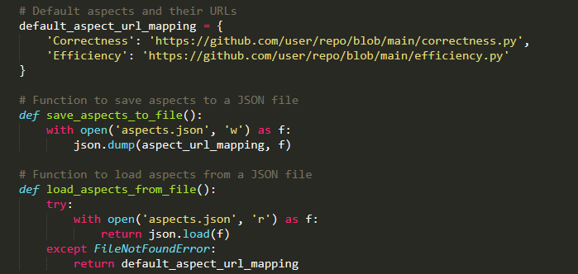
Load Aspects

Slide 5
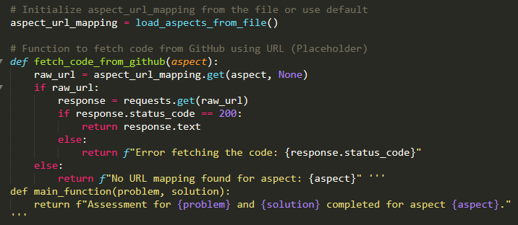
Fetch Assessment Code

Slide 6
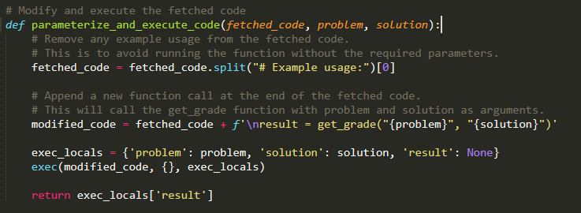
Modify and Execute

Slide 7
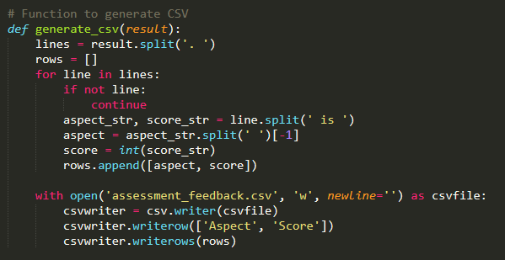
Generate CSV

Slide 8
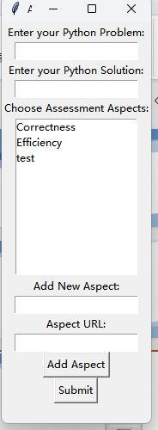
Input Box
The problem and solution input by the user will be sent as an argument to the assessment function.
So now ideally, the assessment code should
accept ‘problem’ and ‘solution’ as parameters
or it may not be able to work properly

Slide 9
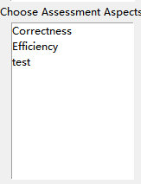
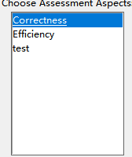
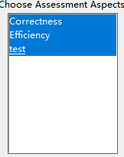
Dropdown Menu
Choose the aspect to be assessed

Slide 10
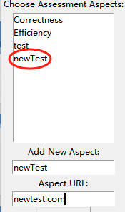
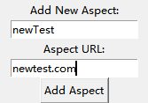

Adding aspects
Enter the name of new aspect
Enter the url in which contains the code
to assess this aspect.
click on add aspect (Or you can add it
directly in the autogenerated Json file called
‘aspects’

Slide 11
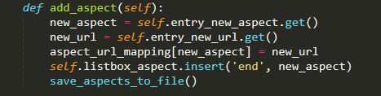
Adding Aspect

Slide 12
Assessment
Enter problem and AI solution
Choose the aspects you want to assess
Click Submit
The program will automatically call the python code in the corresponding url for the aspects one by one and return the result as a whole in the program and also generate a CSV file called ‘Assessment Feedback’

Slide 13
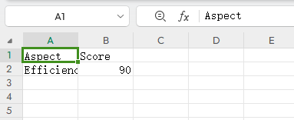

Assessment

