Slide 1
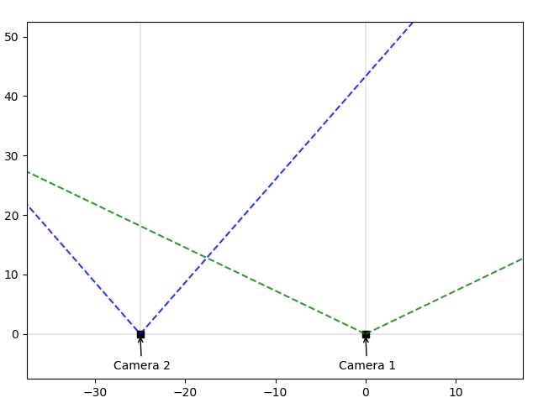






Overlapping Angles of View
A
B
$$y (m)$$
C
(X, Z)
$$β$$
$$δ$$
$$γ$$
$$α$$
(-b, 0)
(0, 0)
$$x (m)$$

