Slide 1
PROJECT-REVIEW-2
On
Advanced Text Classification using RNN with LSTM
Under the guidance of
Dr. Uma Mahesh RN
Associate Professor
Dept. of CSE-AI & ML
ATMECE, Mysuru
Ramya J R 4AD21CI043
Revanth kumar S 4AD21CI044 Sachin V M 4AD21CI045
Usha B D 4AD21CI054

Slide 2
CONTENTS
Introduction
Objective
Literature Survey
Existing System
Problem Statement
Proposed System
Architecture
Flow Diagrams
Software Requirements
Hardware Requirements
Result
Conclusion
References

Slide 3
INTRODUCTION
Text Classification: Essential for NLP tasks like sentiment analysis and topic categorization.
Traditional Methods: SVM and Naive Bayes struggle with sequential and contextual relationships in language.
RNNs: Process text sequentially but face the vanishing gradient problem.
LSTM:
- Overcome vanishing gradients.
- Capture long-term dependencies effectively.

Slide 4
OBJECTIVE
To develop an advanced text classification system using Recurrent Neural Networks (RNNs) that effectively analyzes and categorizes textual data across various domains, such as sentiment analysis, spam detection, and topic classification. By leveraging the sequential nature of text.
This project aims to enhance performance metrics like accuracy, precision etc, showcasing the advantages of RNNs over traditional machine learning methods.
Ultimately, we aspire to demonstrate how RNNs can revolutionize text classification, making it more efficient and impactful.

Slide 5
EXISTING SYSTEM
Traditional Machine Learning Approaches
a. Support Vector Machines (SVM)
SVMs find a hyperplane that separates classes in high-dimensional spaces.
b. Naive Bayes
Based on Bayes' theorem, Naive Bayes assumes feature independence, making it suitable for tasks like spam detection.
c. Decision Trees and Random Forests
Decision trees create a tree-like model for decisions, while random forests average multiple trees for improved accuracy.
2. Early Deep Learning Approaches
Convolutional Neural Networks (CNNs)
Adapted from image processing, CNNs capture local patterns in text.

Slide 6
PROBLEM STATEMENT
Text classification is essential in natural language processing, with applications in sentiment analysis and topic categorization. Traditional methods like Support Vector Machines (SVM) and Naive Bayes often fail to capture the complex sequential and contextual relationships in text. While Recurrent Neural Networks (RNNs) provide some solutions, they face challenges such as the vanishing gradient problem, limiting their effectiveness on longer sequences.

Slide 7
LIMITATIONS OF EXISTING SYSTEM
Context Capture: Traditional models often miss sequential meaning.
Scalability: Many methods struggle with large datasets.
Overfitting: Basic models tend to overfit complex text data.
Performance: Limited effectiveness on nuanced classification tasks.

Slide 8
LITERATURE SURVEY
[1] Text Classification with Attention-based Recurrent Neural Networks Authors: C. Du & L. Huang (2018) Focus: Attention-based RNNs for text classification. Results: Improved performance in various text classification tasks.
[2] A Systematic Review of Text Classification Research Based on Deep Learning Models in Arabic Language Authors: A. Wahdan, S. Hantoobi, S. A. Salloum, K. Shaalan (2020) Focus: Deep learning models for Arabic text classification. Results: Insights into challenges and solutions in Arabic text processing.

Slide 9
LITERATURE SURVEY
[3] Spam Text Classification Using LSTM Recurrent Neural Network Authors: Y. Zagabathuni (2021) Focus: LSTM networks for spam classification. Results: High performance in distinguishing spam from legitimate messages.
[4] Text Classification Using Capsules Authors: J. Kim, S. Jang, S. Choi (2018) Focus: Capsule Networks for text classification. Results: Improved handling of complex linguistic structures in text.

Slide 10
LITERATURE SURVEY
[5] Deep Learning Bangla Text Classification Using Recurrent Neural Network Authors: A. Habib, A. Akter (2022) Focus: RNN-based deep learning for Bangla text classification. Results: Effective application in low-resource Bangla language text classification.

Slide 11
PROPOSED SYSTEM
Advanced Text Classification with LSTM
System Architecture
Input Layer: Preprocessed text as word embeddings.
Embedding Layer: Uses pre-trained embeddings (GloVe,Word2Vec).
Recurrent Layer (LSTM): Retains long-range dependencies.
Fully Connected Layer: Maps features to output classes.
Output Layer: Softmax activation for class probabilities.

Slide 12
PROPOSED SYSTEM
Data Preprocessing
Text Cleaning, Tokenization, Padding, Encoding.
Model Training
Loss Function: Categorical cross-entropy.
Optimizer: Adam.
Validation: Early stopping to prevent overfitting.

Slide 13
PROPOSED SYSTEM
Performance Evaluation
Metrics: Accuracy, Precision, Recall, F1-score, Confusion Matrix.
Comparison with Existing Systems
Benchmark against SVM, Naive Bayes, and CNNs.
Implementation and Tools
Language: Python
Framework: TensorFlow/Keras
Libraries: Pandas, Matplotlib
Future Enhancements
Hyperparameter tuning, Attention mechanisms, BERT, Ensemble methods.

Slide 14
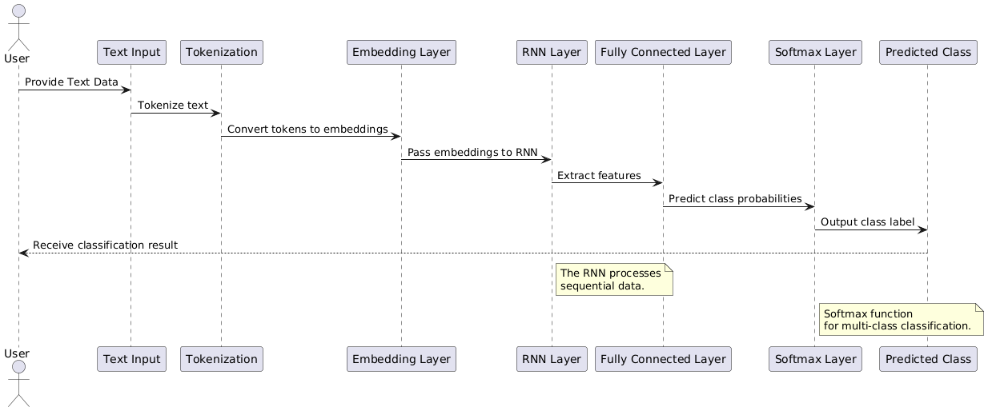
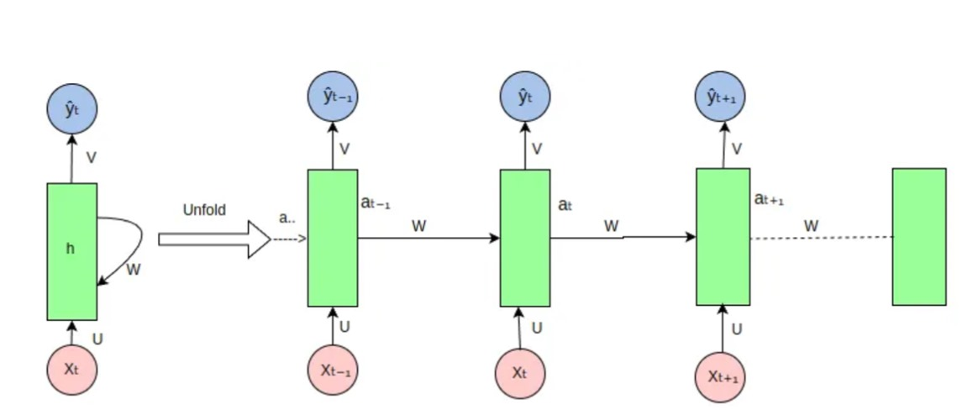
ARCHITECTURE

Slide 15
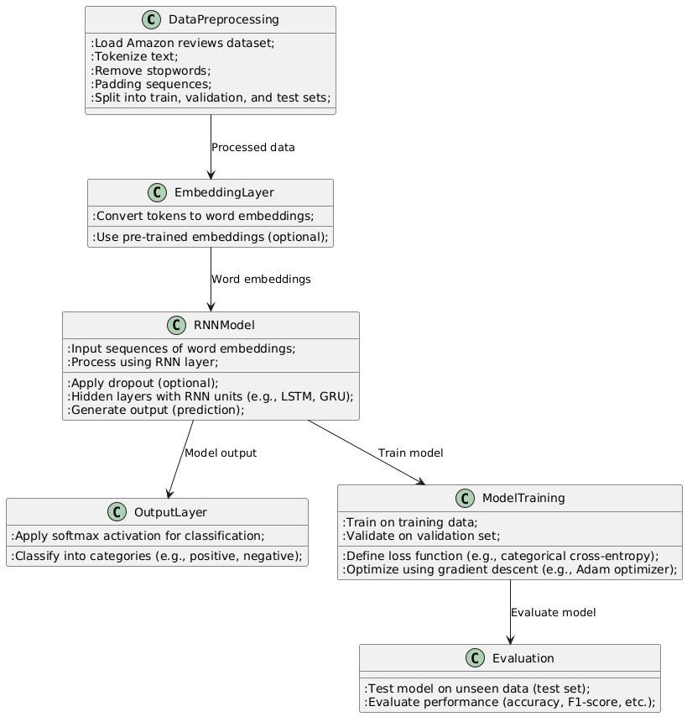
FLOW DIAGRAM

Slide 16
SOFTWARE REQUIREMENTS:
Python (3.7 or above)
TensorFlow/Keras (2.x)
NLTK or SpaCy for text preprocessing
Jupyter Notebook for development and experimentation
Pandas and NumPy for data handling and manipulation

Slide 17
HARDWARE REQUIREMENTS:
Minimum 8 GB RAM (16 GB recommended)
NVIDIA GPU (with CUDA support) for training deep learning models
At least 10 GB of free disk space for datasets and model storage
A modern processor (Intel i5 or equivalent)

Slide 18
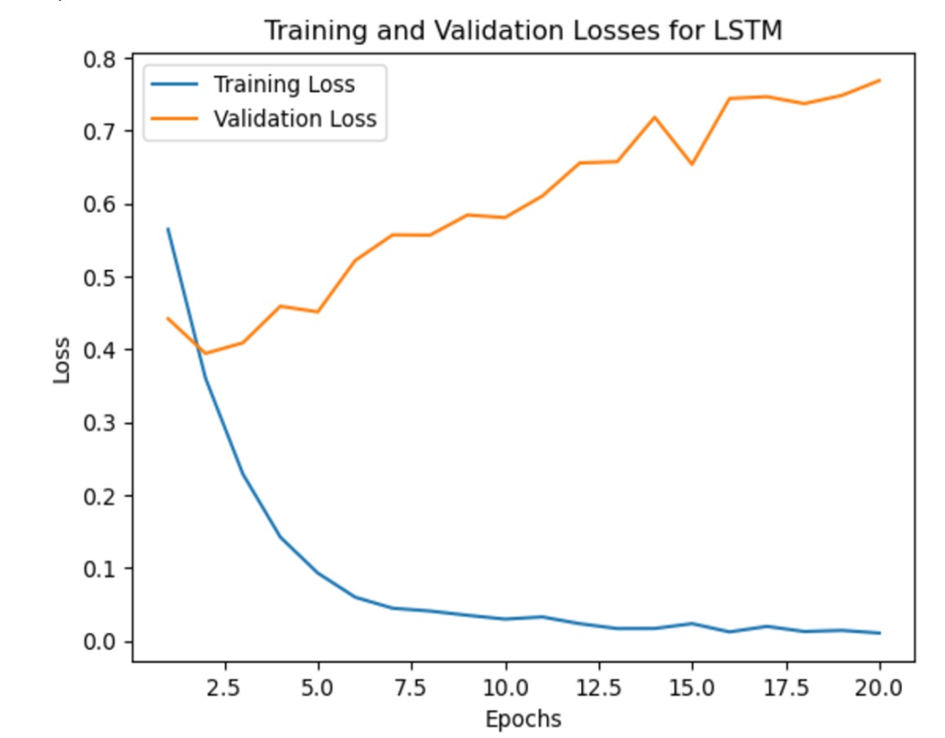
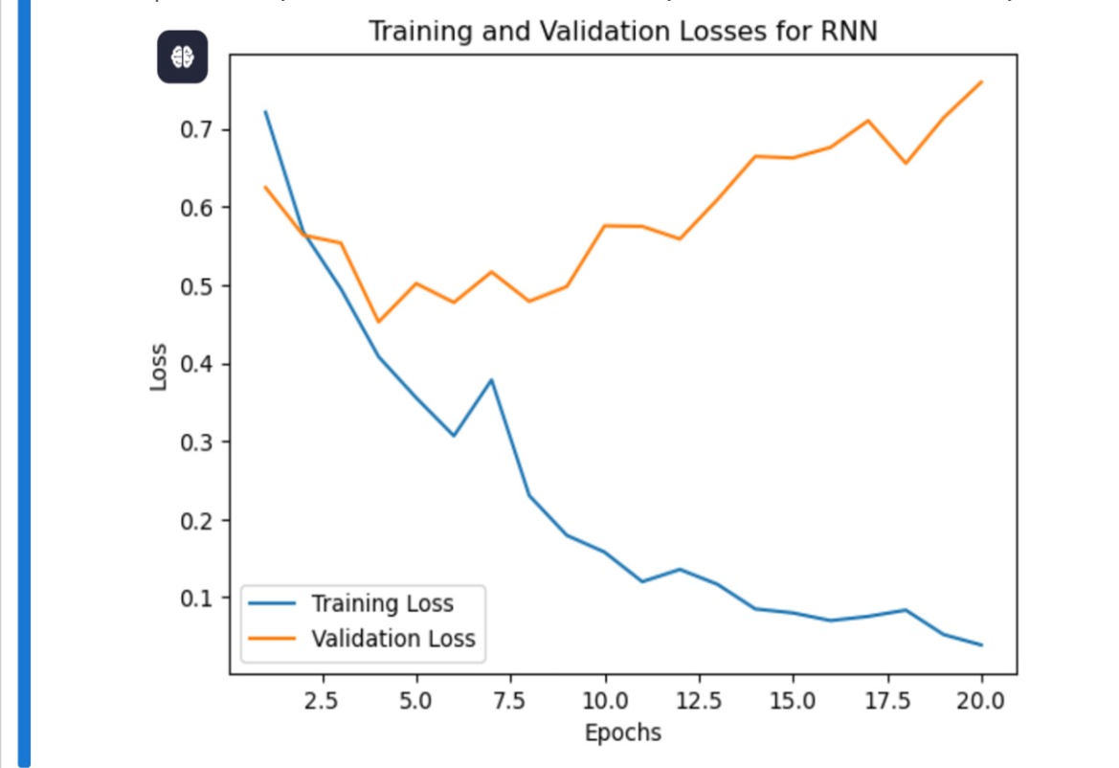
RESULT:

Slide 19
CONCLUSION
Strengths: RNNs are ideal for sequential data, capturing long-range dependencies in text, improving tasks like sentiment analysis.
Challenges: Basic RNNs struggle with long sequences (vanishing gradients) and require significant computational resources.
Advancements: LSTM overcome RNN limitations, enabling better performance, with future potential in attention mechanisms and transfer learning (e.g., BERT).

Slide 20
REFERENCES
Changshun Du, Lei Huang, "Text Classification Research with Attention-based Recurrent Neural Networks,“ International Journal of Computers Communications & Control ISSN 1841-9836, 13(1), 50-61, February 2018.
“Ahlam Wahdan , Sendeyah Hantoobi , Said A. Salloum , Khaled Shaalan "A systematic review of text classification research based on deep learning models in Arabic language " International Journal of Electrical and Computer Engineering (IJECE) Vol. 10, No. 6, December 2020, pp. 6629~6643 ISSN: 2088-8708, DOI: 10.11591/ijece.v10i6.pp6629-6643
Yeshwanth Zagabathuni, "Spam text classification using LSTM Recurrent Neural Network" International Journal of Emerging Trends in Engineering Research, Published Date : September 07, 2021.
Jaeyoung Kim, Sion Jang and Sungchul Choi "Text Classification using Capsules," arXiv:1808.03976v2 [cs.CL] 14 Aug 2018
Ahsan Habib, Asma Akter, "Deep learning Bangla text classification using recurrent neural network”, International Journal of Research in Advanced Engineering and Technology, Published: 10-03-2022 Volume 8, Issue 1, 2022, Page No. 10-16

