Slide 1
Group Number: 1
QYF Virtual Internship
Group Members (Presenters):
Simamnkele Vange
Tshepiso Brier
Masingita Maswanganye
14/01/2026
QYF Virtual Internship 1

Slide 2




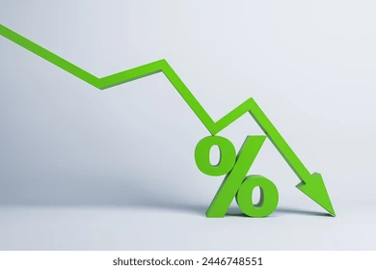
Section 2: Credit Risk
Potential risks associated with this project (e.g. market saturation and economic downturns)
Market Saturation
  High number of sustainable industrial complexes leads to oversupply, decreasing tenant attraction and retention
Macroeconomic and Recession
  Economic downturn could cause companies to downsize, reducing demand for EnergiCore’s facilities
Cash Flow Dependency
  Ability to service the loan depends heavily on rental income, which is volatile to real estate market conditions.
Construction and Completion
  Delays or cost overruns could postpone rental income while loan repayments still need to be made
Interest Rate Risk
  An increase in interest rates would raise EnergiCore’s debt servicing costs
While the EnergiCore project aligns with sustainability objectives, the combined effects of market, economic, cash flow, construction, and interest rate risks increase PD, may raise EAD, and can worsen LGD, thereby elevating Nedbank’s overall credit risk exposure.
QYF Virtual Internship 2

Slide 3
Section 2: Credit Risk
RAROC of this deal.
The deal, with the given assumptions, has a risk-adjusted return on capital of 14.7%
Interest rate to be charged to the client to get a RAROC of 17%?
To achieve a RAROC of 17%, the bank would need to charge 14.07% interest on the loan
What is the break-even point of the loan? In other words, what is interest rate needed to achieve an EP of R0. How would you use this result?
The loan has a break-even point of 13.71%. The 13.71% break-even rate indicates the minimum interest rate at which Nedbank neither creates nor destroys economic value. It serves as a pricing floor, guiding loan approval, negotiation, and risk mitigation decisions.
QYF Virtual Internship 3

Slide 4
Section 2: Credit Risk
Sensitivity Analysis of PD vs RAROC and Trends.
As PD increases, RAROC increase:
PD<2% results in a high RAROC, signaling a more profitable investment.
When PD is approximately 7%, RAROC approaches 0%
PD>7% results in a negative RAROC, signaling loss
Pricing Implications:
If the probability of default is high, the bank must increase interest rate of monthly fees to maintain a RAROC above the hurdle rate
Risk Management Implications:
Avoid too many high-PD loans
For >PD clients, require stronger collateral
Practice portfolio diversification
QYF Virtual Internship 4

Slide 5
Conclusion
The hurdle rate needed is 17%, while the risk-adjusted return on capital (RAROC) for this loan is 14.7%, which is lower.
The project that EnergiCore seeks to embark on has significant market risks attached, all of which increase probability of default and decrease (RAROC).
Due to these unfavourable conditions, and the effect that this loan will have on our credit risk, it is our recommendation to not grant this loan to EnergiCore.
QYF Virtual Internship 5

Slide 6
Thank You
QYF Virtual Internship 6

