Slide 1
Object Oriented Software Development Lab
Subject code: CSS 2213 Credits: 2
Sem and Branch: 4CSE D1 Batch
Faculties: Ms. Jayashree Hegde K, Dr. Ramya D Shetty

Slide 2
Installation
JDK (latest)
Visual Studio Code
Java for Visual Studio Code

Slide 3
Week 1: Review of Object-Oriented Programming Concepts
Class and Object
Encapsulation
Inheritance
Polymorphism
Method Overloading and Overriding
this and super keywords
Constructors
Abstraction

Slide 4
Class and Object
A class is a blueprint used to create objects that share common properties and behavior.
An object is an instance of a class. It represents a specific entity created from the class template.

Slide 5
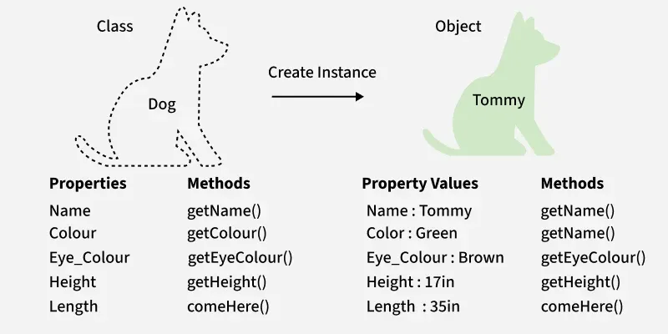
Class and Object

Slide 6
Class and Object - Example
class Student {
int id;
String n;
public Student(int id, String n) {
this.id = id;
this.n = n;
}
}
public class Main {
public static void main(String[] args) {
Student s1 = new Student(10, "Alice");
System.out.println(s1.id);
System.out.println(s1.n);
}
}

Slide 7
Encapsulation
Encapsulation means combining data and the functions that work on that data into a single unit, like a class. In Object-Oriented Programming, it helps keep things organized and secure.
A class can hide the implementation part and discloses only the functionalities required by other classes. By making class data and methods private, representations or implementations can later be changed without impacting the codes that uses this class.

Slide 8
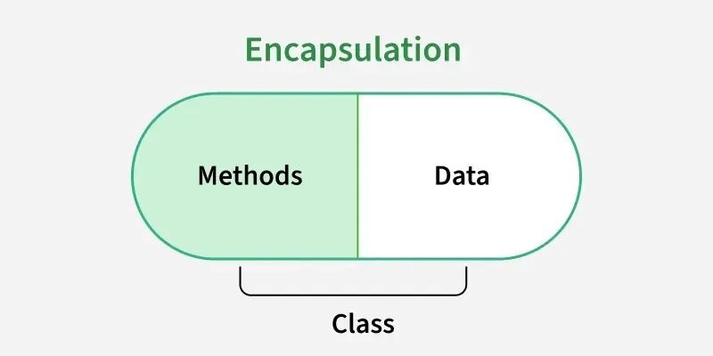
Encapsulation

Slide 9
Implementation of Encapsulation
Declare data as private: Hide the class data so it cannot be accessed directly from outside the class.
Use getters and setters: Keep variables private and provide public getter and setter methods for controlled access and safe modification, often with validation.
Apply proper access modifiers: Use private for data hiding and public for methods that provide access.

Slide 10
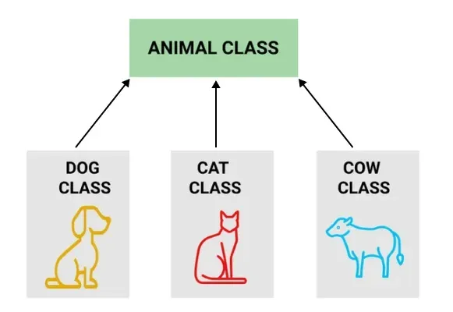
Inheritance
Inheritance means creating new classes based on existing ones. A class that inherits from another class can reuse the methods and fields of that class.

Slide 11
// Parent class
class Animal {
void sound() {
System.out.println("Animal makes a sound");
}
}
// Child class
class Dog extends Animal {
void sound() {
System.out.println("Dog barks");
}
}
// Child class
class Cat extends Animal {
void sound() {
System.out.println("Cat meows");
}
}
// Child class
class Cow extends Animal {
void sound() {
System.out.println("Cow moos");
}
}
// Main class
public class InheritanceDemo {
public static void main(String[] args) {
Animal a;
a = new Dog();
a.sound();
a = new Cat();
a.sound();
a = new Cow();
a.sound();
}
}

Slide 12
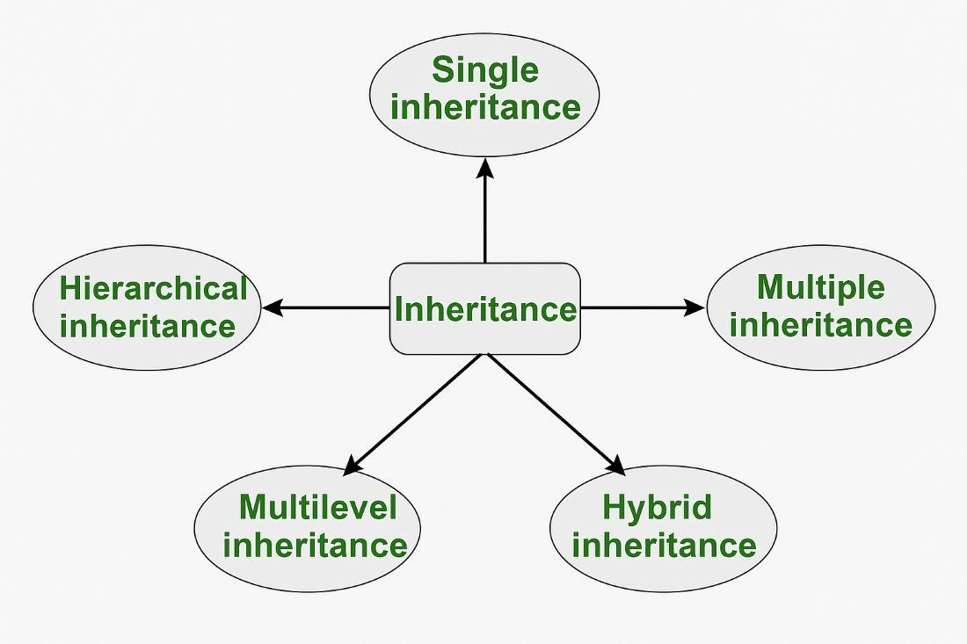
Types of Inheritance

Slide 13
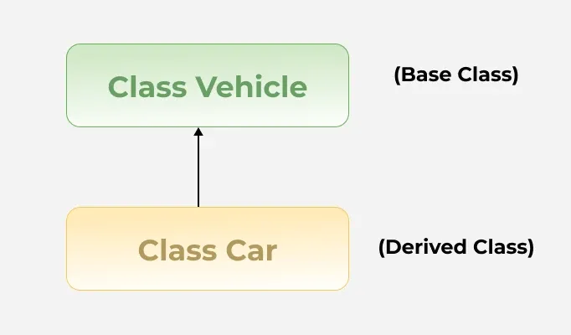
1. Single Inheritance

Slide 14
//Super class
class Vehicle {
Vehicle() {
System.out.println("This is a Vehicle");
}
}
// Subclass
class Car extends Vehicle {
Car() {
System.out.println("This Vehicle is Car");
}
}
public class Test {
public static void main(String[] args) {
// Creating object of subclass invokes base class constructor
Car obj = new Car();
}
}

Slide 15
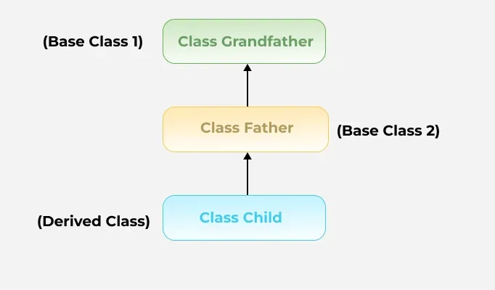
2. Multilevel Inheritance

Slide 16
class Vehicle {
Vehicle() {
System.out.println("This is a Vehicle");
}
}
class FourWheeler extends Vehicle {
FourWheeler() {
System.out.println("4 Wheeler Vehicles");
}
}
class Car extends FourWheeler {
Car() {
System.out.println("This 4 Wheeler Vehicle is a Car");
}
}
public class Test {
public static void main(String[] args) {
Car obj = new Car(); // Triggers all constructors in order
}
}

Slide 17
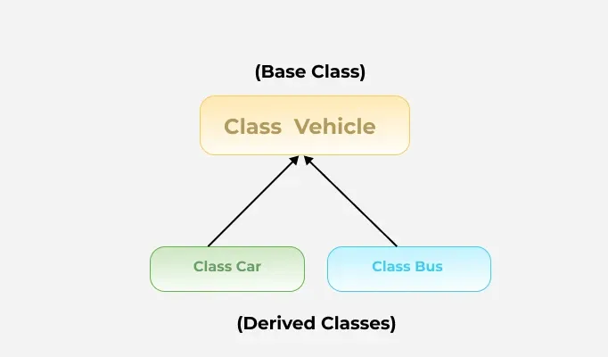
3. Hierarchical Inheritance

Slide 18
class Vehicle {
Vehicle() {
System.out.println("This is a Vehicle");
}
}
class Car extends Vehicle {
Car() {
System.out.println("This Vehicle is Car");
}
}
class Bus extends Vehicle {
Bus() {
System.out.println("This Vehicle is Bus");
}
}
public class Test {
public static void main(String[] args) {
Car obj1 = new Car();
Bus obj2 = new Bus();
}
}

Slide 19
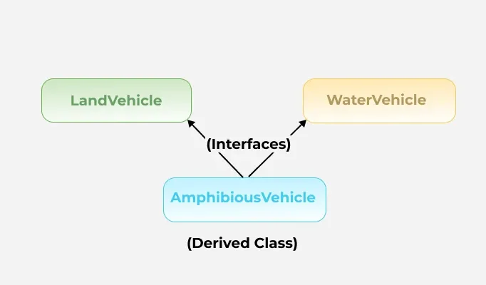
4. Multiple Inheritance (through interface)

Slide 20
interface LandVehicle {
default void landInfo() {
System.out.println("This is a LandVehicle");
}
}
interface WaterVehicle {
default void waterInfo() {
System.out.println("This is a WaterVehicle");
}
}
// Subclass implementing both interfaces
class AmphibiousVehicle implements LandVehicle, WaterVehicle {
AmphibiousVehicle() {
System.out.println("This is an AmphibiousVehicle");
}
}
public class Test {
public static void main(String[] args) {
AmphibiousVehicle obj = new AmphibiousVehicle();
obj.waterInfo();
obj.landInfo();
}
}

Slide 21
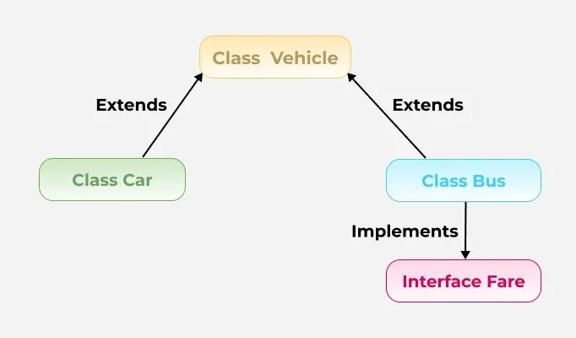
5. Hybrid Inheritance

Slide 22
Polymorphism
Polymorphism allows the same method or object to behave differently based on the context, specially on the project's actual runtime class.
Poly means many; morphs - forms

Slide 23
// Base class Person
class Person {
// Method that displays the
// role of a person
void role() {
System.out.println("I am a person.");
}
}
// Derived class Father that
// overrides the role method
class Father extends Person {
// Overridden method to show
// the role of a father
@Override
void role() {
System.out.println("I am a father.");
}
}
public class Main {
public static void main(String[] args) {
// Creating a reference of type Person
// but initializing it with Father class object
Person p = new Father();
// Calling the role method. It calls the
// overridden version in Father class
p.role();
}
}

Slide 24
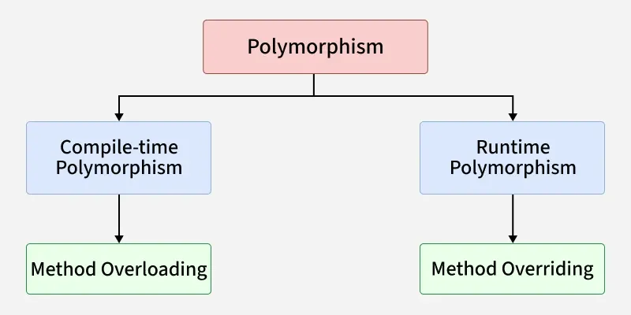
Types of Polymorphism

Slide 25
Method Overloading
Compile-Time Polymorphism in Java is also known as static polymorphism and also known as method overloading. This happens when multiple methods in the same class have the same name but different parameters.
Method overloading in Java means when there are multiple functions with the same name but different parameters then these functions are said to be overloaded. Functions can be overloaded by changes in the number of arguments or/and a change in the type of arguments.

Slide 26
// Class 1
// Helper class
class Helper {
// Method with 2 integer parameters
static int Multiply(int a, int b)
{
// Returns product of integer numbers
return a * b;
}
// Method 2
// With same name but with 2 double parameters
static double Multiply(double a, double b)
{
// Returns product of double numbers
return a * b;
}
}
// Class 2
// Main class
class Geeks
{
// Main driver method
public static void main(String[] args) {
// Calling method by passing
// input as in arguments
System.out.println(Helper.Multiply(2, 4));
System.out.println(Helper.Multiply(5.5, 6.3));
}
}

Slide 27
Method Overriding
Runtime Polymorphism in Java known as Dynamic Method Dispatch. It is a process in which a function call to the overridden method is resolved at Runtime. This type of polymorphism is achieved by Method Overriding.
Method overriding in Java means when a subclass provides a specific implementation of a method that is already defined in its superclass. The method in the subclass must have the same name, return type, and parameters as the method in the superclass.

Slide 28
Method Overriding
Method overriding allows a subclass to modify or extend the behavior of an existing method in the parent class. This enables dynamic method dispatch, where the method that gets executed is determined at runtime based on the object's actual type.

Slide 29
super and this keywords
super keyword is used to access methods of the parent class while this is used to access methods of the current class.

Slide 30
this keyword
this keyword is a reserved keyword in java i.e, we can't use it as an identifier. It is used to refer current class's instance as well as static members. It can be used in various contexts as given below:
to refer instance variable of current class
to invoke or initiate current class constructor
can be passed as an argument in the method call
can be passed as argument in the constructor call
can be used to return the current class instance

Slide 31
// Program to illustrate this keyword
// is used to refer current class
class RR {
// instance variable
int a = 10;
// static variable
static int b = 20;
void GFG()
{
// referring current class(i.e, class RR)
// instance variable(i.e, a)
this.a = 100;
System.out.println(a);
// referring current class(i.e, class RR)
// static variable(i.e, b)
this.b = 600;
System.out.println(b);
}
public static void main(String[] args)
{
// Uncomment this and see here you get
// Compile Time Error since cannot use
// 'this' in static context.
// this.a = 700;
new RR().GFG();
}
}

Slide 32
super keyword
super is a reserved keyword in java i.e, we can't use it as an identifier.
super is used to refer super-class's instance as well as static members.
super is also used to invoke super-class's method or constructor.
super keyword in java programming language refers to the superclass of the class where the super keyword is currently being used.
The most common use of super keyword is that it eliminates the confusion between the superclasses and subclasses that have methods with same name.

Slide 33
// Program to illustrate super keyword
// refers super-class instance
class Parent {
// instance variable
int a = 10;
// static variable
static int b = 20;
}
class Base extends Parent {
void rr()
{
// referring parent class(i.e, class Parent)
// instance variable(i.e, a)
System.out.println(super.a);
// referring parent class(i.e, class Parent)
// static variable(i.e, b)
System.out.println(super.b);
}
public static void main(String[] args)
{
// Uncomment this and see here you get
// Compile Time Error since cannot use 'super'
// in static context.
// super.a = 700;
new Base().rr();
}
}

Slide 34
Constructors
A constructor in Java is a special member that is called when an object is created. It initializes the new object’s state. It is used to set default or user-defined values for the object's attributes.
  A constructor has the same name as the class.
  It does not have a return type, not even void.
  It can accept parameters to initialize object properties.

Slide 35
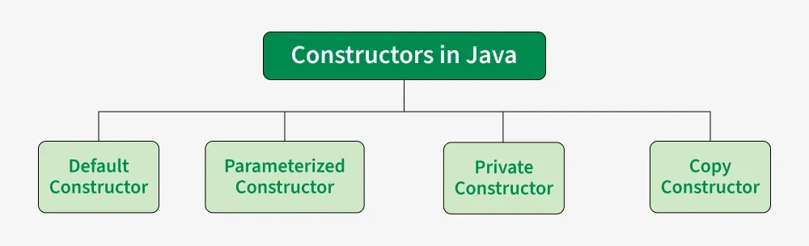
Types of Constructors

Slide 36
1. Default Constructors
A default constructor has no parameters. It’s used to assign default values to an object. If no constructor is explicitly defined, Java provides a default constructor.

Slide 37
class Testing{
// Default Constructor
Geeks(){
System.out.println("Default constructor");
}
public static void main(String[] args){
Testing hello = new Testing();
}
}

Slide 38
2. Parameterized Constructors
A constructor that has parameters is known as parameterized constructor. If we want to initialize fields of the class with our own values, then use a parameterized constructor.

Slide 39
class Demo{
// data members of the class
String name;
int id;
// Parameterized Constructor
Demo(String name, int id)
{
this.name = name;
this.id = id;
}
// Method to display object data
void display(){
System.out.println("Name: " + name
+ " and Id: " + id);
}
// main() method — placed inside the same class for
// universal compatibility
public static void main(String[] args){
// This will invoke the parameterized constructor
Demo d= new Demo("Sweta", 68);
d.display();
}
}

Slide 40
3. Copy Constructors
Unlike other constructors copy constructor is passed with another object which copies the data available from the passed object to the newly created object.

Slide 41
class Test{
// data members of the class
String name;
int id;
// Parameterized Constructor
Test(String name, int id)
{
this.name = name;
this.id = id;
}
// Copy Constructor
Test(Test obj2)
{
this.name = obj2.name;
this.id = obj2.id;
}
}
class GFG {
public static void main(String[] args)
{
// This would invoke the parameterized constructor
System.out.println("First Object");
Test t = new Test("Sweta", 68);
System.out.println("Name: " + t.name
+ " and Id: " + tgeek1.id);
System.out.println();
// This would invoke the copy constructor
Test t1 = new Test(t);
System.out.println(
"Copy Constructor used Second Object");
System.out.println("Name: " + t1.name
+ " and Id: " + t1.id);
}
}

Slide 42
4. Private Constructors
A private constructor cannot be accessed from outside the class. It is commonly used in:
Singleton Pattern: To ensure only one instance of a class is created.
Utility/Helper Classes: To prevent instantiation of a class containing only static methods.

Slide 43
class GFG {
// Private constructor
private GFG(){
System.out.println("Private constructor called");
}
// Static method
public static void displayMessage(){
System.out.println("Hello from GFG class!");
}
}
class Main{
public static void main(String[] args){
// GFG u = new GFG(); // Error: constructor is
// private
GFG.displayMessage();
}
}

Slide 44
Abstraction
Abstraction in Java is the process of hiding internal implementation details and showing only essential functionality to the user. It focuses on what an object does rather than how it does it.

Slide 45
Abstraction
Abstraction hides the complex details and shows only essential features.
Abstract classes may have methods without implementation and must be implemented by subclasses.
By abstracting functionality, changes in the implementation do not affect the code that depends on the abstraction.

Slide 46
abstract class TV{
abstract void turnOn();
abstract void turnOff();
}
// Concrete class implementing the abstract methods
class TVRemote extends TV{
@Override
void turnOn(){
System.out.println("TV is turned ON.");
}
@Override
void turnOff(){
System.out.println("TV is turned OFF.");
}
}
// Main class to demonstrate abstraction
public class Test{
public static void main(String[] args){
TV remote = new TVRemote();
remote.turnOn();
remote.turnOff();
}
}

