Slide 1
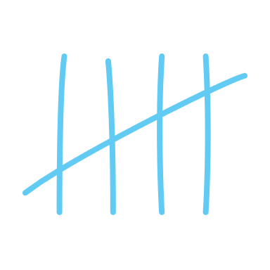








Timing Attacks
CS102
Notes:
Might overrun a bit, if you need to leave, you need to leave
# Based on this video by mCoding: https://youtu.be/XThL0LP3RjY

Slide 2
Good evening :)
What is timing?
Why is it a target?
Side-Channel
How can it be ‘attacked’?
Phishing attacks != side-channels
Zero-day attacks != side-channels
Notes:
Well, it’s just how long sth takes…
That’s really all there is to it, it’s just measuring how long it takes something for something to happen.
It can be a target, cos most anything that provides any kind of information can be targeted, since information/data is very useful.
But crucially, it’s very very difficult to mask/cover-up the leaking of timing information, leaking this just comes with having a real-time system.
As in, it’s not just sth people don’t usually think about, but even once you do know, things just take time, how are you supposed to plug that leak / hide that info?
[1] That’s what makes time such an effective side-channel :)
If you’re clever enough about what timing info you collect and how you use it, you can extract information on much more important things, like the exact memory locations of secrets, or even the value of a secret.
Just to quickly explain what a side channel is:
A path/channel through which information can be _leaked_, where that is the crucial point
A side-channel attack is one that specifically targets information that’s leaked from the way that a program runs, and not to do with a vulnerability in the program itself
If you get passwords through a phishing attack or by utilising a zero-day exploit, that’s not a side channel attack, but rather direct, as in no information has been leaked, it’s been taken [2]
E.g. installing a keylogger by exploiting a new vulnerability in someone’s browser, but rather discovering the password by listening to the sound that someone’s keyboard makes when they type in their password, or sth, where the sounds from your keyboard would be your side channel
Don’t worry if you didn’t understand all the words that I just used, you’re more than welcome to ask us anything anytime :)

Slide 3
Timing Attacks: Keys
You’re with a friend, at their front door. They’ve forgotten their keys.
“Ahh, lemme quickly grab my keys.”

Slide 4
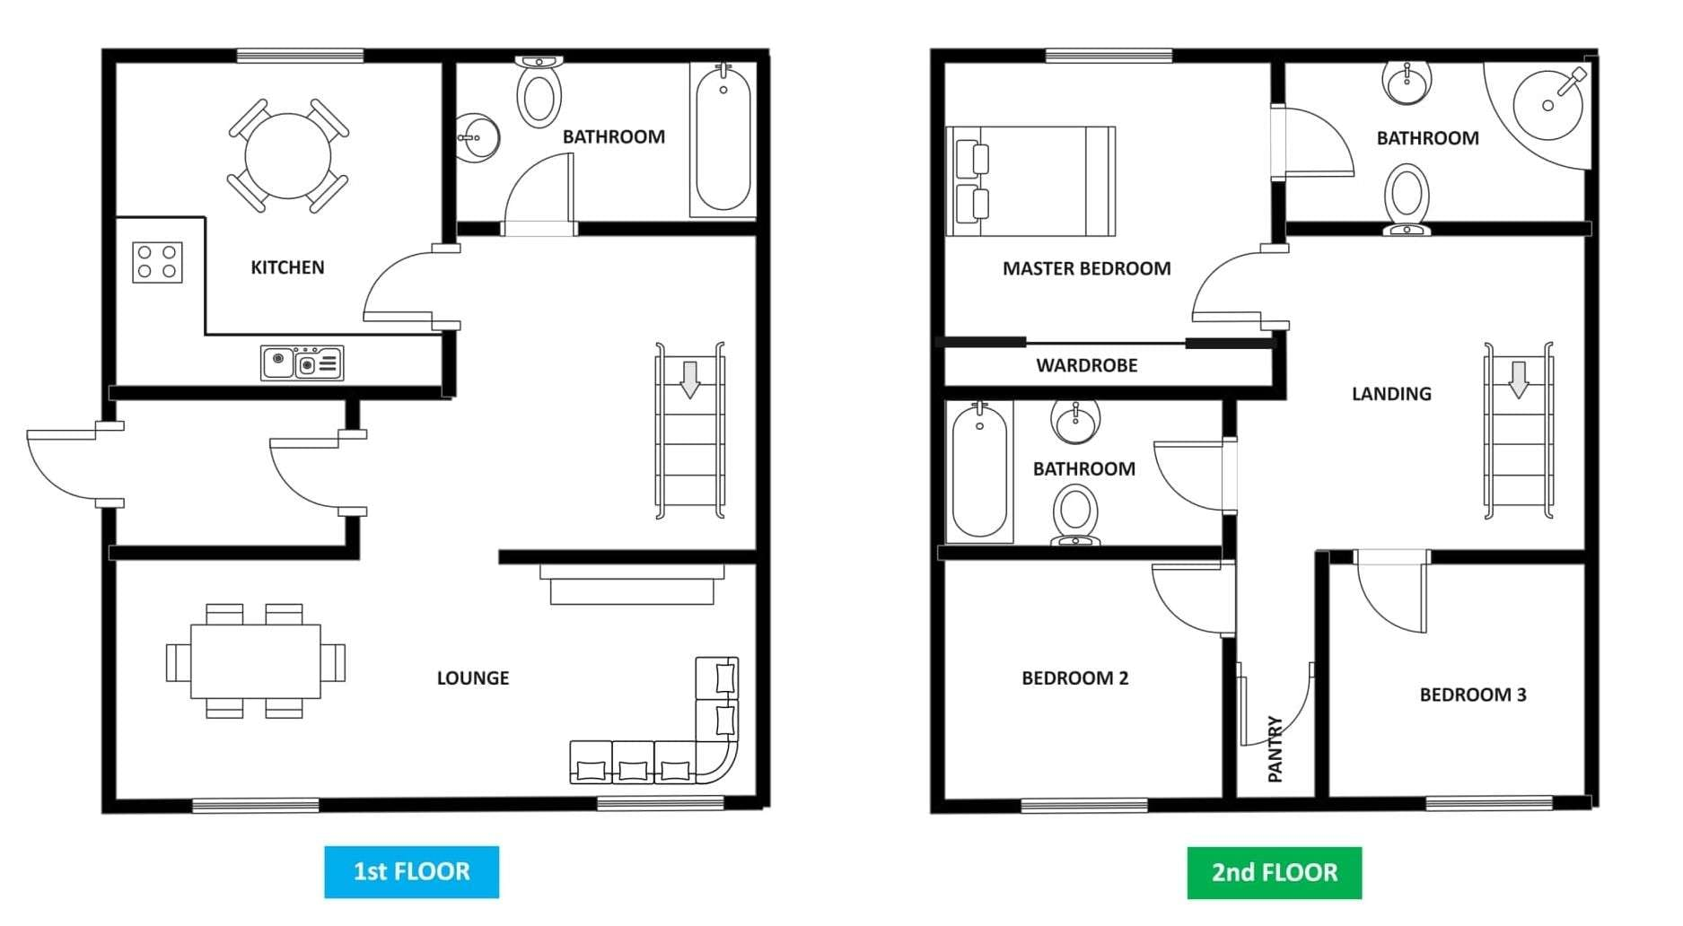
Timing Attacks: Keys
“Lemme grab my keys”
You are here
Notes:
# Give some example locations and how long each would take:
Front porch -> very quick (you’ll also see them…)
Kitchen bowl -> bit longer
Bedroom 2 -> absolutely ages
But also keep in mind, that maybe your friend has to search for keys, adds a bit of uncertainty and randomness into calculation

Slide 5
Real-world Attacks
Password cracking :D
Blind SQL injections
Spectre & Meltdown
(future talk)
Many, many more
Stealing cryptographic keys by measuring LED flickering
Notes:
Password cracking is what we’re going to try today :)
Blind SQL injections are somewhat like a more realistic version of what we’re about to do:
inject SQL into a server and make it do any SQL process you want
but don’t receive any of the outputs
Only know when that command has finished executing, because the server will return a message of some kind
There’s your timing information
Spectre and Meltdown are hardware vulnerabilities that leak information from side-channels that are inherent to the way that CPUs work and were a real pain to patch when

Slide 6
Design a basic checker
Just comparing two strings
Make it Fast
Make it Efficient
Return early where possible
Notes:
Let’s pretend we didn’t see all those previous slides and we’re just trying to make a fast and efficient string equality checker
Specs for this are just to make it fast and efficient, don’t worry about timing or anything yet :p
# Give them <= 8 minutes to have a go and try to design their own, in code or on paper

Slide 7
Checkers?
How would you check if an input is the correct password?
Notes:
# Getting hands-up here is good, just to get them warmed up, don’t need anyone to come up

Slide 8
Buffer slide

Slide 9
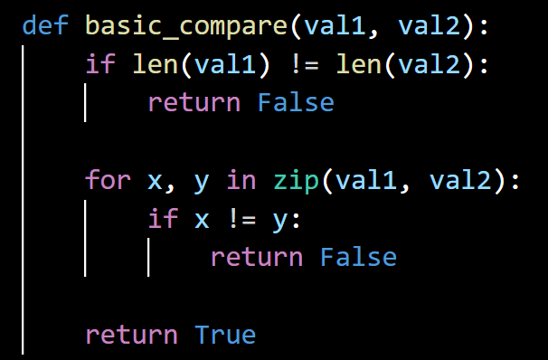
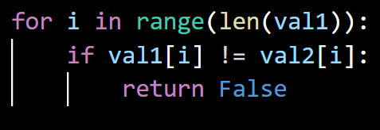
Basic Checker Example
Notes:
This is a basic under-the-hood implementation of a fast comparison fn.
Note that the two middle sections are interchangeable, the LHS is just more pythonic.
Compare string lengths, if they’re not the same length you know that the strings can’t be the same, so return early
Then run through both strings at the same time, character, by character, if even one is wrong, you know the strings differ, so return early
If it passes all of those checks, then it must be the same string, and we can return True

Slide 10
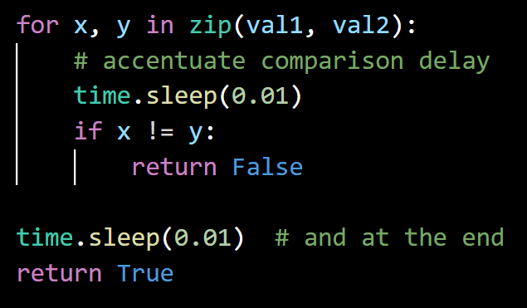
Try cracking the basic checker
Remember how the basic checker works:
Check attempt length
Check attempt, character by character, against the password
Notes:
# Let them have at it, idk if I should give them more hints and things beforehand, but this is the main part of the workshop
# Give them 8 minutes of un-hinted work time
For those of you writing and running code, I recommend adding these `time.sleep(0.01)` commands, this just helps to exaggerate the time taken per comparison, and makes it easier for you to write a cracker for :)

Slide 11
Buffer slide

Slide 12
Hint 1 – Cracking Length
String Object | Length | Mem. location | …other attr. | …methods
my_string | 20 | 0x28fc2de1 | … | …
A rough approximation of a Python string’s object
Note: length is stored here, Python doesn’t count every time
We would say that checking the length is an O(1) or “constant time” operation
Notes:
Here’s a hint to the first part, if anyone’s gotten stuck.
Before you start trying to crack the password, it could help to find out the length of the password. Not necessary but would help narrow your search.
It’s worth noting that due to the way that Python strings are implemented, checking the length of a string takes a constant amount of time, i.e. it takes the same amount of time, no matter how long the strings are.
But, remember that this is the first thing that’s checked, so if the comparison returns immediately…
# Now give them another 8 minutes

Slide 13
Buffer slide

Slide 14
Hint 2 – Cracking Characters
String comparison is done step-by-step
Exits after 4 comparisons
Exits after 7 comparisons
p | a | s | s | w | o | r | d
p | a | s | w
p | a | s | s | w | o | r | d
p | a | s | s | w | o | @
Notes:
So, for this second hint, I’d like to point out that the way that string comparison is done.
A simple checker will exit earlier (and thus return faster), the moment it finds a non-matching character, which means:
let a character comparison take c amount of time, Ex1 will exit after 4c and Ex2 after 7c, so Ex2 takes longer and has gotten more character right
# Give them another 8 minutes

Slide 15
Your Solutions
What have you come up with? :D
Notes:
# Let them present their solutions, give them a duck: 2-3 teams?

Slide 16
Buffer slide

Slide 17
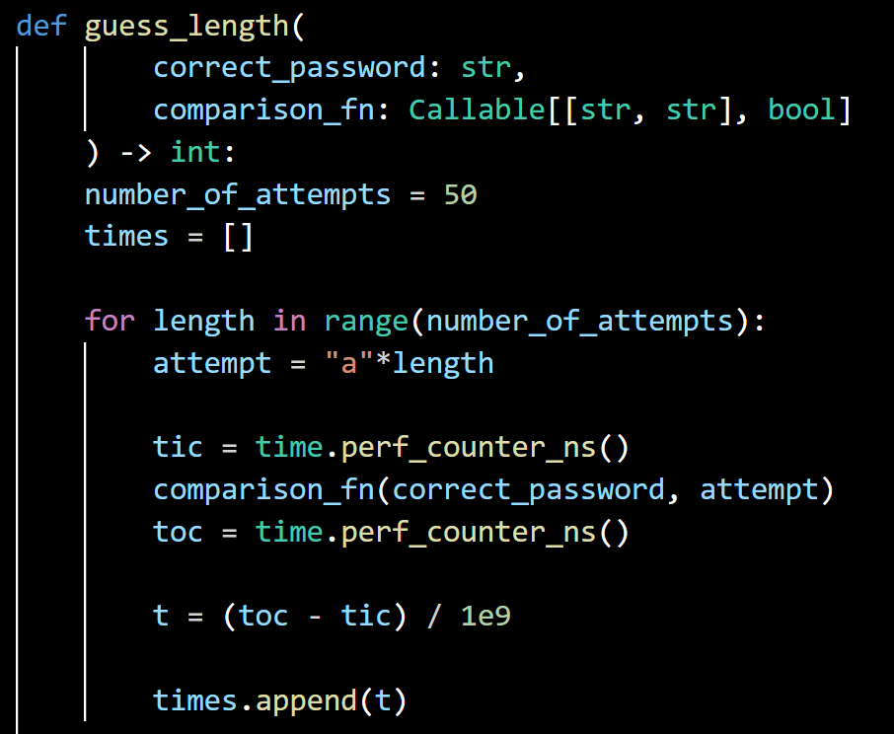
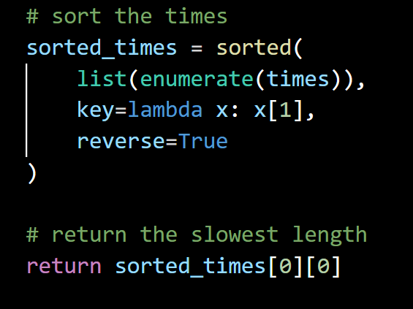
My Solution
Password Length
Notes:
Point out the function declaration and the types # quickly
Show the loop setup and describe the loop
It generates the attempt of given length
Times the running of the fn
Adds the time to the overall list of times
Describe the wrap-up, sorting the list and picking the one that takes the longest

Slide 18
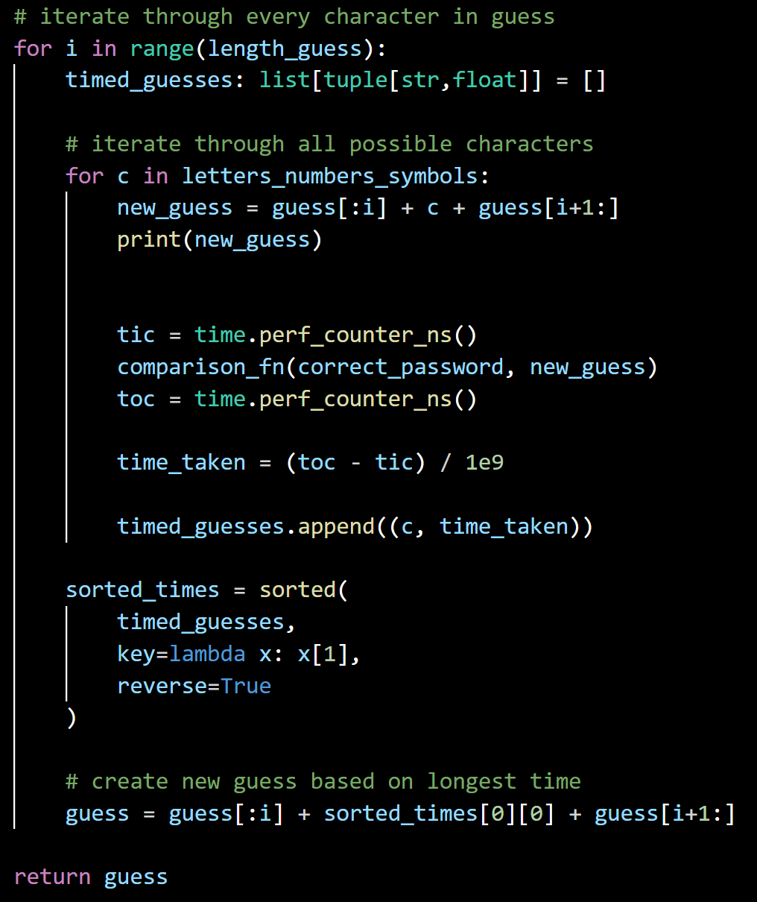
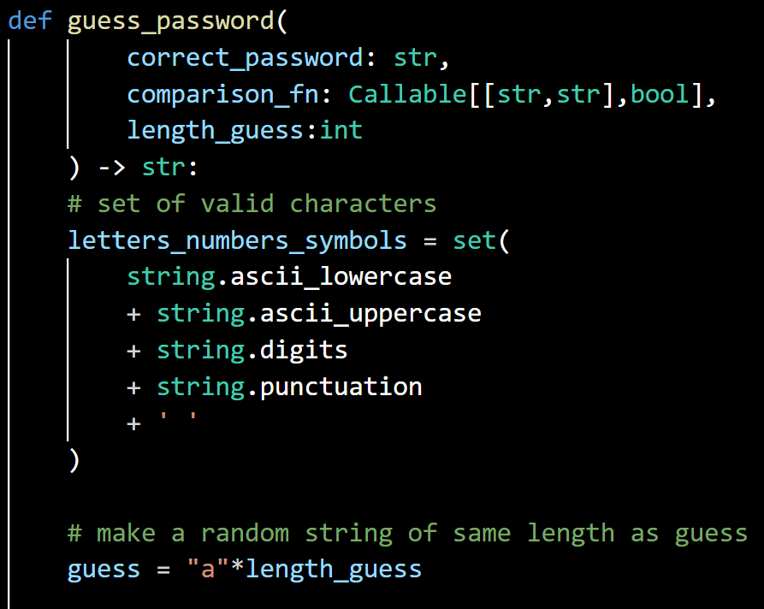
My Solution
Password Value
Notes:
Point out the function declaration and the types # v quickly
Describe the way that the character set is generated
Describe the first and second loop header
Describe the inner loop and how that works
How is each guess generated?
Times the running of the fn
Adds the time to the overall list of times along with the character that was used to get that time
Describe the wrap-up, sorting the list and picking the one that takes the longest
Note that this is looped by the outer loop

Slide 19
Live Demo
(fingers crossed)
Notes:
Aaaaaaaaaah, hope it works D:

Slide 20
Red vs Blue
Iterate in your groups back-and-forth:
Design a better checker to be resistant to the previous cracker
Design a better cracker to be break the better checker
etc.
Notes:
Now have a go at iterating on those checkers and crackers, see if you can come up with a slightly better checker (resistant to our last cracker), then a better cracker, and so on :)
If you want an extra challenge, you can remove the `time.sleep` you may have added earlier (I didn’t…)
If you really don’t want to be here anymore or have somewhere you need to go, now would be a good time to do that :p

Slide 21
Your turn
What have you come up with? :D
Notes:
# Invite 1 or 2 eager teams up to present their back and forths, it’s fine if they only had the one iteration, in which case, maybe bump up to 2 or 3

Slide 22
Buffer slide

Slide 23
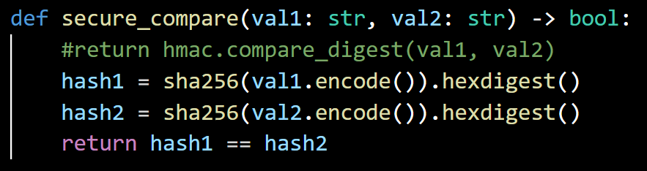
A good solution
Takes the same amount of time regardless of:
Input length
Password length
Notes:
Note the hmac digest command, that’s what’s been suggested to be the most secure option on python. What I’ve written below is like a little example of what that function does under the hood:
First, it calculates the hashes of both strings, and then it just compares those hashes to see if they’re equal.
This latter equality check is now more secure, because the output hashes are always the same length, so this doesn’t betray anything about the original strings.

Slide 24
That’s all
Thanks for attending :)

