Slide 1
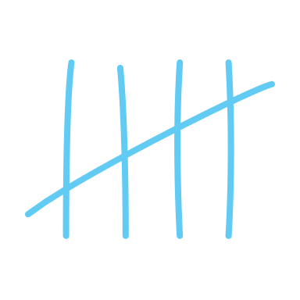








Timing Attacks
CS102
Notes:
Might overrun a bit, if you need to leave, you need to leave

Slide 2
Good evening :)
What is timing?
Why is it a target?
Side-Channel
How can it be ‘attacked’?
Phishing attacks != side-channels
Zero-day attacks != side-channels
Notes:
Well, it’s just how long sth takes…
That’s really all there is to it, it’s just measuring how long it takes something for something to happen.
It can be a target, cos most anything that provides any kind of information can be targeted, since information/data is very useful.
But crucially, it’s very very difficult to mask/cover-up the leaking of timing information, leaking this just comes with having a real-time system.
As in, it’s not just sth people don’t usually think about, but even once you do know, things just take time, how are you supposed to plug that leak / hide that info?
[1] That’s what makes time such an effective side-channel :)
If you’re clever enough about what timing info you collect and how you use it, you can extract information on much more important things, like the exact memory locations of secrets, or even the value of a secret.
Just to quickly explain what a side channel is:
A path/channel through which information can be _leaked_, where that is the crucial point
A side-channel attack is one that specifically targets information that’s leaked from the way that a program runs, and not to do with a vulnerability in the program itself
If you get passwords through a phishing attack or by utilising a zero-day exploit, that’s not a side channel attack, but rather direct, as in no information has been leaked, it’s been taken [2]
E.g. installing a keylogger by exploiting a new vulnerability in someone’s browser, but rather discovering the password by listening to the sound that someone’s keyboard makes when they type in their password, or sth, where the sounds from your keyboard would be your side channel
Don’t worry if you didn’t understand all the words that I just used, you’re more than welcome to ask us anything anytime :)

Slide 3
Timing Attacks: Keys
You’re with a friend, at their front door. They’ve forgotten their keys.
“Ahh, lemme quickly grab my keys.”

Slide 4
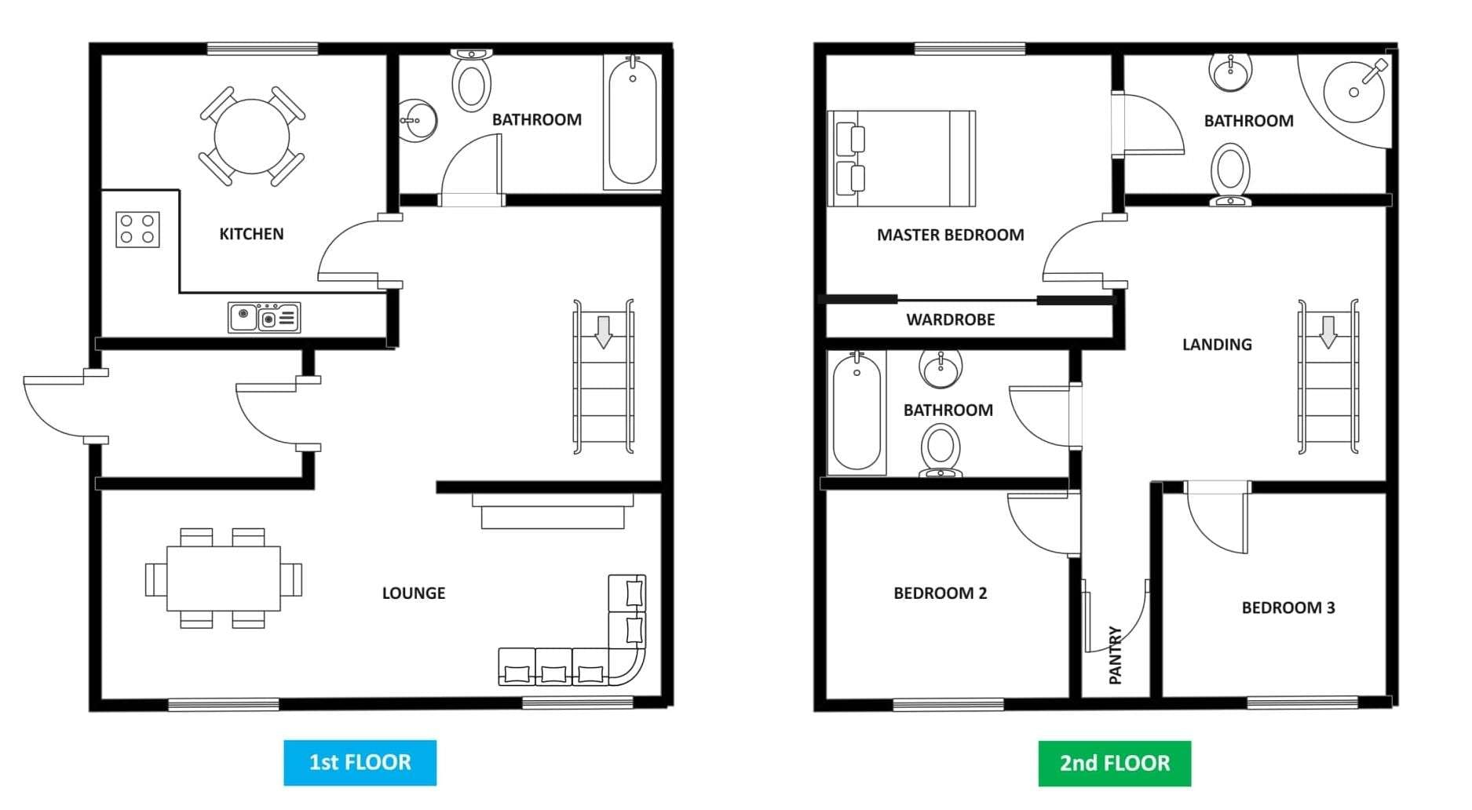
Timing Attacks: Keys
“Lemme grab my keys”
You are here
Notes:
# Give some example locations and how long each would take:
Front porch -> very quick (you’ll also see them…)
Kitchen bowl -> bit longer
Bedroom 2 -> absolutely ages
But also keep in mind, that maybe your friend has to search for keys, adds a bit of uncertainty and randomness into calculation

Slide 5
Real-world Attacks
Password cracking :D
Blind SQL injections
Spectre & Meltdown
(future talk)
Many, many more
Stealing cryptographic keys by measuring LED flickering
Notes:
Password cracking is what we’re going to try today :)
Blind SQL injections are somewhat like a more realistic version of what we’re about to do:
inject SQL into a server and make it do any SQL process you want
but don’t receive any of the outputs
Only know when that command has finished executing, because the server will return a message of some kind
There’s your timing information
Spectre and Meltdown are hardware vulnerabilities that leak information from side-channels that are inherent to the way that CPUs work and were a real pain to patch when

Slide 6
Design a basic checker
Just comparing two strings
Make it Fast
Make it Efficient
Return early where possible
Notes:
Let’s pretend we didn’t see all those previous slides and we’re just trying to make a fast and efficient string equality checker
Specs for this are just to make it fast and efficient, don’t worry about timing or anything yet :p
# Give them <= 8 minutes to have a go and try to design their own, in code or on paper

Slide 7
Checkers?
How would you check if an input is the correct password?
Notes:
# Getting hands-up here is good, just to get them warmed up, don’t need anyone to come up

Slide 8
Buffer slide

Slide 9
Try cracking the basic checker
Remember how the basic checker works:
Check attempt length
Check attempt, character by character, against the password
Good luck :)

Slide 10
Buffer slide

Slide 11
Hint 1 – Cracking Length

Slide 12
Buffer slide

Slide 13
Hint 2 – Cracking Characters

Slide 14
Your Solutions
What have you come up with? :D

Slide 15
Buffer slide

Slide 16
My Solution
TODO: add screenshots of the bits of the solution
Multiple slides
Then a demo

Slide 17
Live Demo

Slide 18
Can you do better?
TODO: get them to make their own better checkers
And then their own better crackers, doesn’t need to be successful

Slide 19
Red vs Blue
TODO: SHOW ME YOUR SOLUTIONS

Slide 20
Your turn
What have you come up with? :D

Slide 21
Buffer slide

Slide 22
A good solution
TODO: add in the hash solution here, probably some code I can explain

Slide 23
That’s all
Thanks for attending :)

