Slide 1
DeepFin
Team: HackHive
Pradeep Kumar Singh
Satheesh J Hegde
Rahul Pandey
Srinivas K
26-Mar-2025

Slide 2
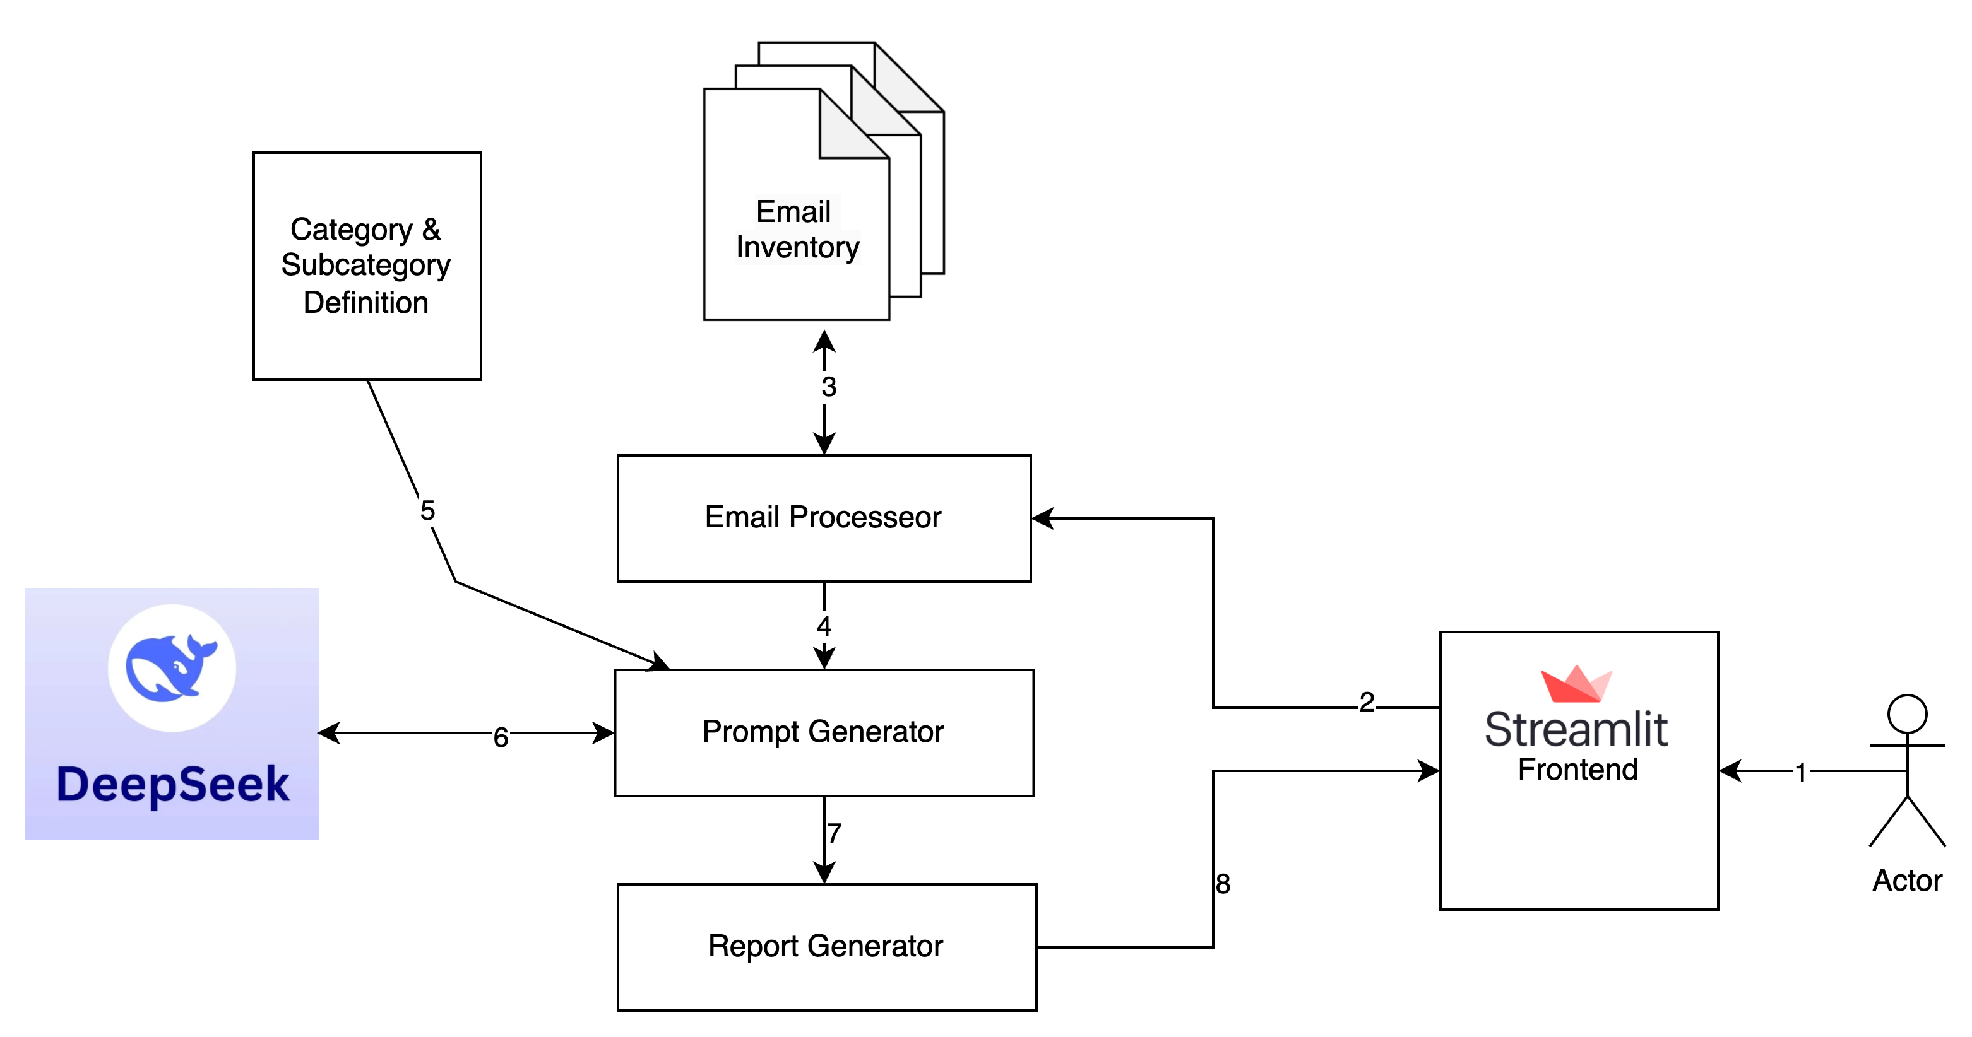
Component Diagram

Slide 3
Design Description: Email Classification and Reporting System
Overview
This system is designed to classify emails and their attachments into predefined categories and subcategories using a Deep Seek AI model, with results presented in a user-friendly table via a Streamlit front-end interface. The system supports manual file uploads or directory-based email inventory processing, leveraging an object-oriented Python architecture for modularity and scalability.
System Architecture
The system comprises the following key components:
Streamlit Front-End: User interface for input selection and result visualization.
File Handler: Manages file uploads and folder path processing.
Email Processor: Handles email extraction and preparation.
Prompt Generator: Constructs prompts for the AI model.
Deep Seek Model: Performs classification and metadata extraction.
Report Generator: Formats classification results into JSON.
Result Renderer: Displays results as a table in Streamlit.
Actors
User: An individual interacting with the Streamlit front-end to upload emails or specify an email inventory path and view the classification results.

