Slide 1
HBase
The Hadoop database

Slide 2
Agenda
Overview
Architecture
Installation
Shell
Basic Commands
Java API
Java Admin API
Key Design

Slide 3
Overview

Slide 4
Overview
Column-Oriented data store, known as “Hadoop Database”
Supports random real-time CRUD operations (unlike HDFS)
Distributed – designed to serve large tables
Billions of rows and millions of columns
Runs on a cluster of commodity hardware
Server hardware, not laptop/desktops
Open-source, written in Java
Type of “NoSQL” DB
Does not provide a SQL based access
– Does not adhere to Relational Model for storage

Slide 5
HBase
Horizontally scalable
Automatic sharding
Strongly consistent reads and writes
Automatic fail-over
Simple Java API
Integration with Map/Reduce framework
Thrift, Avro and REST-ful Web-services
Based on Google's Bigtable
http://labs.google.com/papers/bigtable.html
Just like BigTable is built on top of Google File System (GFS), HBase is implemented on top of HDFS

Slide 6
HBase History
Year | Event
Nov 2006 | Google released the paper on BigTable.
Feb 2007 | Initial HBase prototype was created as a Hadoop contribution.
Oct 2007 | The first usable HBase along with Hadoop 0.15.0 was released.
Jan 2008 | HBase became the sub project of Hadoop.
Oct 2008 | HBase 0.18.1 was released.
Jan 2009 | HBase 0.19.0 was released.
Sept 2009 | HBase 0.20.0 was released.
May 2010 | HBase became Apache top-level project.

Slide 7
Who Uses HBase?
Here is a very limited list of well known names
Facebook
Adobe
Twitter
Yahoo!
Netflix
Meetup
Stumbleupon
You????

Slide 8
When To Use HBase
Not suitable for every problem
Compared to RDBMs has VERY simple and limited API
Good for large amounts of data
100s of millions or billions of rows
If data is too small all the records will end up on a single node leaving the rest of the cluster idle

Slide 9
When To Use HBase
Have to have enough hardware!!
At the minimum 5 nodes
There are multiple management daemon processes: Namenode, HBaseMaster, Zookeeper, etc....
HDFS won't do well on anything under 5 nodes anyway;particularly with a block replication of 3
HBase is memory and CPU intensive
Carefully evaluate HBase for mixed work loads
Client Request vs. Batch processing (Map/Reduce)
SLAs on client requests would need evaluation
HBase has intermittent but large IO access
May affect response latency!!!

Slide 10
When To Use HBase
Two well-known use cases
Lots and lots of data (already mentioned)
Large amount of clients/requests (usually cause a lot of data)
Great for single random selects and range scans by key
Great for variable schema
Rows may drastically differ
If your schema has many columns and most of them are null

Slide 11
When NOT to Use HBase
Bad for traditional RDBMs retrieval
Transactional applications
Relational Analytics
'group by', 'join', and 'where column like', etc....
Currently bad for text-based search access
There is work being done in this arena
HBasene: https://github.com/akkumar/hbasene/wiki
HBASE-3529: 100% integration of HBase and Lucene based on HBase' coprocessors
Some projects provide solution that use HBase
Lily=HBase+Solr http://www.lilyproject.org

Slide 12
HBase Data Model
In HBase:
Table is a collection of rows.
Row is a collection of column families.
Column family is a collection of columns.
Column is a collection of key value pairs.

Slide 13
HBase Data Model
Column Family
column
Row Key | Personal Info |  |  | Professional Info
 | Name | Addr | married | dept | salary | desig | mgr
row1 | Pavan | Hyd | yes | IT | 30000 | Dev | Rahul
row2 | Arun | Blore | yes | Acc | 20000 | CA | Shan
row3 | Kiran | GGN | No | IT | 30000 | Admin | Rahul
Row key

Slide 14
HBase Data Model
Data is stored in Tables
Tables contain rows
Rows are referenced by a unique key
Key is an array of bytes – good news
Anything can be a key: string, long and your own serialized data structures
Rows made of columns which are grouped in column families
Data is stored in cells
Identified by row x column-family x column
Cell's content is also an array of bytes

Slide 15
HBase Timestamps
Cells' values are versioned
For each cell multiple versions are kept
3 by default
Another dimension to identify your data
Either explicitly timestamped by region server or provided by the client
Versions are stored in decreasing timestamp order
Read the latest first – optimization to read the current value
You can specify how many versions are kept
More on this later....

Slide 16
HBase Row Keys
Rows are sorted lexicographically by key
Compared on a binary level from left to right
For example keys 1,2,3,10,15 will get sorted as
1, 10, 15, 2, 3
Somewhat similar to Relational DB primary index
Always unique
Some but minimal secondary indexes support

Slide 17
HBase Architecture

Slide 18
HBase Architecture
Table is made of regions
Region – a range of rows stored together
Single shard, used for scaling
Dynamically split as they become too big and merged if too small
Region Server- serves one or more regions
A region is served by only 1 Region Server
Master Server – daemon responsible for managing HBase cluster, aka Region Servers
HBase stores its data into HDFS
relies on HDFS's high availability and fault-tolerance features
HBase utilizes Zookeeper for distributed coordination

Slide 19
Hbase Architecture
HBase has three major components:
The client library,
A master server
Region servers
Region servers can be added or removed as per requirement.

Slide 20
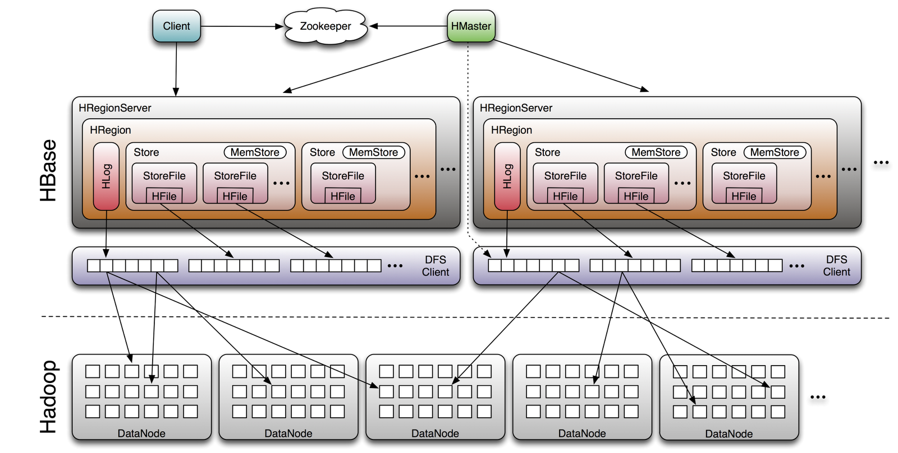
HBase Architecture

Slide 21
MasterServer
Assigns regions to the region servers and takes the help of Apache ZooKeeper for this task.
Handles load balancing of the regions across region servers.
It unloads the busy servers and shifts the regions to less occupied servers.
Maintains the state of the cluster by negotiating the load balancing.
Is responsible for schema changes and other metadata operations such as creation of tables and column families.

Slide 22
Region Server
Regions
Regions are nothing but tables that are split up and spread across the region servers.
Region server
The region servers have regions that -
Communicate with the client and handle data-related operations.
Handle read and write requests for all the regions under it.
Decide the size of the region by following the region size thresholds.

Slide 23
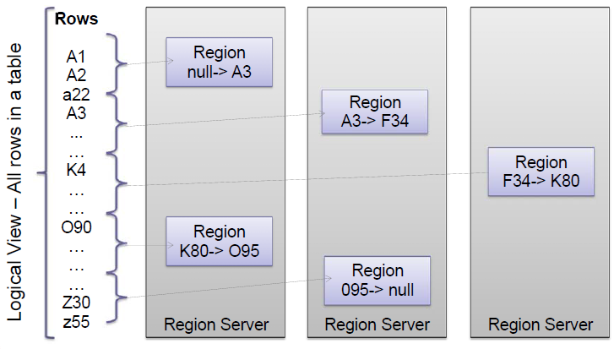
Rows Distribution Between Region Servers

Slide 24
Zookeeper
Zookeeper is an open-source project that provides services like maintaining configuration information, naming, providing distributed synchronization, etc.
Zookeeper has ephemeral nodes representing different region servers.
Master servers use these nodes to discover available servers.
In addition to availability, the nodes are also used to track server failures or network partitions.
Clients communicate with region servers via zookeeper.
In pseudo and standalone modes, HBase itself will take care of zookeeper.

Slide 25
Installation

Slide 26
Installation Prerequisites
Java and Hadoop are required to proceed with Hbase installation

Slide 27
Install HBase
HBase can be installed in 3 different modes:
Standalone mode
Requires only local file system
Pseudo Distributed mode
Requires HDFS
Fully Distributed mode.
Requires Hadoop Cluster (HDFS part only)

Slide 28
Install HBase
Demo

Slide 29
HBase Shell

Slide 30
HBase Shell
To interact with HBase , it provides a command line interface which we call HBase Shell
It allows you to execute a number of HBase Commands.

Slide 31
HBase Shell – General Commands
status - Provides the status of HBase, for example, the number of servers.
version - Provides the version of HBase being used.
table_help - Provides help for table-reference commands.
whoami - Provides information about the user.

Slide 32
HBase Shell- DDL
create - Creates a table.
list - Lists all the tables in HBase.
disable - Disables a table.
is_disabled - Verifies whether a table is disabled.
enable - Enables a table.
is_enabled - Verifies whether a table is enabled.
describe - Provides the description of a table.
alter - Alters a table.
exists - Verifies whether a table exists.
drop - Drops a table from HBase.
drop_all - Drops the tables matching the ‘regex’ given in the command.
Java Admin API - Prior to all the above commands, Java provides an Admin API to achieve DDL functionalities through programming

Slide 33
HBase Shell- Data Manipulation Language
put - Puts a cell value at a specified column in a specified row in a particular table.
get - Fetches the contents of row or a cell.
delete - Deletes a cell value in a table.
deleteall - Deletes all the cells in a given row.
scan - Scans and returns the table data.
count - Counts and returns the number of rows in a table.
truncate - Disables, drops, and recreates a specified table.
Java client API - Prior to all the above commands, Java provides
a client API to achieve DML functionalities

Slide 34
HBase Shell—How to start?
Navigate to HBase home folder
e.g. cd /usr/hbase
Issue the command as
./bin/hbase shell
On success it will show you message and a prompt one like :
Base Shell; enter 'help<RETURN>' for list of supported commands.
Type "exit<RETURN>" to leave the HBase Shell
Version 0.94.23, rf42302b28aceaab773b15f234aa8718fff7eea3c
hbase(main):001:0>

Slide 35
Creating a Table using HBase Shell
Syntax
create '<table name>','<column family>‘
Example:
hbase(main):002:0> create 'emp', 'personal', ’professional’
Verify:
hbase(main):002:0> list
TABLE
emp
2 row(s) in 0.0300 seconds

Slide 36
Other DDL Commands
Check the existence of a table
hbase(main):021:0> exists 'emp'
Table emp does exist
0 row(s) in 0.0650 seconds
Drop a Table
Before dropping a table it has to be disabled
hbase(main):010:0> disable 'emp'
0 row(s) in 1.40 seconds
hbase(main):011:0> drop 'emp'
0 row(s) in 0.30 seconds
Other Commands
drop_all

Slide 37
Shutdown HBase
Exit from the shell and then shutdown HBase
hbase(main):021:0> exit
./bin/stop-hbase.sh

Slide 38
Create Data in HBase Table
Command –put
Syntax
put '<tablename>','row1','<colfamily:colname>','<value>‘
Example:
hbase(main):005:0> put 'emp','row1','personal:name','Shantanu'
0 row(s) in 0.600 seconds
hbase(main):006:0> put 'emp','row1','personal:city','hyderabad'
0 row(s) in 0.040 seconds
hbase(main):007:0> put 'emp','row1','professional:designation','manager'
0 row(s) in 0.020 seconds
hbase(main):008:0> put 'emp','row1','professional:salary','80000'
0 row(s) in 0.0200 seconds

Slide 39
Display the inserted data
scan <table name>
Example : ‘scan emp’

Slide 40
Updating Data using HBase Shell
You can update an existing cell value using the put command. To do so, just follow the same syntax and mention your new value as shown below.
put ‘<table name>','row','Column family:column name','new value'
Example:
hbase(main):006:0> put 'emp','row1','personal:city',’Bangalore'
0 row(s) in 0.040 seconds

Slide 41
Read Data
Command: get
Syntax: get <table name> <row>
Example
hbase(main):012:0> get 'emp', '1‘
COLUMN CELL
personal : city timestamp = 1417521848375, value = Bangalore
personal : name timestamp = 1417521785385, value = Shantanu
professional: designation timestamp = 1417521885277, value = manager
professional: salary timestamp = 1417521903862, value = 80000
4 row(s) in 0.0270 seconds

Slide 42
Reading a Specific Column
Command: get
Syntax:
hbase> get 'table name', ‘rowid’, {COLUMN ⇒ ‘column family:column name ’}
hbase(main):030:0> get 'emp', 'row1', {COLUMN ⇒ 'personal:name'}
COLUMN CELL
personal:name timestamp = 1418035791555, value = Shantanu
1 row(s) in 0.0080 seconds

Slide 43
Delete data
Delete a cell
delete ‘<table name>’, ‘<row>’, ‘<column name >’, ‘<time stamp>’
Delete the entire row
deleteall ‘<table name>’, ‘<row>’

Slide 44
Summary
In this class we have Understood
what is HBase
How to install HBase
HBase architecture
HBase Shell
HBase Shell commands
HBase CRUD commands

Slide 45
Q&A

