Slide 1
Richardson Maturity Model and HATEOAS
Towards Truly RESTful Services

Slide 2
Richardson Maturity Model (RMM)
How much RESTful is your REST Service—is the goal of RMM.
Leonard Richardson analyzed a hundred different web service designs and divided them in four categories based on how much they are REST compliant.
This model of division of REST services to identify their maturity level – is called Richardson Maturity Model.

Slide 3
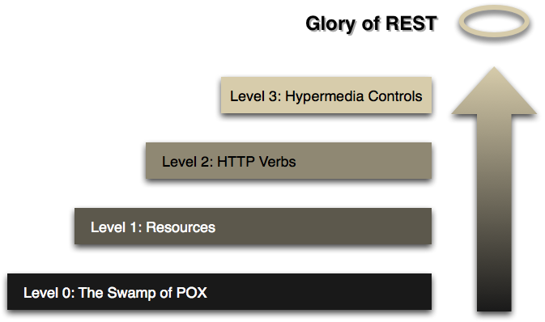
Richardson Maturity Model (RMM)
Richardson used three factors to decide the maturity of a service i.e. URI, HTTP Methods and HATEOAS (Hypermedia)
The more a service employs these technologies – more mature it shall be considered.

Slide 4
Level 0: The Swamp of POX
Use HTTP as a transport system for remote interactions
No use of any of the mechanisms of the web.
At this Level, there is no concept of Resource Based URI, Hypermedia, and no proper use of HTTP Protocol (which are key characteristics of a REST API).
Essentially what you are doing here is using HTTP as a tunneling mechanism for your own remote interaction mechanism, usually based on Remote Procedure Invocation.
API designed at this level are not at all Rest APIs.
This is where SOAP based web services takes place.

Slide 5
Level 0: The Swamp of POX
The Client makes a POST Request to an Endpoint
http://localhost:8088/ws/emp
The server replies with its response as XML Block.
All the communications to the server is made using XML payload to invoke various actions and no specific URI for each action is used! Only One URI.
<createEmployee>
<emp>
<empId>100</empId>
<city>Hyderabad</city>
<name>Jagga</name>
<salary>78000</salary>
</emp>
</createEmployee>
<updateEmployee>
<emp>
<empId>100</empId>
<city>London</city>
<name>Jagga</name>
<salary>98000</salary>
</emp>
</createEmployee>
<deleteEmployee>
<arg0>101</arg0> </deleteEmployee>
<findOne>
<empId>101</empId>
<findOne>
Actions/Operations forms the part of the XML Payload
This is called swamp of POX (plain old XML) approach. So, everything is defined by XML in the case of SOAP web service and that is called POX(Plain Old XML)

Slide 6
Level 1 - Resources
This is a starting Level for a REST API.
In this Level, the Concept of Resource-based Address is introduced, which tells you there should be Individual URI for each Resource on the server (unlike LEVEL 0 where we have a single URI for each incoming request from Client).
One HTTP Verb i.e. POST generally used but many Resource URI.
The Actions are now represented by their OWN URI

Slide 7
Level 1 - Resources
If we just designed Resource-based URI and nothing else, then we are at LEVEL 1 of the maturity model.
In this, the HTTP is just used as a tunnel between client and server and we have not leveraged the potential of HTTP as an application Layer Protocol.
Most of the developers who are beginners for REST design REST API at this LEVEL.
Some Examples of Resource URI
http://myresource.com/emp [Lists all employees]
http://myresource.com/emp/find/100 [Lists employee with id 100]
http://myresource.com/emp/update [updates an employee]
http://myresource.com/emp/save [saves an employee]
http://myresource.com/emp/delete?id=101 [deletes an employee]

Slide 8
Level 2 - HTTP Verbs
REST developed under this level leverages the full potential of HTTP as an application Layer Protocol.
REST API developed at this LEVEL uses Standard HTTP methods/verbs and different HTTP status codes to do different operations on Resource URI.
The Request Body will no longer carry Operation information at this level.
Along with Resource URI, we use HTTP Verbs GET, POST,PUT, DELETE,HEAD…..

Slide 9
Level 2 - HTTP Verbs
# A request to get a representation of a resource
GET /tx/1234 HTTP/1.1
Host: www.example.org
# Response
HTTP/1.1 200 OK
Content-Type: application/xml;charset=UTF-8
Content-Length: xxx
<status>
...
</status>

Slide 10
Level 2 - HTTP Verbs
# Request to create a resource
POST /user/smith HTTP/1.1
Host: www.example.org
Content-Type: application/xml;charset=UTF-8
<address>
<street>1, Main Street</street>
<city>Some City</city>
</address>
# Response
HTTP/1.1 201 Created
Location: http://www.example.org/user/smith/address/1
Content-Location: http://www.example.org/user/smith/address/1
Content-Type: application/xml;charset=UTF-8
<address>
<id>urn:example:user:smith:address:1</id>
<atom:link rel="self" href="http://www.example.org/user/smith/address/1"/>
<street>1, Main Street</street>
<city>Some City</city>
</address>

Slide 11
LEVEL 3: Use Hypermedia or HATEOAS
LEVEL 3 makes use of Hypermedia (also Called HATEOAS–Hypermedia as Engine of Application state in REST world), which drives the interaction for the API Client.
Generally, the API Client is not aware of all resource endpoints and REST does not deal much with API documents (which can tell API client information about all endpoints), unlike SOAP where we have WSDL, which provides information about service to the API Client.
Different Resource Based Endpoints are made aware to API Client using concept HATEOAS i.e. sending some hypermedia as the response of endpoint response which in turns acts as Engine of Application state and hence the name HATEOAS.
The HATEOAS concept in REST API makes API self-documented and hence no need for API documentation.
API developed at this LEVEL 3 is generally considered as fully RESTful API and this is where we see the charm of REST API.

Slide 12
LEVEL 3: Use Hypermedia or HATEOAS
A HATEOAS-based response JSON would look like this:
{
"name": "Alice",
"links": [ {
"rel": "self",
"href": "http://localhost:8088/emp/1"
} ]
}

Slide 13
LEVEL 3: Use Hypermedia or HATEOAS
HTTP/1.1 200 OK Content-Type: application/xml Content-Length: ...
<?xml version="1.0"?>
<account>
<account_number>12345</account_number>
<balance currency="usd">100.00</balance>
<link rel="deposit" href="https://bank.com/acc/123?deposit=12345" />
<link rel="withdraw" href="https://bank.com/acc/123?withdraw=12345" />
<link rel="transfer" href="https://bank.com/acc/123?transfer=12345" />
<link rel="close" href="https://bank.com/acc/123?status=close" />
</account>
A HATEOAS-based response JSON would look like this:

Slide 14
RMM -- Conclusion
RMM provides a good step by step way to understand the basic ideas behind restful thinking.
It can be seen as tool to help us learn about the concepts and not something that should be used in some kind of assessment mechanism.

Slide 15
RMM -- Conclusion
To Summarize
Level 1 tackles the question of handling complexity by using divide and conquer, breaking a large service endpoint down into multiple resources.
Level 2 introduces a standard set of verbs so that we handle similar situations in the same way, removing unnecessary variation.
Level 3 introduces discoverability, providing a way of making a protocol more self-documenting.
The result is a model that helps us think about the kind of HTTP service we want to provide and frame the expectations of people looking to interact with it.
To Summarize
Level 1 tackles the question of handling complexity by using divide and conquer, breaking a large service endpoint down into multiple resources.
Level 2 introduces a standard set of verbs so that we handle similar situations in the same way, removing unnecessary variation.
Level 3 introduces discoverability, providing a way of making a protocol more self-documenting.
The result is a model that helps us think about the kind of HTTP service we want to provide and frame the expectations of people looking to interact with it.

