Slide 2
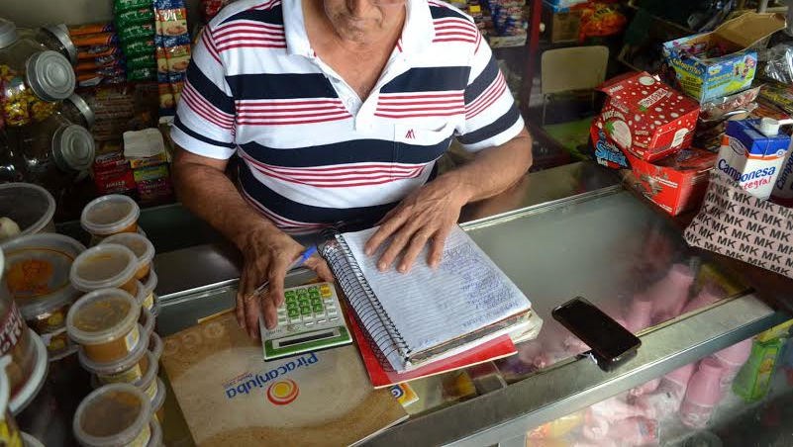

Slide 3

BOM DIA !!

