Slide 1
Game Recommender
Helps customers discover new games they can enjoy!

Slide 2
Data Collected
Player info including their preferred category of games.
Games and their categories.
Games played by the Players.
Developers and country where the games were developed.
Devices the games support, and devices players own.

Slide 3
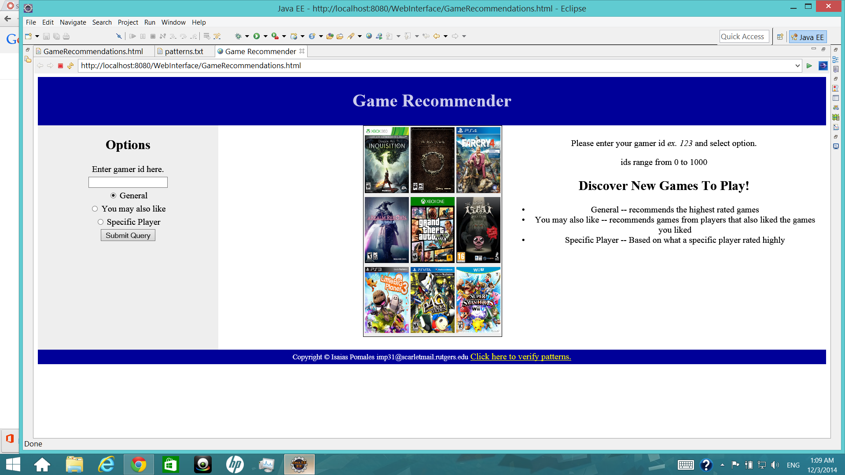
Patterns observed
Players that play games of their preferred category rate those games higher.
Players that play games from the same country rate those games higher.
Most games are supported by Windows. Linux supports the least
Players spend the most hours plays role playing and multiplayer online games.
patterns can be verified at the bottom of the webpage.

Slide 4
Game Recommender 3 options You enter your gamer ID, and this would recommend games you should play.
General -- Shows list of highest rated games overall. This is done by taking the average rating for each game, returning only those higher than 3.0 (ratings range from 0-5)
You may also like -- Based on the games you already rated highly. Searches other players who have rated those as well. Returns games those players rated highly that you have not played.
Specific Player -- Same as "You may also like", but only searches games from one other player which could be your friend or family.

Slide 5
Results 4 tables are shown for recommendations
Highly Recommend -- These recommended games are of the same preference as the player
Games playable on your devices -- These are the recommended games that the player can play with the current devices they own. No need to buy another device!
Games you should check on -- List of Recommended Games.
You can play them with these device -- Here's is where you can find what device you should buy so that you can play these great games!

Slide 6
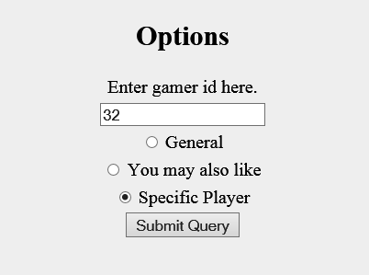
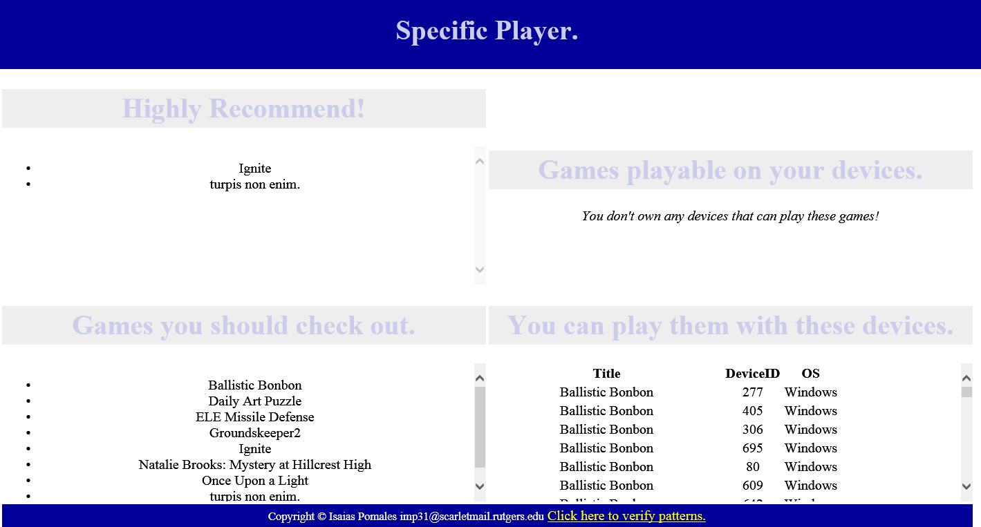
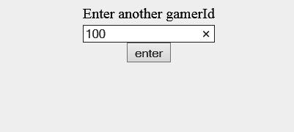
An example with "Specific Player" option

Slide 7
You just might find your new favorite game!

