Slide 1
IBM University Engagement Project Submission
“Exploring the Power of Agentic AI with IBM Granite and LangFlow”

Slide 2
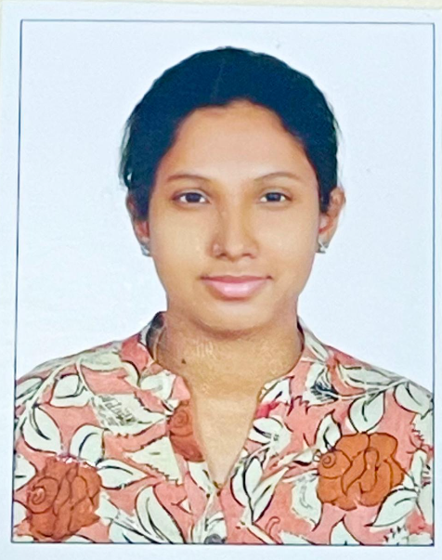
Project Tile – AI Career Counsellor Rural Youth
Domain of Project – [ like Agriculture / Education / Healthcare / … ]
Student Name | Recent Passport Photo | Email ID | Mobile number [WhatsApp]
Sejal Nirat M |  | 160625737054@stanley.edu.in | 9550203970

Slide 3
Problem Statement -
Problem Statement No.23 - AI Career Counsellor Rural Youth
The Challenge
Youth in rural areas often lack access to structured career guidance due to limited exposure, absence of professional counsellors, and poor awareness of skill development opportunities. Many students are unaware of job-oriented courses, government schemes, or online training platforms that could help them build a career aligned with their interests. Traditional methods of career counselling are not scalable and fail to reach underserved communities, contributing to skill mismatch, underemployment, and loss of potential. There is a strong need for a smart, localized, and accessible solution that can provide personalized career guidance to rural youth based on real-time, trusted information.
The Objective
A rural youth in India — with just a phone and basic internet — should be able to open DiशाBot, describe their background in Hindi or English, and walk away with a clear 90-day career action plan, knowing exactly which government scheme to apply for, which free course to enroll in, and what income to expect in 2–3 years.

Slide 4
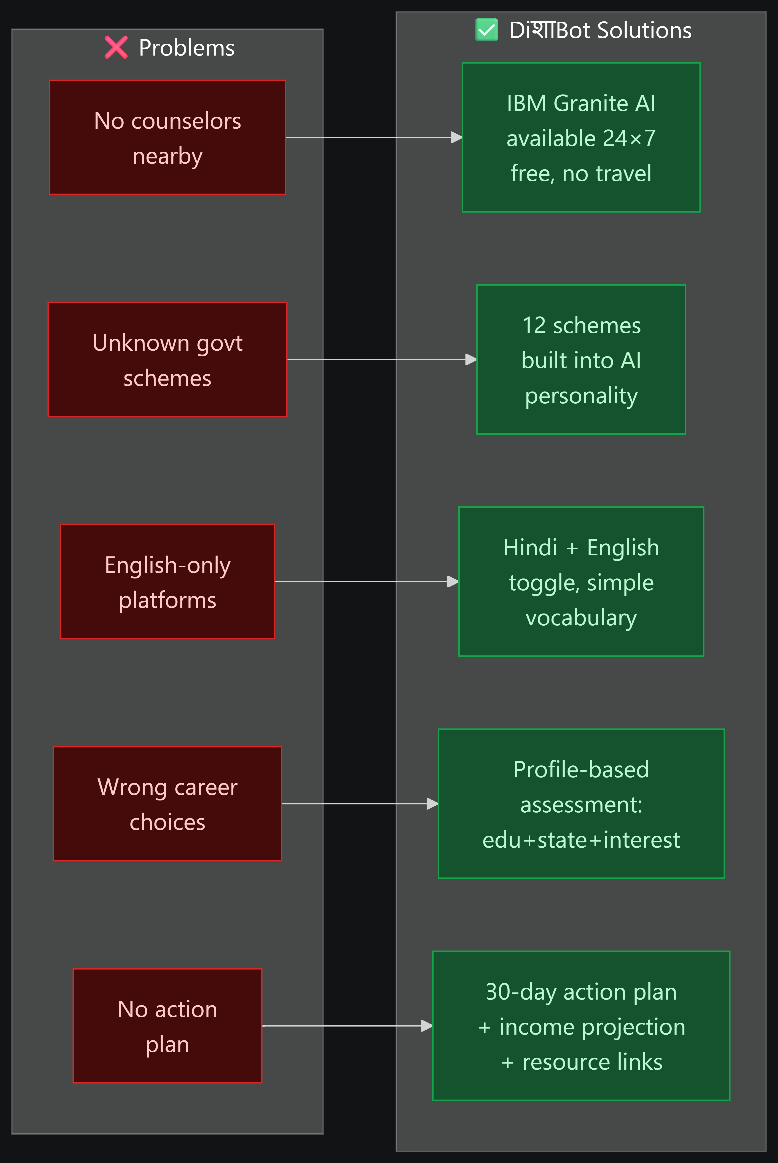
Proposed Solution -
Proposed Solution: AI Mentor for Rural Youth
DiशाBot uses IBM Granite 4 as a multi-role agentic AI — simultaneously acting as a career counsellor, scheme advisor, action planner, and bilingual mentor — to give every rural youth in India the same quality of guidance that was previously available only to the privileged few in cities, at zero cost, in their own language, on any device with a browser.

Slide 5
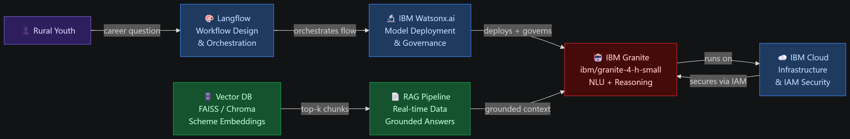
Technology Used
IBM Granite + IBM Cloud + Watsonx.ai are live and working in the app right now. Langflow represents the visual design of the same logic already coded in Express. RAG + Vector DB are the next major upgrade — they would replace the static scheme cards with live, sourced, always-accurate government data.

Slide 6
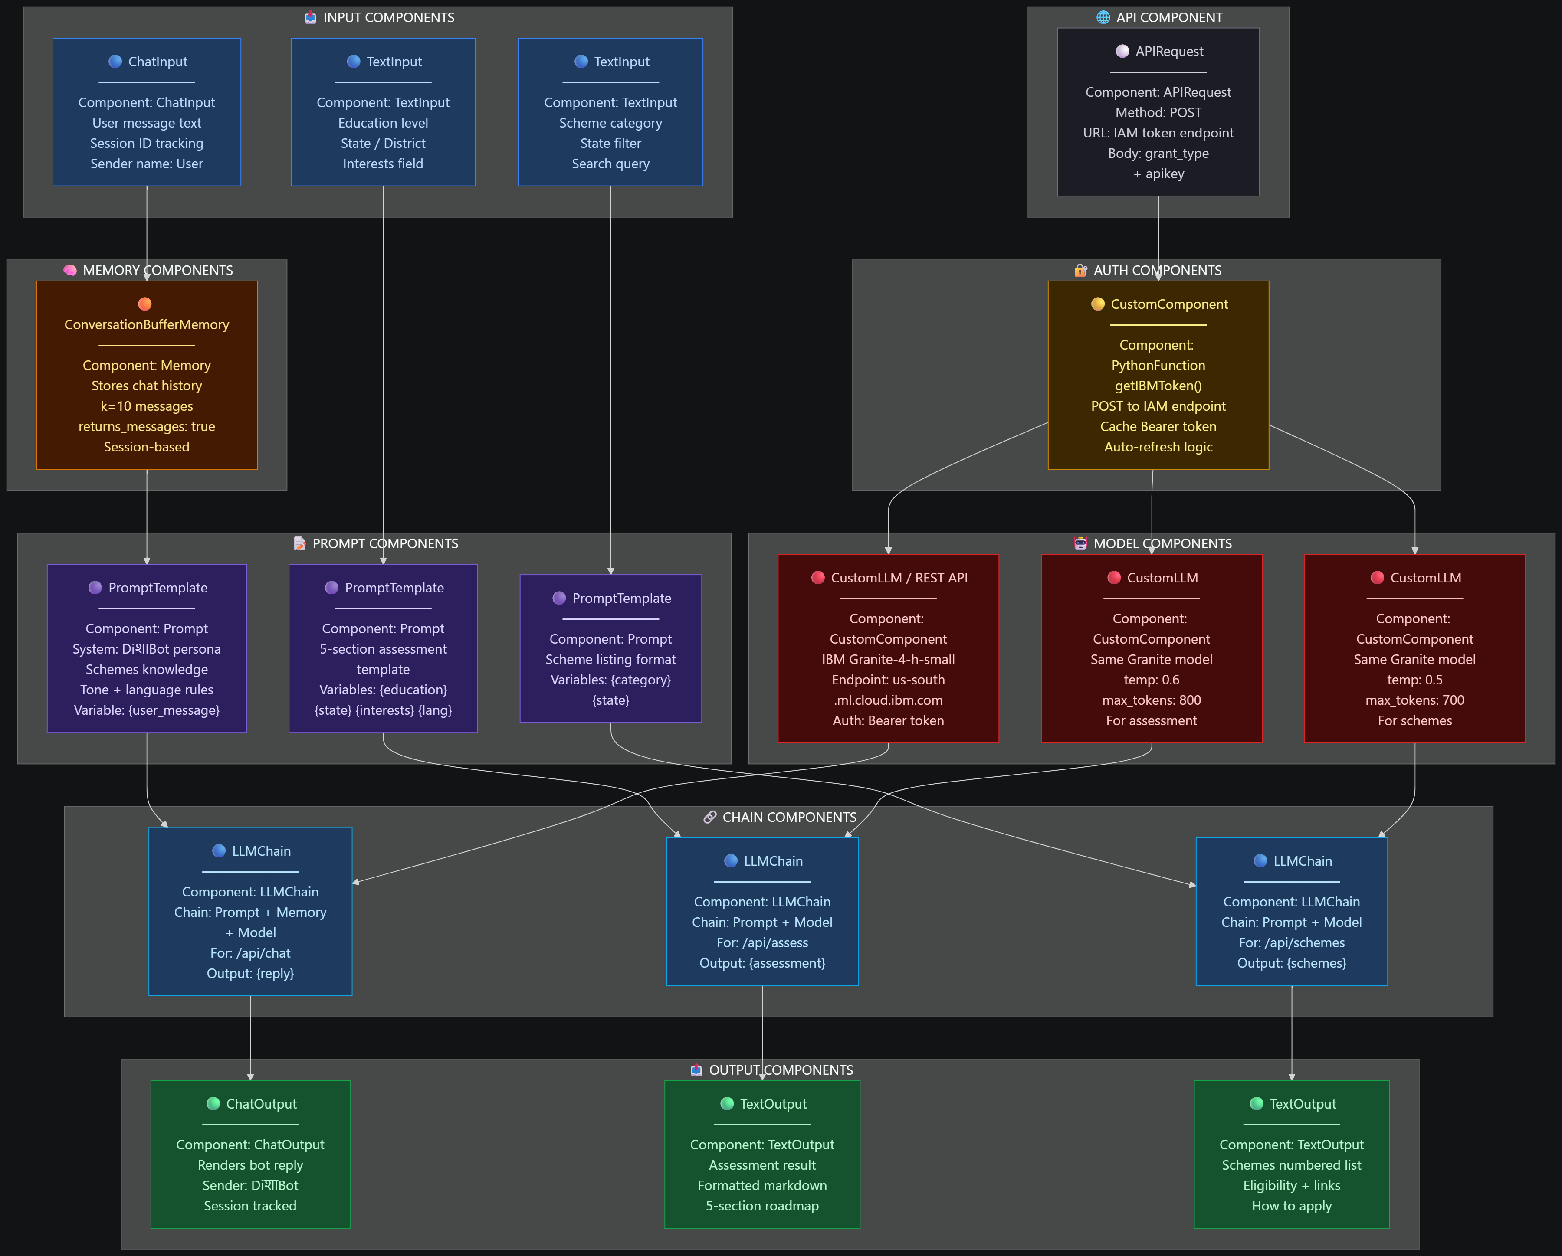
Langflow component Used -

Slide 7
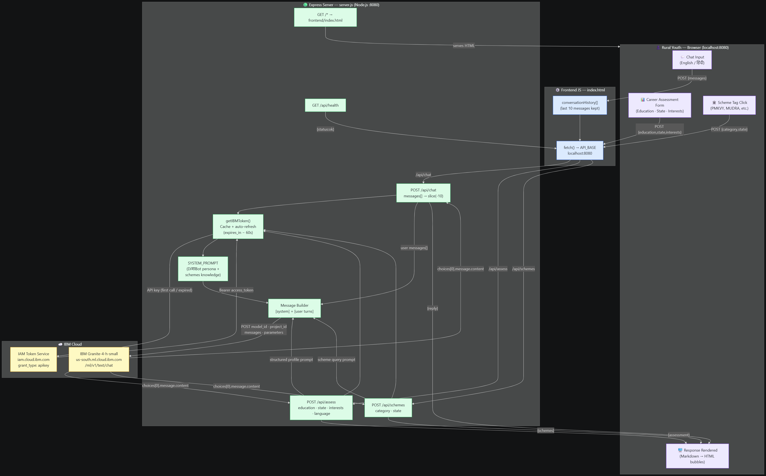
Langflow workflow -

Slide 8
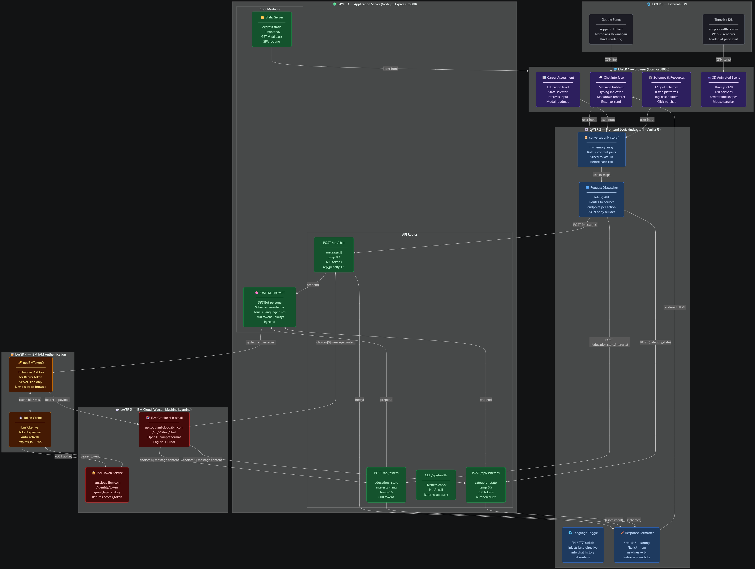
Architecture blueprint

Slide 9
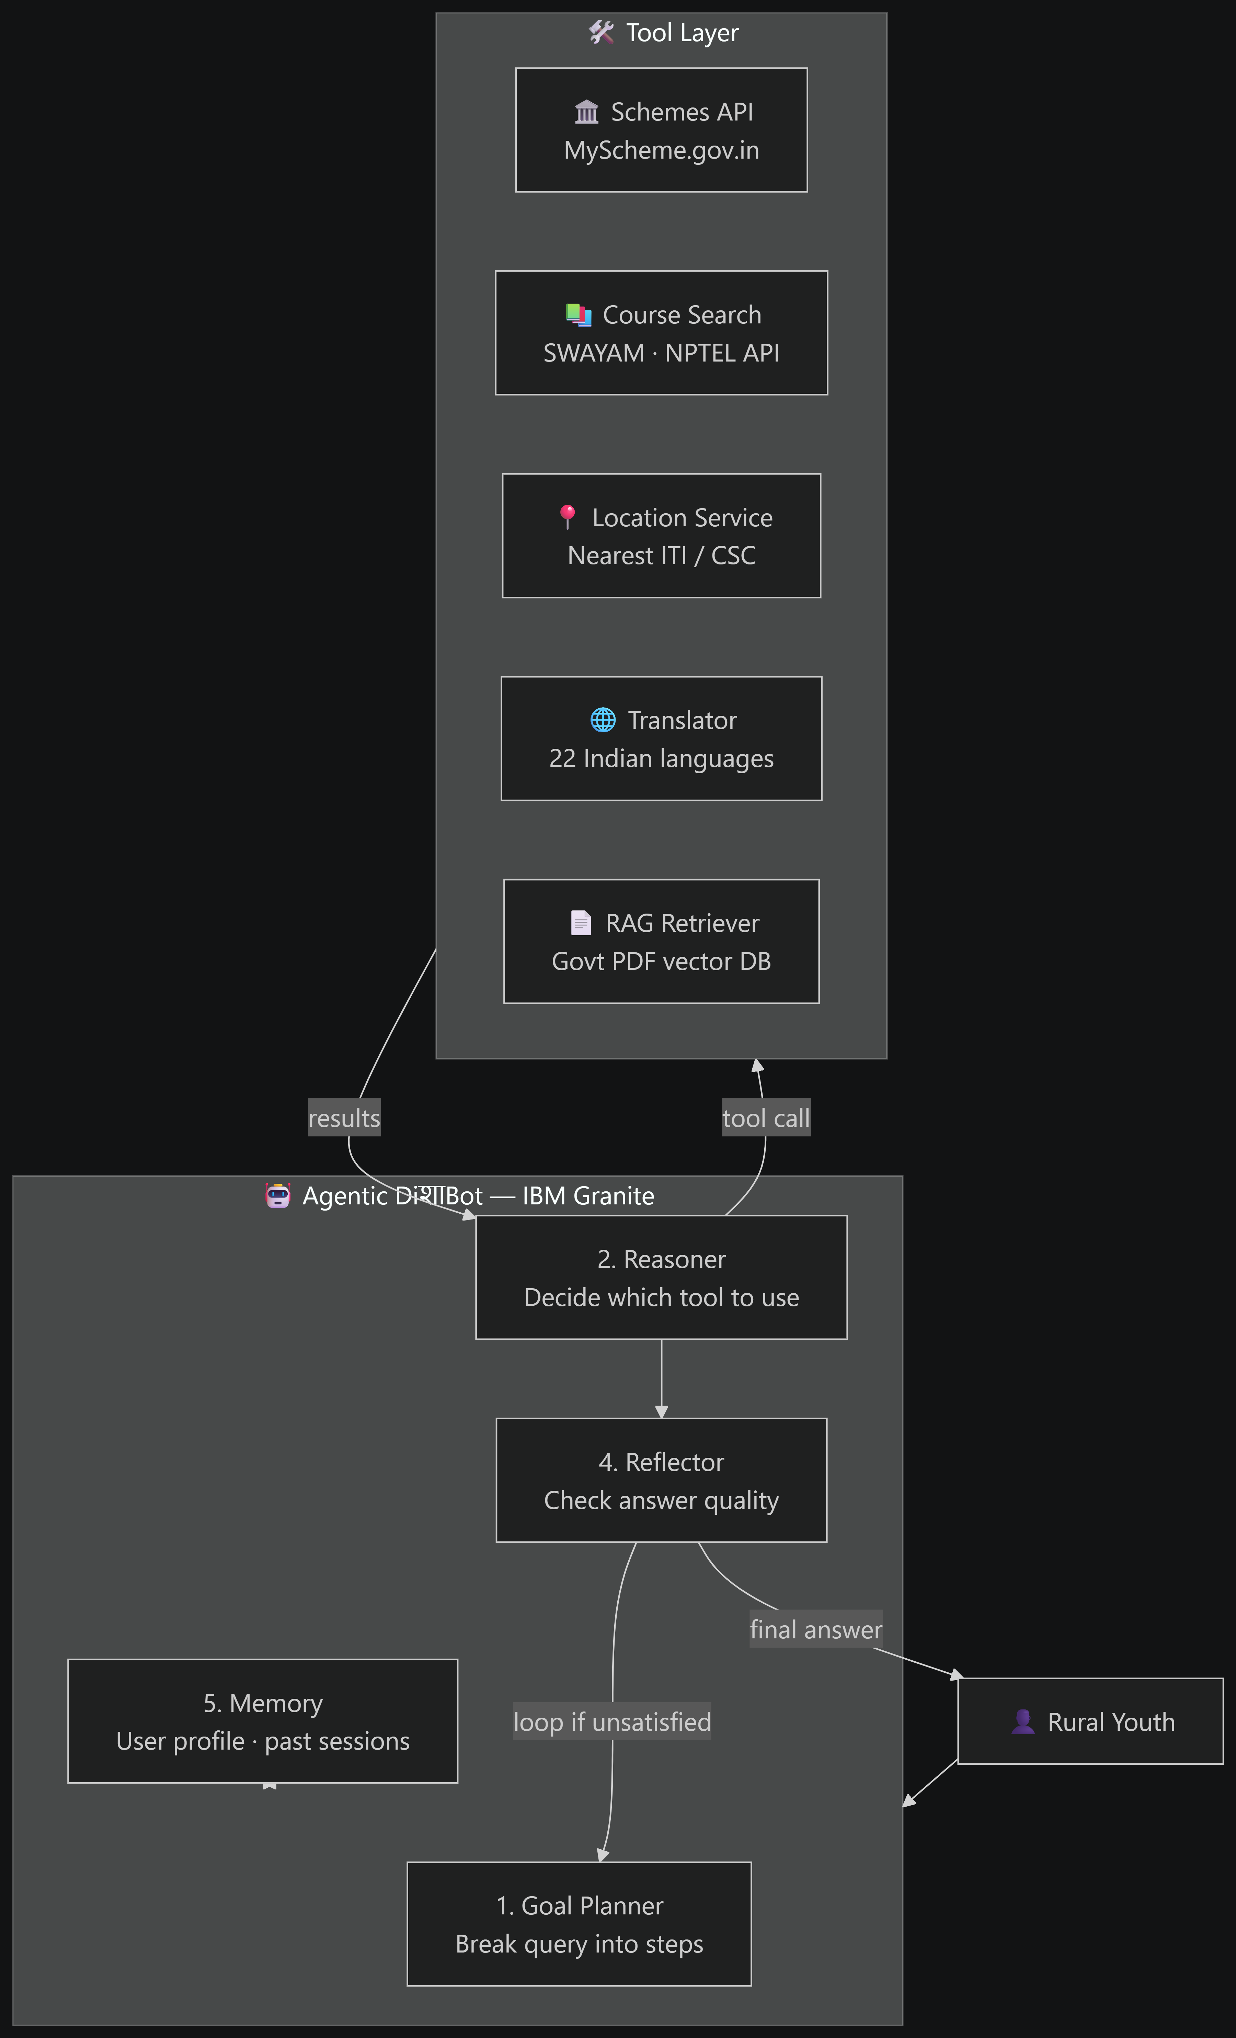
Role of Agentic AI in the solution
🛠️ Tool-Using Agent
Now: Granite only uses its training knowledge (may be outdated).
Agentic: Granite calls real tools:
search schemes(state, category) → live data from MyScheme.gov.in API
find courses(interest) → live results from SWAYAM API
check eligibility (user profile, scheme id) → real eligibility logic
translate(text, lang) → real-time regional language support (Bhojpuri, Marathi, etc.)
2. 🔄 Reflection & Self-Correction Loop
Now: One shot answer, no validation.
Agentic: After generating career advice, the agent:
Reviews its own answer ("Is this scheme still active?)
Scores confidence — only sends high-confidence answers
3. 📅 Proactive Follow-Up Agent
Now: Stateless — every session starts fresh.
Agentic: Agent stores user profile, checks in after 30 days: "Did you register for PMKVY? Here's the nearest centre in your district."
4. 🌾 RAG Agent
Now: Granite answers from training data only.
Agentic with RAG:
User query--Agent retrieves from vector DB--(latest govt circulars, district-level data)--Granite generates grounded, updated answer--Agent cites source + date

Slide 10
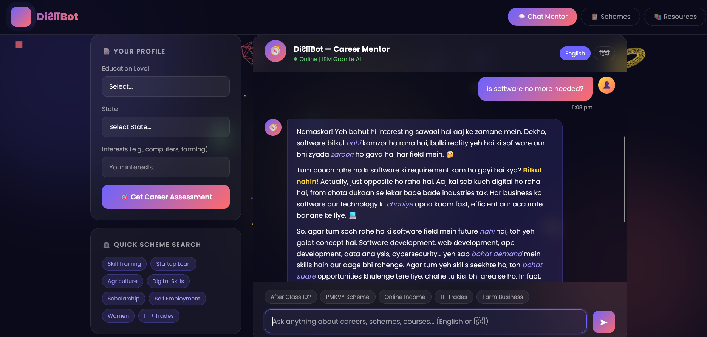

Slide 11
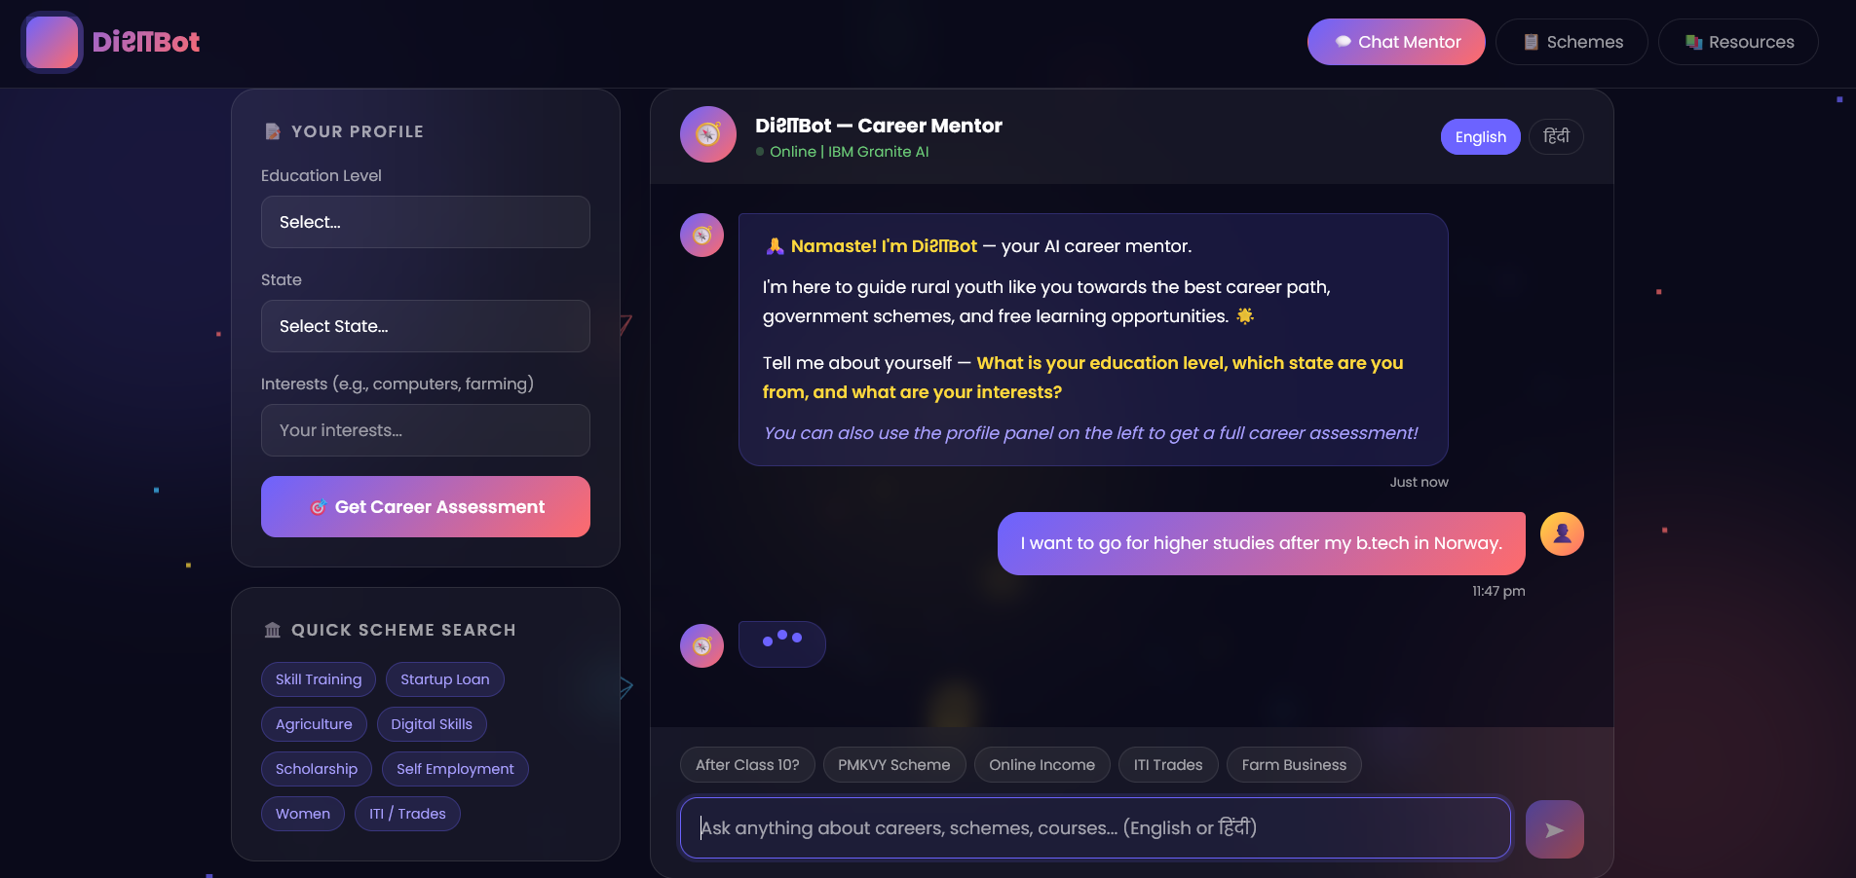

Slide 12
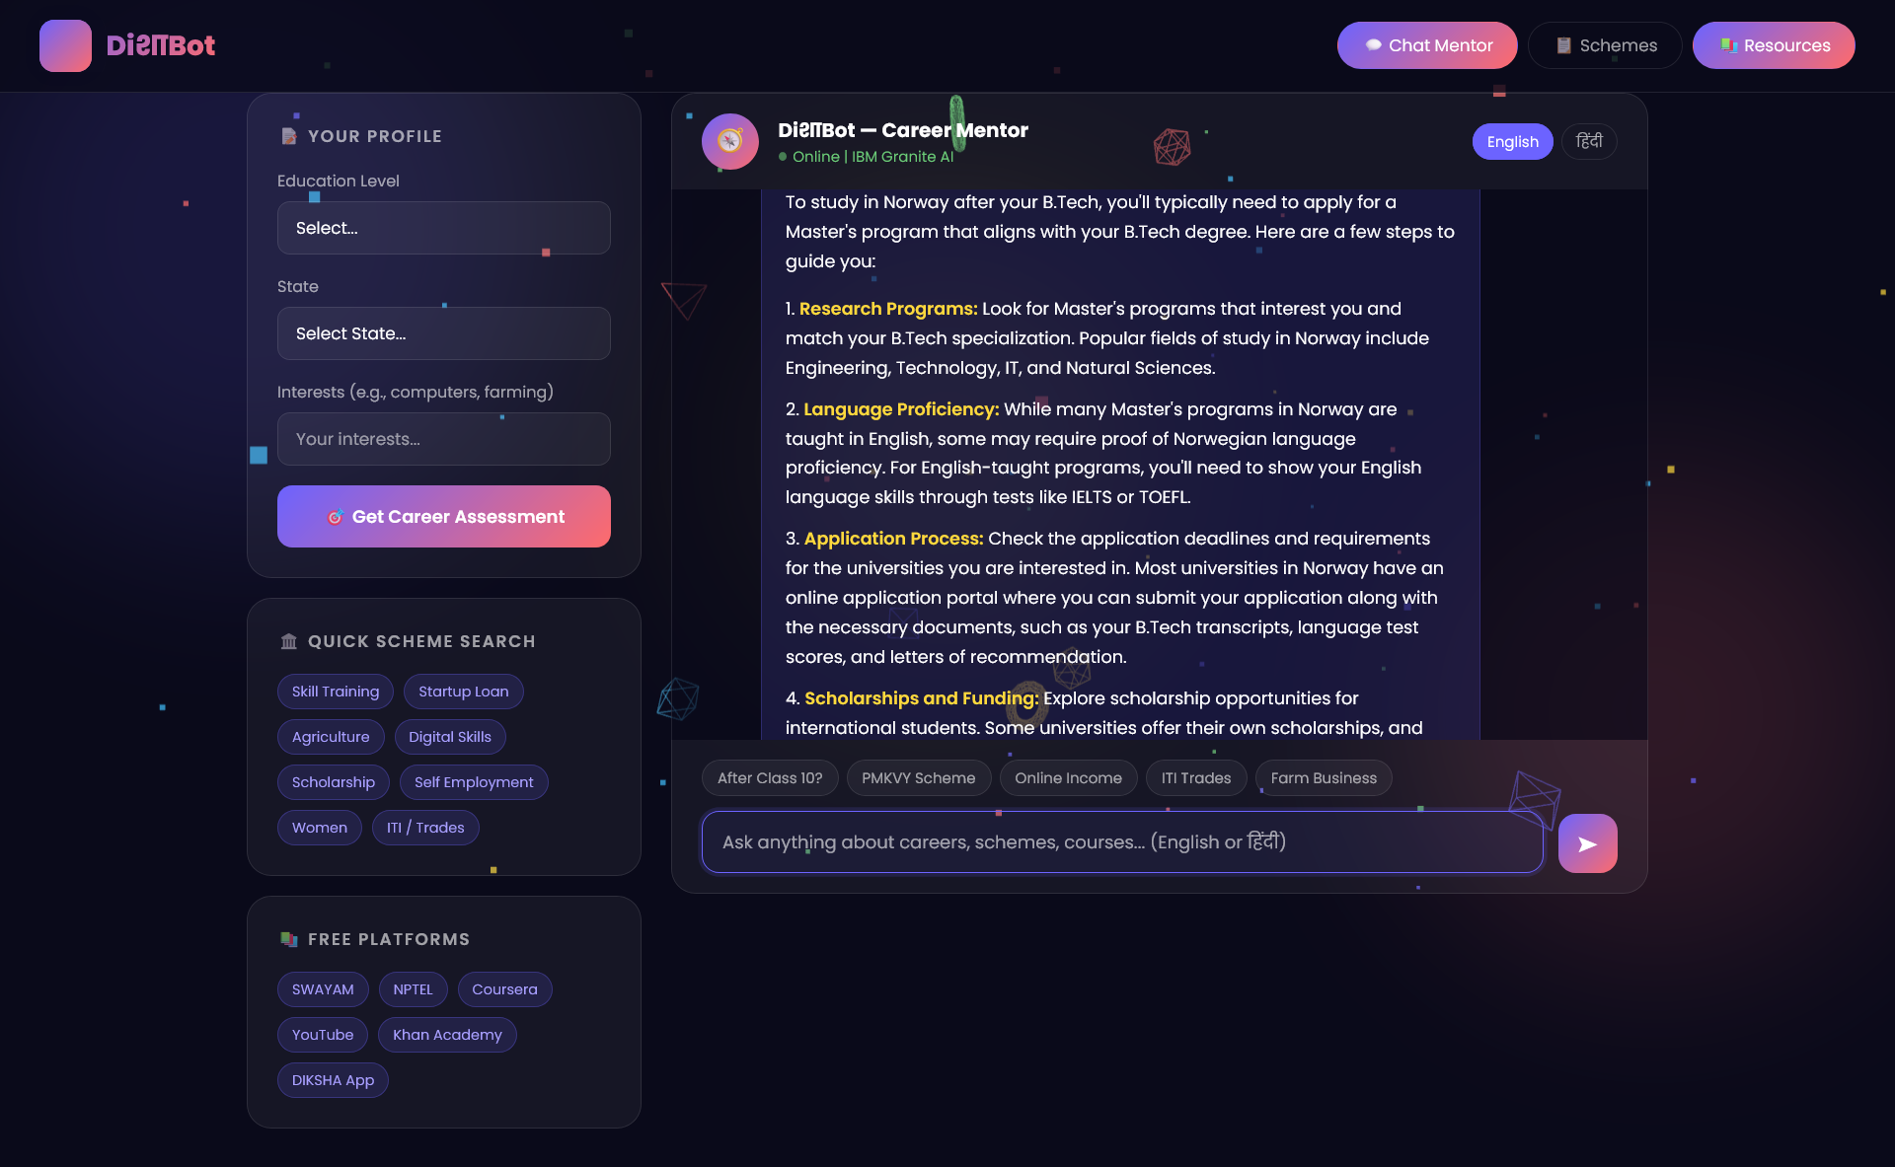

Slide 13
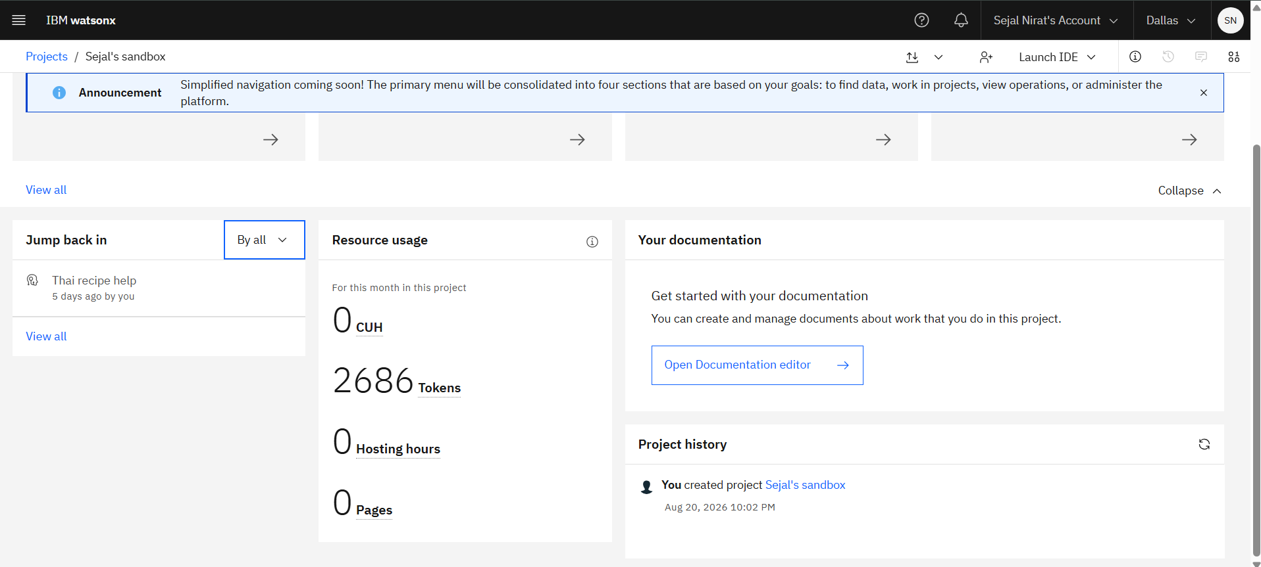
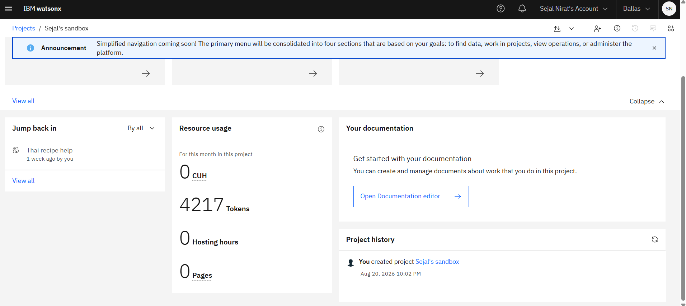
Token Usage
1531 tokens are used
Before Prompt
After the Prompt
·
·
·

Slide 14
Novelty and Uniqueness
DiशाBot is the only tool that combines IBM-grade AI reasoning, deep knowledge of Indian government schemes, bilingual delivery, and a zero-friction browser interface — purpose-built for the 500 million rural Indians who have never had access to a single career counsellor in their life.
Metric | Value
Rural youth aged 15–30 in India | ~250 million
Currently with access to career counseling | < 5%
States covered by DiशाBot | 20
Government schemes integrated | 12
Free learning platforms linked | 8
Cost per guidance session | ₹0
Setup required from user | Zero — just open a browser
Languages | English + Hindi (22 planned)

Slide 15
Git Hub Link
Please test and Paste the working Github URL –
https://github.com/import-sejal-as-nirat/AI-Mentor-for-Rural-Youth.git
·
·
·

Slide 16
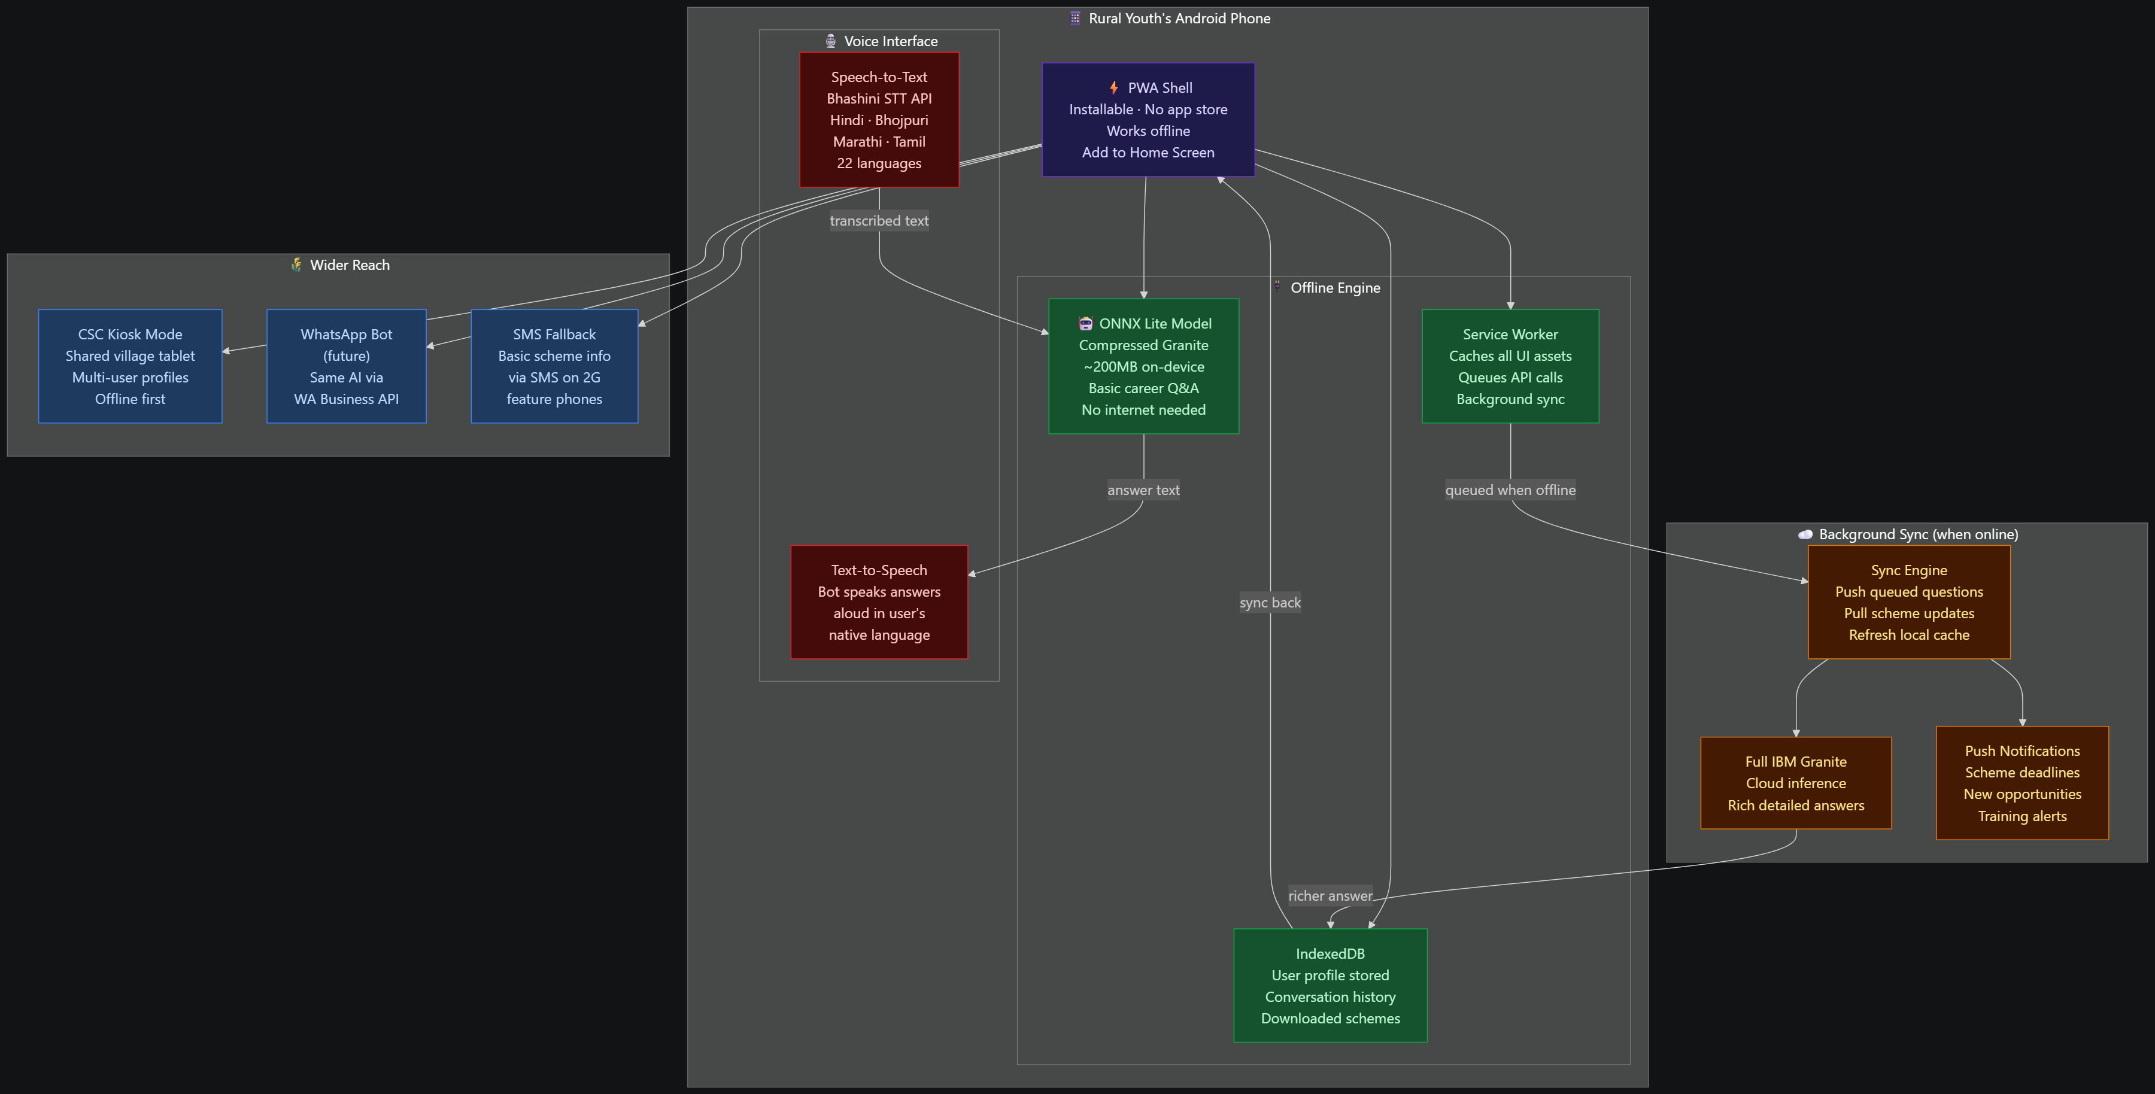
Future Scope
 | Scope 1 — Agentic AI | Scope 2 — Offline PWA
Problem solved | Outdated data, single-shot answers, no follow-through | No internet, no PC, no voice support
Who benefits | Youth with internet who need deep guidance | 500M+ rural users on low-end phones
Core tech | IBM watsonx Orchestrate, LangGraph, Bhashini, RAG | Service Workers, ONNX Runtime, Bhashini STT/TTS
Impact | Turns advisor into a career coach | Turns the app into a village-level utility
·
·
·

Slide 17
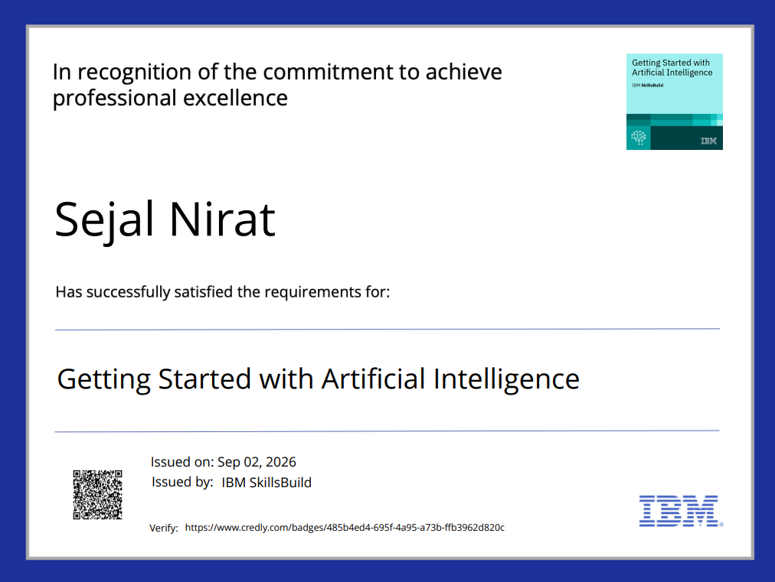
Certificates Earned:

Slide 18
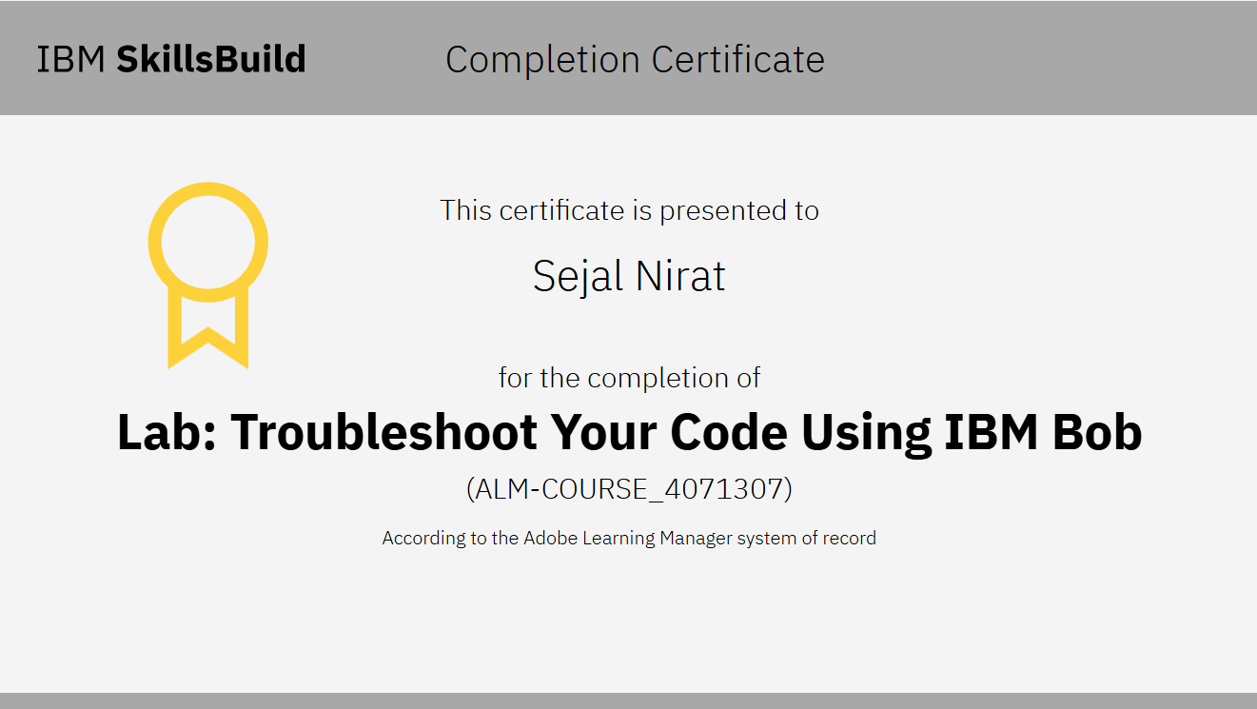
Certificates Earned:​

Slide 19


