Slide 1



Student Depression Dataset

Slide 2
01
数据集来源

Slide 3
数据集来源
Kaggle官网
数据集网址：https://www.kaggle.com/datasets/adilshamim8/student-depression-dataset
由Adil Shamim贡献
2个种类：
抑郁（Depression）
不抑郁（No Depression）
19个属性
ID：Unique identifier for each student
Demographics：Age, Gender, City
Academic Indicators：CGPA, Work/Academic Pressure, Study Satisfaction
Lifestyle & Wellbeing：Sleep Duration, Dietary Habits, Work Pressure, Job Satisfaction, Work/Study Hours
Additional Factors：Profession, Degree, Financial Stress, Family History of Mental Illness, and whether the student has ever had suicidal thoughts

Slide 4
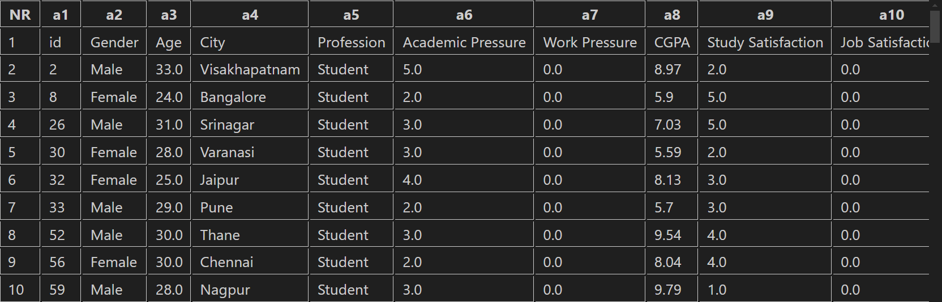
数据展示
这里只展示一部分数据

Slide 5
02
汇总信息

Slide 6
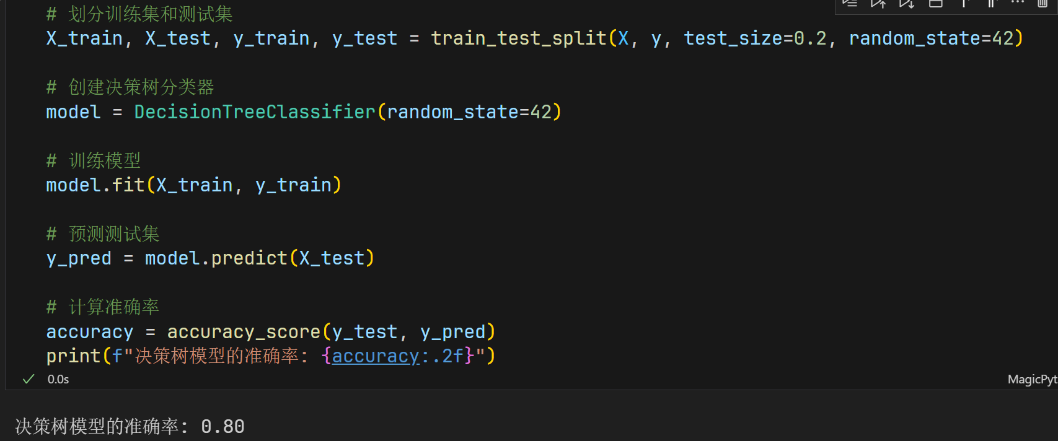
模型准确性

Slide 7
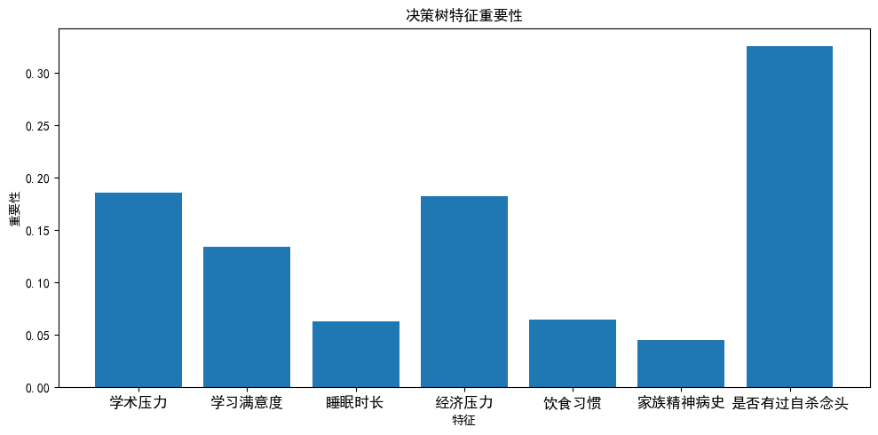
特征重要性

Slide 8
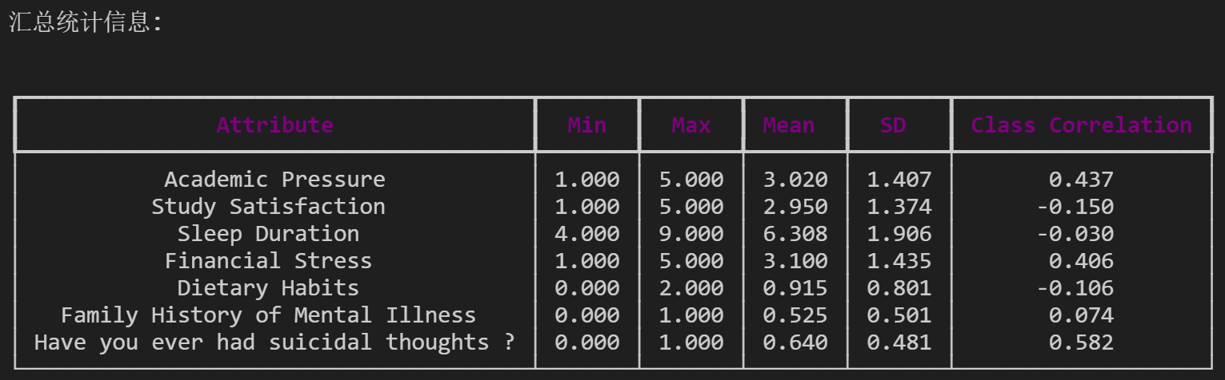
汇总信息
数据信息汇总

