Slide 1

Mutual Fund Analytics
Name: Prabhash Kumar
Organization: Bluestock Fintech
Date:20 June 2026 – 10 July 2026

Slide 2
PROJECT OVERVIEW
The Mutual Fund Analytics project is an end-to-end data analytics solution developed to analyze historical mutual fund performance and generate meaningful business insights. The project collects, cleans, transforms, and stores financial datasets using Python and SQLite before performing exploratory data analysis and advanced financial analytics. Interactive dashboards were developed in Power BI to visualize key performance indicators, investment trends, and risk metrics. The solution enables investors and business users to compare mutual fund schemes, evaluate financial performance, and make informed investment decisions through an intuitive Business Intelligence platform.
Key Objectives
• Build an automated ETL pipeline for financial datasets.
• Analyse mutual fund performance using Python and SQL.
• Develop interactive Power BI dashboards.

Slide 3
INTRODUCTION
Mutual funds generate large volumes of financial data that require systematic analysis.
Comparing fund performance, returns, and investment risk manually is time-consuming.
Automates data collection, cleaning, transformation, and validation using Python.
Stores financial data in SQLite and retrieves insights using optimized SQL queries.
Develops interactive Power BI dashboards to visualize fund performance, KPIs, and investment trends.
Performs advanced analytics using CAGR, Sharpe Ratio, VaR, CVaR, and Rolling Sharpe Ratio.
Includes Investor Cohort Analysis and SIP Continuity Analysis for deeper investment insights.
Supports data-driven investment decisions through Business Intelligence and financial analytics.

Slide 4
OBJECTIVE
Develop an end-to-end Mutual Fund Analytics solution using Python, SQL, SQLite, and Power BI.
Build an automated ETL pipeline for collecting, cleaning, transforming, and validating financial data.
Analyze historical NAV data to evaluate fund performance, returns, and investment risk.
Calculate key financial metrics such as CAGR, Sharpe Ratio, Sortino Ratio, VaR, CVaR, and Rolling Sharpe Ratio.
Design interactive Power BI dashboards with KPIs, filters, slicers, and visualizations.
Perform advanced analytics including Investor Cohort Analysis, SIP Continuity Analysis, and Fund Recommendation.
Generate meaningful business insights to support data-driven investment decisions.

Slide 5
TECHNOLOGY STACK
Technology | Purpose
Python | ETL Pipeline, Data Cleaning & Analytics
Pandas & NumPy | Data Manipulation & Numerical Analysis
Matplotlib | Data Visualization
SQL | Data Querying & Analysis
SQLite | Database Management
Power BI | Dashboard Development & Business Intelligence
Git & GitHub | Version Control & Collaboration
Development Tools: VS Code, Jupyter Notebook

Slide 6
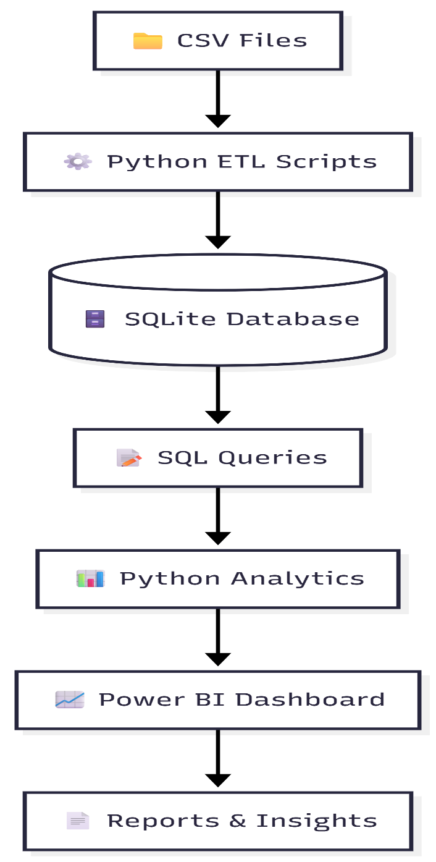
SYSTEM ARCHITECTURE
Collects raw mutual fund datasets from CSV files.
Cleans, transforms, and validates data using Python ETL scripts.
Stores processed data in an SQLite relational database.
Retrieves and analyzes data using optimized SQL queries.
Performs financial analytics using Python.
Creates interactive Power BI dashboards for visualization.
Generates business reports and investment insights.

Slide 7
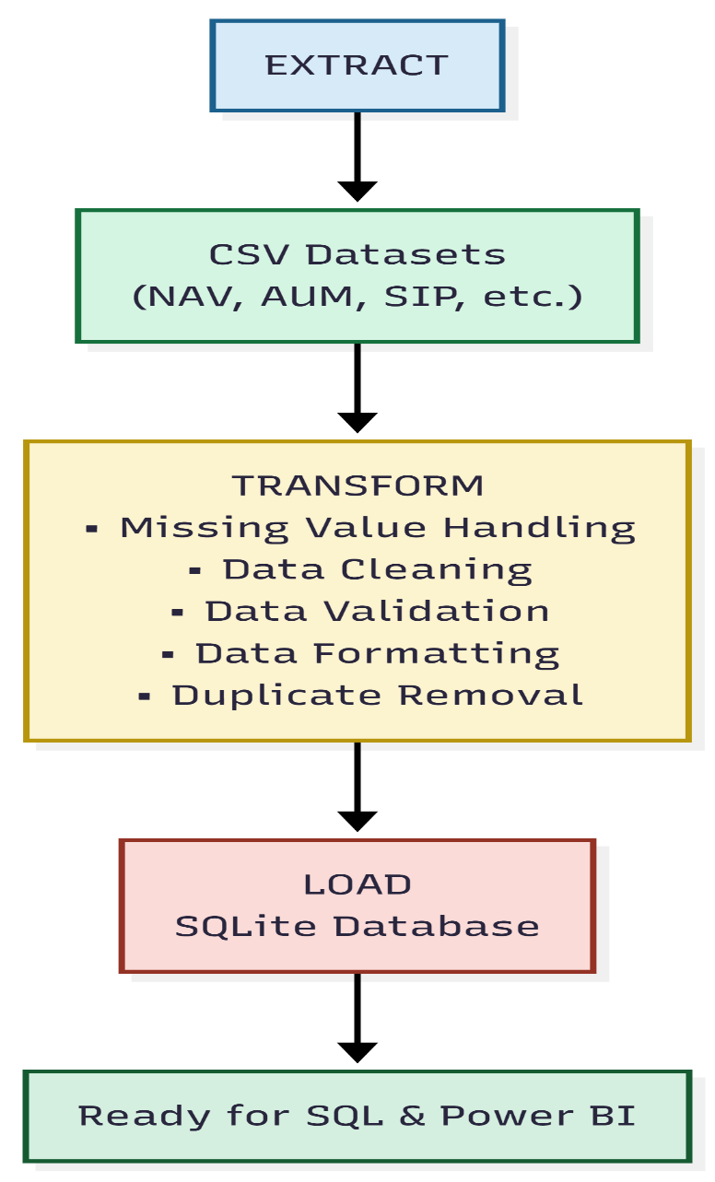
ETL PIPELINE
Extract: Imported 10+ mutual fund datasets from CSV files.
Transform: Cleaned, validated, formatted, and standardized financial data using Python.
Load: Loaded processed data into an SQLite database for efficient querying.
Built reusable ETL scripts for automated data processing.
Improved data quality before analytics and dashboard development.

Slide 8
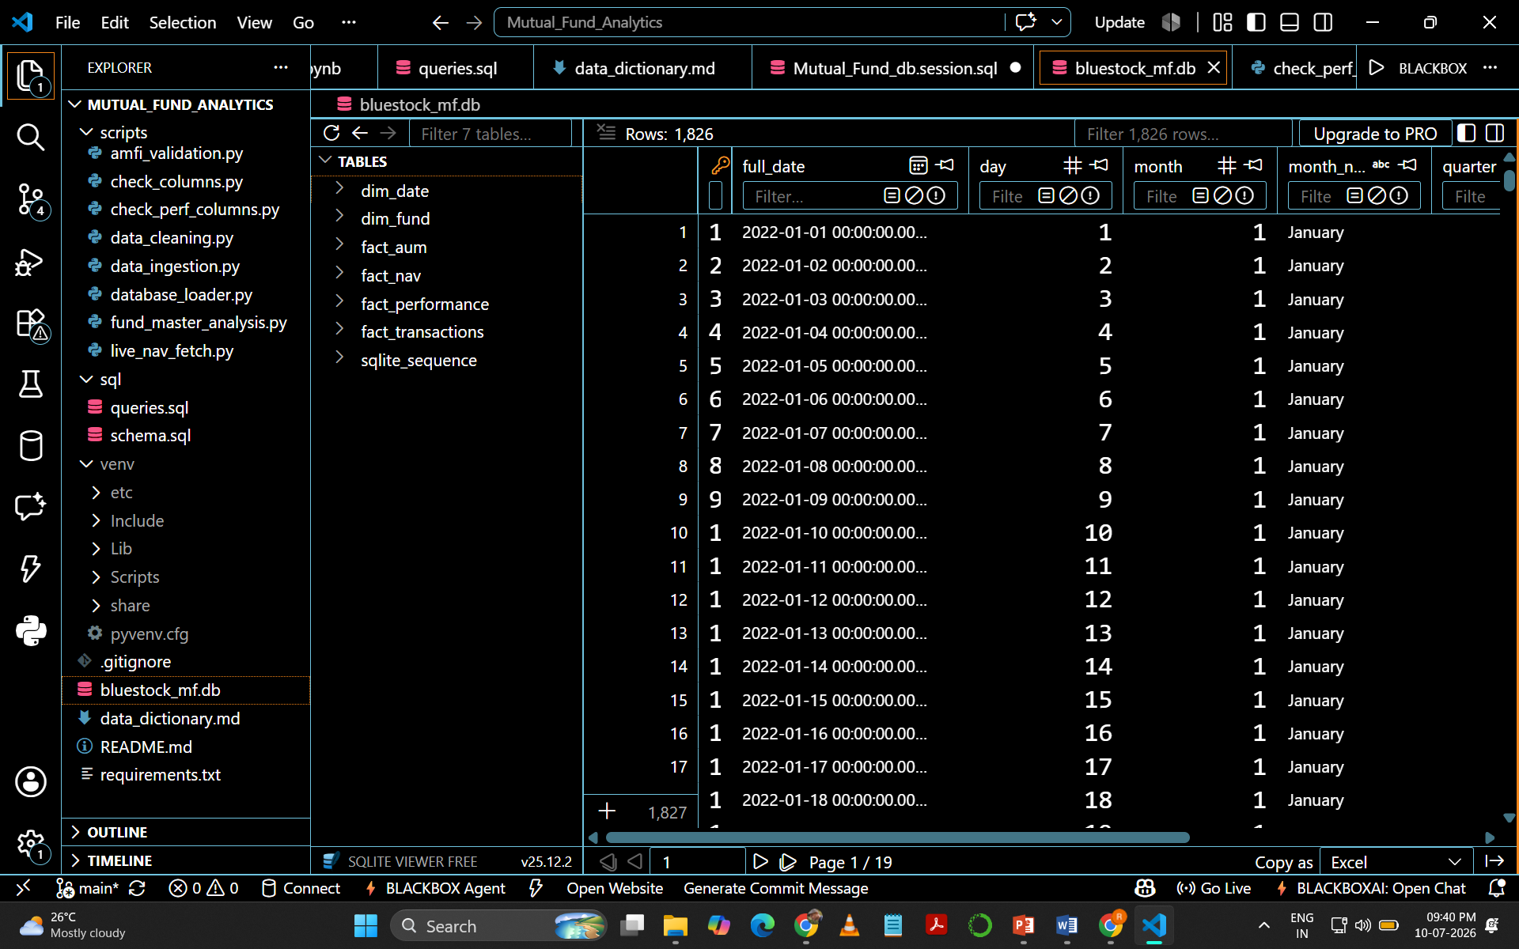
DATABASE DESIGN
Uses SQLite as the relational database.
Implements a Star Schema with Dimension and Fact tables.
dim_fund stores mutual fund information.
dim_date stores date attributes for time-based analysis.
Fact tables store NAV, Transactions, AUM, and Performance data.
Optimized relationships enable fast SQL queries and Power BI reporting.
.

Slide 9
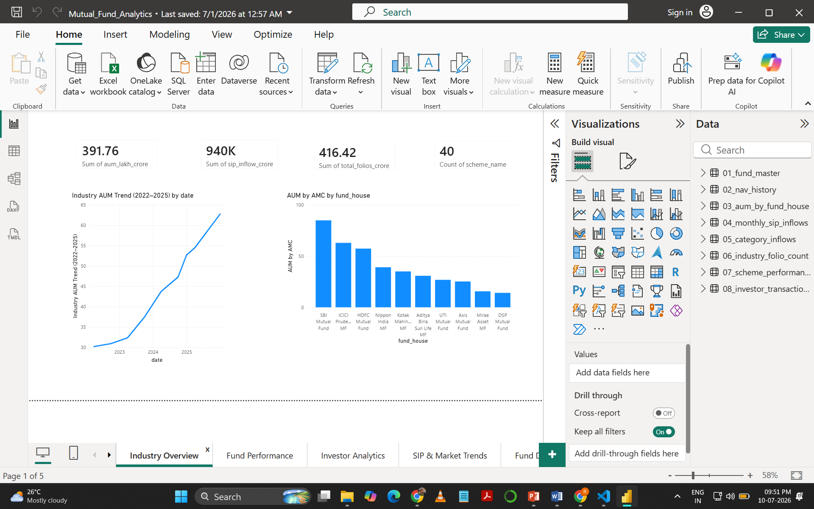
POWER BI DASHBOARD OVERVIEW
Displays key industry KPIs such as AUM, SIP Inflows, Folios, and Total Schemes.
Visualizes Industry AUM Growth (2022–2025).
Compares Assets Under Management (AUM) across major fund houses.
Provides interactive filters for better analysis.
Enables quick navigation to detailed analytics pages.
Supports data-driven investment decision making.

Slide 10
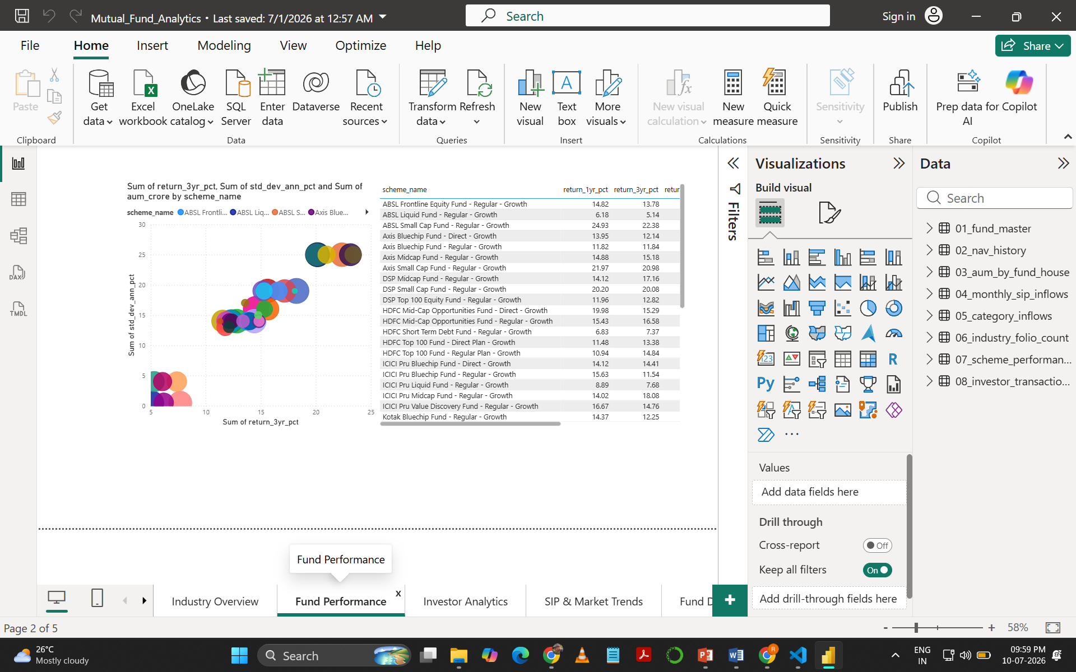
FUND PERFORMANCE DASHBOARD
Displays CAGR, 1-Year, 3-Year, and 5-Year Returns.
Compares performance across different mutual fund schemes.
Shows risk-adjusted performance metrics.
Identifies top-performing funds.
Helps investors evaluate long-term growth.

Slide 11
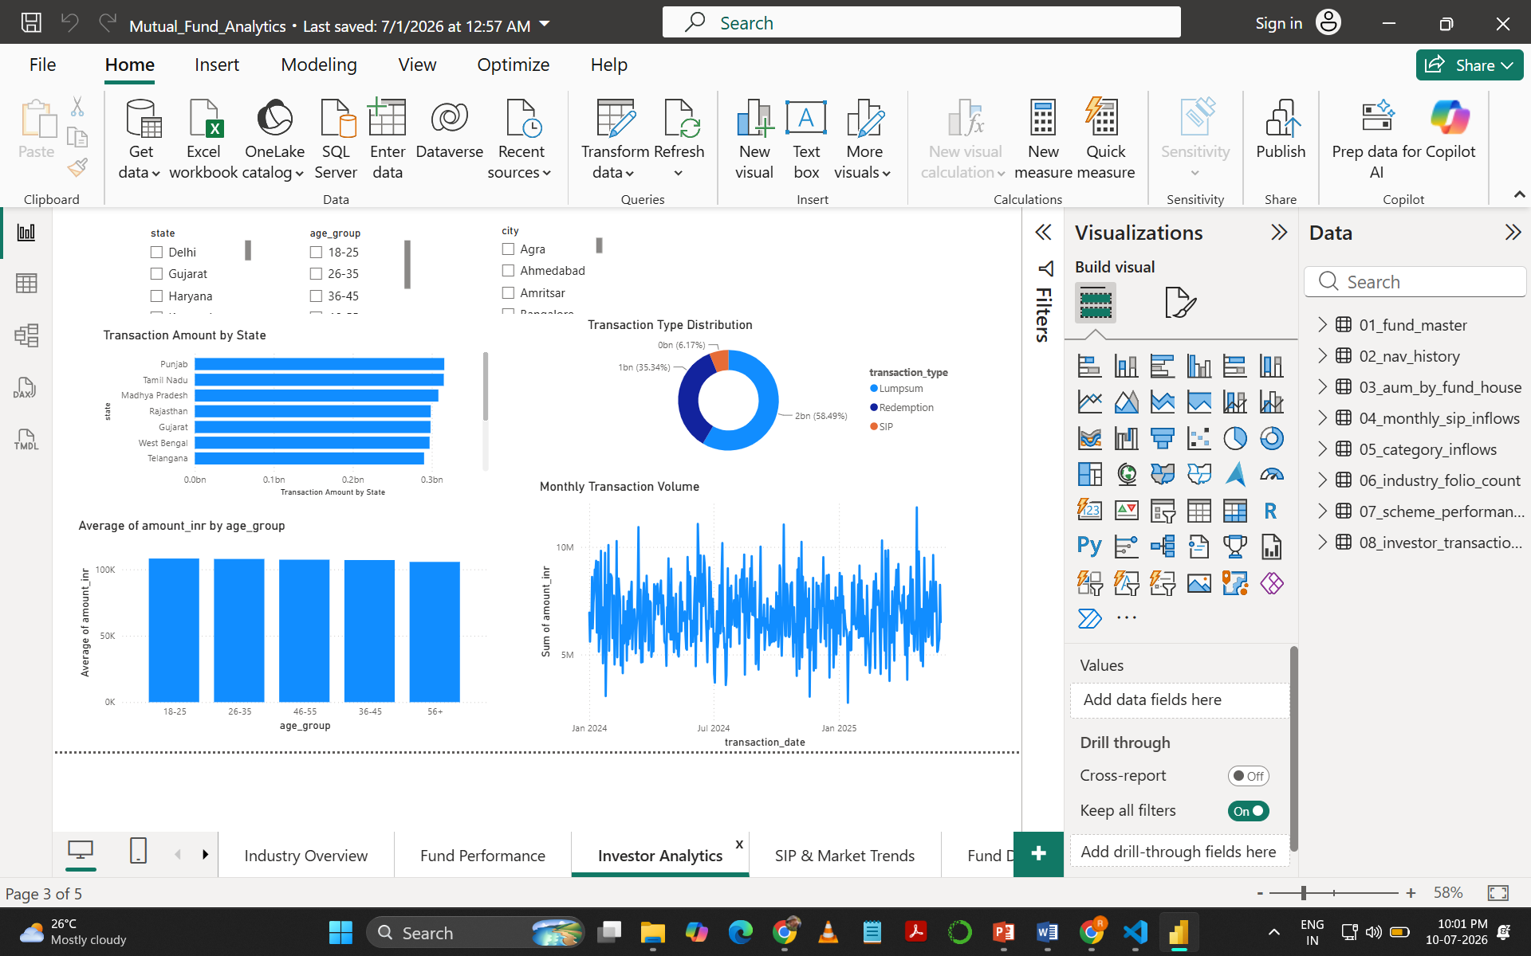
INVESTOR ANALYSIS DASHBOARD
Analyzes investor transactions and behavior.
Shows investment patterns over time.
Performs Investor Cohort Analysis.
Tracks investor retention and engagement.
Supports customer segmentation.

Slide 12
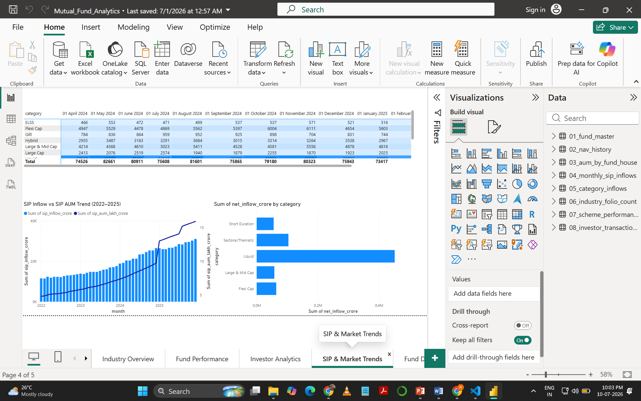
SIP & MARKET TREND ANALYSIS
Visualizes monthly SIP inflows.
Shows industry growth trends.
Compares category-wise fund inflows.
Identifies market investment patterns.
Supports trend forecasting.

Slide 13
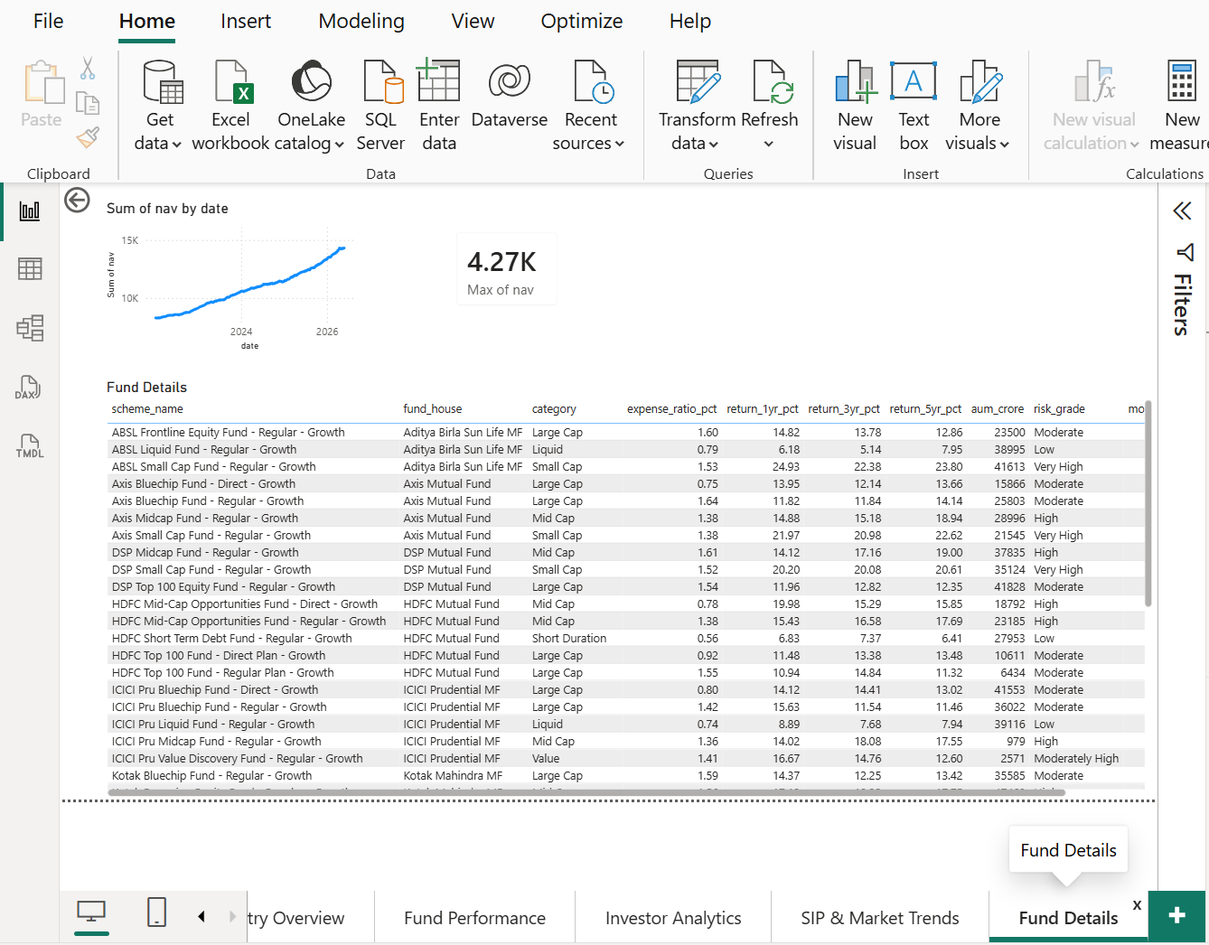
FUND DETAILS ANALYSIS
Displays complete scheme information.
Includes expense ratio, AUM, returns, and risk grade.
Enables scheme-level comparison.
Helps evaluate individual mutual funds.
Supports informed investment decisions.

Slide 14
KEY INSIGHTS
Performance Insights
Industry AUM showed consistent growth.
Large-cap funds contributed the highest AUM.
Top-performing funds delivered strong long-term returns.
Risk-adjusted metrics helped compare fund quality
Business Insights
SIP inflows increased steadily over time.
Interactive dashboards simplified analysis.
Python ETL reduced manual effort.
Power BI enabled faster decision-making.

Slide 15
CHALLENGES
Handling missing and inconsistent financial datasets.
Cleaning and validating data from multiple CSV sources.
Designing an efficient ETL pipeline using Python.
Managing relationships between SQLite database tables.
Calculating advanced financial metrics (Sharpe Ratio, VaR, CVaR).
Optimizing Power BI dashboards for smooth performance.
Ensuring data consistency across Python, SQLite, SQL, and Power BI.

Slide 16
CONCLUSION
Successfully developed an end-to-end Mutual Fund Analytics solution.
Automated data extraction, cleaning, and loading using Python.
Designed a normalized SQLite database for efficient querying.
Built interactive Power BI dashboards for business insights.
Implemented advanced financial analytics for fund evaluation.
Enabled data-driven investment decision making.

Slide 17
FUTURE SCOPE
Live mutual fund API integration.
AI/ML-based return prediction.
Portfolio optimization using Markowitz Model.
Monte Carlo simulation for forecasting.
Streamlit web application deployment.
Mobile-friendly dashboard.
Automated email reporting system.

Slide 18

END OF THE SLIDE
THANKYOU
Prabhash Kumar
Data Analytics Intern
Bluestock Fintech

