Slide 1
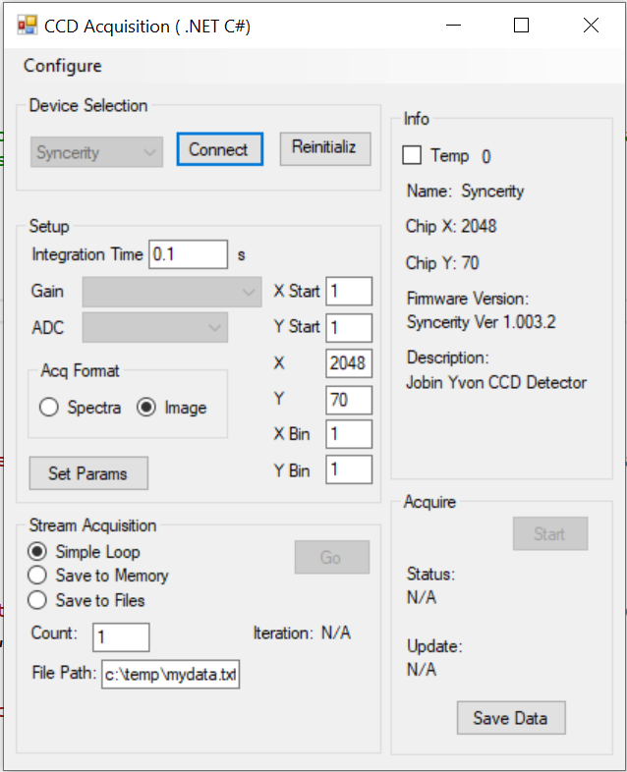
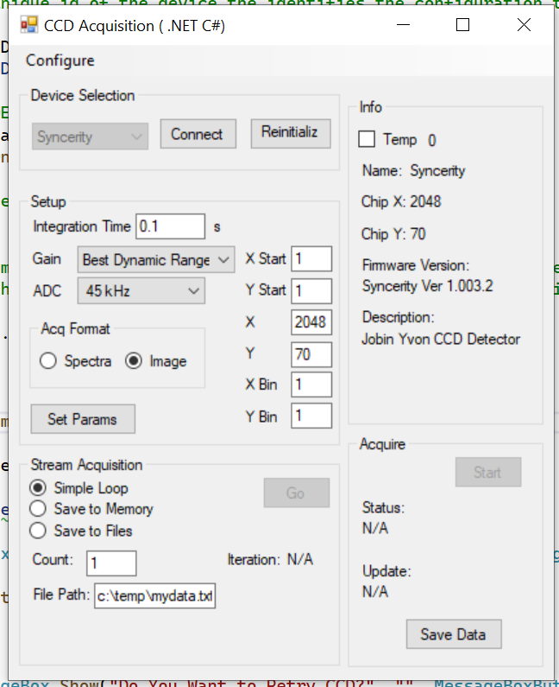
after first initialize
after second (re)initialize
First call to connect gives an access violation.
Second call to connect succeeds.
First call to initialize does not load Gain and ADC settings
Second call to (Re)initialize loads them.

Slide 2
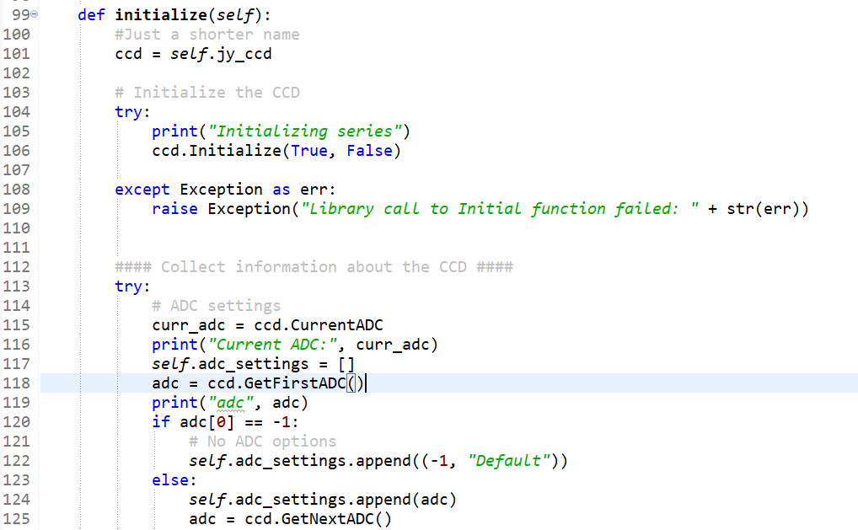
ADC settings and gains load fine if I set the emulate flag to True.

