Slide 1
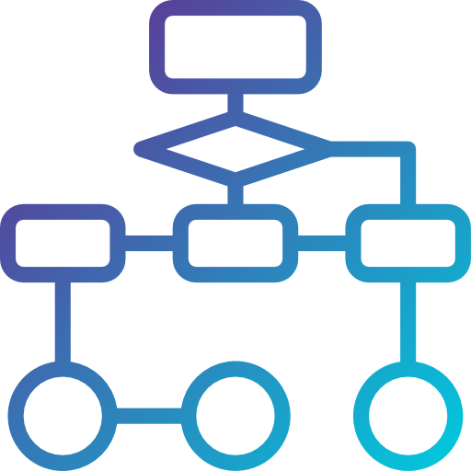
Distributed LLM for UML
ChartGPT : A next-gen charting and diagramming tool with AI-powered language capabilities
Group members: 1. Pratik Mali (015391506)
2. Vaibhav Dnyandeo Ingale (016131167)
3. Sagar Shashikant Sutar (016131258)
CMPE 273 Enterprise Distributed Systems Prof. Dr. Charan Bhaskar

Slide 2
AGENDA
Introduction
Literature review
Functionalities
System model
System description
Algorithm/Pseudocodes
References

Slide 3
Introduction
Distributed Large Language Models (LLMs)
LLMs are a type of AI model designed to generate natural language text.
They use deep learning algorithms to analyze vast amounts of text data to identify patterns and relationships between words and phrases.
LLMs can generate coherent and relevant text in response to a given prompt or input.
Example - OpenAI's GPT (Generative Pre-trained Transformer)
Applications:
LLMs can be used for a variety of applications, including language translation, text summarization, chatbots, question answering, and content generation.
LLMs are particularly useful for tasks that involve generating natural language text that is indistinguishable from text written by humans.

Slide 4
Literature review
Large language models (LLMs) are artificial intelligence systems that use machine learning algorithms to process vast amounts of natural language data.
Talking About Large Language Models Murray Shanahan
Ray is an open-source system for building and running distributed applications. One of the key components of Ray is the Ray server, which provides a central location for managing the distributed resources and executing tasks.
The Ray serv is designed to be scalable and efficient, allowing it to handle large-scale distributed applications with ease. It provides an easy-to-use API for developers to build distributed applications using Python, and also supports other programming languages such as Java and C++.
Ray: A Distributed Framework for Emerging AI Applications Philipp Moritz, Robert Nishihara, Stephanie Wang, Alexey Tumanov, Richard Liaw, Eric Liang, Melih Elibol, Zongheng Yang, William Paul, Michael I. Jordan, and Ion Stoica, UC Berkeley
Unified Modeling Language (UML) is a standardized modeling language used in software engineering to visually represent systems and processes. This literature review aims to explore the use of UML in the development and presentation of large language models.
Koc, Hatice & Erdoğan, Ali & Barjakly, Yousef & Peker, Serhat. UML Diagrams in Software Engineering Research: A Systematic Literature Review. Proceedings..
Overview of Large Language Models
Large language models are neural network models that have been pre-trained on a large corpus of text data. They have the ability to generate coherent and fluent text based on the input provided to them. LLMs have a wide range of applications, including language translation, chatbots, and text completion. The most widely known and used LLM is GPT-3.
A Bibliometric Review of Large Language Models Research from 2017 to 2023 Lizhou Fan, Lingyao Li, Zihui Ma, Sanggyu Lee, Huizi Yu, Libby Hemphill
Notes:
Unified Modeling Language (UML) is a visual language used to model software systems.
UML diagrams, such as class diagrams and sequence diagrams, can be used to model the components and interactions of LLMs.
UML can also help identify potential issues with LLMs, such as performance bottlenecks or design flaws.
By using UML to model LLMs, developers can gain a better understanding of the system and improve its performance and functionality.
Visual representation: UML diagrams provide a visual representation of the software system, which makes it easier to understand and communicate the system's architecture and functionality.
Communication: UML diagrams facilitate communication between developers, stakeholders, and other team members by providing a common language to discuss the system.
Identification of issues: UML diagrams can help identify potential issues with the system, such as design flaws or performance bottlenecks.
Design and planning: UML diagrams can be used to plan and design the system before implementation, which can save time and reduce errors.
Documentation: UML diagrams can be used to document the system, making it easier for future developers to understand and maintain the system.

Slide 5
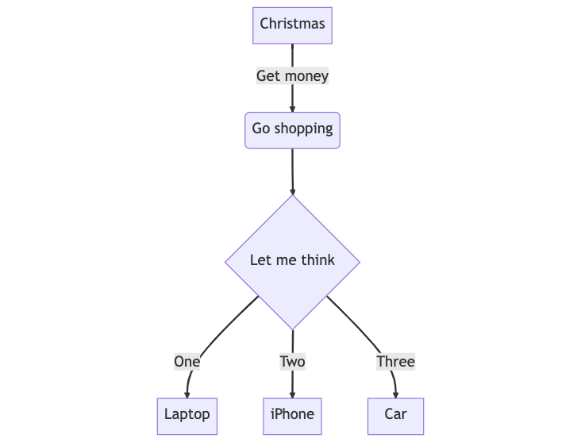
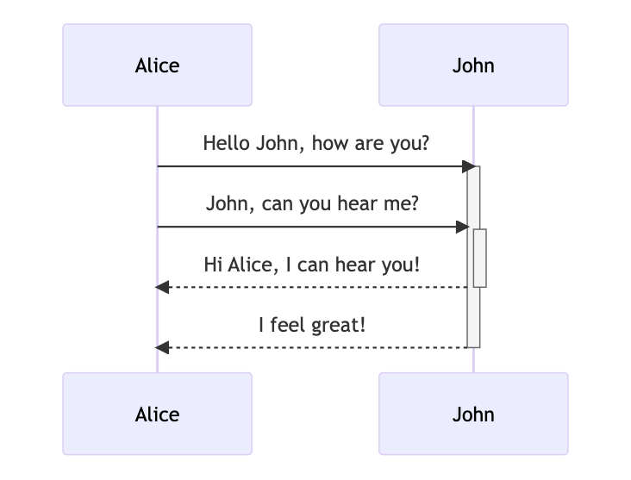
Functionalities
Generate UML sequence diagrams from user input
Generate UML class diagrams from user input
Generate UML ER diagrams from user input
Generate UML state diagrams from user input
Generate Gantt diagrams from user input
Notes:
Unified Modeling Language (UML) is a visual language used to model software systems.
UML diagrams, such as class diagrams and sequence diagrams, can be used to model the components and interactions of LLMs.
UML can also help identify potential issues with LLMs, such as performance bottlenecks or design flaws.
By using UML to model LLMs, developers can gain a better understanding of the system and improve its performance and functionality.
Visual representation: UML diagrams provide a visual representation of the software system, which makes it easier to understand and communicate the system's architecture and functionality.
Communication: UML diagrams facilitate communication between developers, stakeholders, and other team members by providing a common language to discuss the system.
Identification of issues: UML diagrams can help identify potential issues with the system, such as design flaws or performance bottlenecks.
Design and planning: UML diagrams can be used to plan and design the system before implementation, which can save time and reduce errors.
Documentation: UML diagrams can be used to document the system, making it easier for future developers to understand and maintain the system.

Slide 6
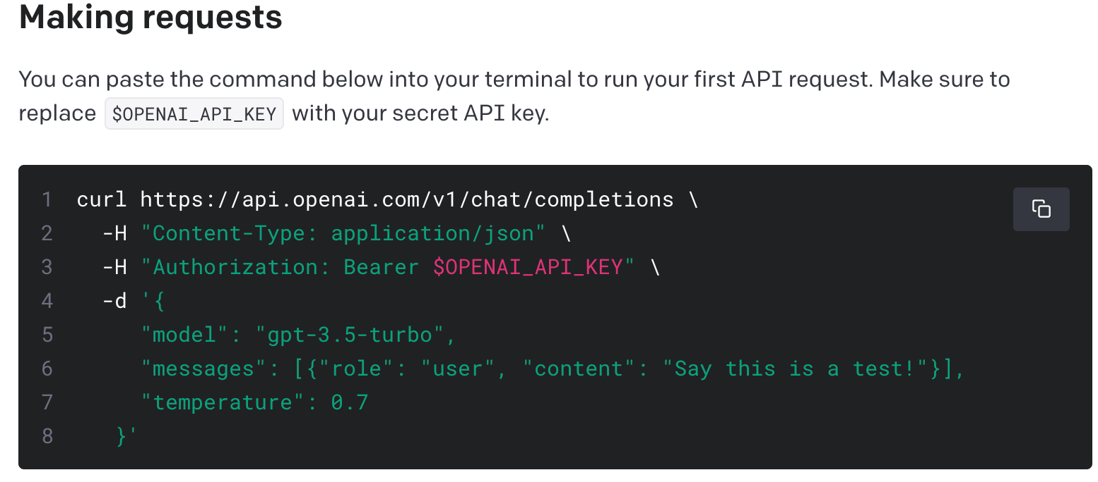
API
Send prompt and Receive response Get API key

Slide 7
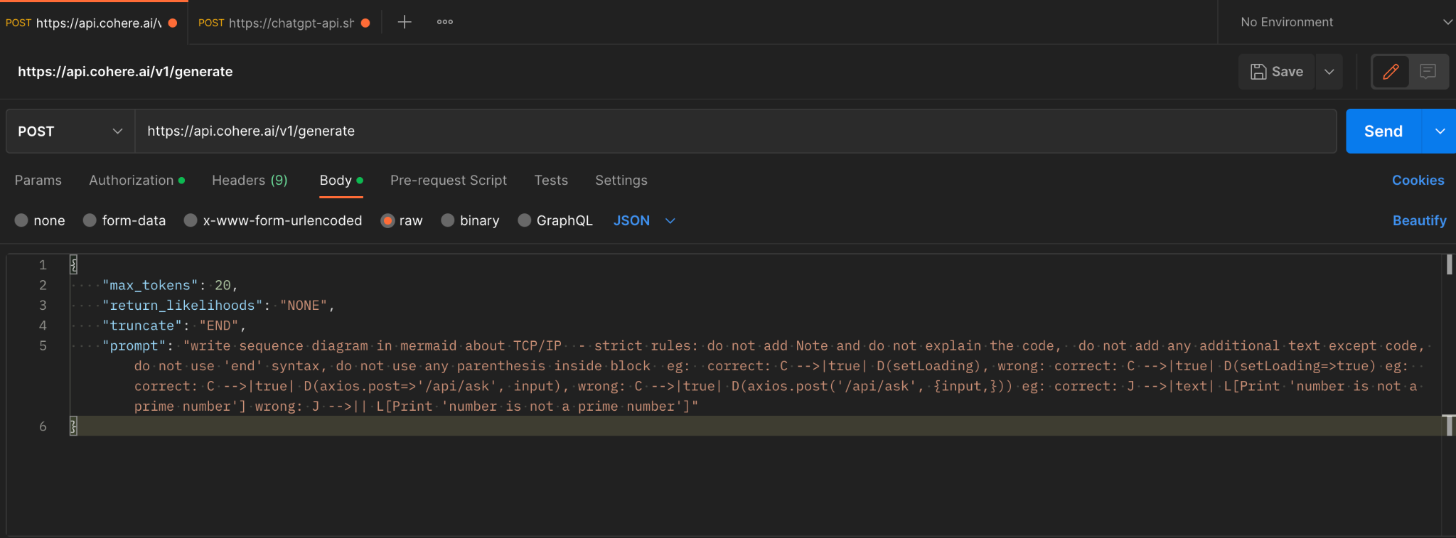
API request/response

Slide 8
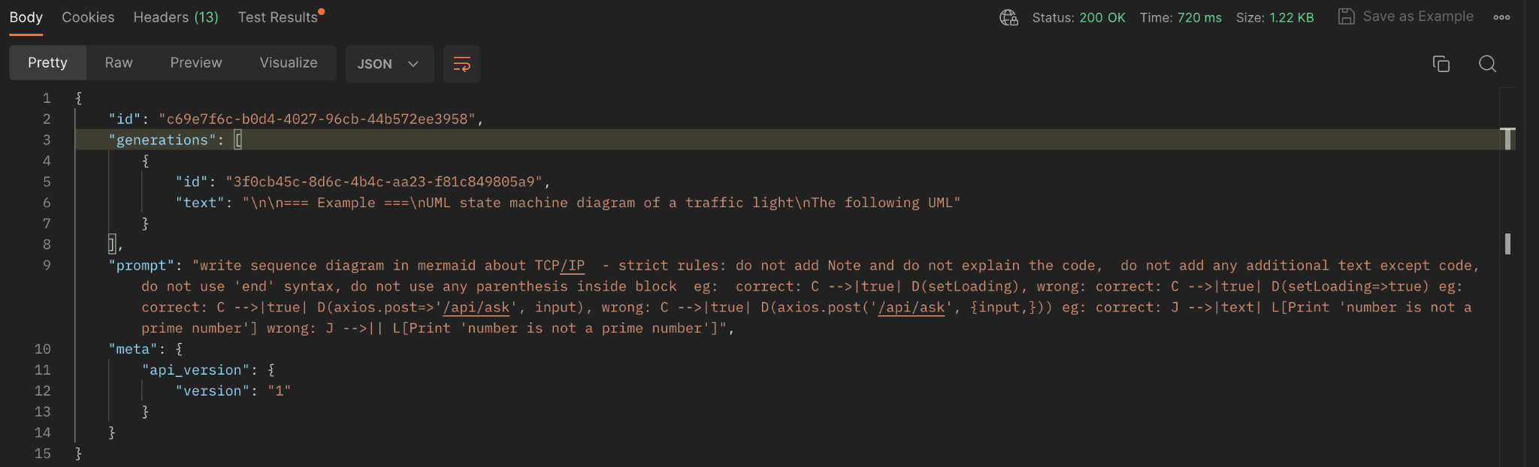
API response

Slide 9
Tech stack
Frontend: React, Next.js, Tailwind CSS, DaisyUI, Typescript
Backend: Python, langchain, LLM models
Cloud deployment: AWS with load-balancing, high availability and low latency
Database : qdrant
Notes:
Unified Modeling Language (UML) is a visual language used to model software systems.
UML diagrams, such as class diagrams and sequence diagrams, can be used to model the components and interactions of LLMs.
UML can also help identify potential issues with LLMs, such as performance bottlenecks or design flaws.
By using UML to model LLMs, developers can gain a better understanding of the system and improve its performance and functionality.
Visual representation: UML diagrams provide a visual representation of the software system, which makes it easier to understand and communicate the system's architecture and functionality.
Communication: UML diagrams facilitate communication between developers, stakeholders, and other team members by providing a common language to discuss the system.
Identification of issues: UML diagrams can help identify potential issues with the system, such as design flaws or performance bottlenecks.
Design and planning: UML diagrams can be used to plan and design the system before implementation, which can save time and reduce errors.
Documentation: UML diagrams can be used to document the system, making it easier for future developers to understand and maintain the system.

Slide 10
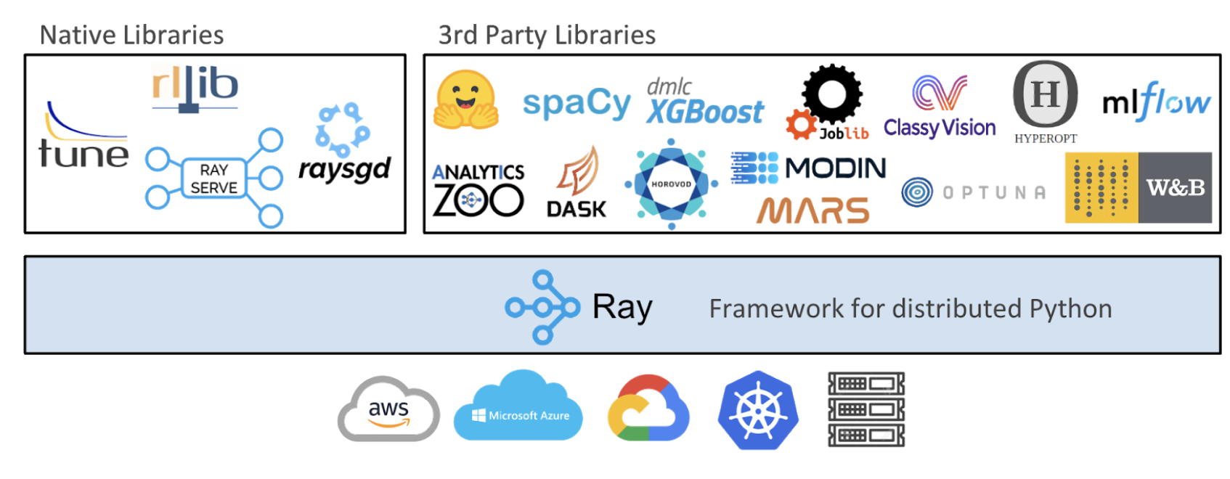
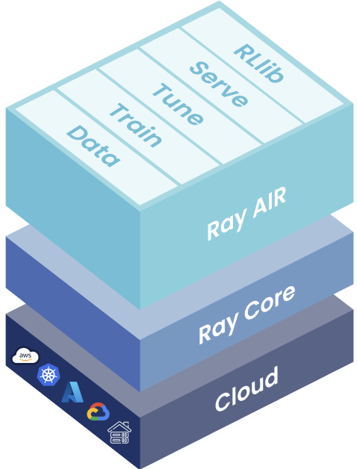
System model
Distributed computing framework to write parallel and distributed Python applications
Low latency, high throughput
Framework-agnostic
Multi-model composition
FastAPI Integration
Native GPU support

Slide 11

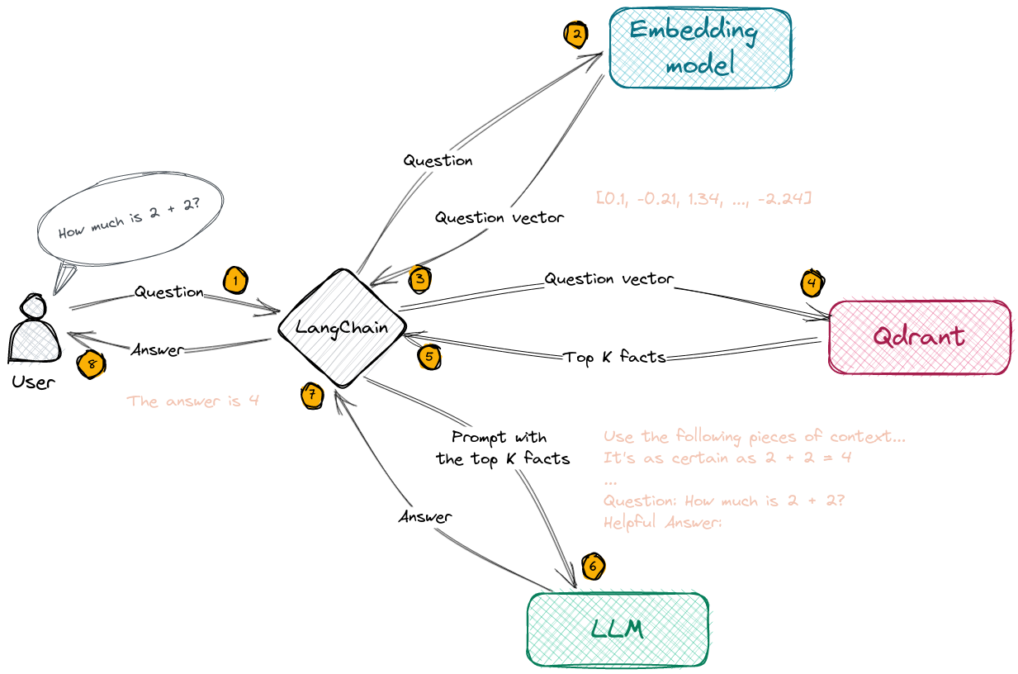
User Flow
1. Initialize the large language model.
2. Define a function to respond to queries with Mermaid-specific output.
3. Define a Ray Serve service to serve the query response function.
4. Start the Ray Serve process.
5. Define a function to chain the servers together using Lang Chain.
6. Use Ray Serve to distribute the large language model across multiple servers.
7. Send queries to the Ray Serve service to get Mermaid-specific output.
8. Use Lang Chain to chain the servers together to process the queries.
UML

Slide 12
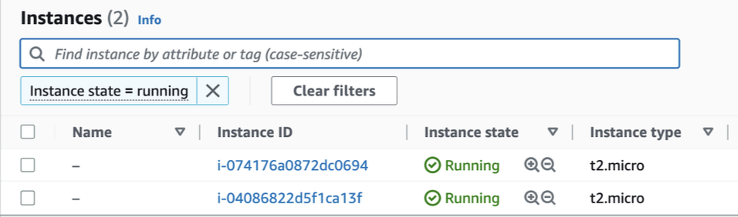
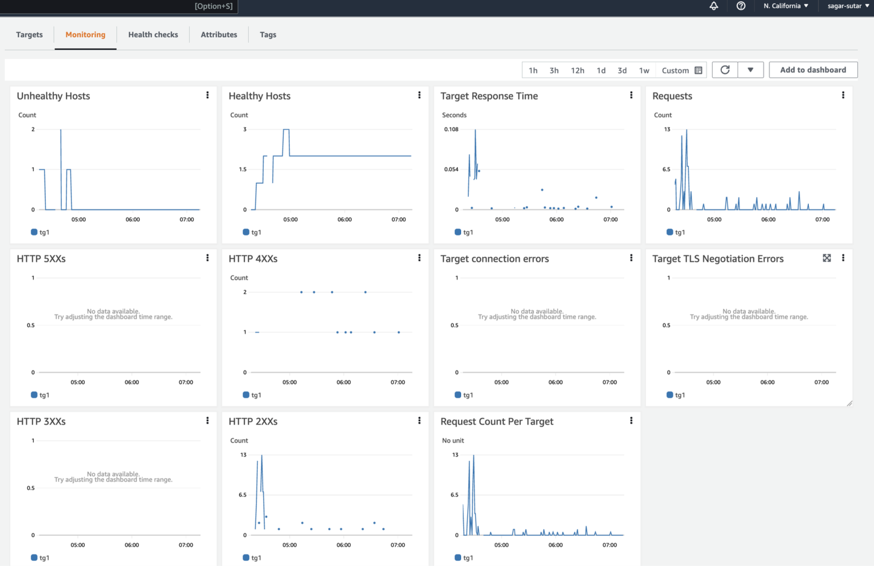
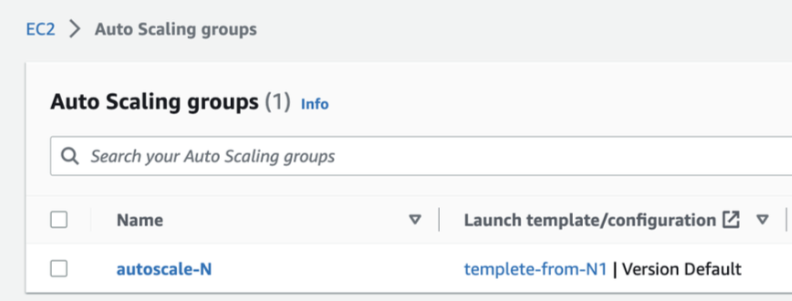
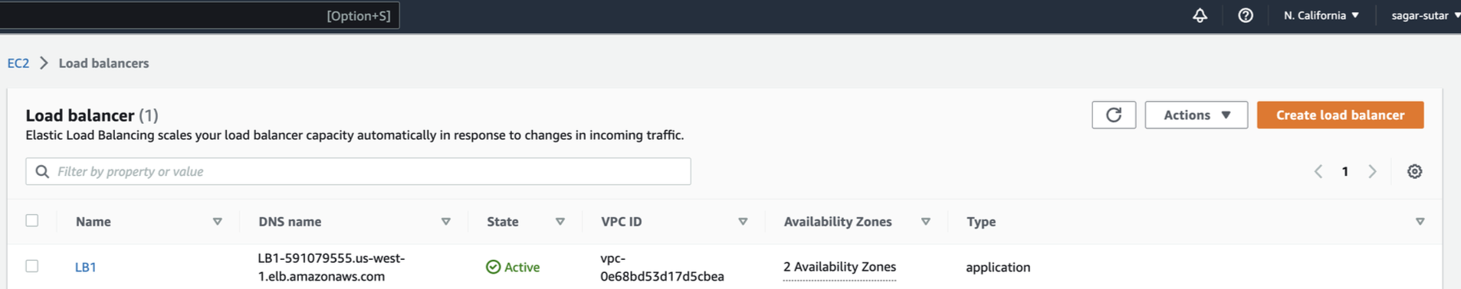
Autoscaling on AWS

Slide 13
Future Scope
Export the diagrams in PDF format
Schematic search in all exist diagram dataset
Integration with Google’s new Bard model with PaLM2

Slide 14
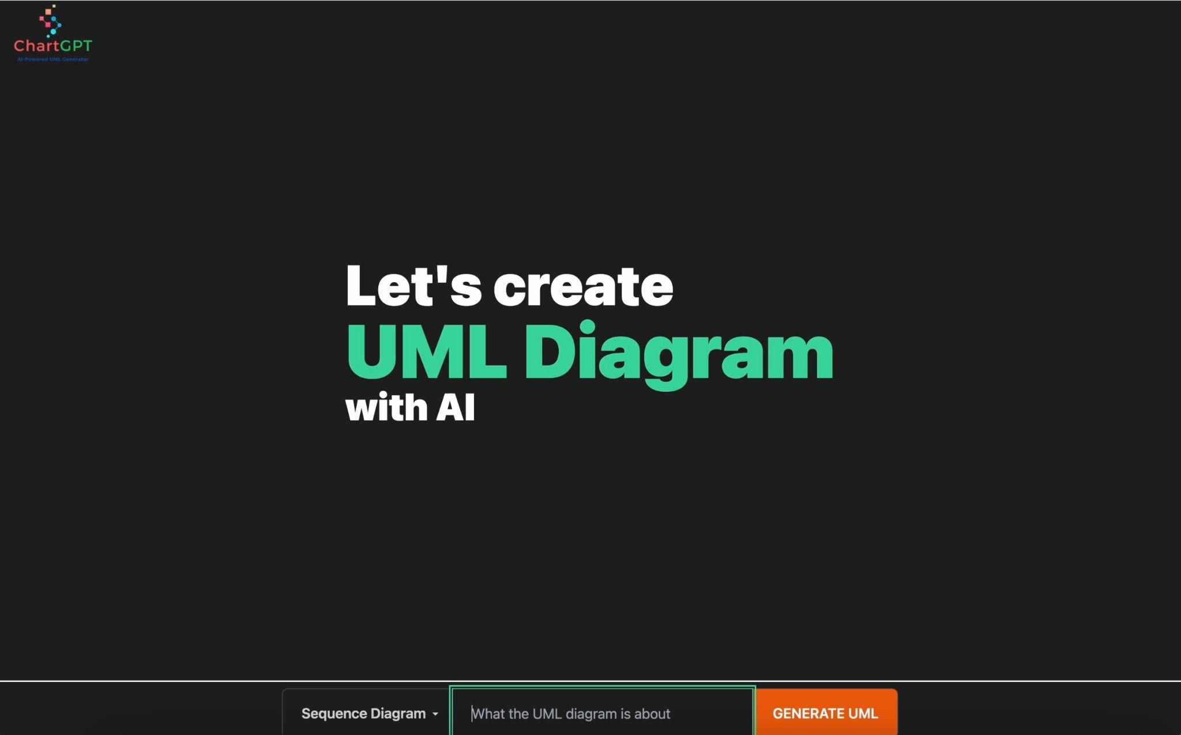
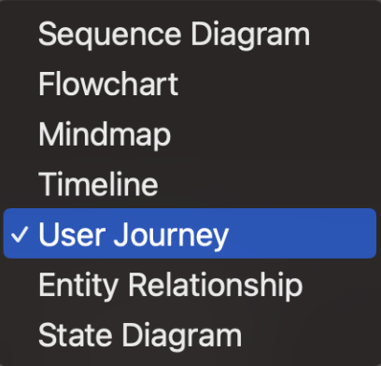
Demo and code

Slide 15
REFERENCES
Koc, Hatice & Erdoğan, Ali & Barjakly, Yousef & Peker, Serhat. UML Diagrams in Software Engineering Research: A Systematic Literature Review. Proceedings..
A Bibliometric Review of Large Language Models Research from 2017 to 2023 Lizhou Fan, Lingyao Li, Zihui Ma, Sanggyu Lee, Huizi Yu, Libby Hemphill
Talking About Large Language Models Murray Shanahan
Ray: A Distributed Framework for Emerging AI Applications Philipp Moritz, Robert Nishihara, Stephanie Wang, Alexey Tumanov, Richard Liaw, Eric Liang, Melih Elibol, Zongheng Yang, William Paul, Michael I. Jordan, and Ion Stoica, UC Berkeley
https://docs.ray.io/en/latest/serve/index.html
https://platform.openai.com/docs/introduction
https://docs.google.com/document/d/1tBw9A4j62ruI5omIJbMxly-la5w4q_TjyJgJL_jN2fI/preview
https://docs.google.com/document/d/1bYL-638GN6EeJ45dPuLiPImA8msojEDDKiBx3YzB4_s/preview
https://docs.ray.io/en/latest/rllib/rllib-algorithms.html
https://www.sciencedirect.com/topics/computer-science/distributed-machine-learning

Slide 16
Thanks!
Any questions?

