Slide 1


Hyper Velocity
and HVE Core
A shared approach to AI-assisted
software development
Julio Diaz
HVE Core developed by
11/03/2026

Slide 2

Hypervelocity Engineering and HVE Core
Hypervelocity Engineering
An approach to using AI across the software development lifecycle to accelerate work while applying engineering practices.
HVE Core
Microsoft’s framework and collection of reusable components for putting that approach into practice.
Julio Diaz

Slide 3
How HVE Core works
Building block
Purpose
Example
Agent
Provides a specialized role and guidance
DT Coach or RPI Agent
Instruction
Supplies applicable project or engineering guidance
A coding standard
Skill
Provides a reusable workflow
RPI research or planning
Artifact
Records task context and results
Research, plan, or review file
Julio Diaz

Slide 4
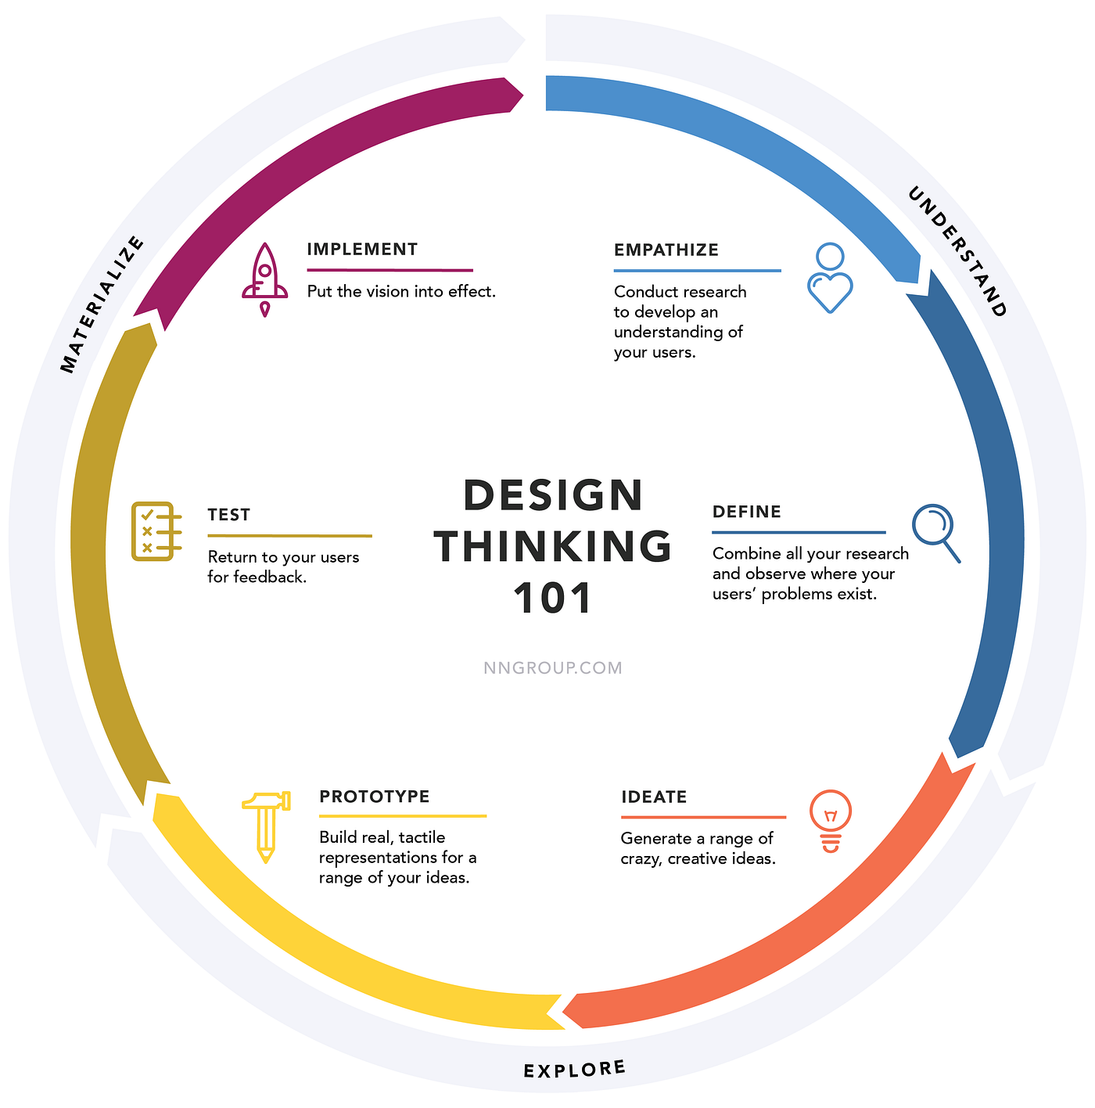
Design Thinking
A human-centered approach to understanding users and their needs, developing ideas, and testing solutions.
HVE Core
The DT Coach guides teams through methods across the problem, solution, and implementation spaces.
Julio Diaz

Slide 5
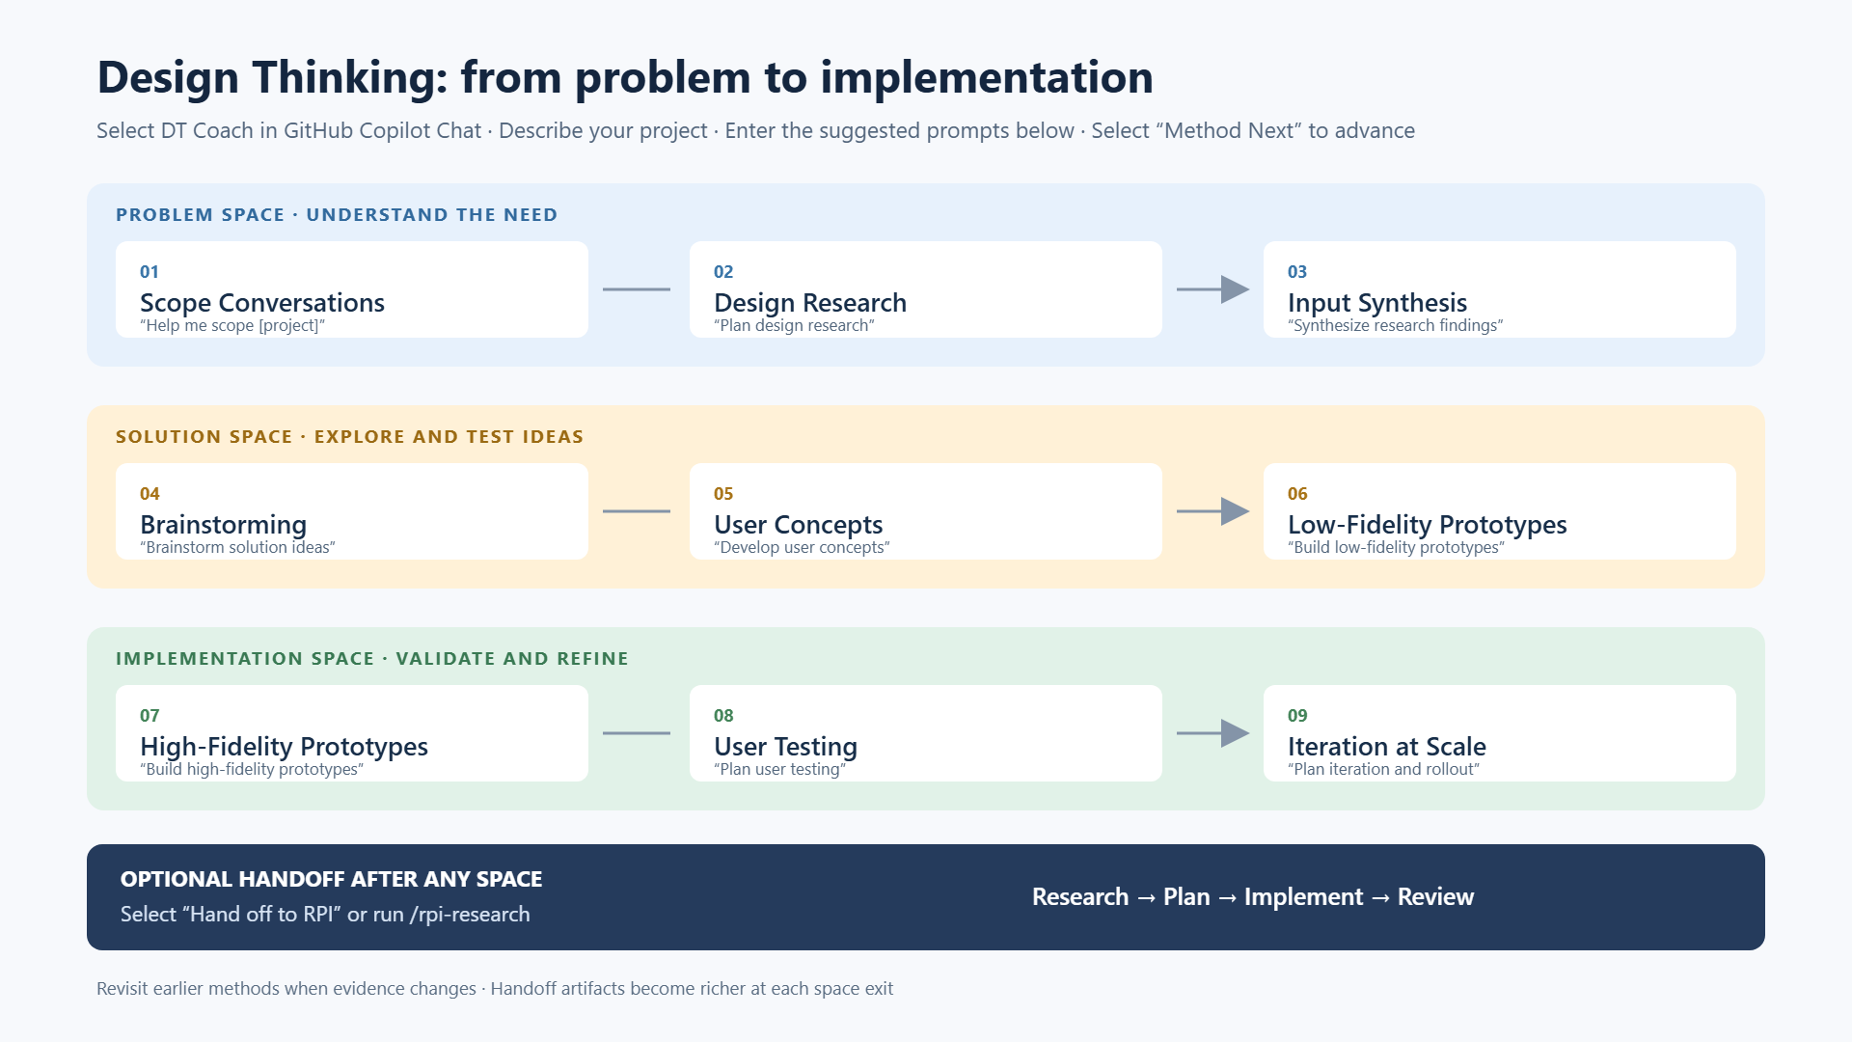

Slide 6
The RPI lifecycle
RPI structures complex engineering tasks around evidence, planning, implementation, review, and follow-up.
Research
Investigate evidence gaps and record findings
Plan
Define a sequenced, verifiable implementation strategy
Implement
Carry out approved work and record validation
Review
Optionally assess the result against acceptance criteria
Follow-up
Route defects, decisions, evidence gaps, or remaining work
Research is used when existing evidence is insufficient; not every task needs every activity.
Julio Diaz

Slide 7
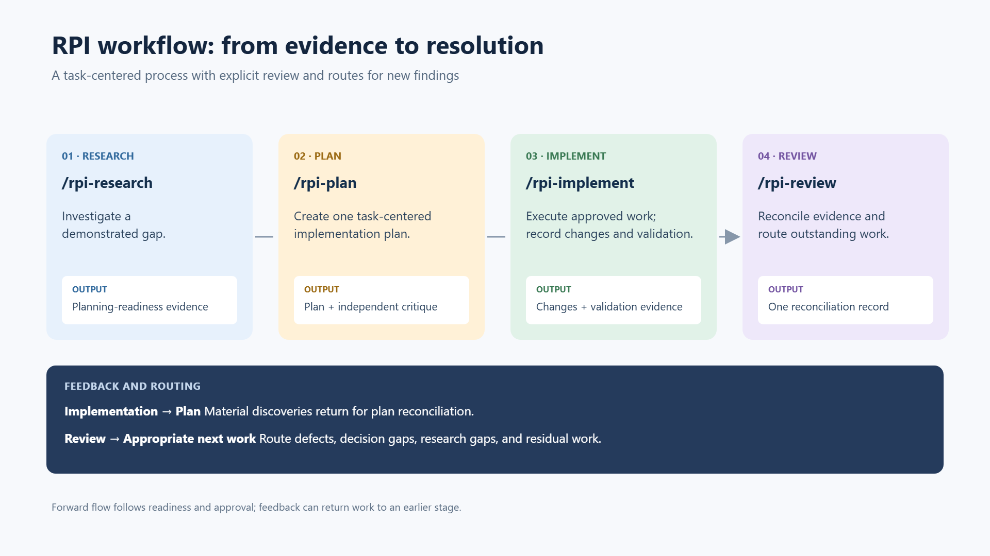

Slide 8
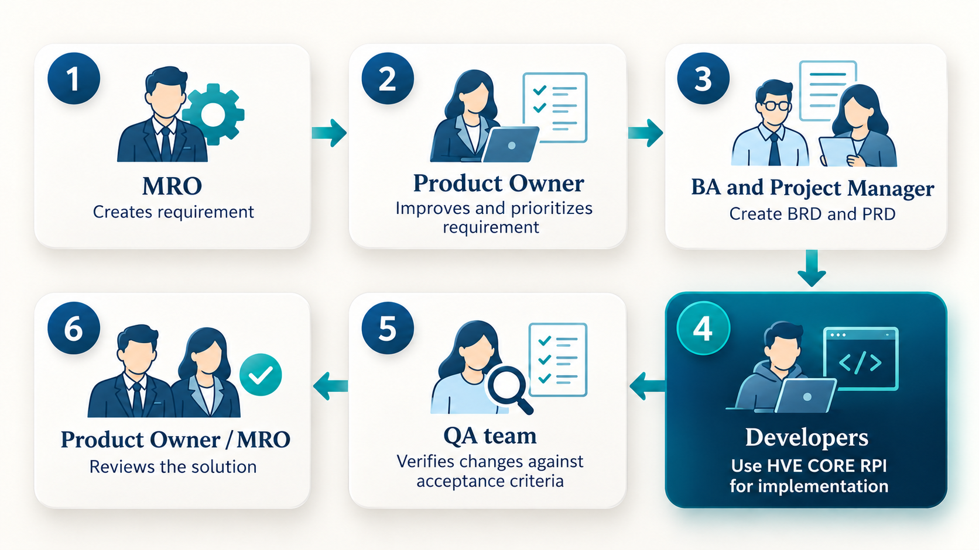
How this fits our current process
Our current process stays in place. Developers adopt HVE Core RPI for implementation.

Slide 9
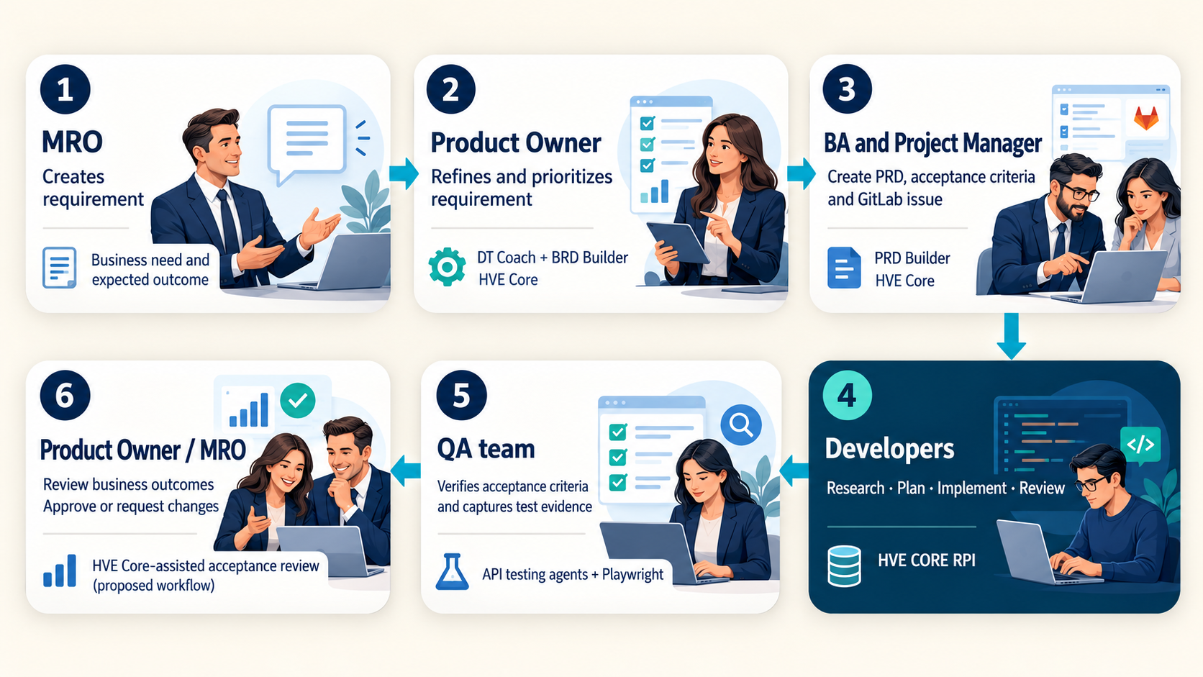
A possible future: AI across the SDLC
Stakeholders use HVE Core agents to support their work throughout the software development process

