Slide 1
Spec-Driven Development: Moving Beyond Vibe Coding
Implementing structured specifications to improve software quality

Slide 2

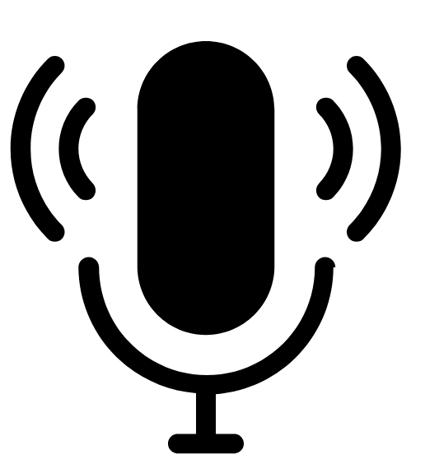
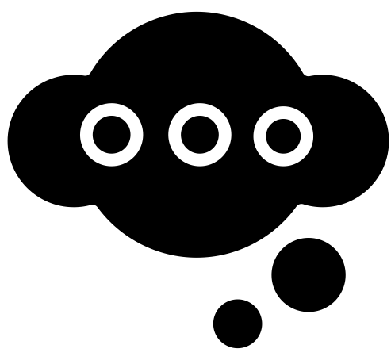
Ground Rules
Turn on your video and your mics (when speaking)
Jump in with your thoughts and questions
Notes:
Encourage collaboration.

Slide 3
Artificial Intelligence Maturity Model
8
7
Orchestrate
6
Supervise
5
Coordinate
4
Delegate
3
Workflow
2
Task
1
Off the shelf
Zero AI
Wave 1: Tools
Wave 2: Process
Wave 3: Agentic Operations
As trust increases, humans shift from doing to directing
3
Notes:
This is the maturity progression. Everyone is somewhere on here, both personally and in their department. This typically doesn't apply to an organization as a whole because it's domain-specific — your sales department may be in a different place than your engineering department.
Stage 0 (Zero AI): You don't use AI for work. Maybe you write a Valentine's note with ChatGPT, but that's not work output.

Slide 4

Class Agenda
Define Vibe Coding
Where does Vibe Coding break down?
Introduce Spec-Driven Development (SDD)
Test-Driven Development (TDD)
Introduce OpenSpec
OpenSpec Demo
OpenSpec Lab
Introduce BMAD (as time allows)
Notes:
This class is designed as a natural continuation of the existing “AI for Developers” training, which introduced large language models (LLMs), Prompt/Context engineering, agentic IDEs, and tools like Windsurf.
While those foundations focused on capabilities—what modern AI tools can do—this session deliberately shifts attention to workflow. As AI becomes more deeply embedded in daily development, the limiting factor is no longer access to powerful models, but the consistency and reliability of the development process itself.
Many teams experience a productivity spike when first adopting AI, followed by frustration as systems become harder to reason about, review, and evolve. This session exists to address that gap. Its goal is not to teach new AI features or prompts, but to explain how engineers can structure their work so that AI assistance produces predictable, reviewable, and maintainable outcomes. At a high level, this means moving away from ad‑hoc interactions with AI tools and toward workflows that make intent explicit and durable.
The emphasis is on conceptual with a brief opportunity for hands-on learning. Attendees should leave with a shared vocabulary, a clear understanding of why their current approach may not scale, and awareness of concrete tools, such as OpenSpec and BMAD, that operationalize a more disciplined approach called Spec‑Driven Development. The intent is to spark curiosity and alignment, preparing participants for deeper workshops or experimentation on their own teams.

Slide 5
What Is Vibe Coding?
1. Idea
3. AI Generates Code
4. Review Output
2. Prompt
Definition of Vibe Coding
Vibe coding is an informal AI-assisted coding method using iterative prompts and feedback loops.
Benefits of Vibe Coding
This approach enables fast prototyping and encourages creative momentum for quick results.
Limitations and Risks
Vibe coding relies on transient conversations, risking lost context and assumptions in long-term projects.
Best Use
Ideal for personal experiments and hackathons but less suited for shared or production codebases.
“There's a new kind of coding I call ‘vibe coding’, where you fully give in to the vibes, embrace exponentials, and forget that the code even exists.” (Andrej Karpathy)
Notes:
Vibe coding refers to an informal, improvisational style of AI-assisted development where engineers describe what they want in a prompt, review the generated code, provide feedback, and repeat this loop until something appears to work. This approach feels fast and intuitive, especially when paired with chat-based interfaces and powerful code-generating models.
For early exploration, prototypes, hackathon projects, and personal experiments, vibe coding can be genuinely effective. It minimizes upfront friction and encourages creative momentum by allowing developers to immediately see results and refine them. However, the core characteristic of vibe coding is that intent mostly lives in transient conversations rather than in durable artifacts. Each iteration often focuses narrowly on the current problem, implicitly relying on the AI to remember and respect earlier decisions. As a result, assumptions quietly accumulate, and constraints are reinterpreted or lost as the conversation evolves.
While this may not matter for throwaway work, it becomes risky as soon as code is shared with others, expected to evolve over time, or held to production standards. Understanding vibe coding as a valid but limited technique is essential to appreciating why more structured approaches exist. The problem is not that vibe coding is “wrong,” but that it optimizes for short-term speed at the expense of long-term clarity and stability.

Slide 6
Where Vibe Coding Breaks Down
Ideas get lost in iterative conversation (aka. context)
1. Idea
3. AI Generates Code
4. Review Output
2. Prompt
Intent Drift
Over time, AI systems may gradually diverge from the original project objectives, even when changes seem reasonable, leading to unintended outcomes.
Hidden Assumptions
Unstated requirements result in implicit decisions that are difficult to detect, making code reviews and future maintenance more challenging.
Fragile Context
Relying on chat history for context is fragile and prone to loss, often requiring repeated explanations and causing extra work.
Increased Debugging Efforts
Teams end up spending more time resolving issues and clarifying requirements than the time initially saved.
Notes:
As projects grow beyond trivial scope, vibe coding tends to reveal consistent failures. One of the most common is intent drift: with each new prompt and correction, the AI makes fresh assumptions to fill gaps in the request, sometimes overriding earlier decisions. Over time, the implemented behavior can subtly diverge from what was originally intended, even though each individual change seemed reasonable.
Another issue is the proliferation of hidden assumptions. Because requirements and constraints are not explicitly captured, the resulting code may encode choices that are invisible to reviewers and future maintainers. This makes code reviews harder, as reviewers see what was built but lack insight into why it was built that way or which alternatives were considered. Regression risk also increases, because modifying one area may accidentally undo behavior that was only implicitly specified.
Finally, when intent lives primarily in chat history, context is fragile. New team members, new AI sessions, or even a break of a few days can erase critical understanding. The cumulative effect is that teams spend more time debugging, re‑explaining requirements, and reworking features than they saved during initial implementation. These breakdowns are not caused by weak models; they are a consequence of an unstructured workflow.

Slide 7
What Is Spec-Driven Development (SDD)?
AI Assisted
Specify
Functional Spec (PRD)
Design
Technical Spec
Plan
Task List
Implement
Code Generation
Primary Source of Truth
SDD treats specifications as the main reference, guiding development before coding begins.
Lightweight and Iterative
Specs in SDD are lightweight, evolve iteratively, and closely align with ongoing development work.
Version Control for Intent
Specifications record evolving understanding like version control systems track code changes over time.
Alignment with AI Agents
Specs provide stable context that keeps humans and AI agents aligned beyond individual chat sessions.
If you don’t specify it, AI will invent it!
Notes:
Spec‑Driven Development is an approach that treats specifications as the primary source of truth in the development process. Instead of jumping directly from a prompt to code, teams first externalize intent in the form of explicit, reviewable artifacts that describe what the system should do and why.
In SDD, code is understood as an implementation detail—one possible realization of decisions that have already been articulated and agreed upon. This does not imply heavy documentation or waterfall-style upfront planning. Rather, specs are lightweight, iterative, and closely tied to actual development work. They evolve alongside the code and can be revised as understanding improves.
A useful way to think about SDD is as version control for intent: just as Git records how code changes over time, specifications record how understanding and requirements change. When AI agents are involved, this distinction becomes even more important. Specs provide stable context that persists beyond any single chat session, ensuring that both humans and machines are aligned. By making intent explicit, SDD reduces ambiguity, improves reviewability, and creates a shared reference point that supports collaboration and long-term maintainability.

Slide 8
What Makes a Good AI-Ready Spec
AI Assisted
Specify
Functional Spec (PRD)
Design
Technical Spec
Plan
Task List
Implement
Code Generation
Prioritize Clarity Over Detail
Effective AI specifications focus on clear, concise instructions that minimize ambiguity, rather than overwhelming with exhaustive implementation details.
Define Behavior with User Scenarios and Acceptance Criteria
Use concrete user scenarios paired with expected system responses and clear acceptance criteria to precisely outline what success looks like and to facilitate testing.
Set Boundaries with Constraints and Non-Goals
Explicitly state constraints and non-goals to prevent unwanted behaviors and ensure the AI operates within intended limits.
Maintain Living Documentation
Keep specs closely integrated with the codebase, regularly updating them in version control so they remain accurate, relevant, and reliable throughout development.
The Spec is ready when you and the model agree it’s ready!
Notes:
An effective AI‑ready specification focuses on clarity rather than volume. Its purpose is to reduce guesswork, not to exhaustively describe every implementation detail.
Key elements typically include clear behavioral descriptions, such as user scenarios and system responses, which define what success looks like from the outside. Acceptance criteria make these scenarios testable, providing concrete signals for both humans and AI agents to validate whether the work is complete. Constraints are equally important: non‑functional requirements related to performance, security, compliance, or architectural boundaries help prevent the AI from inventing solutions that are technically correct but contextually inappropriate. Explicit non‑goals or out‑of‑scope statements further reduce ambiguity by clarifying what should not be built.
Just as importantly, good specs live with the codebase. They are checked into version control, updated alongside implementation, and reviewed as part of normal development workflows. This proximity ensures that specs remain relevant and trusted, rather than becoming stale documents. When these elements are present, AI tools can operate with greater confidence and consistency, producing outputs that align with team expectations instead of improvising based on incomplete information.
SPECS LIVE WITH THE CODE BECAUSE THEY ARE JUST AS IMPORTANT AS THE CODE ITSELF!!!
RTCC
Role, Task, Context, Constraints

Slide 9
Test‑Driven Development (TDD) as a Guardrail for SDD
Making intent executable and enforceable
Why TDD Matters in Spec‑Driven Development
Specs Define Intent — Tests Enforce It
Tests turn written specifications into executable, verifiable contracts.
Helps to Prevents AI Intent Drift
Failing tests immediately surface when AI‑generated code diverges from the spec.
Shared Source of Truth
Specs describe what; tests prove what works — together they anchor behavior.
TDD + SDD = Stable AI‑Assisted Development
Before Code: Spec defines expected behavior
Before Implementation: Tests codify that behavior
During AI Coding: Tests constrain and validate AI output
Over Time: Regression tests preserve intent as systems evolve
Key Takeaway
TDD is not optional ceremony — it is the safety rail that keeps Spec‑Driven Development on track, especially with AI‑generated code.
Specs explain the system to humans. Tests explain it to machines — including AI.
Notes:
“Okay, specs sound good… but how do we stop AI from going off the rails?”
The answer is tests.
The big mindset shift here is this: Specs explain the system to humans. Tests explain it to machines — including AI.
So the takeaway isn’t “everyone must become a TDD purist.” The takeaway is: if you want AI to scale safely in real codebases, tests are the enforcement mechanism that makes Spec‑Driven Development stick.
Key takeaway: TDD isn’t optional ceremony in AI‑assisted development—it’s the safety rail that keeps Spec‑Driven Development from sliding back into vibe coding.
Brownfield Tip: The first thing to do with an existing codebase is ask an LLM to generate documentation. The second thing to do is ask it to generate unit tests.

Slide 10
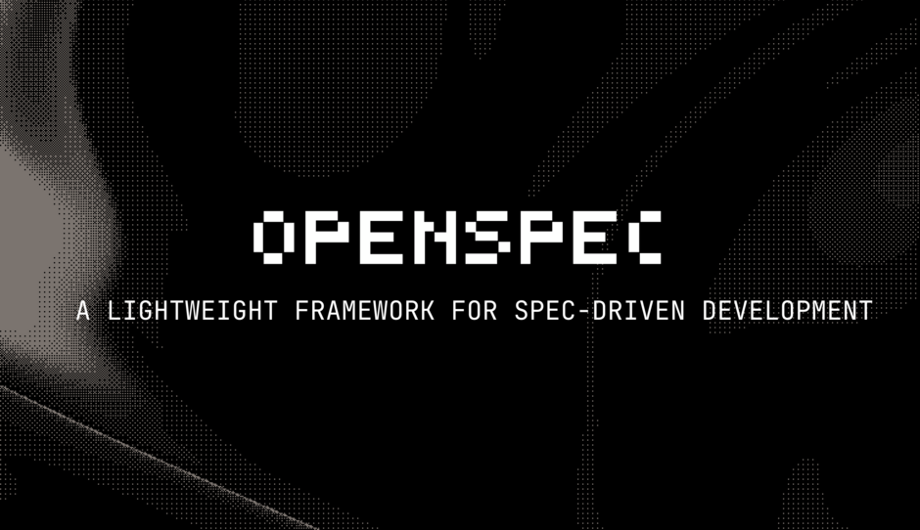
OpenSpec as Lightweight SDD
Lightweight Framework Benefits
OpenSpec adds minimal structure to capture development intent without heavy process overhead.
Integrated Specification Management
Specifications and changes are organized directly within the code repository as the source of truth.
Reviewing Intent Before Code
Explicit spec changes help reviewers understand change rationale before reading implementation code.
Tool-Agnostic Integration
OpenSpec integrates with AI coding assistants and existing tools, enabling incremental SDD adoption.
https://github.com/Fission-AI/OpenSpec
Notes:
OpenSpec is a lightweight framework designed to make Spec‑Driven Development practical and approachable, especially for individual developers and small teams. Its core value proposition is that it adds just enough structure to capture intent without imposing heavy process overhead.
OpenSpec organizes specifications and changes directly within the repository, ensuring that the source of truth for system behavior lives alongside the code. A typical workflow involves creating a proposal for a change, defining the corresponding specification updates or deltas, breaking the work into explicit tasks, and then implementing those tasks systematically.
One of OpenSpec’s strengths is its emphasis on reviewing intent before writing code. By making spec changes explicit, reviewers can quickly understand the scope and rationale of a change without reading every line of implementation. This reduces cognitive load and improves alignment across the team.
Because OpenSpec is tool‑agnostic and integrates with many AI coding assistants, it fits naturally into existing environments. In the context of this class, OpenSpec serves as a concrete example of how SDD can be adopted incrementally, offering immediate benefits without requiring a wholesale transformation of development practices.

Slide 11
OpenSpec Workflow (DEMO)
OpenSpec Workflow: Key Agents
3. Apply
4. Archive
2. Propose
1. Explore
OpenSpec-Explore
A phase where exploration and investigation can occur to inform proposals or refine specifications before formal application.
OpenSpec-Propose
This agent initiates the process by presenting a proposal that outlines the intended change and its objectives, fostering a clear and shared understanding among stakeholders. Tasks are then generated based on these specifications to ensure structured and manageable execution.
OpenSpec-Apply-Change
Following the proposal, the Apply agent updates or extends the specifications to define new behaviors, creating a precise contract that guides implementation.
OpenSpec-Archive-Change
Upon completion, the Archive agent stores the finalized changes and designates the updated specification as the definitive source of truth.
https://github.com/Fission-AI/OpenSpec/blob/main/docs/workflows.md
Notes:
The flow begins with a proposal that explains what is being changed and why, establishing shared understanding before any code is written. From there, the specification is updated or extended to reflect new behaviors or constraints, creating a clear contract for implementation. Tasks are then generated to translate the specification into manageable units of work. Only after these steps does implementation begin, guided by the agreed‑upon artifacts. Once the work is complete, the change is archived, and the updated specification becomes the new source of truth.
Walking through this sequence illustrates how OpenSpec transforms development from a conversational guessing game into an intent‑driven process. Even without writing code live, seeing the artifacts and their relationships helps attendees visualize how SDD reduces ambiguity and creates a durable trail of decisions that benefits both humans and AI agents over time.
Use the initial-prompt.md for the Bug Tracker App for the demo.
Supplementary sample prompt for /opsx-propose
# Initial Prompt
Build a small mobile-first, frontend web application called 'Runaway Mouse' as a digital entertainment toy for a cat on a touchscreen device. The application should display a mouse that 'runs away' to a new pseudo-random position when tapped, increment a visible counter, and support rapid taps without glitches. Make sure the mouse always stays on the screen regardless of the screen size. It needs to be responsive and follow a Test-Driven Development (TDD) approach. This is a demo for a SDD presentation about OpenSpec so make it fast and simple. To reiterate, focus on simplicity and speed of development for the demo.
## Architecture
- Vanilla JavaScript: No framework dependencies for maximum performance
- CSS3 Animations: Hardware-accelerated transitions for smooth movement
- Touch Events: Native touch event handling for responsive interaction
- Responsive Layout: Flexbox-based layout that adapts to any screen size

Slide 12
OpenSpec Group Lab (30 Minutes)
Create your own app using OpenSpec
1. Explore
3. Apply
4. Archive
2. Propose
Explore an idea:
openspec-explore
Create a proposal:
openspec-propose
Apply the change (generate the code):
openspec-apply-change
Archive the change:
openspec-archive-change
Notes:
Provide the initial-prompt.md file to learners. A reasonably strong model is best for generating specs. Good results from Claude Sonnet 4.6 (non-thinking) and GPT 5.4.
They can prompt as follows:
/opsx-propose create three proposals from @initial-prompt.md: create-bug, list-bugs, triage-bug.
Once the specs are created, they can inspect them. When ready they can move on to implement the first spec.
/opsx-apply create-bug
There should be a README on the root to give instructions on how to run the app. Once satisfied, they can archive the spec and move onto the next one.
/opsx-archive create-bug
/opsx-apply list-bugs
Etc…….

Slide 13

Key Takeaways and Next Steps
Limitations of Vibe Coding
Vibe coding offers initial speed and creativity but lacks long-term reliability for AI-driven software development. Intent Drift and Fragile Context are major drawbacks.
Spec-Driven Development Benefits
Spec-Driven Development balances AI assistance with disciplined engineering through explicit intent and durable context.
Don’t forget about Test-Driven Development
Incremental Adoption Tools
Tools like OpenSpec and BMAD enable incremental, pragmatic adoption of Spec-Driven Development for teams of varying sizes.
Notes:
The central message of this class is that while vibe coding offers speed and creativity at the start of a project, it is not sufficient as a long‑term strategy for building reliable software with AI. As such, it should be avoided as a primary method on client projects.
Spec‑Driven Development provides a way to retain the benefits of AI assistance while restoring engineering discipline through explicit, durable intent. Tools like OpenSpec and BMAD demonstrate that SDD does not have to be heavyweight or slow; instead, it can be incremental and pragmatic. OpenSpec offers an accessible entry point for individuals and small teams, while BMAD illustrates how the same principles extend to full lifecycle, team‑scale delivery.
The recommended next steps for attendees are intentionally modest: try introducing a lightweight spec for a single feature, observe how it changes review conversations, and evaluate whether more structured approaches make sense for your context. For teams interested in deeper adoption, hands‑on workshops and guided experimentation can build on the concepts introduced here. Ultimately, the goal is not to eliminate improvisation, but to ensure that when projects move beyond experimentation, intent is clear, shared, and built to last.

Slide 14
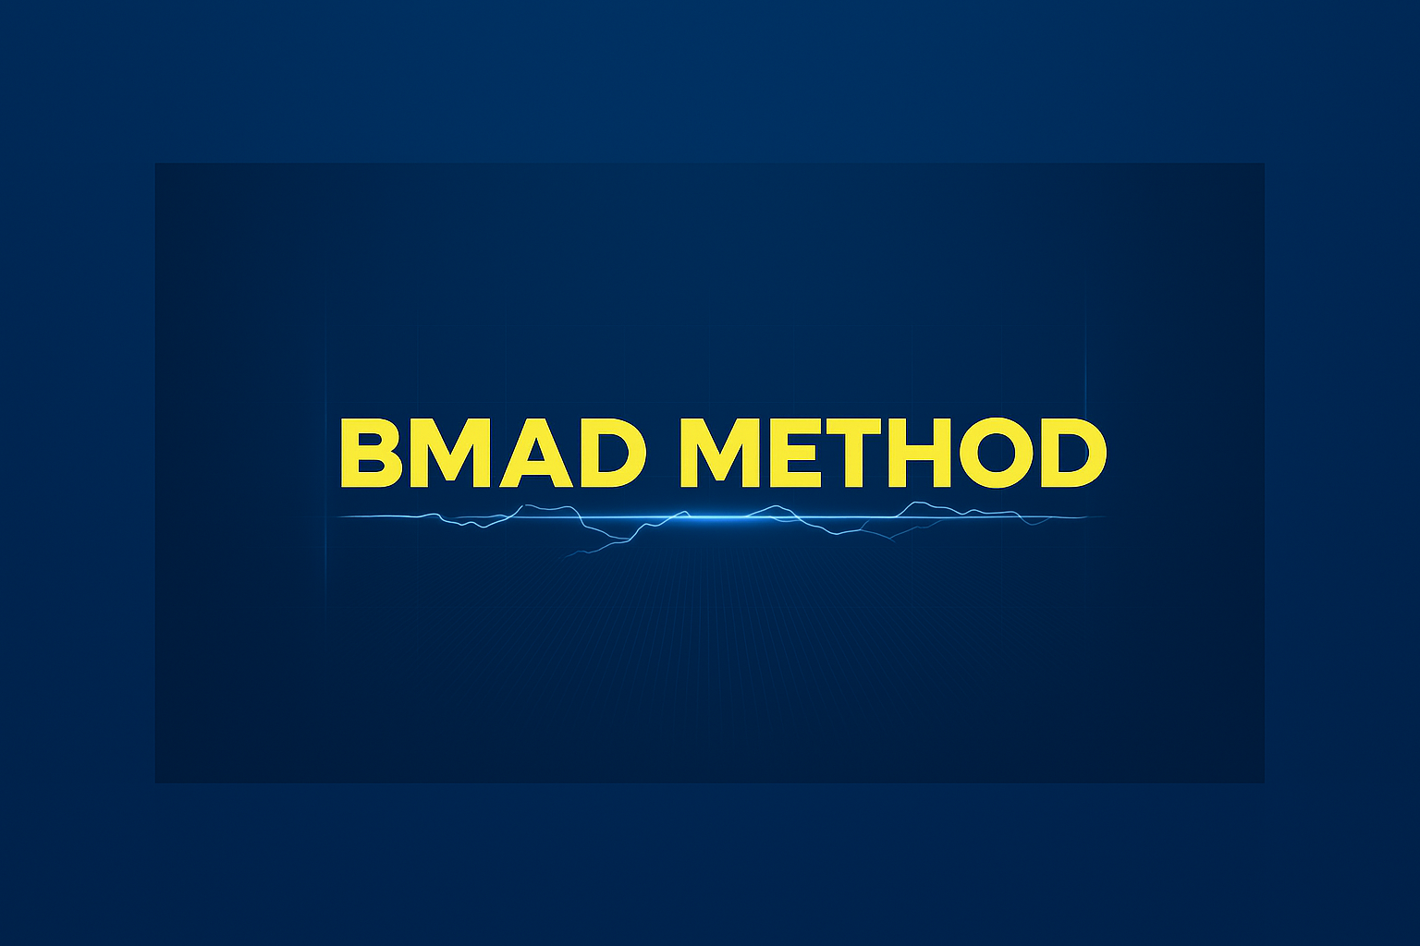
BMAD as Team-Scale SDD
Build More Architect Dreams
Role-Based Collaboration
BMAD uses specialized AI agents mirroring agile roles to collaborate with humans on core development artifacts.
Context Preservation
BMAD preserves context across development phases, reducing rework and improving predictability in AI-driven workflows.
Scalable Spec-Driven Development
BMAD scales Spec-Driven Development from individual use to team-scale for multi-contributor production systems.
https://docs.bmad-method.org/
Notes:
BMAD, the Breakthrough Method for Agile AI‑Driven Development, represents a more structured, team‑scale implementation of Spec‑Driven Development. While OpenSpec focuses on lightweight artifact management, BMAD emphasizes role‑based collaboration through specialized AI agents that mirror a real agile team.

Slide 15
BMAD Agent Personas
Meet your virtual Agile Scrum team!
Mary: Analyst
John: Product Manager
Winston: Architect
Bob: Scrum Master
Amelia: Developer
Quinn: QA Engineer
Barry: Quick Solo Dev
Sally: UX Engineer
Paige: Technical Writer
https://docs.bmad-method.org/reference/agents/
Notes:
In the BMAD approach, planning agents such as Analyst, Product Manager, Architect, and UX Designer collaborate with humans to produce core artifacts like product requirements, architectural decisions, and UX specifications. These artifacts then flow into an execution phase, where a Scrum Master agent transforms them into context‑rich story files. Developers and QA agents work from these stories to implement and validate features.
The key advantage of BMAD is context preservation across handoffs. Instead of re‑prompting a general AI with partial information at each step, BMAD ensures that decisions made earlier in the lifecycle are explicitly carried forward. This reduces inconsistency, improves predictability, and aligns AI behavior with established team practices.

Slide 16
BMAD Workflow at a Glance
Analysis (Mary)
Planning
Solutioning
Implementation
Brainstorm
Research
Product Brief
PRD (John)
UX Design (Sally)
Architecture (Winston)
Epics and Stories (John)
Readiness (John)
Sprint Planning (Bob)
Dev Story (Amelia)
Code Review (Amelia)
Correct Course (John)
Retrospective (Bob)
Create Story (Bob)
https://docs.bmad-method.org/reference/workflow-map/
Notes:
The bullets listed in yellow are the only steps where code is written. This is a huge departure from vibe-coding!
At a high level, the BMAD workflow can be understood as two connected phases: planning and execution. The planning phase focuses on understanding the problem and shaping intent through collaborative artifacts. Requirements are clarified, architectural boundaries are established, and UX considerations are addressed upfront, but in an iterative, conversational manner.
Once these artifacts reach an acceptable level of clarity, the execution phase begins. Here, detailed story files act as the operational bridge between planning and coding, embedding relevant context so that implementation can proceed with minimal ambiguity. This structure closely resembles how mature agile teams operate, but with AI agents actively participating in each role. In the context of this session, the goal is not to master BMAD, but to recognize how it embodies the principles of SDD at scale. Seeing the workflow at a glance helps developers understand when a more comprehensive framework may be appropriate, particularly in environments where coordination, governance, and long‑term maintainability matter.
For organizations building production systems with multiple contributors, BMAD demonstrates how SDD can scale beyond individual use.

