Slide 1
PRESENTATION ON IOT MINI PROJECT
TITLE: measuring the heart rate using Arduino
by:
Ashwini s u guide:
[1ox22mc007] d. puja Shashi
Impan K g PROF & HEAD
[1OX22MC017] DEPT OF MCA TOCE

Slide 2
Measuring heart rate using Arduino involves using sensors like photoplethysmography (PPG) or electrocardiography (ECG) to capture heartbeats. These sensors detect changes in blood volume or electrical activity, respectively. Arduino processes the sensor data and calculates the heart rate based on the time between beats, usually measured in beats per minute (BPM).
The aim of measuring heart rate using Arduino is to monitor and display a person's heartbeats in real-time. This can be useful for health and fitness applications, biofeedback, or medical monitoring. Arduino provides a platform for interfacing with sensors, processing data, and presenting heart rate information, enabling various applications in healthcare, sports, and wellness.

Slide 3
HARDWARE REQUIREMENT SPECIFICATION
ARDUINO UNO
HEART BEAT SENSOR
CONNECTING WIRES
BREADBOARD
OLED DISPLAY

Slide 4
Heartbeat sensor
A heart rate monitor is a personal monitoring device that allows one tomeasure one's heart rate in real time or record the heart rate for later study
Stethoscope and Electrocardiogram are the common apparatus to measureheart
beatsArduinobased heart rate monitoring is simply measured by placing thethumb over the subject’s arterial pulsation

Slide 5
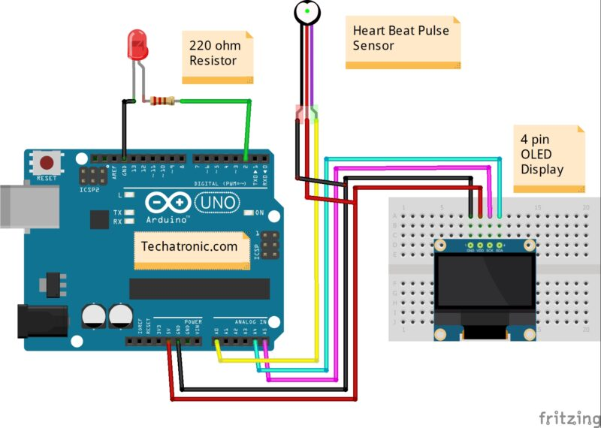
Circuit Diagram:

Slide 6
Thank you …

