Slide 1
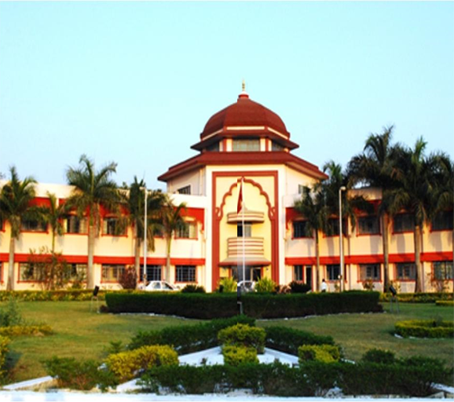



Army Institute of Technology Pune
With
Capgemini
Presents
TECHNOFROLIX - 2020

Slide 2

Army Institute of Technology
NIRF Rank 91 , A grade by NAAC and NBA accreditation.
Visited By A.P.J. Abdul Kalam, Padma Shri Milkha Singh.
KPIT 2019 won by AIT students and cash price of 10Lacks.
AIT Students secured the 2nd position in a HACKATHON conducted by NPCI, whole NEC Hackathon at IIT Delhi.
Best professional College award 2016-2017 by SPPU
AIT functions under the aegis of the Army Welfare Education Society (AWES) .
Record placement of 98% with avg. placement of 6 lacks

Slide 3

Computer society of india
Established in 1965 with 72 CSI Chapters,511 student branches with 10k+ dedicated members.
Consistent participation by AIT PUNE CSI BRANCH:
Workshop on Cloud for CSI Members.
FDP on Machine Learning and Image Processing sponsored by SPPU and in association with CSI.
3rd position at CSI Discover Thinking Programming Contest 2015.
2nd position at National Level Talent Hunt Event “IT Olympiad-2016” at COEP.

Slide 4
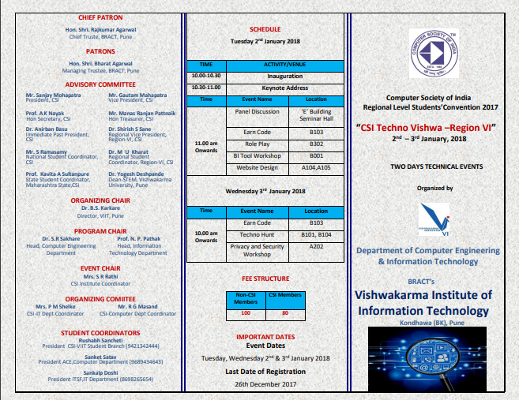


Previous Events of CSI pune chapter

Slide 5
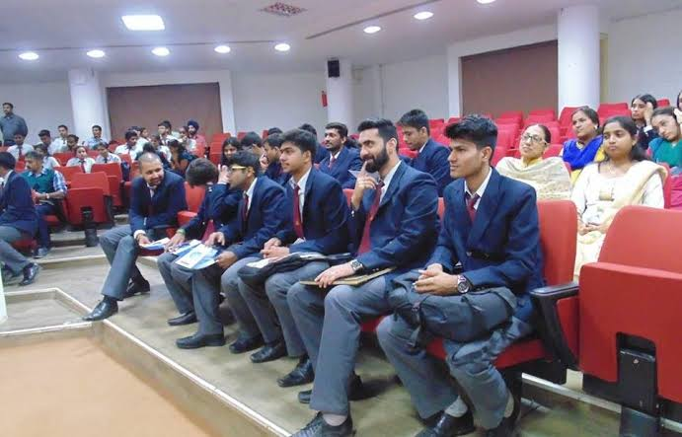
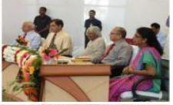

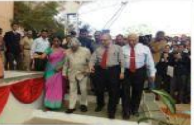
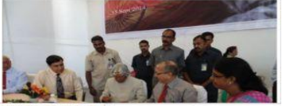
technofrolix
The annual CSI Regional-Level Project competition is one of the largest and one of its kind in Pune.
500+ Participants from all over India including prestigious colleges like COEP , PICT, MIT ,KIIT BHUVNESHWAR .
The event attracts hundreds of visitors to the campus annually.

Slide 6
80+ Colleges
What’s Special at Technofrolix?
Hosted in Association with CSI PUNE CHAPTER.
Eminent dignitaries from Industry are going to attended the
event.
Guest lecture on Cyber Security .
500+
Students
Events at Technofrolix:
Hardware Projects Demonstration
Software Projects Demonstration
Mainly targeted audience are students from colleges in and around Pune.
National Level Event

Slide 7

Themes
Agriculture & Rural Development
Health and Technology
Banking and finance
Transport
Cyber Security

Slide 8

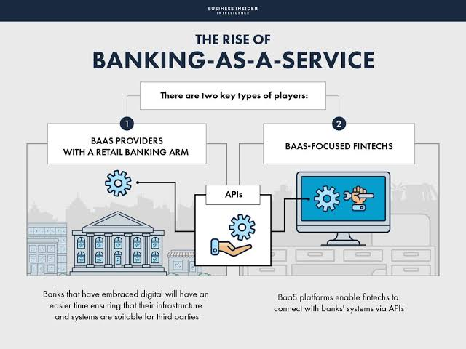




Themes

Slide 9
WHAT WE EXPECT
FROM YOU.
Capital for events.
Goodies / Merchandise.
T-shirts.
Certificates.

Slide 10
SPONSORSHIP BENEFITS
BENEFITS | TITLE SPONSOR | POWER SPONSOR | ASSOCIATE SPONSOR | EVENT SPONSOR
Name and logo on official invites/ Confirmation mails
Online Space on official pages on Social Media Platforms
Permission to put up stalls in fest area (6’x6’).
Advertisement in Annual magazine “SRIJNA”
Regular announcements about sponsor names during the event On the Radio club of AIT

Slide 11
BENEFITS | TITLE SPONSOR | POWER SPONSOR | ASSOCIATE SPONSOR | EVENT SPONSOR
Media coverage
Logo on main posters and banners of festival
Permission to put up promotional banners.
Logo and name on webpage
Promotions through flyers, flexes, social networking sites, SMS campaigns, etc.)
Logo and name on event specific posters
Name and logo on certificates
And Lots more………

Slide 12

POWER SPONSOR – Rs 100K
ASSOCIATE SPONSOR – Rs 60K
EVENT SPONSOR – Rs 40K
T-SHIRT SPONSOR – 300 Qt
SPONSORSHIP CATEGORIES

Slide 13
CONTACT US:
Coordinators:
Prof. Vaishali Ingale
+91 9371165218
Dr. Ashwini Sapkal
+91 9372172260
Saurabh Kumar
+91 7875226959
Deepak Kumar Chauhan
+91 7222820771
Notes:
S

Slide 14
THANK YOU

