Slide 1
Data Recovery
Techniques
By
Danny Seltzer
and
Evan Hollander

Slide 2

NOT a Data Recovery Technique

Slide 3
What is Data Loss?
Data has accidentally been erased or data control structures have been overwritten.
Data has been corrupted or made inaccessible.
Data is unable to be accessed from a previous functioning computer system or backup.

Slide 4
Common Computer Problems
Computer won’t boot up
Applications that are unable to run or load data
Hard drive crashes
Corrupt files or data
Accidental reformatting of partitions
Inaccessible drives and partitions
Media surface contamination and damage

Slide 5
What Causes Data Loss?
Sabotage
Natural Disaster
Hardware Error
Virus Attack
Human Error
  Intentional deletion
  Accidental overwriting of files
Software Corruption

Slide 6
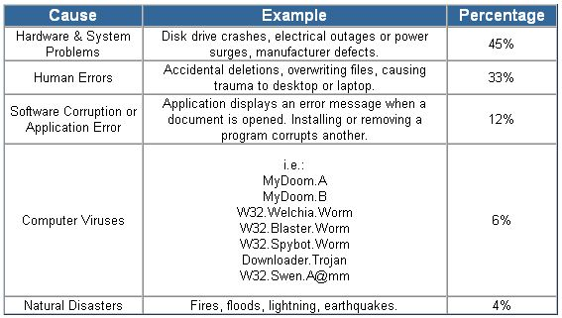
What Causes Data Loss?

Slide 7
How to Prevent Data Loss
Don’t upgrade hardware or software without having a backup
Physically secure your system from intruders
Use firewalls and virus protection
Be prepared for physical disasters

Slide 8


Things to Know About Data Loss
Data loss is disastrous at home, but for companies it causes setbacks in time and money.
“93% of companies that experience data loss for more than 10 days file for bankruptcy within one year of the disaster.”
If the data loss recovery is dealt with quickly or the necessary precautions are taken prior to any problem, the company could retrieve the data more easily or not experience a problem at all.

Slide 9
Data Recovery
The majority of data loss situations are recoverable.
Computer storage systems may fail, but the data stored on them is not always completely lost.
There are occasions when damage to data is permanent and complete data recovery is not possible. However, some data is usually always recoverable.
Data recovery professionals can recover data from crashed hard drives, operating systems, storage devices, servers, desktops, and laptops using various proprietary data recovery tools and techniques.

Slide 10
Data Recovery Tips
DO’s
  Backup your data frequently.
  If you believe there is something wrong with your computer shut it down, do not continue to power up because you may do more damage.
  If you here a clunk, clunk sound when you power up the drive, shut down! Do not panic nor turn the power button on and off.
  Package the drive properly when you send it in to a data recovery specialist. You can cause additional damage to the hard drive if it is poorly packaged.
DON’TS
  Do not ever assume that data recovery is impossible; even in the worst cases, such as natural disasters data recovery specialists have been able to retrieve valuable data.
  Never remove the cover from the hard drive; this will only cause further damage.
  Do not rest your computer on a moveable object or piece of furniture. Shock and vibration can result in serious damage to the hard drive.
  Do not subject the drive to extreme temperatures changes both hot and cold.
  In the case where a drive has been exposed to water, fire or even smoke do not try to power up.

Slide 11
Data Recovery Techniques
Use of software to recover data
Use of machines to recover data

Slide 12
Software Data Extraction
Data extraction is the process of moving data off of the imaged drive to another destination location.
Data extraction software scans sectors of the hard drive and restructures the file system either in memory or another hard drive.
The software can be used to copy the recoverable data to a destination location.

Slide 13
Software Recovery
Data loss can occur because the hard drive may have problems accessing the data it contains at a software or logical level.
By making a complete sector copy (an exact copy including all deleted information) of the hard drive, using a program such as Norton GHOST, most data recovery programs search for deleted MFT (Master File Table) entries to undelete files.
If the MFT is corrupt or defective, this method will not work. Some data recovery programs will ignore the MFT and search all of the unallocated clusters to try to find and recover files.

Slide 14
Data Recovery
The user may send a failed hard disk drive to a private data recovery company that offers secure and confidential data recovery.
The data recovery company will carefully perform part replacement of the heads, spindle motor and base casting, the electronics board, etc. in a clean room environment.
Part replacement has historically been successful for data recovery about 40%-60% of the time.

Slide 15
Data Recovery
When data is written to a medium, the head sets the polarity of most, but not all of the magnetic domains.
When a 1 is written to disk the media records a 1, and when a 0 is written the media records a 0. However the actual effect is closer to obtaining a 0.95 when a 0 is overwritten with a 1, and a 1.05 when a 1 is overwritten with a 1.

Slide 16
Data Recovery
Normal disk circuitry is set up so that both these values are read as ones, but using specialized circuitry it is possible to work out what previous "layers" contained.
The recovery of at least one or two layers of overwritten data isn't too hard to perform by reading the signal from the analog head electronics with a high-quality digital sampling oscilloscope, downloading the sampled waveform to a PC, and analyzing it in software to recover the previously recorded signal.

Slide 17
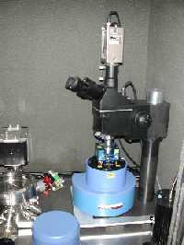
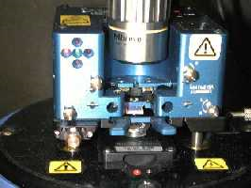
Data Recovery Techniques
Scanning Probe Microscopy (SPM)
A technique that is used to image and measure surfaces at the atomic level.
Scans an atomically sharp probe over a surface which produces a 3D topographic image of the surface at the atomic scale.

Slide 18
Data Recovery Techniques
Magnetic Force Microscopy (MFM)
MFM (Magnetic Force Microscopy) is a new technique which images the spatial variation of magnetic forces on a sample surface.
MFM is derived from scanning probe microscopy (SPM) and uses a sharp magnetic tip attached to a flexible cantilever for analysis.
An image of the field at the surface is formed by moving the tip across the surface and measuring the force.

Slide 19
Magnetic Force Microscopy (MFM)
Detectable old data will be present beside new data on the track which is usually ignored.
Together with software, MFM can see past various kinds of data loss/removal.
Each track contains an image of everything ever written to it, but each layer gets progressively smaller the earlier it was written.

Slide 20
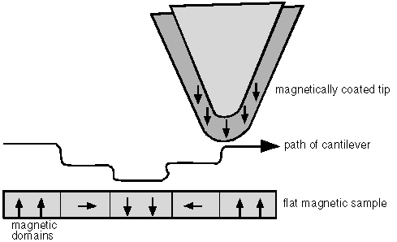
Magnetic Force Microscopy (MFM)
MFM looks at the minute sampling region to detect remnant magnetization at track edges.

Slide 21
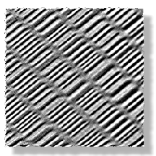
MFM image showing the bits of a hard disk

Slide 22
Data Recovery Techniques
Scanning Tunneling Microscopy (STM)
STM (Scanning Tunneling Microscopy) is a more recent variation of MFM which uses a probe tip typically made by plating nickel onto a pre-patterned surface.
The probe is scanned across the surface that is to be analyzed. STM measures a weak electrical current flowing between the tip and the sample. The image is then generated in the same way as MFM.

Slide 23


Slide 24
Summary
Individuals or companies may experience data loss at any time for many reasons.
There are various steps that should be implemented to help prevent data loss.
Data loss can be very costly and very upsetting.
There are several data recovery techniques that have proven to be successful or partially successful in recovering data.
Utilizing qualified professional data recovery specialists will aid in the degree of success of data recovery.

Slide 25
Bibliography
http://www.intellirecovery.com/data/recovery.html
http://www.data-recovery-info.com
http://mechmat.caltech.edu/~kaushik/park/1-3-0.htm
http://www.eng.yale.edu/reedlab/research/spm/spm.html
http://www.cs.auckland.ac.nz/~pgut001/pubs/secure_del.html
http://www.ebaumsworld.com
http://www.disklabs.com

