Slide 1
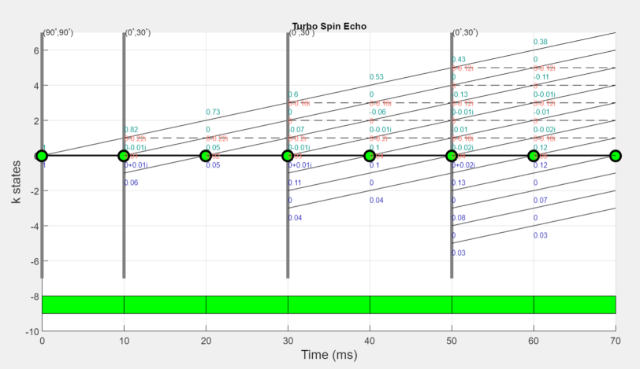
EPG Math
Gehua’s notes to accompany MATLAB EPG simulator
Weigel, Matthias. "Extended phase graphs: dephasing, RF pulses, and echoes ‐ pure and simple." Journal of Magnetic Resonance Imaging 41.2 (2015): 266-295.

Slide 2
INTRODUCTION
The extended phase graph (EPG) is a mathematical & graphical simulation tool for multi-echo MRI sequences
Correctly coded, it tells you the timing and intensity of an echo
In contrast to time-domain simulation, which numerically integrates the Bloch equations, EPG operates in the Fourier domain and employs matrices
Let’s dive into the math!

Slide 3
EPG Math: Assumptions and Overview
Spins are assumed to rotate counterclockwise (CCW) with regard to the +z axis, as opposed to what happens physically (clockwise - CW). So a positive gradient value leads to a faster CCW precession. This doesn’t change the echo timings and intensities. Everything spatial happens in a CCW rotational frame.
RF is modeled as instantaneous/hard pulses.
At some point we reduce from 3D to 1D. Our current code only works in 1D.
Three “populations”: F+(k), F-(k), Z(k) are acted upon by RF pulses, gradients, T1&T2 relaxation, motion, diffusion, etc., in discrete steps.

Slide 4
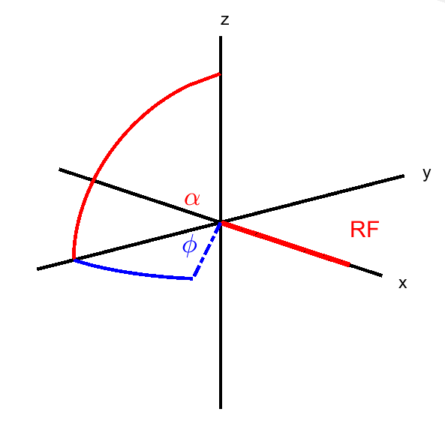

General rotation
In the Larmor-rotational frame:
Rotation around x represents RF with zero phase
Rotation around z represents dephasing
$$R_{x}\left(α\right)=\left(\begin{matrix}1 & 0 & 0 \\ 0 & cos α & −sin⁡α \\ 0 & \sin{α} & \cos{α}\end{matrix}\right)$$
$$R_{z}(φ)=\left(\begin{matrix}cos⁡φ & −sin⁡φ & 0 \\ sin⁡φ & cos⁡φ & 0 \\ 0 & 0 & 1\end{matrix}\right)$$

Slide 5

RF Pulse (with any phase Φ)
Let’s write out the rotation caused by an RF pulse with flip angle $α$ pointed +Φ from the +x axis:
$$R_{Φ}\left(α\right)=R_{z}\left(Φ\right)R_{x}\left(α\right)R_{z}\left(−Φ\right)$$

Slide 6

Defining M+,M- and Mz
To make describing dephasing easier, we use a complex representation of the x and y components of the 3D vector M:
$$M_{+}=M_{x}+iM_{y}$$
$$M_{−}=M_{x}−iM_{y}$$
$$M_{z}=M_{z}$$
M+ and M- are complex conjugates (therefore, redundant representation) and Mz remains the same between the real and complex representations.

Slide 7

Converting between real & complex representations
Change-of-basis matrices:
$S= \left(\begin{matrix}1 & +i & 0 \\ 1 & −i & 0 \\ 0 & 0 & 1\end{matrix}\right), S^{−1}=\frac{1}{2}\left(\begin{matrix}1 & 1 & 0 \\ −i & +i & 0 \\ 0 & 0 & 2\end{matrix}\right)$
So we have: $\left(\begin{aligned}M_{+} \\ M_{−} \\ M_{z}\end{aligned}\right)$ $=S\left(\begin{aligned}M_{x} \\ M_{y} \\ M_{z}\end{aligned}\right)$ , $\left(\begin{aligned}M_{x} \\ M_{y} \\ M_{z}\end{aligned}\right)$ $=S^{−1}\left(\begin{aligned}M_{+} \\ M_{−} \\ M_{z}\end{aligned}\right)$

Slide 8


Rotation matrices in complex representation
Let’s call them “T”
Then $T=S R{ S}^{−1}$
$T_{x}\left(α\right)=\left(\begin{matrix}\cos^{2}{\frac{α}{2}} & \sin^{2}{\frac{α}{2}} & −i\sin{α} \\ \sin^{2}{\frac{α}{2}} & \cos^{2}{\frac{α}{2}} & +i\sin{α} \\ −\frac{i}{2}\sin{α} & +\frac{i}{2}\sin{α} & \cos{α}\end{matrix}\right)$
$T_{z}\left(φ\right)=\left(\begin{matrix}e^{+iφ} & 0 & 0 \\ 0 & e^{−iφ} & 0 \\ 0 & 0 & 1\end{matrix}\right)$
$$T_{Φ}\left(α\right)=T_{z}\left(Φ\right)T_{x}\left(α\right)T_{z}\left(−Φ\right)= \left(\begin{matrix}\cos^{2}{\frac{α}{2}} & e^{2iΦ}\sin^{2}{\frac{α}{2}} & −ie^{iΦ}\sin{α} \\ e^{−2iΦ}\sin^{2}{\frac{α}{2}} & \cos^{2}{\frac{α}{2}} & +ie^{−iΦ}\sin{α} \\ −\frac{i}{2}e^{−iΦ}\sin{α} & +\frac{i}{2}e^{iΦ}\sin{α} & \cos{α}\end{matrix}\right)$$
So we can represent the effect of a general RF pulse with phase Φ on the complex magnetization as:
$${\left(\begin{aligned}{M_{+} \atop M_{−}} \\ M_{z}\end{aligned}\right)}^{′}=T_{Φ}(α)\left(\begin{aligned}{M_{+} \atop M_{−}} \\ M_{z}\end{aligned}\right)$$

Slide 9

Dephasing (z-rotation)
Transverse magnetization dephases when a gradient $\overset{⃑}{G} \left(t\right)$is applied
The extent of dephasing increases with time
Define: $\overset{⃑}{k}\left(t\right):=γ\int_{0}^{t}{\overset{⃑}{G}\left(τ\right)dτ}=(k_{x}\left(t\right),k_{y}\left(t\right),k_{z}\left(t\right))$ [rad/m]
Then, in the rotational frame, the complex transverse magnetization at any position is:
$M_{+}\left(\overset{⃑}{r}\right)=M_{+}e^{i\overset{⃑}{k}∙\overset{⃑}{r}}$ where $\overset{⃑}{r}=(x,y,z)$
Note: when the gradient is constant, k increases linearly in time

Slide 10


Into the Fourier Domain!
What are these?
3D Fourier transform of the complex magnetization components!
$\overset{⃑}{r}$ : 3D spatial location
* Integral happens over 3D volume
* At k = 0, F+(0) is simply the net magnetization of the entire volume
* This transformation is LINEAR !
$$F_{+}\left(\overset{⃑}{k}\right)=\iiint{M_{+}(\overset{⃑}{r})e^{−i\overset{⃑}{k}∙\overset{⃑}{r}}d^{3}r}$$
$$F_{−}\left(\overset{⃑}{k}\right)=\iiint{M_{−}(\overset{⃑}{r})e^{−i\overset{⃑}{k}∙\overset{⃑}{r}}d^{3}r}$$
$$Z\left(\overset{⃑}{k}\right)=\iiint{M_{z}(\overset{⃑}{r})e^{−i\overset{⃑}{k}∙\overset{⃑}{r}}d^{3}r}$$

Slide 11

More about F+, F-, and Z
Fact: $F_{−}\left(k\right)=F_{+}^{∗}(−k)$
What do F-(k) and Z(k) represent?
$F_{+}\left(k\right)$: Amount of x-y magnetization that aligns with dephasing order k (meaning, the complex exponential term would be perfectly cancelled at all points in space!)
$F_{−}\left(k\right)$ : Amount of conjugate x-y magnetization that aligns with dephasing order k
(equivalently, conjugate of the amount of x-y magnetization that aligns with order –k)
$Z\left(k\right)$ : longitudinally stored z magnetization at dephasing order k
At k = 0, everything is in phase.
If a gradient is applied, k changes with time (see gradient operator slides).

Slide 12



















EPG Math: Operators
Now we are ready to tackle the 3 basic operations that happen to the populations F+(k),F-(k), Z(k)
They are: (1) RF pulse (2) Gradients (3) Relaxation
RF pulse
Gradient
Relaxation
$$F_{+}(k)$$
$$(Φ, α)$$
$$F_{+}^{′}(k)$$
$$F_{+}$$
$${ F}_{+}$$
$$F_{+}(k)$$
$${∙e}^{−\frac{t}{T_{2}}}$$
$$F_{−}(k)$$
$$F_{−}^{′}(k)$$
$$F_{−}$$
$$F_{−}$$
$$F_{−}(k)$$
$${∙e}^{−\frac{t}{T_{2}}}$$
*Pink term only applies to k=0
$$Z$$
$$Z(k)$$
$${∙e}^{−\frac{t}{T_{1}}}+M_{0}(1−e^{−\frac{t}{T_{1}}})$$
$$Z(k)$$
$$Z^{′}(k)$$
$$Z$$
k
k+1

Slide 13

RF Operator
Amazingly, since the 3DFT is linear, our RF rotation operator in Fourier representation is the SAME MATRIX $T_{Φ}(α)$! (prove it yourself):
${\left(\begin{aligned}F_{+}(k) \\ F_{−}(k) \\ Z\left(k\right)\end{aligned}\right)}^{′}$ $<= \left(\begin{matrix}\cos^{2}{\frac{α}{2}} & e^{2iΦ}\sin^{2}{\frac{α}{2}} & −ie^{iΦ}\sin{α} \\ e^{−2iΦ}\sin^{2}{\frac{α}{2}} & \cos^{2}{\frac{α}{2}} & +ie^{−iΦ}\sin{α} \\ −\frac{i}{2}e^{−iΦ}\sin{α} & +\frac{i}{2}e^{iΦ}\sin{α} & \cos{α}\end{matrix}\right)\left(\begin{aligned}F_{+}(k) \\ F_{−}(k) \\ Z(k)\end{aligned}\right)$
At each RF, the 3 populations are redistributed among each other, forming a maximum of 9 paths, the weights of which are in the T matrix.

Slide 14

RF: examples
T(x,90)
$$\left(\begin{matrix}0.5 & 0.5 & −i \\ 0.5 & 0.5 & i \\ −0.5i & 0.5i & 0\end{matrix}\right)$$
T(y,180)
$$\left(\begin{matrix}0 & 1 & 0 \\ 1 & 0 & 0 \\ 0 & 0 & −1\end{matrix}\right)$$
Check that these make sense physically!

Slide 15
Gradient Shift Operator
Gradients shift up or down the k-order of all populations as time goes by.
In practice, we can use an integer (Δk=-2,-1,0,1,2,3, etc.) step and define it to be the effect of a constant gradient over our (Δt) interval.
We shift all values to a higher k if G > 0 and a lower k if G < 0.

Slide 16

How to apply gradients
We represent 1D (F+(k),F-(k),Z(k)) in a matrix:
$Ω=\left(\begin{matrix}F_{0} & F_{1} & ⋯ & F_{K} \\ F_{0}^{∗} & F_{−1}^{∗} & ⋯ & F_{−K}^{∗} \\ Z_{0} & Z_{1} & ⋯ & Z_{K}\end{matrix}\right)$ where $F_{k}=F_{+}\left(k\right), Z_{K}=Z(k)$
Suppose k changes by +1 in our time interval Δt, then the populations shift in the following way :
$F_{k+1}^{t+Δt}←F_{k}^{t}$
Hence, the number of columns increase as gradients are applied over time, because either a higher k (G>0) or a lower –k (G<0) is being generated.

Slide 17

Time for Echoes!
RF remixes $(F_{k},F_{−k}^{∗},Z_{k})$, within the same k
Gradients exchange populations across different k’s
Where is our echo?
THE ASSUMPTION: nonzero k generates no signal (spins are all dephased to some extent)
Therefore, we define an echo in the EPG context to happen
At timings where $F_{0}=F_{0}^{∗}$ is nonzero
With intensity ${|F}_{0}|$.
They can be easily retrieved from our stored matrices over time!

Slide 18

Relaxation Operator
T1 and T2 relaxation are happening any time we deviate from the equilibrium magnetization
Need to model them in EPG! Let’s write it out. Over an interval Δt,
$M_{z}\left(t+Δt\right)=M_{0}+\left(M_{z}(t)−M_{0}\right)e^{−\frac{Δt}{T_{1}}}$
$M_{+}\left(t+Δt\right)=M_{+}\left(t\right)e^{−\frac{Δt}{T_{2}}}$
If we transform them into the Fourier domain…

Slide 19

Relaxation operator
After time Δt:
$F_{+}\left(k,t+Δt\right)=\int{M_{+}\left(x,t\right)e^{−\frac{Δt}{T_{2}}}e^{−ikx}dx}=e^{−\frac{Δt}{T_{2}}} F_{+}(k,t)$
$Z\left(k,t+Δt\right)=\int{{(M}_{0}+\left(M_{z}(k,t)−M_{0}\right)e^{−\frac{Δt}{T_{1}}})e^{−ikx}dx }=\int{M_{0}e^{−ikx}dx+\int{M_{z}(k,t)}e^{−\frac{Δt}{T_{1}}}e^{−ikx}dx−\int{M_{0}}e^{−\frac{Δt}{T_{1}}}e^{−ikx}dx = }$
$$\left\{\begin{aligned}e^{−\frac{Δt}{T_{1}}}Z\left(k,t\right), k≠0 \\ e^{−\frac{Δt}{T_{1}}}Z\left(k,t\right)+M_{0}\left(1−e^{−\frac{Δt}{T_{1}}}\right), k=0\end{aligned}\right.$$

Slide 20

Relaxation Operator: final form
Let $E_{1}=e^{−\frac{Δt}{T_{1}}}, E_{2}=e^{−\frac{Δt}{T_{2}}}$
For k ≠ 0:
$${\left(\begin{matrix}F_{k} \\ F_{−k}^{∗} \\ Z_{k}\end{matrix}\right)}^{′}←\left(\begin{matrix}E_{2} & 0 & 0 \\ 0 & E_{2} & 0 \\ 0 & 0 & E_{1}\end{matrix}\right)\left(\begin{matrix}F_{k} \\ F_{−k}^{∗} \\ Z_{k}\end{matrix}\right)$$
For k = 0:
${\left(\begin{matrix}F_{0} \\ F_{0}^{∗} \\ Z_{0}\end{matrix}\right)}^{′}←\left(\begin{matrix}E_{2} & 0 & 0 \\ 0 & E_{2} & 0 \\ 0 & 0 & E_{1}\end{matrix}\right)\left(\begin{matrix}F_{0} \\ F_{0}^{∗} \\ Z_{0}\end{matrix}\right)+M_{0}$ $\left(\begin{matrix}0 \\ 0 \\ 1−E_{1}\end{matrix}\right)$

Slide 21
Limitations to the current EPG scripts we have
Since k is represented by an index, only regular intervals can be simulated. Arbitrary intervals may be approximated, but it can significantly increase simulation duration.
It only works for uncoupled spin ½ spin system (e.g. hydrogen) (ref. Weigel 2015).
So far, our algorithm enables 1D gradient shifts (k is a scalar, not a 3D vector). This gradient can represent one of two things: off-resonance effects (those that are cancelled by spin echo), or frequency encoding in a single direction.
Motion effects (coherent motion & diffusion) are yet to be included.

Slide 22

Example: Turbo Spin Echo
Let’s simulate a multi - spin echo sequence!
Suppose we use a (phi=0,alpha=90) RF Pulse for the initial excitation and 2 x (phi=0, alpha=180) pulses with spacings [10ms, 20ms]to generate spin echoes. Suppose T1= 1000 ms, T2 = 100 ms.
Initially, $Ω\left(0\right)={\left[0,0,1\right]}^{′}$
90⁰
180⁰
180⁰
We expect 2 spin echoes at 20 ms and 40 ms.
Their intensities should lie on the T2 decay curve.
0
10 ms
20 ms
30 ms
40 ms
t

Slide 23

First RF pulse, gradient, and relaxation
Let’s denote the unit gradient shift by G and the relaxation operator by R
$Ω\left(1\right)=T_{x}\left({90}^{∘}\right) Ω\left(0\right)=\left({−i \atop \begin{aligned}i \\ 0\end{aligned}}\right)$ // all of z is converted into x,y (t=0)
$Ω\left(2\right)=G\left(Ω\left(1\right)\right)=\left(\begin{matrix}0 & −i \\ 0 & 0 \\ 0 & 0\end{matrix}\right)$ // Shift by dk = 1 (t=10ms)
$Ω\left(3\right)=R\left(Ω\left(2\right)\right)=\left(\begin{matrix}0 & −0.905 i \\ 0 & 0 \\ 0.01 & 0\end{matrix}\right)$// decay in xy takes place; (t=10ms) recovery in z happens only for k = 0

Slide 24

Second RF pulse, gradient, relaxation ->echo
$Ω\left(4\right)=T_{x}\left({180}^{∘}\right)Ω\left(3\right)=\left(\begin{matrix}0 & 0 \\ 0 & −0.9048 i \\ −0.01 & 0\end{matrix}\right)$
// we get nonzero F(-1) population! (t = 10 ms)
$Ω\left(5\right)=G\left(Ω\left(4\right)\right)=\left(\begin{matrix}0.9048 i & 0 & 0 \\ −0.9048 i & 0 & 0 \\ −0.01 & 0 & 0\end{matrix}\right)$
// gradient causes F(-1) to shift to F(0); an echo is generated, but we haven’t accounted for relaxation yet! (t = 20 ms)
$Ω\left(6\right)=R\left(Ω\left(5\right)\right)=\left(\begin{matrix}0.8187 i & 0 & 0 \\ −0.8187 i & 0 & 0 \\ 0.0001 & 0 & 0\end{matrix}\right)$
// relaxation - >first echo strength of ~82% @ t = 20ms

Slide 25

Gradient, relax, & 3rd RF pulse
$Ω\left(7\right)=G\left(Ω\left(6\right)\right)=\left(\begin{matrix}0 & 0.8187 i & 0 \\ 0 & 0 & 0 \\ 0.0001 & 0 & 0\end{matrix}\right)$
// grad @ t = 30 ms (i.e. effecting the gradient during t = 20~30 ms)
$Ω\left(8\right)=R\left(Ω\left(7\right)\right)=\left(\begin{matrix}0 & 0.7408 i & 0 & 0 \\ 0 & 0 & 0 & 0 \\ 0.01 & 0 & 0 & 0\end{matrix}\right)$
// relax @ t = 30 ms (i.e .effecting the T1, T2 decay during t= 20~30 ms)
$Ω\left(9\right)=T_{x}\left({180}^{∘}\right)Ω(8)=\left(\begin{matrix}0 & 0 & 0 & 0 \\ 0 & 0.7408 i & 0 & 0 \\ −0.01 & 0 & 0 & 0\end{matrix}\right)$
// second 180-deg pulse @ 30 ms

Slide 26

Last gradient, relax, and echo!
$Ω\left(10\right)=G\left(Ω\left(9\right)\right)=\left(\begin{matrix}−0.7408 i & 0 & 0 & 0 & 0 \\ 0.7408 i & 0 & 0 & 0 & 0 \\ −0.01 & 0 & 0 & 0 & 0\end{matrix}\right)$
$Ω\left(11\right)=R\left(Ω\left(10\right)\right)=\left(\begin{matrix}−0.6703 i & 0 & 0 & 0 & 0 \\ 0.6703 i & 0 & 0 & 0 & 0 \\ 0 & 0 & 0 & 0 & 0\end{matrix}\right)$
// 2nd spin echo happens @ 40 ms with 67% intensity
Check for yourself that the echo values lie on the decay curve for M0 = 1 and T2 = 100 ms.

Slide 27
MATLAB Implementation
Coded by Sairam & Gehua
See the manual and function headers for details!
List of core functions:
rf_rotation(phi,alpha)
grad_shift(omega)
relax(t,T1,T2)
EPG_custom
display_epg
In addition, specific sequences (titled EPGsim_X.m) have been implemented which you can set the parameters of and run conveniently.

Slide 28
