Slide 1
SAFe
(Scaled agile framework)

Slide 2
SAFe
SAFe is an agile framework for software development. It provides simple, lightweight experience for the development team. The whole framework is divided into four segments Portfolio, Value stream, Program and Team.
Version 1.0 was the first official release in 2011. The latest version is 4.0, was released in January 2016.
It’s based on Lean and Agile principles.
It’s designed to meet the needs of all stakeholders within an organization.
It is Agile framework at its core, but can expand to fulfill the need of large system development.

Slide 3
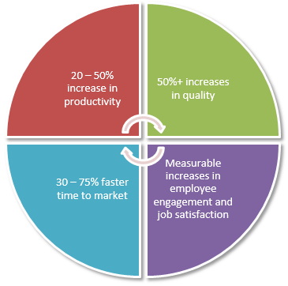
Isn’t simple Agile enough? Why SAFe?
Well, let see what simple Agile offers?

Slide 4
Agile is
Incremental
Customer feedback can be incorporated at any time.
1 – 4 weeks sprint
5 – 9 team members including developers, tester, Scrum master, Product owner and Tech lead.
Plan -> Do -> Check -> Adjust
Works fine for 5 – 7 teams
But……
when there are large number of teams running their own way of agile implementation but facing obstacles, delays and failures.
when teams want to work independently.
when you want to scale Agile at organizational level but don’t know how?
Here comes SAFe(Scaled Agile Framework) to help us achieve the above obejctives.

Slide 5
Epic Owner
Portfolio
EA
EA – Enterprise architect
Value Stream
VSE
SM
SA
VSE – Value Stream Engineer
SM – Solution Management
SA – Solution Architect
PM
RTE
SA
Program
Business owners
System
team
PM – Product Management
RTE – Release Train Engineer
SA – System Architect
SM
Development team
Team
Scrum
PO
SM – Scrum Master
PO – Product Owner

Slide 6
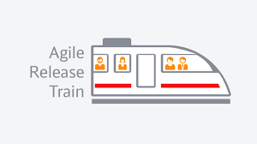
Portfolio
$ $ $
Value Stream
Program
50-125
50-125
Team
5-9
5-9
5-9
5-9
5-9
5-9
5-9
5-9

Slide 7
Team Level
Roles/Teams | Events | Artifacts
Agile team | Sprint planning | Team backlog
Product owner | Backlog - grooming | Non – functional requirements
Scrum master | Daily stand - ups | Team PI objectives
 | Execution | Iterations
 | Sprint demo | Stories
 | Sprint retrospective | Sprint goals
 | IP sprints | Built – in quality
 |  | Spikes
 |  | Team kanban

Slide 8
Program Level
Roles/Teams | Events | Artifacts
DevOps | PI (program increment) planning | Vision
System Team | System Demos | Roadmap
Release management | Inspect and adopt workshop | Milestones
Product management | Architectural runway | Releases
UEX architect | Release anytime | Program epics
Release Train Engineer(RTE) | Agile Release Train | Program backlog
System Architect/Engineer | Release | Non – functional requirements
Business owners |  | Feature
Lean – agile leaders |  | Enabler
Communities of practice |  | Solution
Shared services |  | Value Stream Coordination
Customer |  | Program PI objectives

Slide 9
Value Stream Level
Roles/Teams | Events | Artifacts
DevOps | Pre and Post PI planning | Vision
System team | Solution Demos | Roadmap
Release management | Inspect and adopt workshop | Milestone
Solution management | Agile Release train | Releases
UEX architect |  | Value stream epics
Release Train Engineer (RTE) |  | Value stream backlog
Solution Architect |  | Non – functional requirements
Shared services |  | Capability
Customer |  | Enabler
Supplier |  | Solution context
 |  | Agile architecture
 |  | Economic framework

Slide 10
Portfolio Level
Roles/Teams | Events | Artifacts
Enterprise architect | Strategic investment planning | Strategic themes
Program portfolio mgmt. | Kanban portfolio (Epic) planning | Enterprise
Epic owners |  | Portfolio backlog
 |  | Portfolio Kanban
 |  | Non – functional requirements
 |  | Epic and enabler
 |  | Value stream
 |  | Budgets

Slide 11
Time boxing
PI
(10 weeks)
Program
2 weeks
Team
PI – Program Increment

Slide 12
EPIC
EPIC
EPIC
EPIC
Organizational Strategy
Portfolio
Portfolio backlog
Capabilities
Capabilities
Value Stream
Value stream backlog
Feature
Feature
Program backlog
Program
PI Plan
Team
PI Objective
PI Objective
PI Objective
Team backlog
Team backlog
Team backlog

Slide 13
SAFe recommendation
Continuous collaboration between Program management and Scrum masters (scrum of scrum) or product owners to remove any obstacles.
At the end of every two week sprint, system integration will be done to make a demo-able working software.
We keep doing this incremental development at team level until the last sprint.

Slide 14
Last Sprint
In last sprint, we don’t do any development instead it is reserved for IP (Innovation and planning sprint).
It is kept to do innovations, hardening, hackathons.
The most important is, we plan for next PI in the last sprint.
An Inspect and adapt event is planned and all 50 – 125 members are required to attend the event to see where the system is headed.

Slide 15
Thank You!

