Slide 1

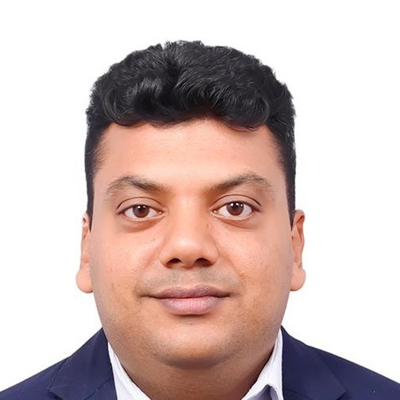
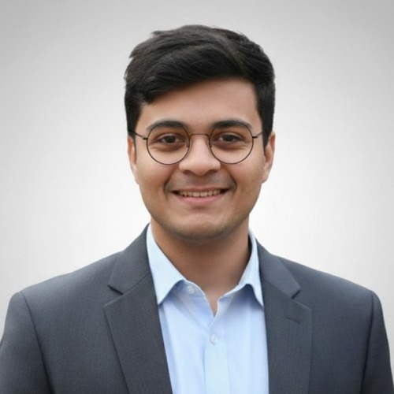

THE FOUNDING TEAM
47 years of scale, financial rigor and 0→1 execution
Two operators who have each put 10,000+ workers to work, and a finance leader who rose from intern to Director at EY
THE SCALE OPERATOR
THE FINANCE GUARDIAN
THE 0→1 BUILDER
Sutanu Dutta
Vaibhav Kedia
Rahul Luthra
Co-founder & CEO · 19 yrs
Co-founder & CFO · 19 yrs
Co-founder · 9 yrs · 2x Founder
MBA, IIM Raipur · B.Com (Hons), SRCC
CA (ICAI) · B.Com (Hons), SRCC
B.Com (Hons) · CS coursework (ICSI)
11,000+
5.3×
19 yrs
Top 10
10,000+
20+
associates deployed
staffing revenue, $2M → $11M
at EY, intern → Director
Fortune & Sensex 30 audits led
gig workers onboarded at Swiggy
cities launched for Swiggy
PREVIOUSLY
WORKED WITH
PREVIOUSLY
Truxapp · Rivigo · HT Media · Peel Works
Amazon · Airtel · ITC · Siemens · Intel · Epson · Happiest Minds
Swiggy · Mitr.work (Founder) · Abacus
Won $16M contracted value from Reliance & ITC; ran a $25M distribution P&L
1x founder: RG Medicare, opened Bangladesh & Oman corridors
On core team that closed a $2.4M seed from Elevar Equity
Leads Big 4 audits of Fortune 500 & listed companies; team of ~25
Delivered a QIP; leads an IPO engagement
Steered global restructuring of an e-commerce MNC (IFRS, US GAAP, SOX)
Scaled two businesses from zero as a 2x founder
Mitr.work: 400+ delivery partners a month for Swiggy, Zomato & Zepto
Built North India staffing at Abacus from scratch to 200+ on payroll
1→100 Scaling
Ops Leadership
Finance & Audit
Big 4 Rigor
0→1 Enabler
GTM
Expansion & Launch
Cross-Border Ops
Nationwide P&L
IPO & Capital Markets
Hiring priorities at close: technology / AI, nurse education and corridor operations. Discussions under way; no offers rolled out yet.
Triple Arrow Global | Confidential · As represented by management from founders’ résumés and profiles; not independently verified. ₹ converted at ₹95/$. Vaibhav’s 19 years include 3 as an intern.
15
Notes:
Founder roles and backgrounds as represented by management. Founder names link to their professional profiles.
Sutanu Dutta (19 years; ex-Truxapp, Rivigo, HT Media, Peel Works; 1x founder) and Rahul Luthra (9 years; ex-Swiggy; 2x founder) are full-time. Vaibhav Kedia joins full-time at close and is a Director at EY until then. Senior technology / AI, nurse-education and operations candidates are in discussion. No offers have been accepted.
Sources: each founder's résumé or professional profile, supplied by the founder. Not independently verified. Sutanu's rupee figures at ₹95/$: staffing revenue ₹20 Cr to ₹106 Cr ($2M to $11M, 5.3×); ₹150 Cr of contracted value ($16M); ₹240 Cr distribution P&L ($25M). Vaibhav's 19 years at EY include 3 years as an intern; clients include Amazon, Airtel, ITC, Siemens, Intel, Epson and Happiest Minds. Rahul's 10,000+ onboarding and 98.6% serviceability are from his Swiggy role (2019–2023).

