Slide 1






IBM ACADEMIC COLLABORATION PROGRAM
Smart Warehouse
Inventory Tracker
A Smart Inventory Management Solution using Java and Object-Oriented Programming
By: Rajeev Ranjan (2B – ERP_11103)
Program:
B.Tech CSE (Artificial Intelligence & Machine Learning)
Academic Partner:
IBM SkillsBuild / IBM Academic Collaboration
Industry Mentor
Mr. Santanu Sasmal
IBM Subject Matter Expert (SME)
Notes:
Welcome to the Smart Warehouse Inventory Tracker presentation. This project has been developed by Rajeev Ranjan as part of the IBM Academic Collaboration Program, under B.Tech CSE (AI & ML). This solution automates warehouse inventory management using Java and Object-Oriented Programming principles, guided by Mr. Santanu Sasmal, IBM Subject Matter Specialist.

Slide 2








Introduction
Warehouse Operations
INVENTORY ANALYTICS
Inventory management is a critical component of modern warehouse operations.
99.8%
3x
Manual Challenges
Accuracy Rate
Faster Tracking
Traditional manual tracking is time-consuming and highly prone to human errors.
247
Real-Time
Business Need
Products Managed
Stock Visibility
Businesses require efficient, real-time stock monitoring and visibility systems.
Smart Solution
This project automates inventory tracking and streamlines stock management workflows.
IBM SkillsBuild | B.Tech CSE (AI & ML) | Rajeev Ranjan
Notes:
This slide introduces the core problem statement. Inventory management is vital for any warehouse operation. Manual methods are inefficient and error-prone. Modern businesses need automated, real-time solutions. This project addresses these challenges through a Java-based smart inventory system.

Slide 3

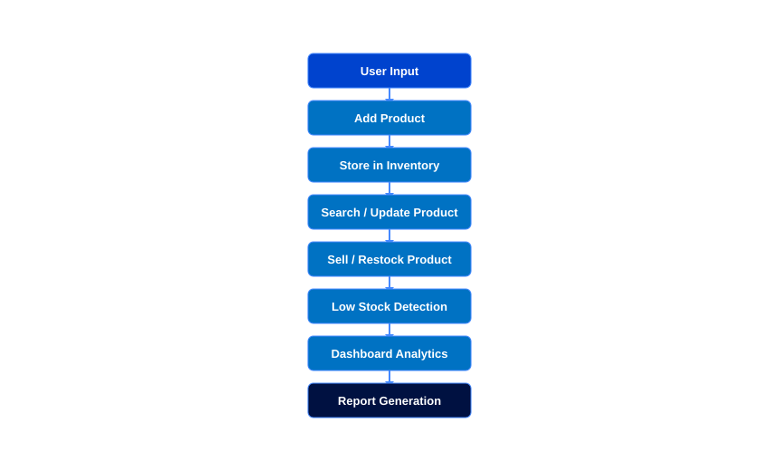







Working of the Project
KEY FEATURES
Product Management
Inventory Tracking
Low Stock Alerts
Dashboard Statistics
Product Search
Inventory Value Calc
Report Export
Data Persistence
IBM SkillsBuild | B.Tech CSE (AI & ML) | Rajeev Ranjan
Notes:
This slide explains the project workflow and key features. The flowchart shows the complete data flow from user input through product management, inventory operations, to report generation. Eight key features are highlighted: Product Management, Inventory Tracking, Smart Low Stock Alerts, Dashboard Statistics, Product Search, Inventory Value Calculation, Report Export, and Data Persistence.

Slide 4

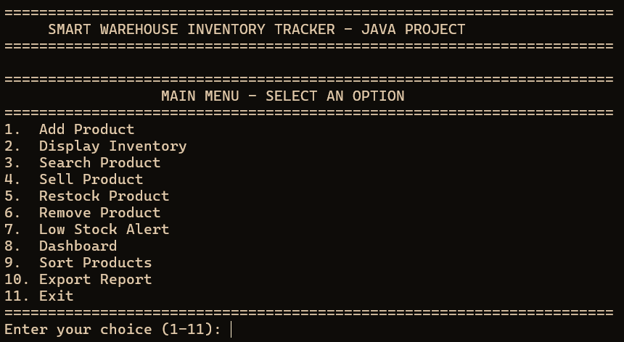
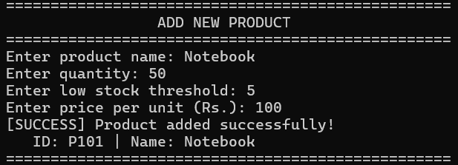
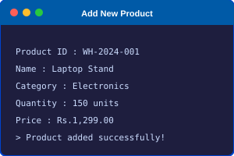
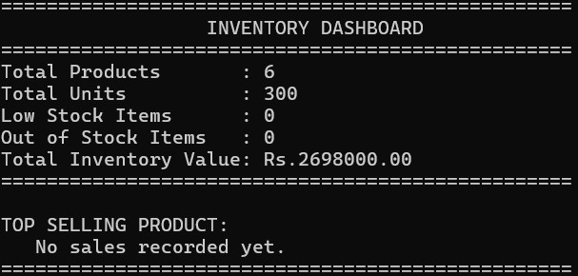
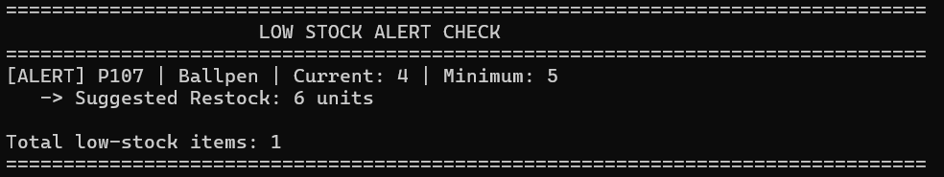
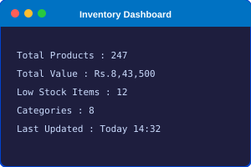
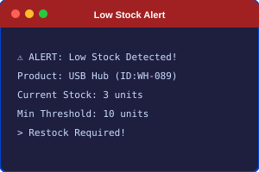
Project Demonstration
Main Menu Screen
Add Product Screen
Command-line navigation interface
New inventory entry form
Inventory Dashboard
Low Stock Alert
IBM SkillsBuild | B.Tech CSE (AI & ML) | Rajeev Ranjan
Notes:
This slide demonstrates the four core screens of the Smart Warehouse Inventory Tracker. The Main Menu provides easy navigation. Add Product screen allows entering new inventory items. The Dashboard displays real-time analytics. The Low Stock Alert screen shows automated notifications when inventory falls below minimum thresholds.

Slide 5









Conclusion and Future Scope
CONCLUSION
FUTURE SCOPE
Successfully developed a smart inventory tracking solution
Database Integration (MySQL)
Barcode / QR Code Support
Improved inventory visibility and real-time stock monitoring
AI-based Demand Forecasting
Applied Object-Oriented Programming concepts effectively
Cloud Deployment (IBM Cloud)
Multi-Warehouse Management
Demonstrated AI-driven automation in warehouse systems
Mobile Application Integration
IBM SkillsBuild | B.Tech CSE (AI & ML) | Rajeev Ranjan
Notes:
This slide summarizes what was achieved and outlines the roadmap ahead. The project successfully delivered a smart inventory system with OOP principles. Future enhancements include database integration with MySQL, QR/barcode scanning, AI-driven demand forecasting, cloud deployment on IBM Cloud, multi-warehouse support, and mobile app integration.

Slide 6




Thank You
for Your Time and Attention
Special Acknowledgment: Mr. Santanu Sasmal — IBM Subject Matter Expert (SME)
B.Tech CSE (AI & ML) • IBM Academic Program • By Rajeev Ranjan
Notes:
This concluding slide wraps up the Smart Warehouse Inventory Tracker presentation. Special thanks to Mr. Santanu Sasmal, IBM Subject Matter Specialist, for his invaluable guidance throughout this project. This presentation was created by Rajeev Ranjan as part of the B.Tech CSE (AI & ML) program under IBM Academic Collaboration.

