Slide 1
Sentiment Analysis from Roman-Urdu Text

Slide 2
Agenda
01
02
Introducation
Problem Statement
03
Methodology
04
Execution Screenshots
05
06
Conclusion
Live Demo

Slide 3
Introduction
Sentiment analysis is the process of extracting opinions and emotions in text, in order to track attitudes and feeling of the people
Sentiment classification has so many uses that are beneficial in business, marketing, and boosting product sales by recognizing the feedback given by clients

Slide 4
Problem Statement
Tweets
Service Reviews
Product Reviews

Slide 5
Methodology
01
02
Pre-Process Data
Dealing with Stop words
04
03
Vectorization
Tokenization
06
05
Encode the Labels
Model Selection

Slide 6
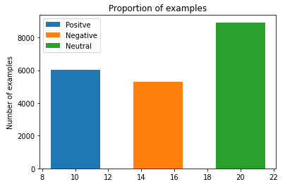
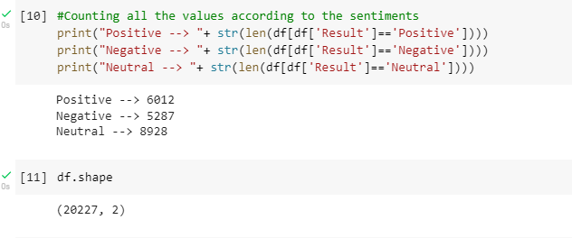
Dataset Records

Slide 7
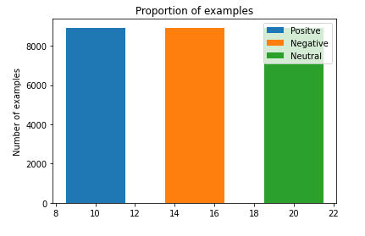
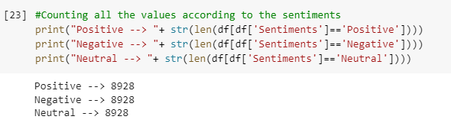
Dataset Records

Slide 8
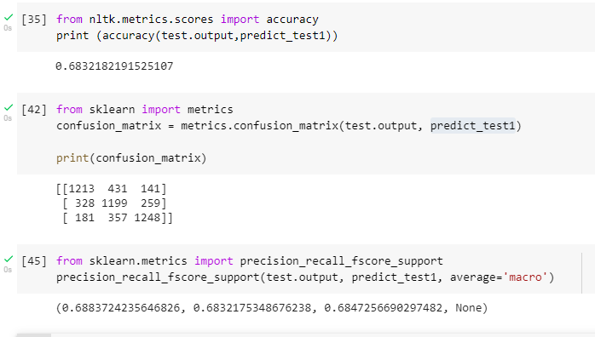
Model Evaluation

Slide 9
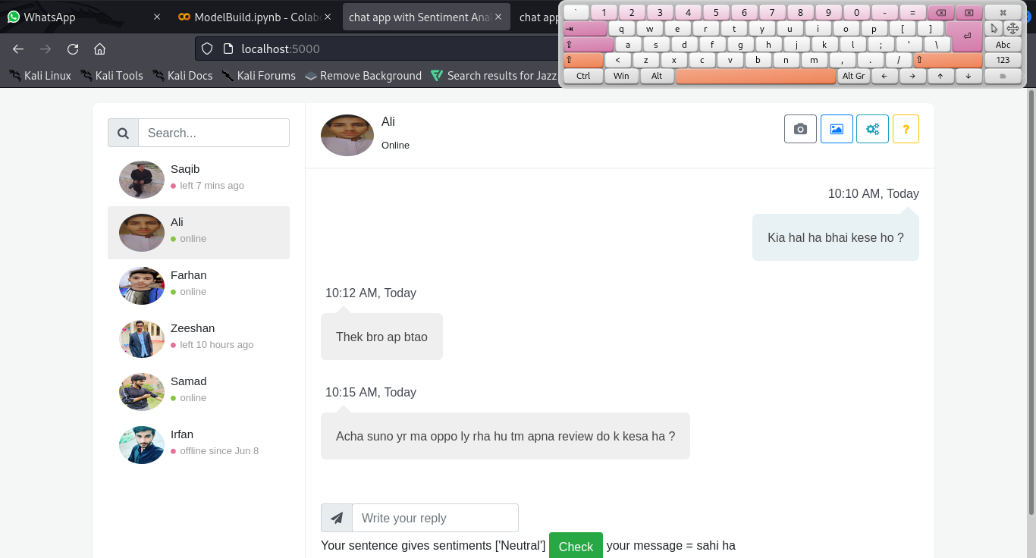
Execution Screenshots

Slide 10
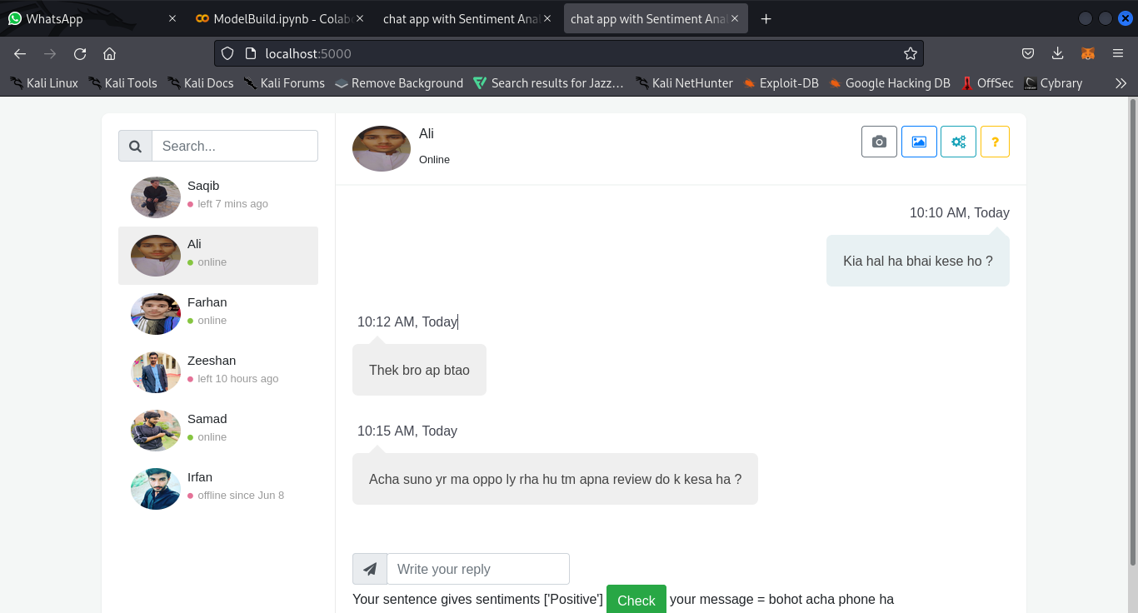
Execution Screenshots

Slide 11
Conclusion
We are developed a machine learning model that process text to classify the text into three classes
Positive negative neutral

Slide 12
Live Demo
Thank You

