Slide 1


Regression Challenge:
Using Linear Regression and KNN Model
MD IMRAN HOSSAIN
Statistical Learning & Data Mining
Erasmus Mundus Joint Master in Medical Imaging and Applications
University of Cassino and Southern Lazio, Italy

Slide 2
Methodology
1
Visualize the training dataset and observe the relation between input variables and the result.
Data Inspection
2
Imputing outliers and removing highly correlated input variables from the train data. Selecting input variables using the Backward Feature Selection and Forward Feature Selection algorithms for training models.
Data Pre-processing
3
Splitting the training dataset into train and test (80:20) and fitting the pre-processed training dataset into Linear Regression and KNN Regression model.
Training Model
4
Predicting the result using the training dataset and calculating the Mean Average Error (MAE), Root Mean Square Error (RMSE) and R-Squared scores for each model. Fitting testing dataset in the best model and importing results.
Prediction
1

Slide 3
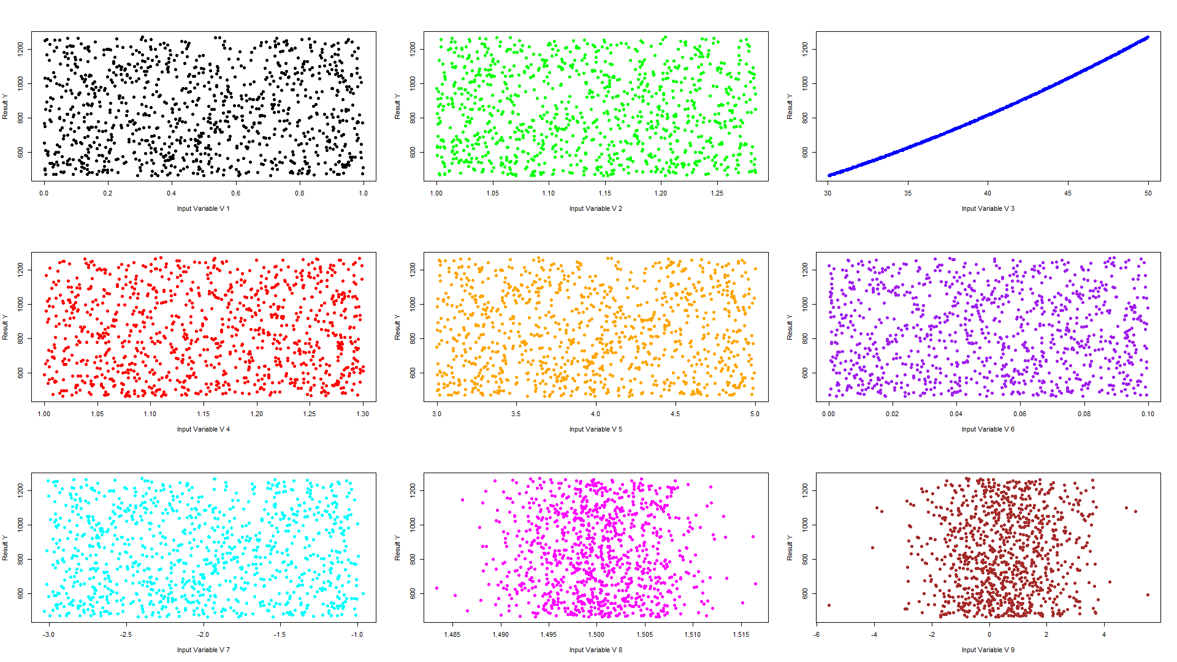
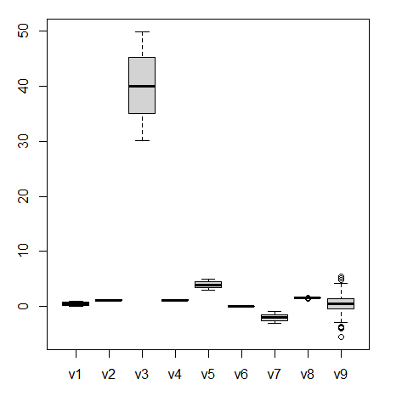
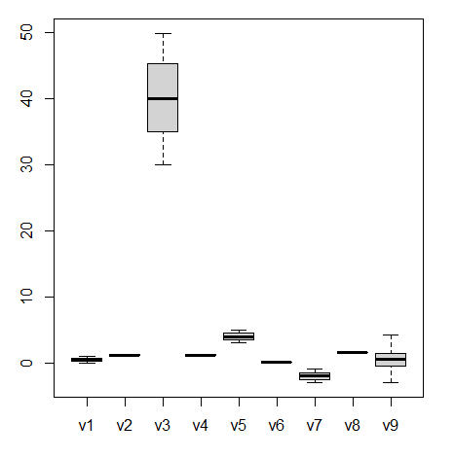
Linear Regression: Data Inspection & Outliers Imputation
Data Inspection
The train data consist of
Number of input variables, X = 9
Result, Y = 1
Total number of samples, N = 1000
Outliers Imputation
The train data has
Outliers containing input variables = v8 and v9
Number of outliers in v8 = 7
Number of outliers in v9 = 5
Total number of outliers = 12
The mean Imputation method is used to impute the outliers instead of removing outliers consisting of samples from the dataset because these samples may contain important information.
Fig-2a & 2b show the boxplots of train data with outliers and without outliers (after mean imputation).
Fig-1: Visualization of the relation of input variables and results of the train data
outliers
Fig-2a: Boxplot of train dataset with outliers
Fig-2b: Boxplot of train dataset without outliers
2

Slide 4
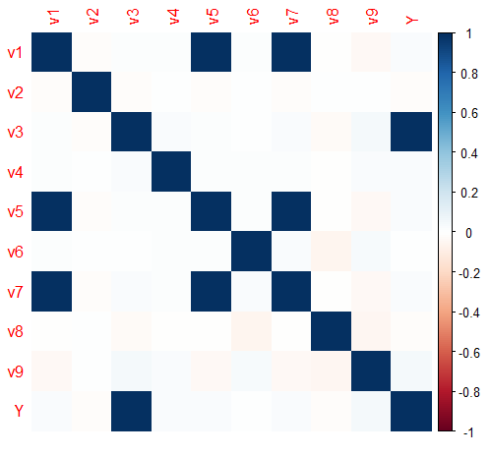
Linear Regression: Correlation & Training Model
Correlation
After observing the correlation among input variables of the train data, it is found that:
Input variables v1, v5, and v7 are highly correlated (more than 0.9) with each other.
Hence, v5 and v7 are removed from the input variables of the train dataset.
Total number of input variables, X = 7
Training Model
Backward Feature Selection:
The linear regression model is trained after the elimination of input variables (v5, v7) of training data based on correlation.
The input variables are eliminated one by one depending on the p-value.
Finally, variables (v1, v3) are selected as they have the lowest p-value of 0.0422 and 2e-16 respectively.
However, the training model with the combination of v1 and v3, and only v3 still provides high Residual Standard Error (RSE) of 14.88 and 14.90 respectively.
Fig-3: Correlation of the train data
Table-1: Backward Feature Selection
Model Name | Selected Variables (based on p-value) | R-Squared | Residual Standard Error
Model 1 | v1+v2+v3+v4+v6+v8+v9 | 0.996 | 14.89
Model 2 | v1+v3+v4+v6+v8+v9 | 0.996 | 14.88
Model 3 | v1+v3+v4+v6+v8 | 0.996 | 14.88
Model 4 | v1+v3+v6+v8 | 0.996 | 14.88
Model 5 | v1+v3+v6 | 0.996 | 14.88
Model 6 | v1+v3 | 0.996 | 14.88
Model 7 | v3 | 0.996 | 14.90
Forward Feature Selection:
Using Interactive terms, I(v1, v3) and Polynomial terms, I(v3, v3) with the combination of input variables, the linear regression model is trained.
It is observed that the combination of input variables and Polynomial terms, I(v3, v3) provides very low p-value (< 1.20) than the combination of input variables and Interactive terms, I(v1, v3).
Finally, the train model with v1 + v2 + v3 + v4 + v6 + v8 + v9 + I(v3 * v3) provides the minimum p-value (0.1289) and it is considered the best model for prediction.
3

Slide 5
Linear Regression: Prediction & Performance
Table-2: Forward Feature Selection with Interactive Terms
Prediction & Performance
Model Name | Selected Variables (based on p-value) | R-squared | Residual Standard Error
Model 8 | v3+I(v1*v3) | 0.996 | 14.88
Model 9 | v1+v3+I(v1*v3) | 0.996 | 14.88
Model 10 | v1+v3+v6+I(v1*v3) | 0.996 | 14.88
Model 11 | v1+v3+v6+v8+I(v1*v3) | 0.996 | 14.88
Model 12 | v1+v3+v4+v6+v8+I(v1*v3) | 0.996 | 14.89
Model 13 | v1+v3+v4+v6+v8+v9+I(v1*v3) | 0.996 | 14.89
Model 14 | v1+v2+v3+v4+v6+v8+v9+I(v1*v3) | 0.996 | 14.90
The entire train data is predicted using the best training (Model 21) and the prediction result provides the following scores:
Table-4: Train Data Prediction Performance
Regression Error Metrics | Scores
Mean Absolute Error (MAE) | 0.0096
Root Mean Squared Error (RMSE) | 0.0128
R-Squared | 1.0000
It is observed that prediction with Model 21 provides the minimum MAE and RMSE, whereas the maximum R-Squared.
Finally, the result of the test data is predicted using the best model (Model 21) in order to get accurate prediction results.
Table-3: Forward Feature Selection with Polynomial Terms
Model Name | Selected Variables (based on p-value) | R-squared | Residual Standard Error
Model 14 | v3+I(v3*v3) | 1 | 1.193
Model 16 | v1+v3+I(v3*v3) | 1 | 0.1065
Model 17 | v1+v3+v6+I(v3*v3) | 1 | 0.08375
Model 18 | v1+v3+v6+v8+I(v3*v3) | 1 | 0.08378
Model 19 | v1+v3+v4+v6+v8+I(v3*v3) | 1 | 0.08381
Model 20 | v1+v3+v4+v6+v8+v9+I(v3*v3) | 1 | 0.08385
Model 21 | v1+v2+v3+v4+v6+v8+v9+I(v3*v3) | 1 | 0.01289
4

Slide 6
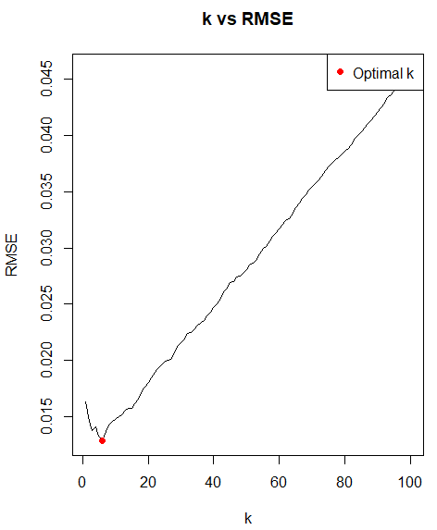
KNN Regression: Data Normalization & Training Model
Data Normalization
The training data is normalized using the min-max normalization technique in order to reduce biasness of output values toward the k-value and input variables.
Model Training
Data Split:
The normalized training data is split into train and test with a ratio of 80 and 20 in order to train the KNN model using the FNN library.
Backward Feature Selection:
At first, the KNN model is trained with all input variables (except v5 and v7 because of the high correlation factor) and the optimal K is selected based on the minimum Root Mean Square Error (RMSE) using the iteration technique.
Input variables are eliminated one by one for training the model depending on the p-value.
Finally, KNN is trained with the combination of v1 and v3 input variables only and it provides the minimum RMSE score (0.0129) with an optimal K value of 6.
Fig-4: Plot of k vs RMSE
Table-5: Forward Feature Selection
Model Name | Selected Variables (based on p-value) | K (optimal) | RMSE
Model 1 | v1+v2+v3+v4+v6+v8+v9 | 6 | 0.0650
Model 2 | v1+v3+v4+v6+v8+v9 | 8 | 0.0580
Model 3 | v1+v3+v4+v6+v8 | 9 | 0.0473
Model 4 | v1+v3+v6+v8 | 4 | 0.0381
Model 5 | v1+v3+v6 | 7 | 0.0295
Model 6 | v1+v3 | 6 | 0.0129
5

Slide 7
KNN Regression: Prediction & Performance
Prediction & Performance
The training data is predicted using the best training (Model 6) and the prediction result provides the following scores:
Table-6: Train Data Prediction Performance
Regression Error Metrics | Scores
Mean Absolute Error (MAE) | 0.00774
Root Mean Squared Error (RMSE) | 0.01030
R-Squared | 0.99788
It is observed that prediction with Model 6 provides the minimum MAE and RMSE, whereas the maximum R-Squared.
Finally, the result of the test data is predicted using the best model (Model 6) in order to get accurate prediction results.
Table-7: Performance between KNN and Linear Model
Linear Regression & KNN Regression
Regression Error Metrics | KNN | Linear
Mean Absolute Error (MAE) | 0.0077 | 0.0096
Root Mean Squared Error (RMSE) | 0.0103 | 0.0128
R-Squared | 0.9978 | 1.0000
The Table-7 indicates a compassion of performance between KNN model and Linear Regression model:
In the case of Mean Absolute Error (MAE) and Root Mean Squared Error (RMSE), the KNN model performed better (with less error) than the Linear Regression model.
In the case of R-Squared, the KNN model performed worse than the Linear Regression model.
6

