Slide 1
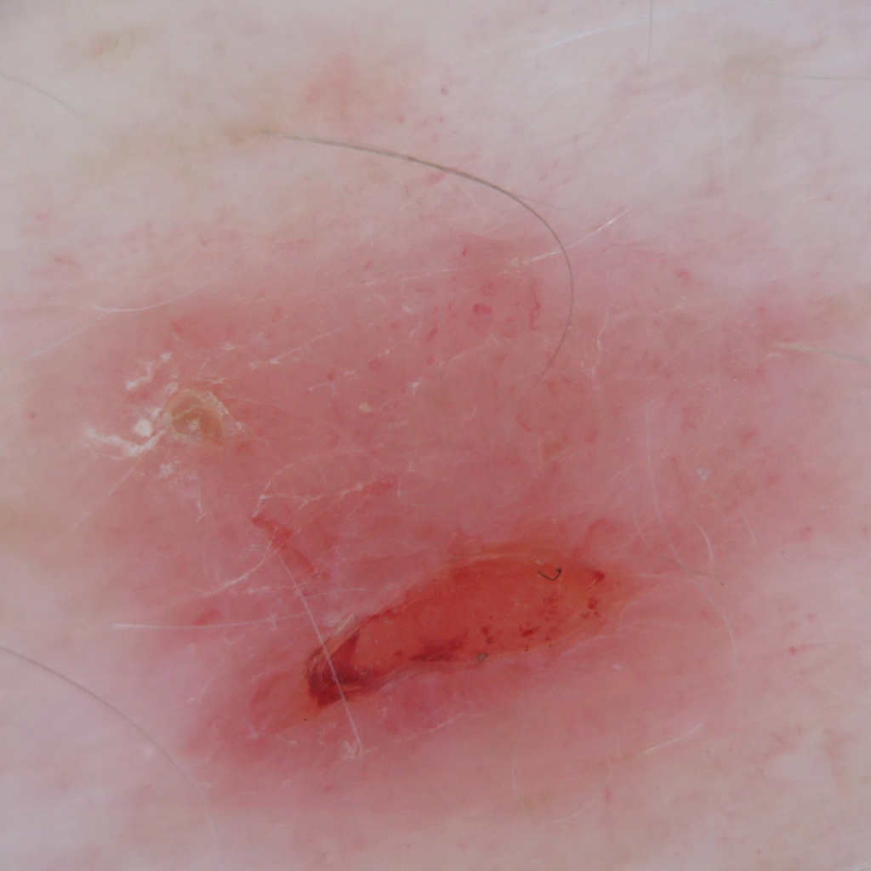
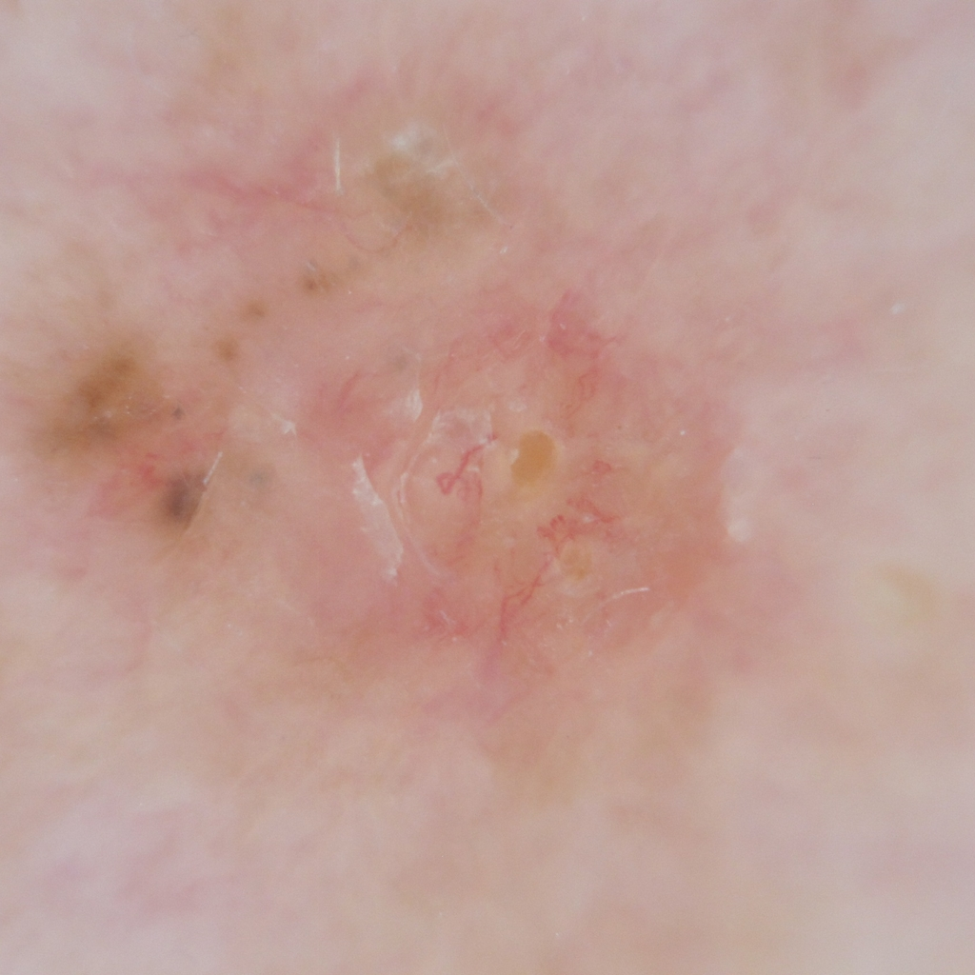
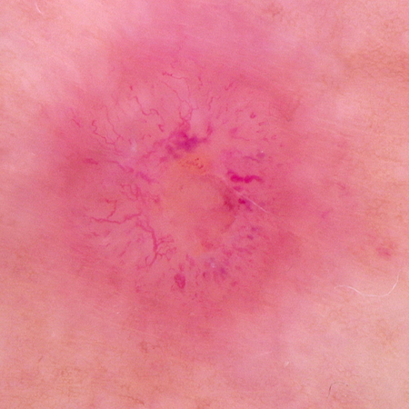


Challenge: Skin Lesion Classification Using Machine Learning
Mohammad Imran Hossain
Enrique Franky Vargas
Computer Aided Diagnosis
Erasmus Mundus Joint Master in Medical Imaging and Applications
CADx| UdG | MaIA
1/19

Slide 2
Challenge #1: Dataset
7725
7470
Total Training Data: 15195
Total Validation Data: 3796
1931
1865
Total Test Data: 6340
nevus
others
nevus
others
Training Dataset
Validation Dataset
CADx| UdG | MaIA
2/19

Slide 3
Challenge #2: Dataset
2713
1993
678
Total Training Data: 5760
Total Validation Data: 1270
498
Total Test Data: 2121
376
94
mel
bcc
scc
mel
bcc
scc
Training Dataset
Validation Dataset
CADx| UdG | MaIA
3/19

Slide 4
Challenge #1: Block diagram of classification model
Image
Preprocessing
Feature Extraction
Dataset
Feature Engineering
nevus
Classification
others
CADx| UdG | MaIA
4/19

Slide 5
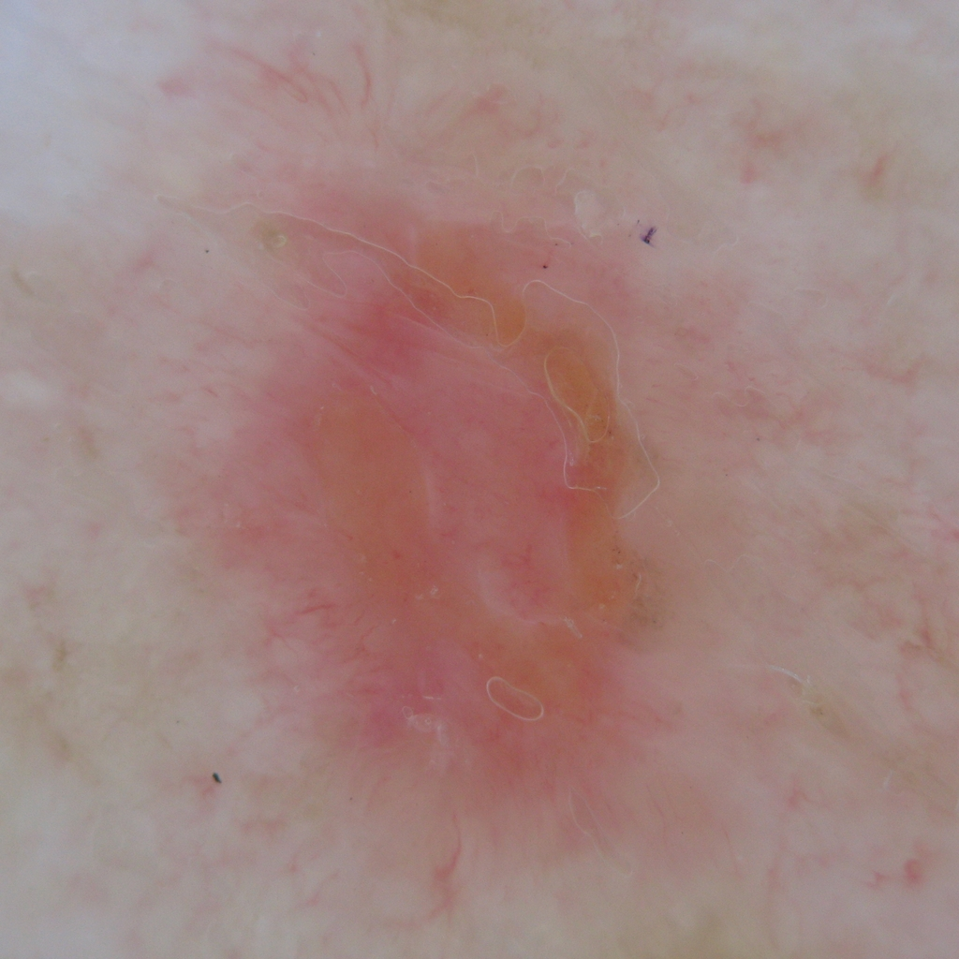
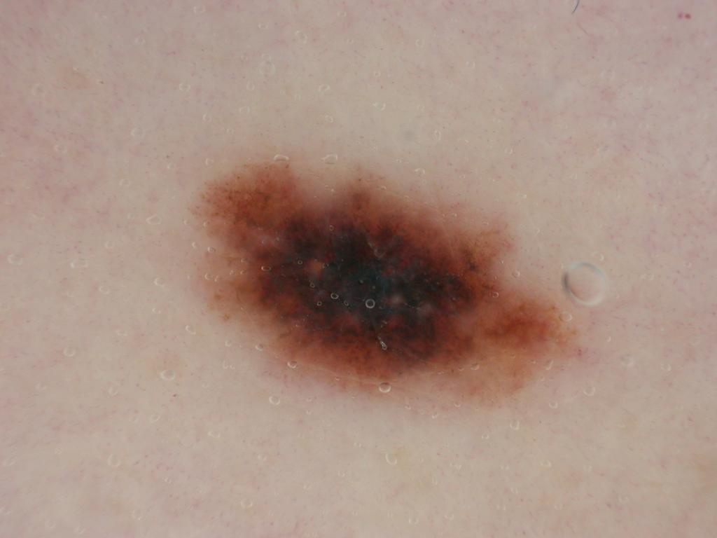
Challenge #2: Block diagram of classification model
Image
Preprocessing
Augmentation
Dataset
Feature Extraction
Feature Engineering
bcc
mel
Classification
scc
CADx| UdG | MaIA
5/19

Slide 6
Image pre-processing
Pre-processor
Hair removing: Apply morphological operation (blackhat).
Vintage cropping: Threshold the diagonal pixels intensities.
Post-processing: Apply contrast enhancement technique (gamma correction).
Hair remove
Vintage crop
Post-process
CADx| UdG | MaIA
6/19

Slide 7
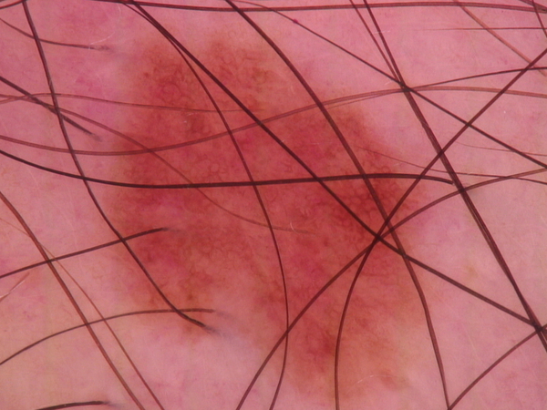
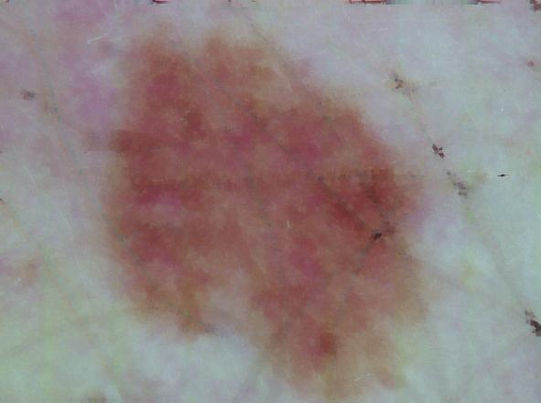
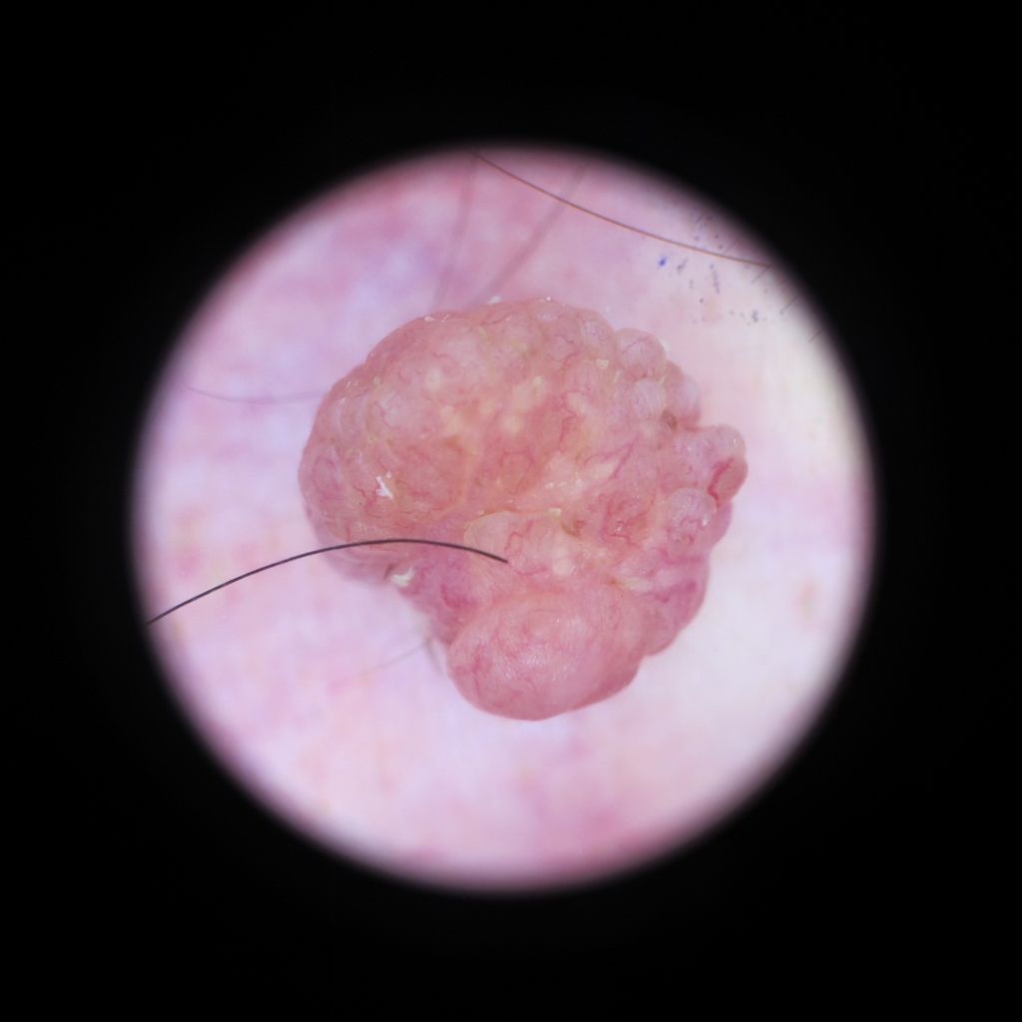
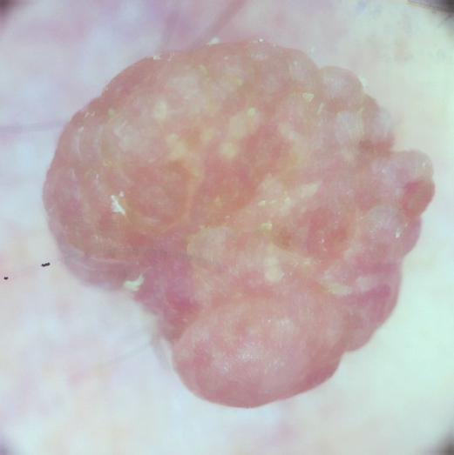
Image pre-processing
Hair remove
Post-processing
Vintage remove
Post-processing
CADx| UdG | MaIA
7/19

Slide 8
Data Augmentation
Augmentor
Cropping: Crop the image from the center based on random radius.
Scaling: Scale the image based on random scaling factor.
Adding noise: Adjust the brightness and contrast randomly as well as add random noise.
Cropping
Scaling
Adding noise
CADx| UdG | MaIA
8/19

Slide 9
Data Augmentation
2713
2713
2503
1993
Before Augmentation [Training]: 5760
After Augmentation [Training]: 6492
1276
376
mel
bcc
scc
mel
bcc
scc
Before Augmentation [Training]
After Augmentation [Training]
CADx| UdG | MaIA
9/19

Slide 10
Features Extraction
Intensity features:
Gray level covariance matrix (GLCM): blue channel, distances [1-5], angles [0-135°]
- contrast, dissimilarity, homogeneity, energy, correlation, entropy.
Intensities: grayscale image
- mean, median, standard deviation, minimum, maximum, skewness, kurtosis, histogram
entropy, 25th and 75th percentile.
Local binary pattern (LBP): blue channel, radius = 1, number of points = 8, uniform
Features Extractor
Intensity features
Color features
Shape features
Wavelet features
Texture features
CADx| UdG | MaIA
10/19

Slide 11
Features Extraction
Features Extractor
Color features:
RGB: color image
- mean, variance, standard deviation, minimum, maximum, skewness for each channel.
- histogram for each channel.
HSV: color image
- mean, variance, standard deviation, minimum, maximum, skewness for each channel.
- histogram for each channel.
LAB: color image
- mean, variance, standard deviation, minimum, maximum, skewness for each channel.
- histogram for each channel.
Intensity features
Color features
Shape features
Wavelet features
Texture features
CADx| UdG | MaIA
11/19

Slide 12
Feature extraction
Features Extractor
Shape features:
Geometric shape: grayscale image
- perimeter, area, circularity, compactness, hue moment
Intensity features
Color features
Shape features
Texture feature:
Haralick texture: blue channel
- mean of each texture
Wavelet features
Texture features
Wavelet feature:
Wavelet : grayscale image
- wavelet mean, standard deviation, energy
CADx| UdG | MaIA
12/19

Slide 13
Features Extraction
Intensity
Color
Shape
Texture
Wavelet
243
+
+
+
+
=
Types of extracted features
Total number of features
CADx| UdG | MaIA
13/19

Slide 14
Machine Learning
ML Classifier
Single Classifier: K-Nearest Neighbors, Support Vector Machine, Random Forest, XGBosst.
Ensemble: Stacking and Majority Voting among classifiers using the best parameters obtained from the grid search.
Single classifier
Ensemble
CADx| UdG | MaIA
14/19

Slide 15
Challenge # 01 : Best parameters - Gird search
Classifiers
Parameters
KNN
n_neighbour = 15
SVM
kernel = rbf, C = 11
RF
n_estimators = 500, criterion = gini, max_depth = 20
XGBoost
num_class = 3, n_estimators = 2000, max_depth = 9, learning_rate = 0.1
CADx| UdG | MaIA
15/19

Slide 16
Challenge # 02 : Best parameters - Gird search
Classifiers
Parameters
KNN
n_neighbour = 5
SVM
kernel = rbf, C = 11
RF
n_estimators = 500, criterion = entropy, max_depth = 13
XGBoost
num_class = 3, n_estimators = 2000, max_depth = 7, learning_rate = 0.1
CADx| UdG | MaIA
16/19

Slide 17
Challenge # 01 : Prediction Results on Validation Data
Classifier | Feature Engineering | Accuracy | Kappa
KNN |  | 0.7729 | 0.5462
KNN | PCA | 0.7819 | 0.5639
KNN | K-best | 0.7919 | 0.5840
KNN | Model Selection | 0.7985 | 0.5970
SVM |  | 0.8361 | 0.6724
 | PCA | 0.8209 | 0.6418
 | K-best | 0.8282 | 0.6566
 | Model Selection | 0.8351 | 0.6702
Classifier | Feature Engineering | Accuracy | Kappa
RF |  | 0.8153 | 0.6307
 | PCA | 0.8177 | 0.6354
 | K-best | 0.8238 | 0.6470
 | Model Selection | 0.8162 | 0.6321
XGBoost |  | 0.8328 | 0.6534
 | PCA | 0.8347 | 0.6433
 | K-best | 0.8301 | 0.6490
 | Model Selection | 0.8390 | 0.6763
Stacking | Accuracy | Kappa
KNN, SVM, RF, XGBosst | 0.8423 | 0.6896
SVM, RF, XGBosst | 0.8434 | 0.7066
SVM, RF | 0.8332 | 0.6872
SVM, XGBosst | 0.8391 | 0.6846
Majority Voting | Accuracy | Kappa
KNN, SVM, RF, XGBosst | 0.8456 | 0.6750
SVM, RF, XGBosst | 0.8472 | 0.6944
SVM, RF | 0.8378 | 0.6929
SVM, XGBosst | 0.8412 | 0.6963
CADx| UdG | MaIA
17/19

Slide 18
Challenge # 02 : Prediction Results on Validation Data
Classifier | Feature Engineering | Accuracy | Kappa | BMA
KNN |  | 0.8774 | 0.6150 | 0.6486
KNN | PCA | 0.7252 | 0.5086 | 0.5816
KNN | K-best | 0.7282 | 0.6166 | 0.6491
KNN | Model Selection | 0.8110 | 0.6576 | 0.6764
SVM |  | 0.7858 | 0.6414 | 0.7522
 | PCA | 0.5504 | 0.2994 | 0.5629
 | K-best | 0.8370 | 0.7138 | 0.7633
 | Model Selection | 0.8307 | 0.6987 | 0.7443
Classifier | Feature Engineering | Accuracy | Kappa | BMA
RF |  | 0.7953 | 0.6304 | 0.6519
 | PCA | 0.7496 | 0.5438 | 0.5837
 | K-best | 0.7835 | 0.5930 | 0.5851
 | Model Selection | 0.8008 | 0.6419 | 0.6688
XGBoost |  | 0.8346 | 0.7084 | 0.7508
 | PCA | 0.7291 | 0.5403 | 0.6478
 | K-best | 0.7976 | 0.6352 | 0.6451
 | Model Selection | 0.8150 | 0.6735 | 0.7107
Stacking | Accuracy | Kappa | BMA
KNN, SVM, RF, XGBosst | 0.8220 | 0.7376 | 0.7758
SVM, RF, XGBosst | 0.8488 | 0.7319 | 0.7647
SVM, RF | 0.8307 | 0.7040 | 0.7609
SVM, XGBosst | 0.8520 | 0.7369 | 0.7638
Majority Voting | Accuracy | Kappa | BMA
KNN, SVM, RF, XGBosst | 0.8551 | 0.7399 | 0.7537
SVM, RF, XGBosst | 0.8504 | 0.7332 | 0.7560
SVM, RF | 0.8386 | 0.7127 | 0.7364
SVM, XGBosst | 0.8528 | 0.7386 | 0.7758
CADx| UdG | MaIA
18/19

Slide 19
Thank You!
CADx| UdG | MaIA
19/19

