Slide 1
E-learning Platform
Requirements Bandits (Team B)
Imran Ahmed 40172931, Joe El-Khoury 40173108, Ali Alp Erdinc 40172910, Arsany Fahmy 40157267 , Hao Yi Liu 40174210,
Pai Peng 40155601, Titouan Sablé 40179062, Steven Franchetto 40112243

Slide 2
Table of Contents
Problem Definition
Purpose of the system
System features
Analysis of Risk
Validation of the Requirements
GUI
Conclusion

Slide 3

Problem Definition
University students have no central platform to find tutors
Gathered data shows most university students must seek tutors themselves
They can be hard to find and reviews are scarce
Information hidden behind paywalls
[6]
Notes:
Alp

Slide 4

Purpose of the system
Help university students to ace their courses
Tutors can advertise their services easily
[1]
Notes:
Imran

Slide 5
System features
Core system features for the proposed E-learning platform
Login and Register system for users of the platform (student, tutor, admin)
Course Cart
Different types of meeting with Tutors
Class Forum for Students
Calendar System for Student and Tutors
Request Management System
Search and Filter Courses based on user input
Notes:
Imran

Slide 6

Analysis of Risk
Sensitive information leak due to data breach
Unauthorized access to an account
Inadequate computer spec
Denial of Service attacks (DOS)
Product related risks are most severe!
[5]
Notes:
Steven

Slide 7
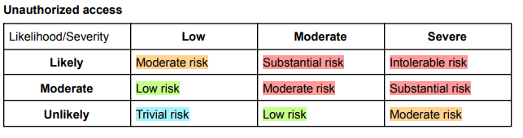
Risk mitigation
Unauthorized access
Enforce a strong password
Use of authenticator
Data breach
Use standard level encryption when storing information in database
Inadequate computer spec
Ask tutors about specs
Denial of Service attacks
Use Firewalls or Load Balancers
Risk assessment matrix from Vision Document

Slide 8
Validation of the Requirements
E-Learning’s objectives & values:
Security & Privacy
User friendly
Handful of resources
Success of students
Peace of mind for tutors
Notes:
Arsany

Slide 9
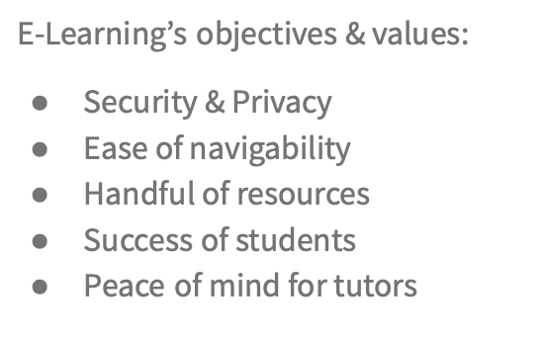
Now let’s take a look at our requirements…
Login and Registration system
Course enrollment & Cart
Scheduled meetings with tutors
Class Forum for Students
Calendar System for Student and Tutors
Request Technical support
Search and Filter Courses based on user input

Slide 10
Quality Assurance
Steps to take before Deployment…
Internal & External Inspections
Language checks
Acceptance testing
Demonstrate requirements adequacy by showing system behaviour
Offer UAT environment
Notes:
In order to fully test the project: both internal and external inspections should be made
Different types of inspection: Defect-Driven & Quality-Specific & Domain-Specific & Language-based

Slide 11
GUI of the system
Notes:
Titouan

Slide 12
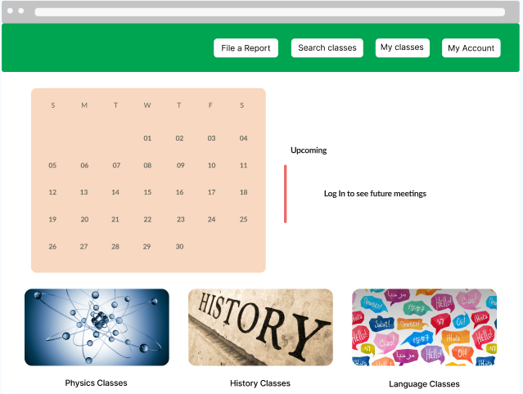
EN/FR
[2] [3] [4]

Slide 13
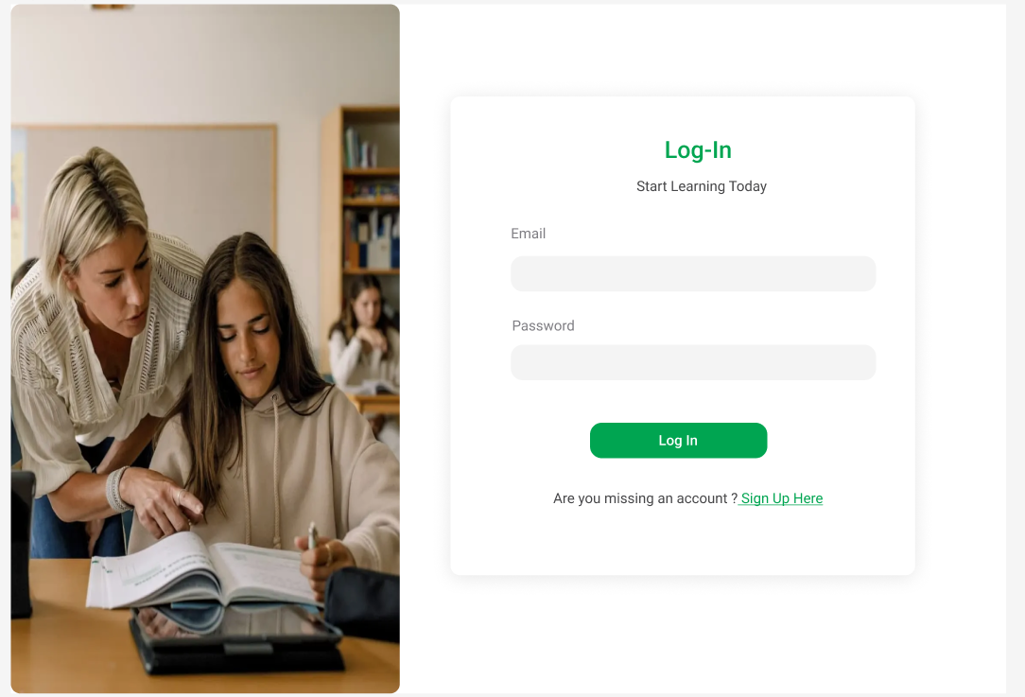
[ 7]
Notes:
Titouan

Slide 14
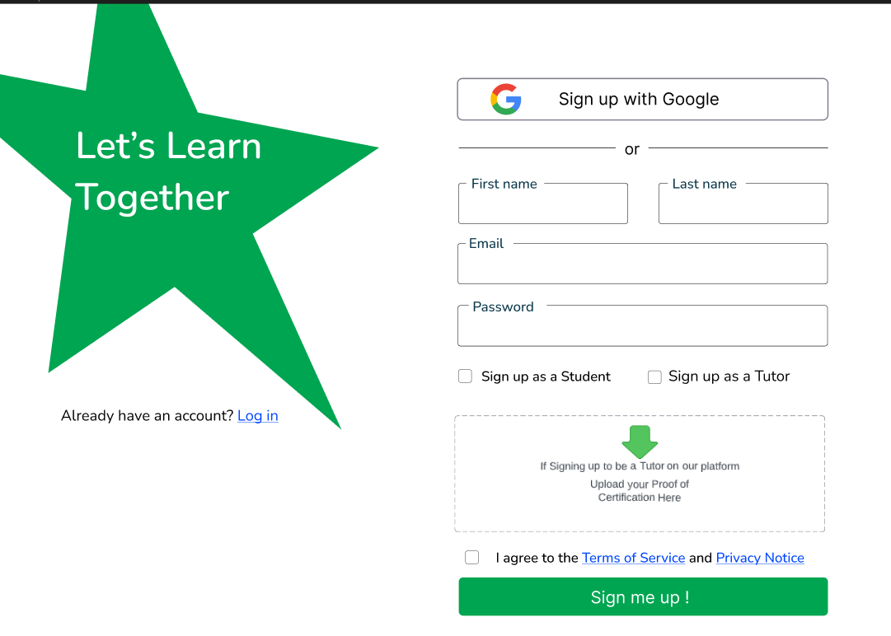

Slide 15
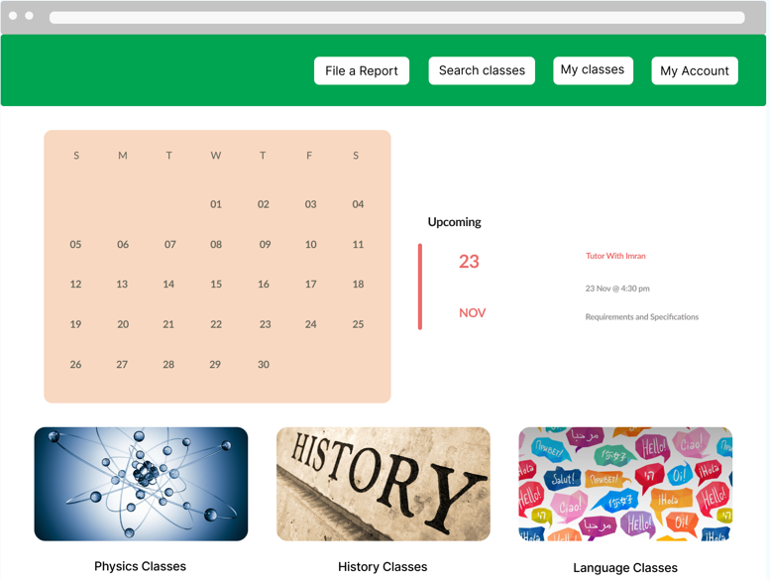
EN/FR
[2] [3] [4]

Slide 16
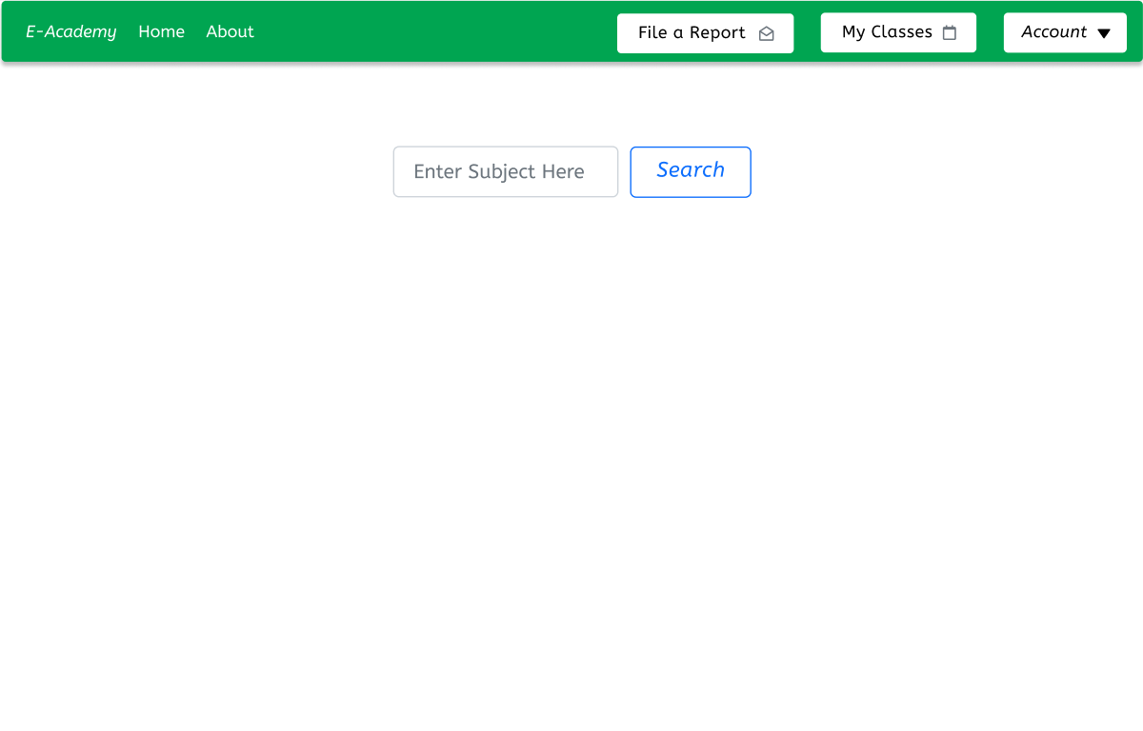

Slide 17
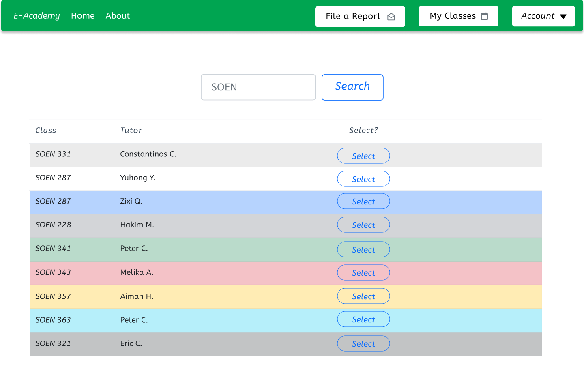

Slide 18
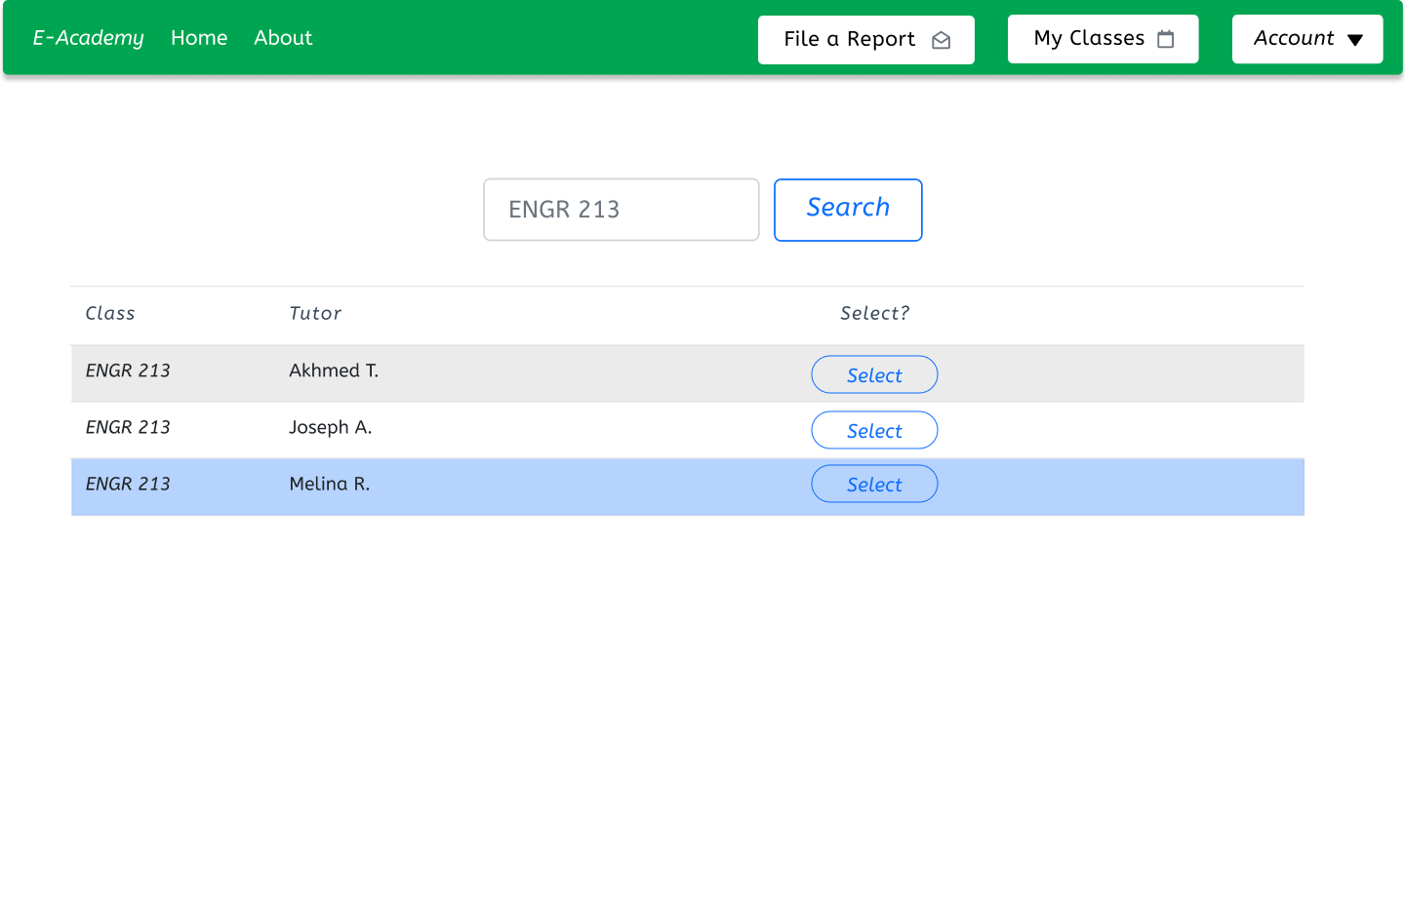

Slide 19
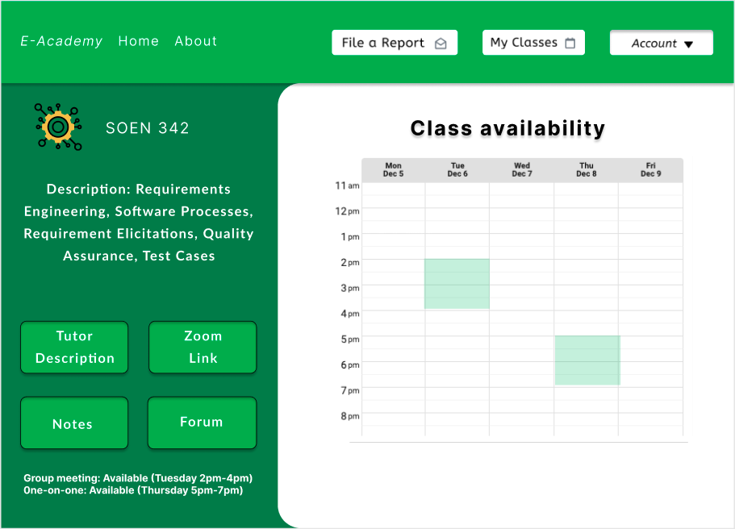

Slide 20
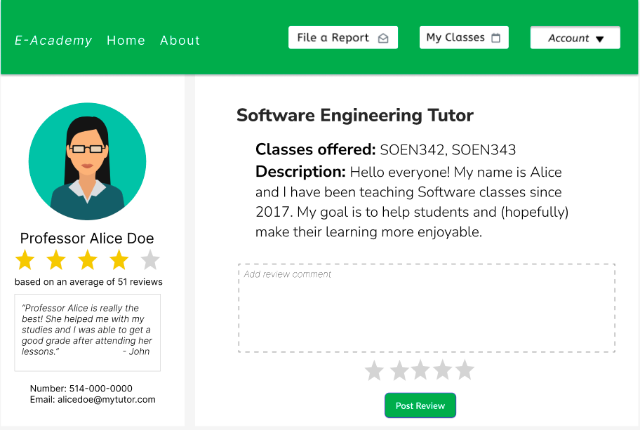

Slide 21
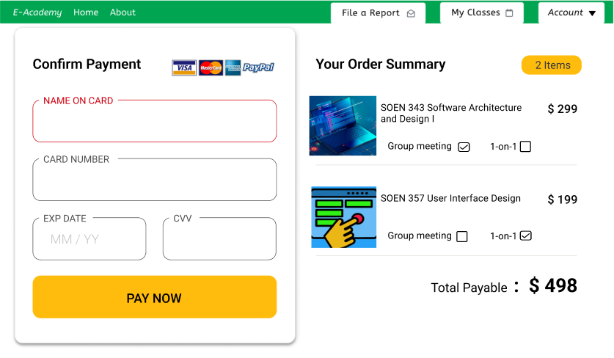

Slide 22
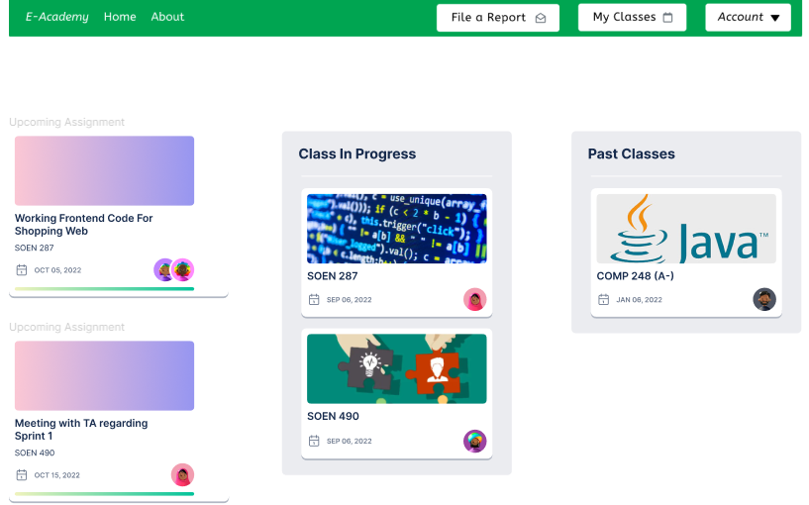

Slide 23
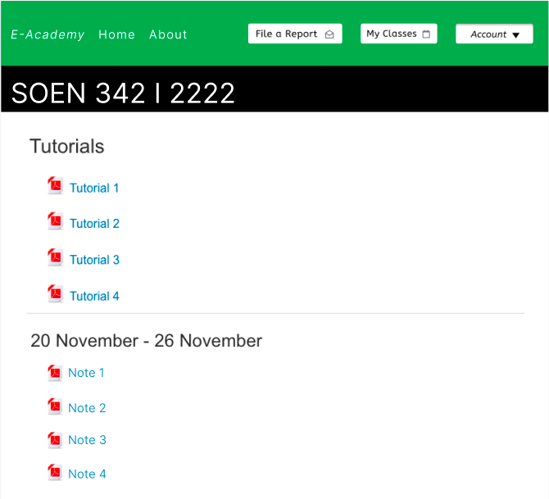

Slide 24
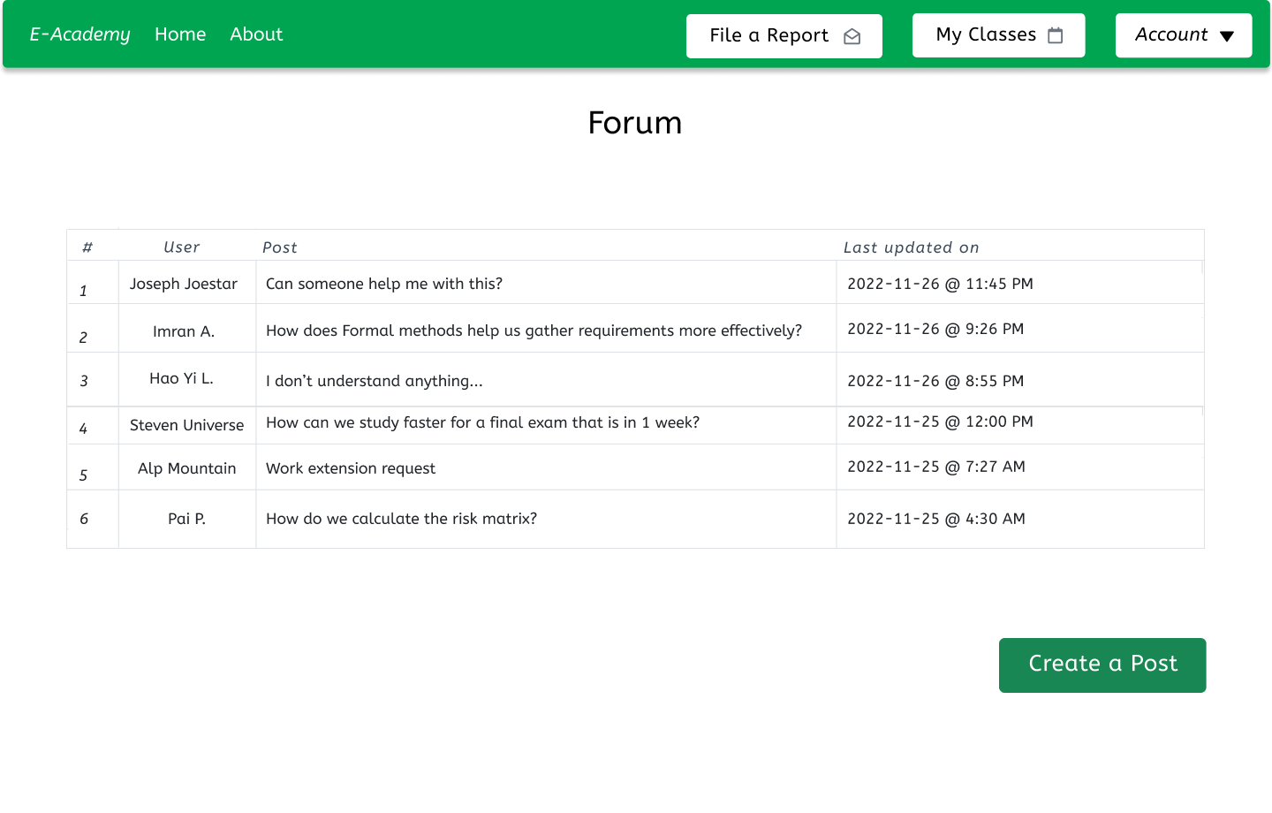

Slide 25
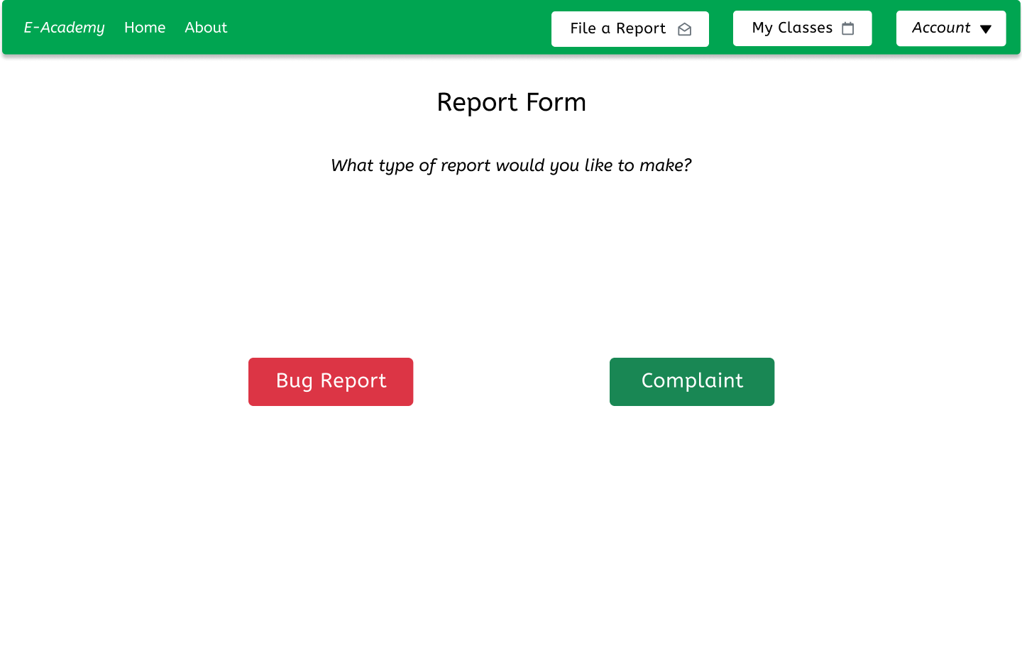

Slide 26
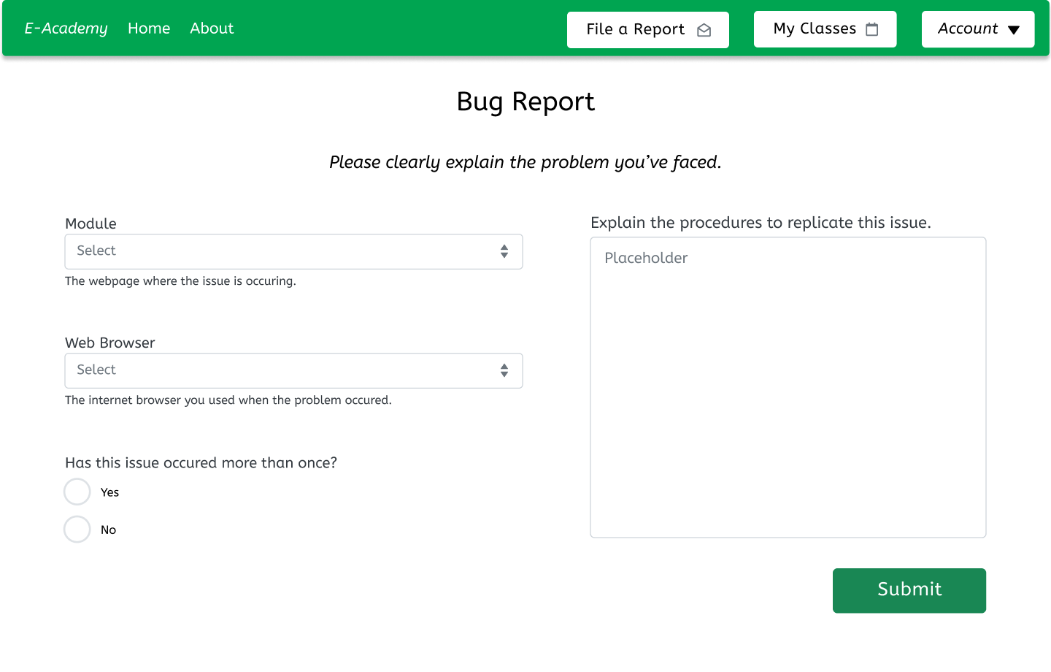

Slide 27
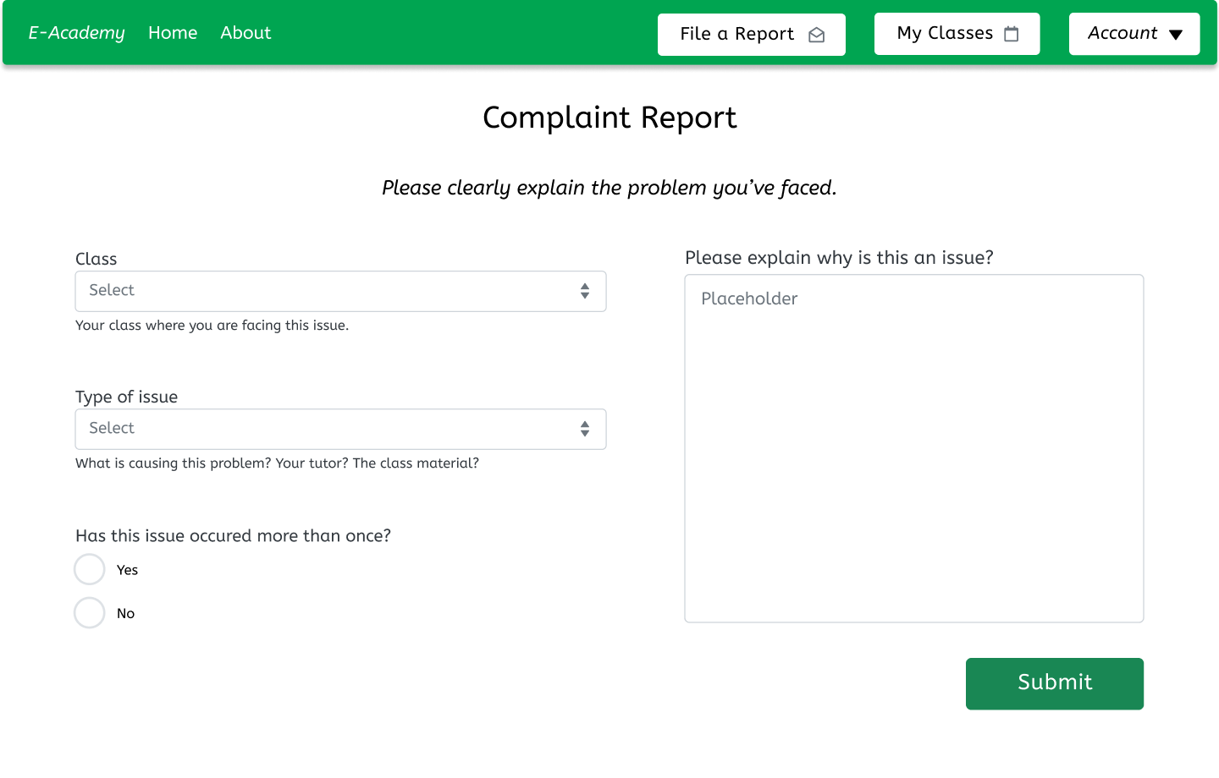

Slide 28
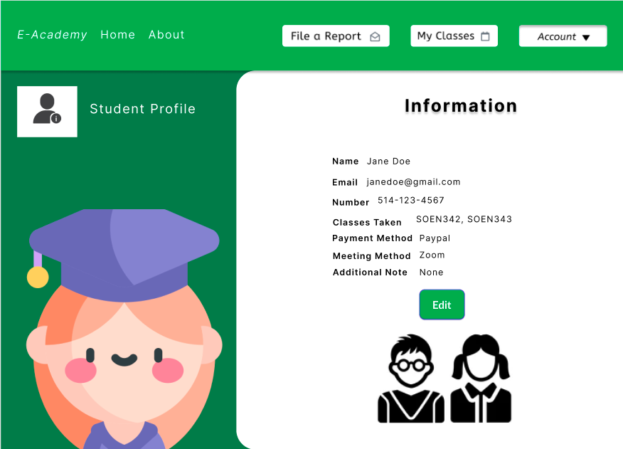

Slide 29
[7]
Notes:
Titouan

Slide 30
EN/FR
[2] [3] [4]

Slide 31
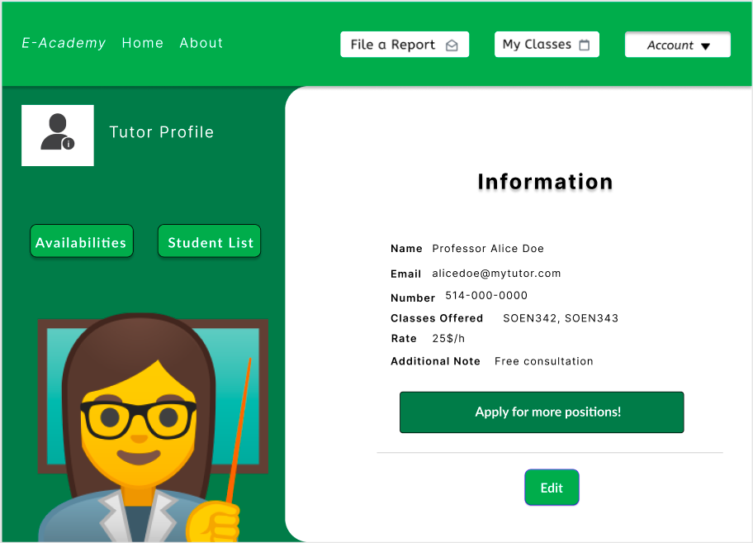

Slide 32
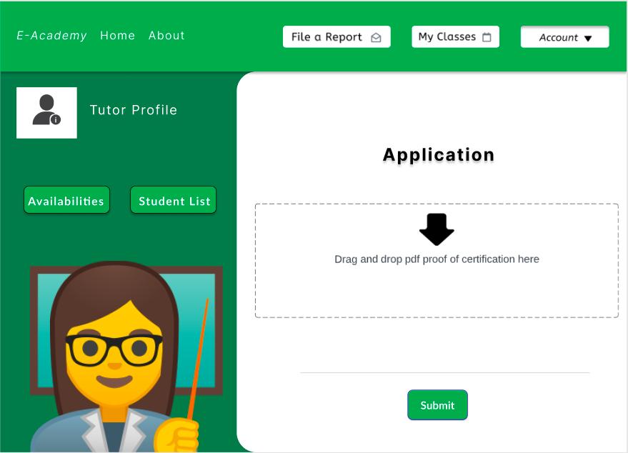

Slide 33
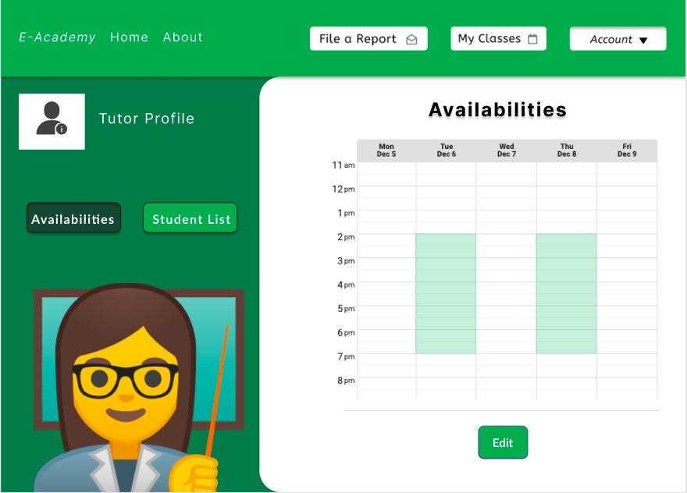

Slide 34
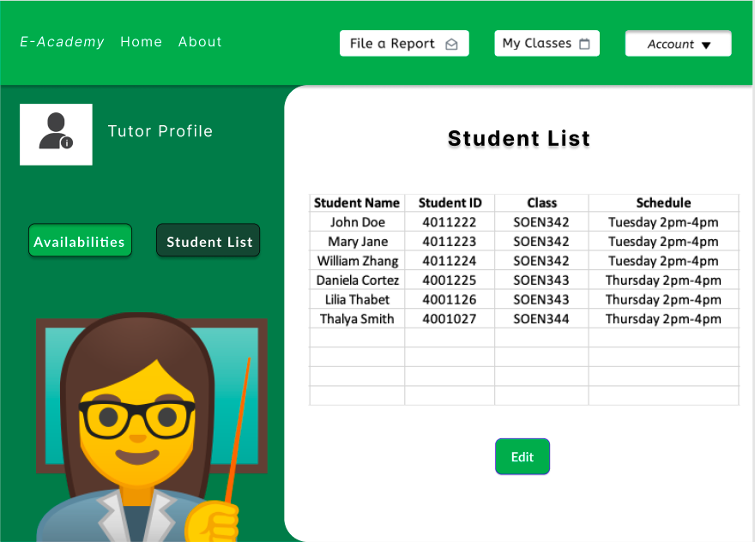

Slide 35
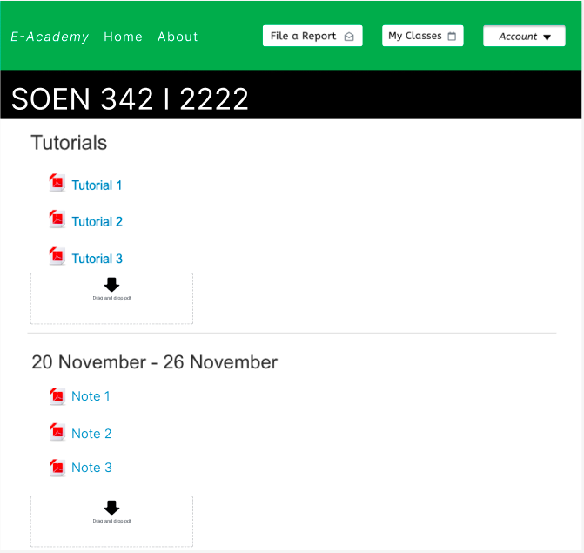

Slide 36
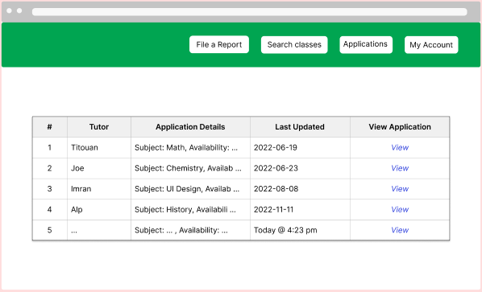

Slide 37
Conclusion
Amount of work needed for development
Notes:
Titouan

Slide 38
References
[1]https://upload.wikimedia.org/wikipedia/commons/thumb/6/66/Modern_Tutor.jpg/300px-Modern_Tutor.jpg
[2] https://www.gulfcoast.edu/academics/programs/physics-aa/index.html
[3]https://www.mypressplus.com/travel/3-historical-places-interest-every-history-student-needs-see/
[4] https://wallpapercave.com/languages-wallpapers
[5] https://g.foolcdn.com/editorial/images/466850/risk-danger-dial-low.jpg
[6] https://unsplash.com/photos/bmJAXAz6ads
[7] https://www.bestcolleges.com/education/what-is-student-teaching/

