Slide 1
Housing Prices EDA
upGrad Webinar with Bikash Debnath

Slide 2
Notes
It is assumed the viewers has some experience with Python programming and how to use Python modules/libraries
Disclaimer – EDA methods may change for different data sets
Disclaimer – This tutorial is for explaining how to EDA on a data set and not teach Python programming.

Slide 3

Problem Statement
With 79 explanatory variables describing (almost) every aspect of residential homes in Ames, Iowa, this competition challenges you to predict the final price of each home.

Slide 4
Data Explanation
Refer to the data_description.txt file
Here you if you have domain experience, it will be very much helpful to understand the data

Slide 5
What we will learn today
Exploratory data analysis (EDA)
Feature engineering and correlation of features with the target (e.g. SalesPrice)
Data Processing/Wrangling
Use libraries such as Seaborn, Pandas, sklearn
Learn how to apply basic regression technique
use gridsearchCV to find the best parameters for each model
compare the performance of different regression algorithm and choose the best one

Slide 6
Important URLs
https://www.kdnuggets.com/2018/02/essential-google-colaboratory-tips-tricks.html
https://colab.research.google.com/notebooks/io.ipynb#scrollTo=BaCkyg5CV5jF

Slide 7
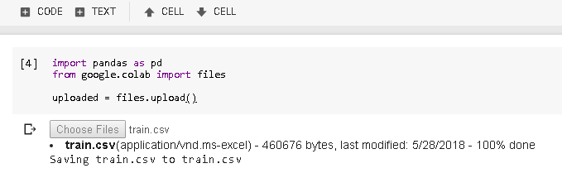
Read File in Google Colab

Slide 8
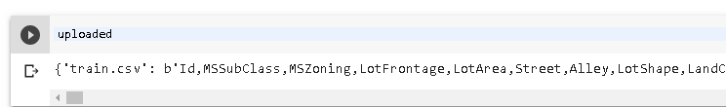
Colab puts data set reference in a Dictionary

Slide 9
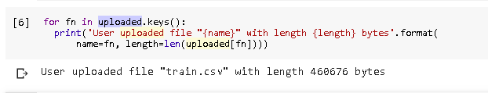
Read dataset from Dictionary
df_train = pd.read_csv(io.StringIO(uploaded[‘train.csv'].decode('utf-8')))
print(df_train.head())

Slide 10
Data Exploration
How many rows and columns are there?
What are the names of the features (variables)?
Which features(columns/variables) are numerical, which are categorical?
How many values are missing in a column/variables?

Slide 11
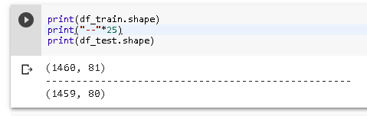
So in train data we have 81 columns out of which 79 are features, 1 ID and the target variables, Sales Price in this case
In the test data we have 80 columns, out of which 79 are features and 1 ID. Now of course in Test data we have to predict the Sales Price hence that column is not there.
Now it’s our work to find which columns are influencing the Sales Price and which are not and in fact may be irrelevant. This is the main essence of EDA.

Slide 12
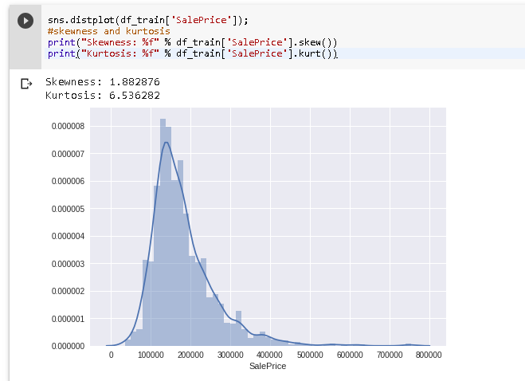
Distribution of Target variable
Right Skewed?? What does it mean?
It means that most houses are in the lower price range. In this case Mean > Median. Also means it is not normally distributed

Slide 13
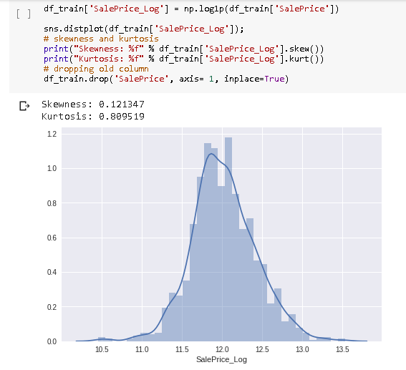
So what do we do next?
If the data is skewed, we then will take a log transformation and try to make it look more normal. If not done, our ML algos will not behave as expected. ML algos expect the data to be normally distributed (Mean = Median).

Slide 14
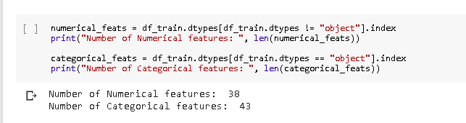
What’s next?
After studying the data distribution, let’s look into the numerical and categorical features.
Why this step is important? Keep in mind we are trying to solve a regression problem, hence it is important to know what is the type of features we have numerical or categorical. We will come back later to deal with the Categorical features.

Slide 15
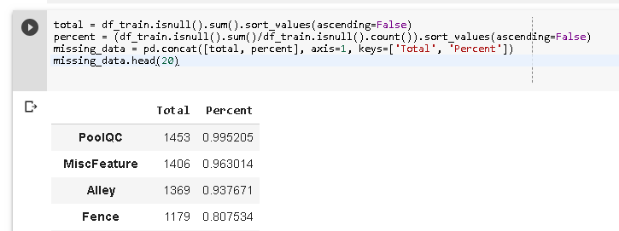
Missing values?
For example, PoolQC, MiscFeature, Fence etc has lots of NaN, now that doesn’t mean they are missing value, in fact if we look at the data, we can estimate that these features are not available in that property/house. For PoolQC means, the house has no pools and similarly no Fence. So we will try to fill in this NaN with None type and for other columns with missing values we will mean/mode.

Slide 16
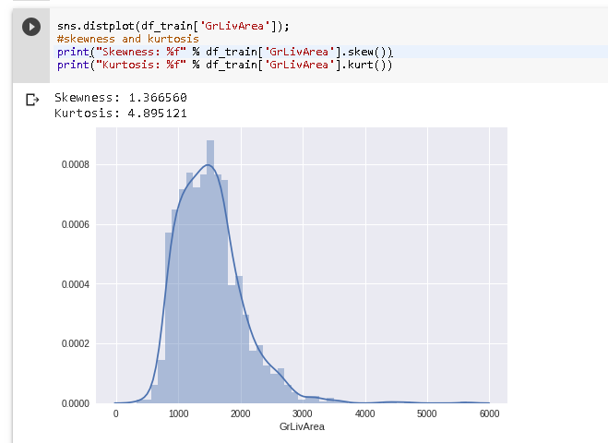
What’s next?
We have already seen that target variable SalePrice is skewed, so we also should check whether other features are skewed or not? If yes, then we need to log transform them as well. For example GrLivArea and LotArea

Slide 17
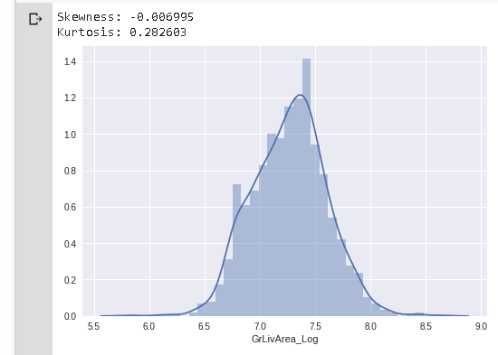
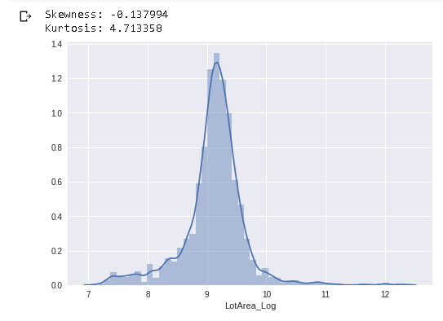
Applying same log transform
You will have to repeat this as many features that has this problem

Slide 18
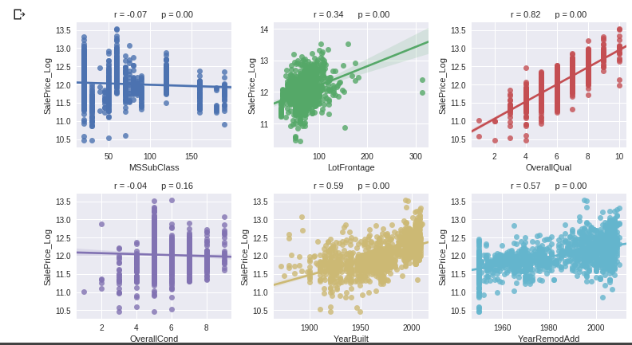
How features are related to target?

Slide 19
What’s next?
Let’s now find columns with strong correlation to target (i.e SalePrice) Only those with r > min_val_corr are used in the ML Regressors. The value for min_val_corr can be chosen in variable declaration.
List of numerical features and their correlation coefficient to target

Slide 20
What’s next?
How Categorical features are related to target variable – SalePrice
From the box plots/violin plots we can see that many of the Categorical features are not strongly co-related to Sale Price, and some have correlation. We can plan to drop the ones that are not highly correlated.

Slide 21
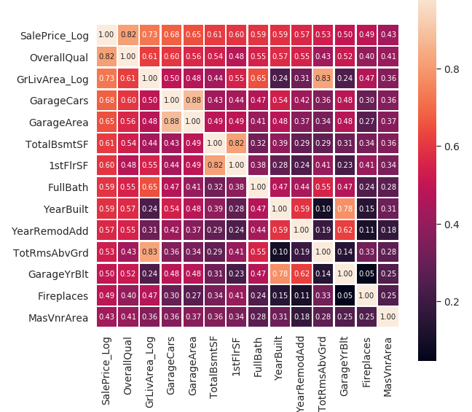
What’s next?
Let’s check all the numerical features with correlation coefficient above the defined threshold
Of those features with the highest correlation to SalePrice, some also are correlated strongly to each other.
To avoid failures of the ML regression models due to multicollinearity we should try to remove those columns. We should be careful about Multicolinearity.

Slide 22
What’s next?
Some of the categorical feature tend to show strong relation to SalePrice, hence we convert them to Numerical variables.
But after converting them to numerical variables, you again have to check the correlation of those variables with Saleprice
There are few columns with quite large correlation to SalePrice (NbHd_num, ExtQ_num, BsQ_num, KiQ_num).

Slide 23
What’s next?
We next aim to List all features with strong correlation to SalePrice_Log and then drop all columns with weak correlation. And then check for Multicolinearity and then drop the ones which has smaller correlation coefficients to target (SalePrice).
After having done that, we will now prepare the list of features that can be used for our ML algorithms – Phewwwwww, long and tedious work!! ☺

Slide 24
Next steps should be easy?
Using StandardScaler –
The idea behind StandardScaler is that it will transform your data such that its distribution will have a mean value 0 and standard deviation of 1. Given the distribution of the data, each value in the dataset will have the sample mean value subtracted, and then divided by the standard deviation of the whole dataset.
We have to do it for both train and test data.

Slide 25
Different ML algos
LinearRegression
Ridge
Lasso
Elastic Net
Stochastic Gradient Descent
DecisionTreeRegressor
RandomForestRegressor
SVR
Next we will do Model tuning and selection with GridSearchCV

Slide 26
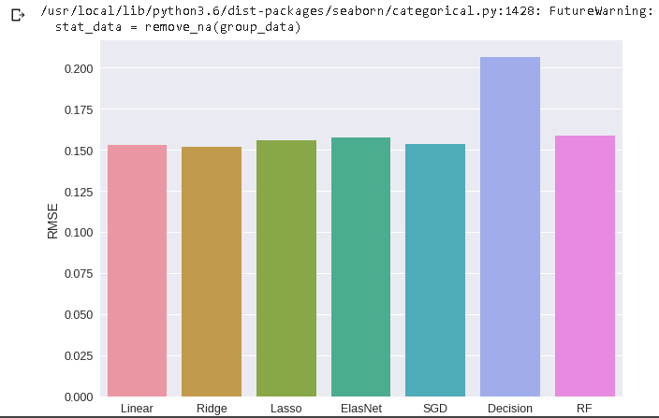
Final Comparison!

Slide 27
Thank you!
Hope you found this helpful!

