Slide 1
Partograph

Slide 2
Learning Objectives
By the end of the session, the learners will be able to:
Describe the significance of using partograph in monitoring the progress of labour, fetal and maternal condition
Describe the frequency of recording different parameters during labour
Plot the case study findings and interpret the filled partograph for decision making

Slide 3
What is a Partograph?
Partograph is the most important tool for health workers at any level to assess the progress of labour and take appropriate actions
Graphic recording of the progress of labor and condition of mother and fetus
Labor record , thus reduces paper work
Partogrpah is applicable for the active phase of first stage of labour i.e., from cervical dilatation >=4cm to full dilatation of cervix

Slide 4
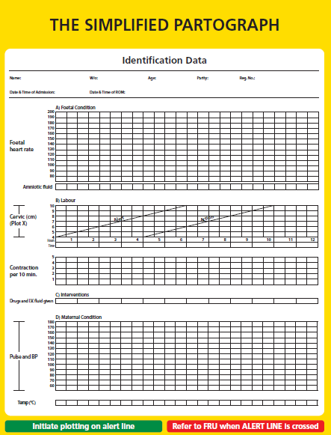

Slide 5
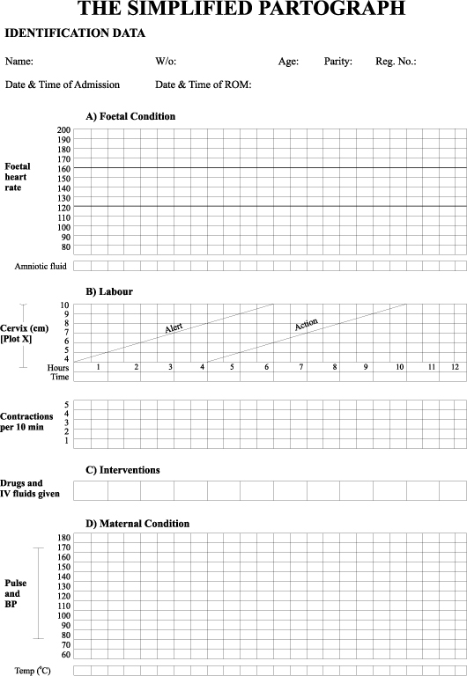
Plotting a Partograph
Identification data
Name
Age,
Parity,
Date and time of admission
Registration number;
Time of rupture of membranes.

Slide 6
Plotting a Partograph
Fetal Condition
Count fetal heart rate every 30 minutes
Count for one full minute, immediately following a uterine contraction
Fetal distress: FHR <120 beats/minute or >160 beats/minute
Arrange for referral

Slide 7
Plotting a Partograph
Record status of membranes and amniotic fluid color every half hourly in Partograph as follows:
Membranes intact (mark ‘I’)
Blood stained (mark ‘B’)
Clear liquor (mark ‘C’)
Meconium stained liquor (mark ‘M’)
Use sterile perineal pad to look for colour of liquor and status of membrane

Slide 8
Plotting a Partograph
Labor
Begin plotting in active labor
Cervical dilatation > = 4 cm and > 2 contractions / 10 minutes
Always plot initial finding at Alert line. Note the time.
Repeat P/V after 4 hours and plot the cervical dilatation
In active phase cervical dilatation should be 1 or ore than 1 cm/ hour.

Slide 9
Plotting a Partograph
Chart the contractions every half an hour
Number of contractions in 10 mins
Duration in seconds.
Less than 20 seconds
Between 20 and 40 seconds
More than 40 seconds

Slide 10
Plotting a Partograph
Maternal Condition
Record maternal pulse every half hour and mark with a dot ( . )
Record maternal BP every 4 hours using a vertical arrow, with upper end signifying systolic BP and lower end diastolic BP
Record the temperature every 4 hours and note on temperature graph

Slide 11
Plotting a Partograph
Interventions
Mention dose, route and time of administration of any drug and IV fluid given before delivery

Slide 12
Interpreting a Partograph
If Alert line is crossed (the plotting moves to the right of the alert line) it indicates abnormal labour : prolonged/ obstructed labour
Note the time
Refer patient to FRU
Send partograph with patient

Slide 13
Interpreting a Partograph
Crossing of the Action line (the plotting moves to the right of the Action line) : indicates the need for intervention
By the time the action line is crossed the woman should ideally have reached the FRU for the appropriate intervention to take place

Slide 14
What are the Indications for Referral to FRU – Interpretation of Partograph for timely referral
FHR is <120 beats / min or >160 beats / min
Meconium and /or blood stained amniotic fluid
When cervical dilatation plotting crosses the alert line (moves towards the right side of the alert line)
Contractions not increasing in duration, intensity and frequency e.g. 2 or less contractions lasting for <20 sec in 10 min

Slide 15
Key Messages
Labour should be plotted on the partograph during the active stage when cervical dilatation is 4 cms or more
FHR, status of membranes and amniotic fluid uterine contractions and pulse are recorded every half an hour
Cervical dilatation, BP and temperature are recorded every 4 hours
Correctly filled partograph helps to identify any abnormality early and helps to decide appropriate care or referral

Slide 16
PARTOGRAPH – CASTE STUDY 1
Radha (wife of Gangaram), 26 years of age, third gravida, was admitted at 5:00 am on 11 June 2009 with the complaint of labour pains since 2:00 am. Her membranes had ruptured at 4:00 am. She has two children of the ages of 5 and 2 years. On admission, her cervix was 2 cm dilated.
Plot the following findings on the partograph:
At 09:00 am: • The cervix is dilated 5 cm.
• She had 3 contractions in 10 minutes, each lasting 20–40 seconds.
• The FHR is 120 beats per minute.
• The membranes have ruptured and the amniotic fluid is clear.
• Her BP is 120/70 mmHg.
• Her temperature is 36.8°C.
• Her pulse is 80 per minute.
9:30 am: FHR 120, contractions 3/10 each 30 seconds, pulse 80/minute, amniotic fluid clear
10:00 am: FHR 136, contractions 3/10 each 35 seconds, pulse 80/minute, amniotic fluid clear
10:30 am: FHR 140, contractions 3/10 each 40 seconds, pulse 88/minute, amniotic fluid clear
11:00 am: FHR 130, contractions 3/10 each 40 seconds, pulse 88/minute, amniotic fluid clear
11:30 am: FHR 136, contractions 4/10 each 45 seconds, pulse 84/minute, amniotic fluid clear
12:00 noon: FHR 140, contractions 4/10 each 45 seconds, pulse 88/minute, amniotic fluid clear
12:30 pm: FHR 130, contractions 4/10 each 50 seconds, pulse 88/minute, amniotic fluid clear
1:00 pm: FHR 140, contractions 4/10 each 55 seconds, pulse 90/minute, temp. 37°C, BP 100/70 , amniotic fluid clear
At 1:00 pm:
• Cervix fully dilated
• Amniotic fluid clear and BP 100/70 mmHg
1:20 pm: Spontaneous birth of a live female infant weighing 2.85 kg.

Slide 17
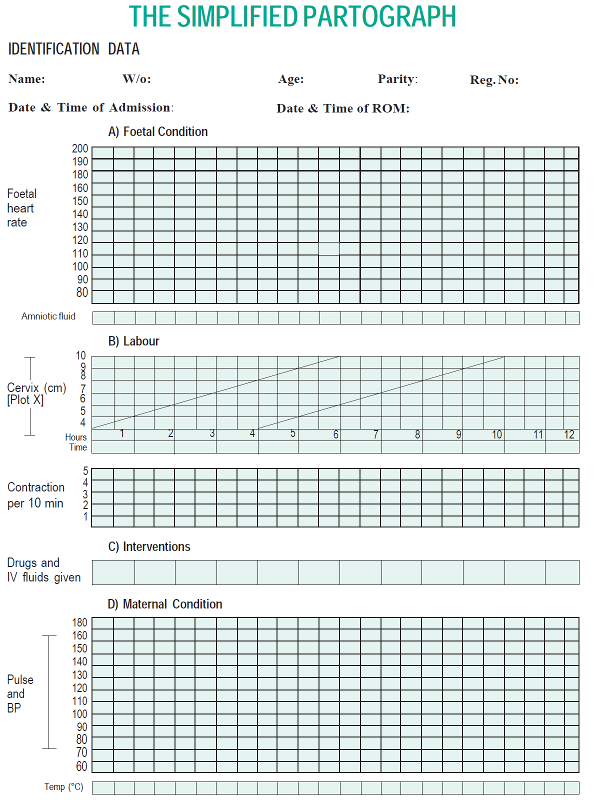
Radha
Gangaram
26 Years
G₃P₂L₂A₀
XYZ1
11/06/09,5:00Hrs
11/06/09, 04:00 Hrs
FHR = 140
FHR = 130
FHR = 136
FHR = 130
FHR = 140
FHR = 140
FHR = 136
FHR = 120
FHR = 120
AMNIOTIC FLUID CLEAR
AMNIOTIC FLUID CLEAR
AMNIOTIC FLUID CLEAR
AMNIOTIC FLUID CLEAR
AMNIOTIC FLUID CLEAR
AMNIOTIC FLUID CLEAR
AMNIOTIC FLUID CLEAR
AMNIOTIC FLUID CLEAR
AMNIOTIC FLUID CLEAR
AMNIOTIC FLUID CLEAR
AMNIOTIC FLUID CLEAR
C
C
C
C
C
C
C
C
C
Cervix fully dilated
Cervix dilated = 5cm
9 AM
10 AM
11 AM
12 PM
1 PM
3 CONTRACTION
3 CONTRACTION
3 CONTRACTION
3 CONTRACTION
4 CONTRACTION
4 CONTRACTION
3 CONTRACTION
4 CONTRACTION
4 CONTRACTION
BP 120/70mmhg
BP 100/70mmhg
Spontaneous birth of a live female infant weighing 2.85 kg at 1.20 PM
Pulse – 80/min
Pulse – 88/min
Pulse – 88/min
Pulse – 80/min
Pulse – 84/min
Pulse – 90/min
Pulse – 80/min
Pulse – 88/min
Pulse – 88/min
Temp – 36.8 C
Temp – 37 C
36.8 C
37 C

