Slide 1

DRUG PERFORMANCE ANALYSIS
A
Mini Project Report
Submitted in the partial fulfilment of the
Requirements for the Degree of BACHELOR OF ENGINEERING IN
INFORMATION TECHNOLOGY
BY
IMRAN – 1602-21-737-097
MIRZA – 1602-21-737-095
CHAITANYA– 1602-21-737-078
ABHIRAM – 1602-21-737-066
Department of Information Technology
Vasavi College of Engineering (Autonomous) (Affiliated to Osmania University)
Ibrahim Bagh, Hyderabad-31 2021

Slide 2
Department of Information Technology
Vasavi College of Engineering (Autonomous) (Affiliated to Osmania University)
Ibrahim Bagh, Hyderabad-31 2023
DECLARATION BY CANDIDATE
We, IMRAN, MIRZA, CHAITANYA, ABHIRAM bearing hall ticker numbers, 1602-21-737-097, 1602-21-737-095, 1602-21-737-078, 1602-21-737-066, hereby declare that the project report titled for the award of the degree of Bachelor of Engineering in Information Technology.
This is a record of bonafide work carried out by me and the results embodied in this project report have not been submitted to any other university or institute for the award of any other degree or diploma.
IMRAN
1602-21-737-097
MIRZA
1602-21-737-095
CHAITANYA
1602-21-737-078
ABHIRAM
1602-21-737-066
(Faculty in-charge)
(Head Dept. IT)

Slide 3
ACKNOWLEDGEMENTS
We are overwhelmed in all humbleness and gratefulness to acknowledge our debt to all those who have helped us put these ideas, well above the level of simplicity and into something concrete. We are extremely thankful to our college, Vasavi College of Engineering, Hyderabad for providing the opportunity to implement our project, "Drug Performance Analysis" which helped us in learning many new things.
We would like to express our gratitude to Ms. Sidam Aruna, Associate Professor, Vasavi College of Engineering, for the esteemed guidance, moral support and invaluable advice provided by her for the success of the project.
We are also thankful for our friends and peers for their help and encouragement throughout the project.
IMRAN
1602-21-737-097
MIRZA
1602-21-737-095
CHAITANYA
1602-21-737-078
ABHIRAM
1602-21-737-066
Date: 04-07-2023

Slide 4
ABSTRACT
The effective evaluation of drug performance plays a pivotal role in optimizing therapeutic outcomes and improving patient care. This project aims to utilize data-driven analysis techniques to assess and analyze the performance of pharmaceutical drugs in various therapeutic areas. By leveraging large-scale data sources, including clinical trials, electronic health records, and pharmacovigilance databases, we aim to identify patterns, trends, and factors influencing drug performance
The project begins with a comprehensive data collection phase, where relevant datasets are obtained and curated. These datasets encompass a wide range of variables, including patient demographics, treatment protocols, drug dosages, adverse events, and treatment responses. Following data preprocessing and cleaning, advanced statistical and machine learning algorithms are applied to extract meaningful insights and patterns.
Through our analysis, we aim to identify drugs that demonstrate superior efficacy, safety profiles, and tolerability. We examine factors such as drug-drug interactions, patient characteristics, and treatment adherence, which influence the overall therapeutic outcome. Moreover, we investigate the impact of various interventions, such as combination therapies and dose adjustments, on drug performance.

Slide 5
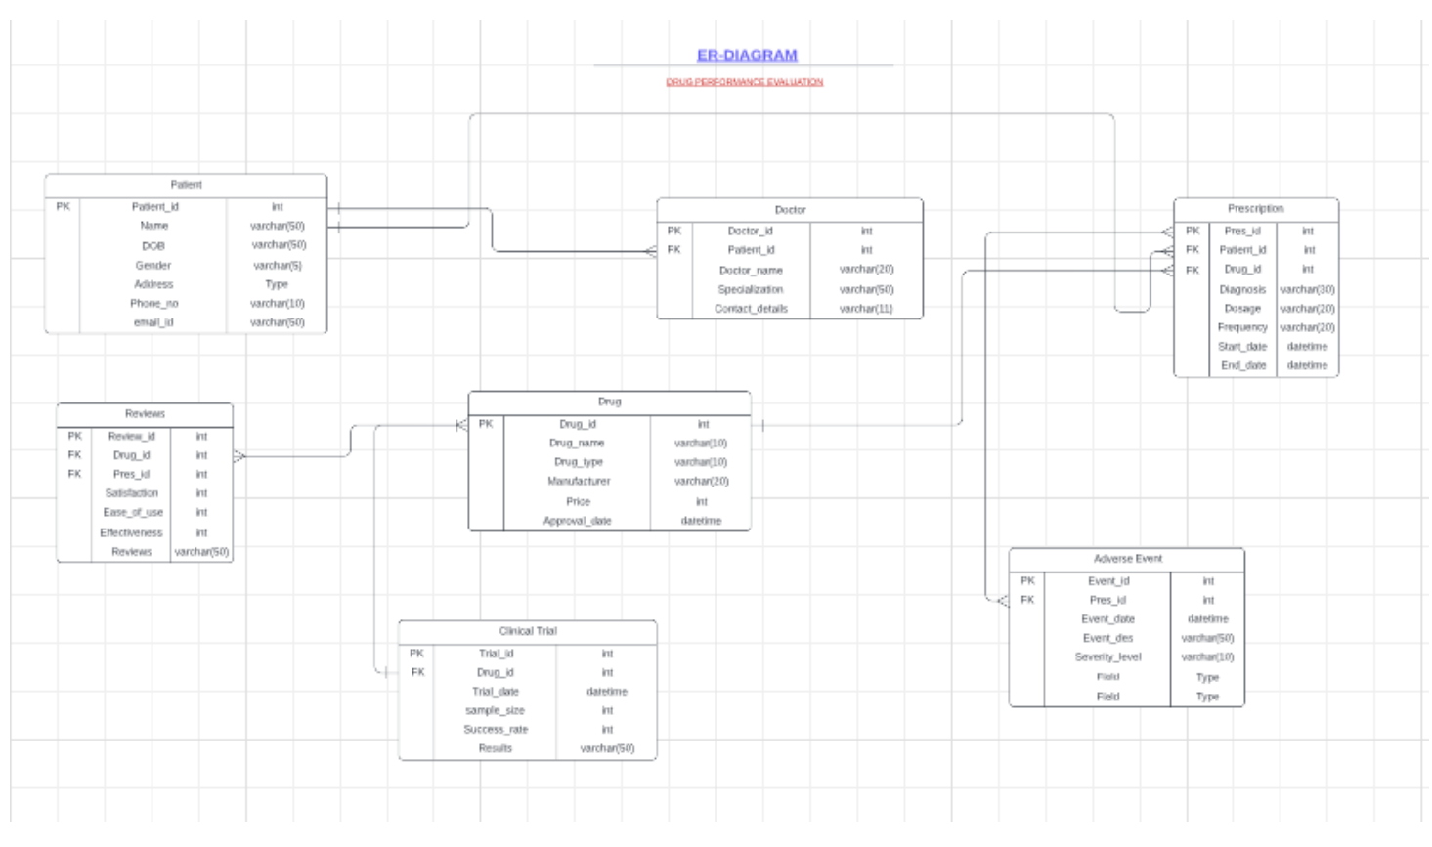
ER DIAGRAM
~ 5 ~

Slide 6
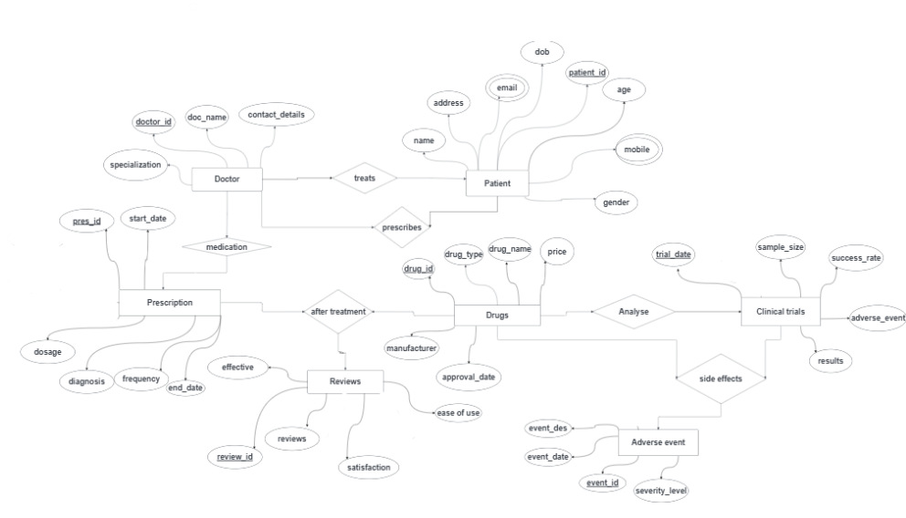

Slide 7
CARDINALITY
Mapping cardinalities:
• One doctor can have zero to many patients. (1:N)
• One patient can have zero to many prescriptions. (1:N)
• One drug can have zero to many prescriptions. (1:N)
• One drug can have zero to many clinical trials. (1:N)
• One drug can have zero to many reviews. (1:N)
• One prescription can have zero to many adverse events (1:N)

Slide 8
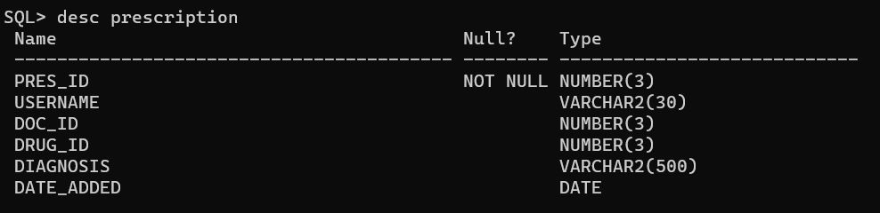
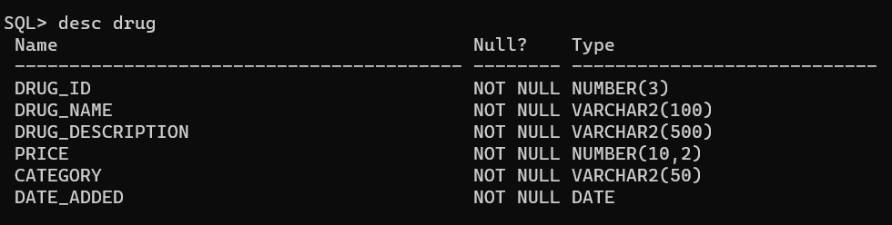
TABLES USED IN DATABASE
PRESCRIPTION TABLE :
DRUG TABLE :

Slide 9
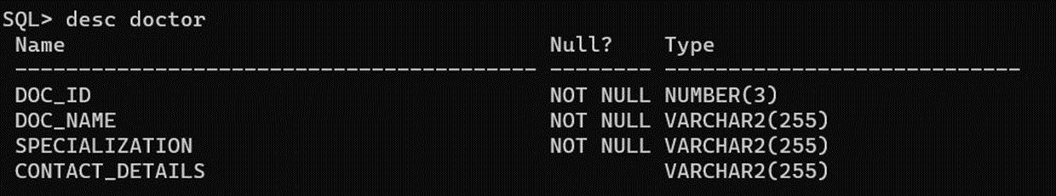
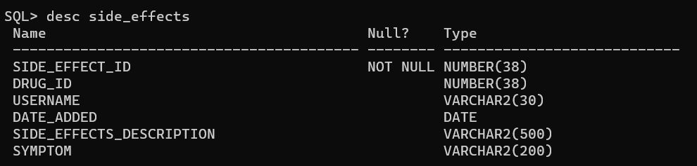
DOCTOR TABLE :
SIDEEFFECTS TABLE :

Slide 10
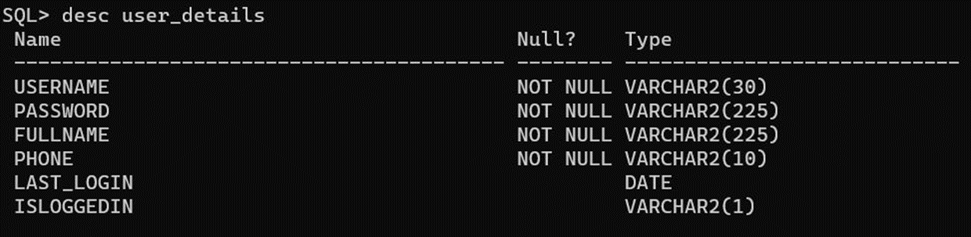
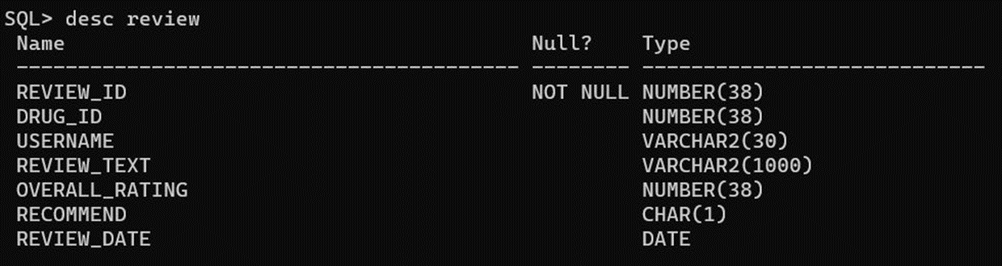
USER TABLE :
REVIEW TABLE :

Slide 11
DDL OPERATIONS :
SQL> CREATE TABLE Patient (
patient_id INT PRIMARY KEY,
name VARCHAR(50) NOT NULL,
date_of_birth DATE NOT NULL,
gender CHAR(1) NOT NULL,
address VARCHAR(100),
phone_number VARCHAR(20),
email VARCHAR(50) );
Table created.
SQL> CREATE TABLE Doctor (
doctor_id INT PRIMARY KEY, doctor_name VARCHAR(50) NOT NULL, specialization VARCHAR(50) NOT NULL, contact_details VARCHAR(100) );
Table created.
SQL> CREATE TABLE Drug (
drug_id INT PRIMARY KEY,
drug_name VARCHAR(50) NOT NULL, drug_type VARCHAR(50) NOT NULL, manufacturer VARCHAR(50) NOT NULL, approval_date DATE NOT NULL, side_effects VARCHAR(200),
price DECIMAL(10,2),
form VARCHAR(50) NOT NULL,
type VARCHAR(50) NOT NULL );
Table created.

Slide 12
SQL>
CREATE TABLE Prescription (
prescription_id INT PRIMARY KEY,
patient_id INT ,
drug_id INT,
diagnosis VARCHAR(200),
dosage VARCHAR(50),
frequency VARCHAR(50),
start_date DATE, end_date DATE, FOREIGN KEY (patient_id) REFERENCES Patient(patient_id), FOREIGN KEY (drug_id) REFERENCES Drug(drug_id) );
Table created.
SQL>
CREATE TABLE Reviews (
ReviewID INT PRIMARY KEY,
DrugID INT,
ConditionID INT,
Satisfaction INT,
EaseOfUse INT,
Effective INT,
Reviews VARCHAR(500),
FOREIGN KEY (DrugID) REFERENCES Drug(drug_id) );
Table created.

Slide 13
SQL>
CREATE TABLE Clinical_trial (
trial_id INT PRIMARY KEY,
drug_id INT,
trial_date DATE,
sample_size INT,
success_rate FLOAT,
adverse_events VARCHAR(500),
results VARCHAR(500),
FOREIGN KEY (drug_id) REFERENCES Drug(drug_id) );
Table created.
SQL>
CREATE TABLE Adverse_event (
event_id INT PRIMARY KEY,
prescription_id INT,
event_date DATE,
event_description VARCHAR(200),
severity_level VARCHAR(50),
FOREIGN KEY (prescription_id) REFERENCES Prescription(prescription_id) );
Table created.

Slide 14
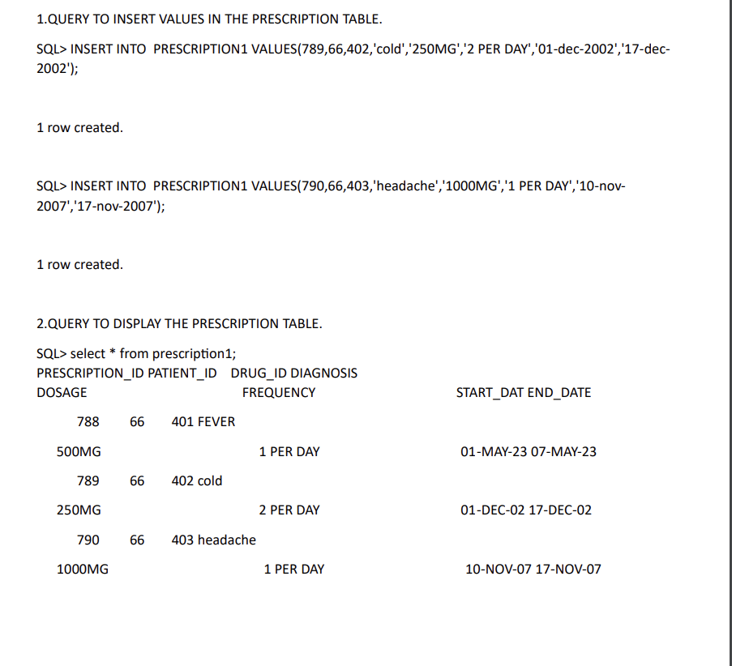
DML OPERATIONS :
1.QUERY TO INSERT VALUES IN THE PRESCRIPTION TABLE.
SQL> INSERT INTO PRESCRIPTION1 VALUES(
789,66,402,'cold','250MG','2 PER DAY','01-dec-2002','17-dec2002’);
1 row created.
SQL> INSERT INTO PRESCRIPTION1 VALUES(
790,66,403,'headache','1000MG','1 PER DAY','10-nov2007','17-nov-2007’);
1 row created.
2.QUERY TO DISPLAY THE PRESCRIPTION TABLE.
SQL> select * from prescription1;

Slide 15
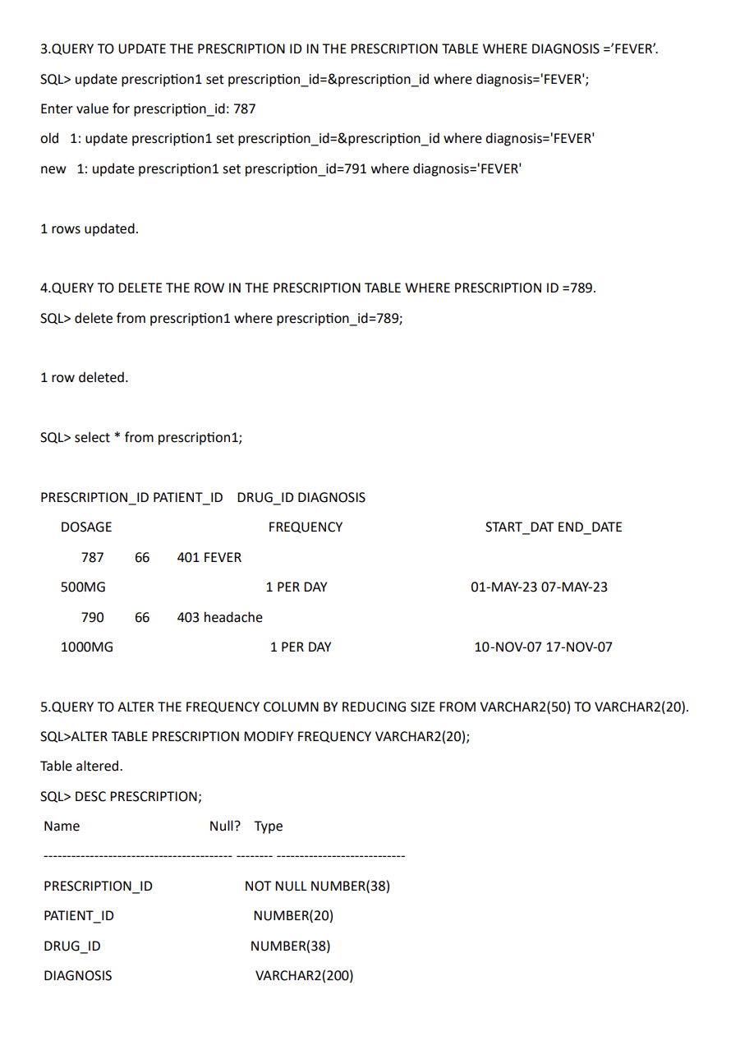

Slide 16
DOSAGE VARCHAR2(50) FREQUENCY VARCHAR(50)
START_DATE DATE
END_DATE DATE

Slide 17
Code for Home Page:
import javax.swing.*;
import java.awt.*;
import java.awt.event.MouseAdapter;
import java.awt.event.MouseEvent;
public class HomePage extends JFrame {
public static void main(String[] args) {
SwingUtilities.invokeLater(() -> {
HomePage homepage = new HomePage();
homepage.createAndShowGUI();
});
}
public void createAndShowGUI() {
setDefaultCloseOperation(JFrame.EXIT_ON_CLOSE);
setTitle("Project Homepage");
setSize(800, 600);
setLocationRelativeTo(null);
// Create the layout components
JPanel welcomeInfoImagePanel = new JPanel();
JPanel topPanel = new JPanel();
JPanel infoImagePanel = new JPanel();
JPanel infoPanel = new JPanel();
JPanel imagePanel = new JPanel();

Slide 18
// Create the buttons
JButton homeButton = new JButton("Home");
JButton reviewButton = new JButton("Review");
JButton profileButton = new JButton("Profile");
JButton logoutButton = new JButton("Logout");
JButton exitButton = new JButton("Exit");
// Set the button colors
Color buttonColor = new Color(17, 30, 108);
Color buttonHoverColor = new Color(175, 238, 238);
homeButton.setBackground(buttonColor);
homeButton.setForeground(Color.WHITE);
homeButton.setFocusPainted(false);
homeButton.addMouseListener(new ButtonHoverListener(homeButton, buttonColor, buttonHoverColor));
reviewButton.setBackground(buttonColor);
reviewButton.setForeground(Color.WHITE);
reviewButton.setFocusPainted(false);
reviewButton.addMouseListener(new ButtonHoverListener(reviewButton, buttonColor, buttonHoverColor));
profileButton.setBackground(buttonColor);
profileButton.setForeground(Color.WHITE);
profileButton.setFocusPainted(false);
profileButton.addMouseListener(new ButtonHoverListener(profileButton, buttonColor, buttonHoverColor));
logoutButton.setBackground(buttonColor);
logoutButton.setForeground(Color.WHITE);
logoutButton.setFocusPainted(false);
logoutButton.addMouseListener(new ButtonHoverListener(logoutButton, buttonColor, buttonHoverColor));

Slide 19
exitButton.setBackground(buttonColor);
exitButton.setForeground(Color.WHITE);
exitButton.setFocusPainted(false);
exitButton.addMouseListener(new ButtonHoverListener(exitButton, buttonColor, buttonHoverColor));
JLabel welcomeLabel = new JLabel("<html><body><font size='6'>Welcome!</font></body></html>");
// Create the project info label
JLabel infoLabel = new JLabel("<html><body><font size='5'>This is a project that allows users to search for medicine reviews, "
+ "insert new reviews, delete existing reviews, and update their own reviews.<br><br>"
+ "Please explore the various functionalities available!</font></body></html>");
infoLabel.setHorizontalAlignment(SwingConstants.CENTER);
// Create the image label
JLabel imageLabel = new JLabel();
ImageIcon imageIcon = new ImageIcon("image.jpg"); // Replace "path_to_image.jpg" with your image path
imageIcon.setImage(imageIcon.getImage().getScaledInstance(390, -1, Image.SCALE_SMOOTH)); // Adjust image size
imageLabel.setIcon(imageIcon);

Slide 20
// Set the layouts
welcomeInfoImagePanel.setLayout(new BorderLayout());
topPanel.setLayout(new BoxLayout(topPanel, BoxLayout.X_AXIS));
infoImagePanel.setLayout(new GridLayout(1, 2));
infoPanel.setLayout(new BorderLayout());
imagePanel.setLayout(new BorderLayout());
// Adjust the welcome message panel
JPanel welcomePanel = new JPanel(new FlowLayout(FlowLayout.CENTER));
welcomePanel.add(welcomeLabel);
welcomePanel.setBorder(BorderFactory.createEmptyBorder(10, 10, 10, 10)); // Add padding around the label
// Set background color for panels
topPanel.setBackground(Color.WHITE);
welcomePanel.setBackground(new Color(224, 236, 255));
infoPanel.setBackground(Color.WHITE);
imagePanel.setBackground(new Color(224, 236, 255));
// Add components to their respective containers
topPanel.add(homeButton);
topPanel.add(reviewButton);
topPanel.add(profileButton);
topPanel.add(logoutButton);
topPanel.add(Box.createHorizontalGlue()); // Add horizontal glue to right-align the exit button
topPanel.add(exitButton);
topPanel.setBackground(new Color(224, 236, 255));

Slide 21
welcomeInfoImagePanel.add(topPanel, BorderLayout.NORTH);
welcomeInfoImagePanel.add(welcomePanel, BorderLayout.CENTER);
infoPanel.add(infoLabel, BorderLayout.CENTER);
imagePanel.add(imageLabel, BorderLayout.CENTER);
infoImagePanel.add(infoPanel);
infoImagePanel.add(imagePanel);
infoPanel.setBackground(new Color(224, 236, 255));
// Add panels to the frame
getContentPane().setLayout(new BorderLayout());
getContentPane().add(welcomeInfoImagePanel, BorderLayout.NORTH);
getContentPane().add(infoImagePanel, BorderLayout.CENTER);
exitButton.addActionListener(e -> dispose());
/*homeButton.addActionListener(e -> {
dispose();
// Create and show the Home screen
HomePage homePage = new HomePage();
homePage.createAndShowGUI();
});*/
reviewButton.addActionListener(e -> {
dispose();
// Create and show the Review screen
Review review=new Review();
review.createAndShowGUI();

Slide 22
profileButton.addActionListener(e -> {
dispose();
// Create and show the Profile screen
Profile profilePage = new Profile();
profilePage.createAndShowGUI();
});
logoutButton.addActionListener(e -> {
dispose();
LoginSignUpScreen loginSignUpScreen = new LoginSignUpScreen();
loginSignUpScreen.setVisible(true);
});
setVisible(true);
}
private static class ButtonHoverListener extends MouseAdapter {
private final JButton button;
private final Color originalColor;
private final Color hoverColor;
public ButtonHoverListener(JButton button, Color originalColor, Color hoverColor) {
this.button = button;
this.originalColor = originalColor;
this.hoverColor = hoverColor;
}

Slide 23
@Override
public void mouseEntered(MouseEvent e) {
button.setBackground(hoverColor);
}
@Override
public void mouseExited(MouseEvent e) {
button.setBackground(originalColor);
}
}
}

Slide 24
CODE FOR EDIT PROFILE :
import javax.swing.*;
import java.awt.*;
import java.awt.event.MouseAdapter;
import java.awt.event.MouseEvent;
import java.sql.*;
public class EditProfile extends JFrame {
private static final String JDBC_URL = "jdbc:oracle:thin:@localhost:1521:orcl"; // Update with your database connection URL
private static final String USERNAME = "sys as sysdba"; // Replace with your database username
private static final String PASSWORD = "vasavi"; // Replace with your database password
private JButton homeButton;
private JButton reviewButton;
private JButton profileButton;
private JButton logoutButton;
private JButton exitButton;
private JLabel usernameValueLabel;
private JTextField passwordTextField;
private JTextField fullNameTextField;
private JTextField phoneTextField;
public static void main(String[] args) {
SwingUtilities.invokeLater(EditProfile::new);
}
public EditProfile() {
createAndShowGUI();
}
public void createAndShowGUI() {
setDefaultCloseOperation(JFrame.EXIT_ON_CLOSE);
setTitle("Edit Profile");
setSize(800, 600);
setLocationRelativeTo(null);
// Create the layout components
JPanel topPanel = new JPanel();
JPanel infoPanel = new JPanel();
JPanel titlePanel = new JPanel();
JPanel buttonPanel = new JPanel();
// Create the buttons
homeButton = new JButton("Home");
reviewButton = new JButton("Review");
profileButton = new JButton("Profile");
logoutButton = new JButton("Logout");
exitButton = new JButton("Exit");
JButton submitButton = new JButton("Submit");

Slide 25
// Set the button colors
Color buttonColor = new Color(17, 30, 108);
Color buttonHoverColor = new Color(102, 204, 255);
setButtonStyles(homeButton, buttonColor, buttonHoverColor);
setButtonStyles(reviewButton, buttonColor, buttonHoverColor);
setButtonStyles(profileButton, buttonColor, buttonHoverColor);
setButtonStyles(logoutButton, buttonColor, buttonHoverColor);
setButtonStyles(exitButton, buttonColor, buttonHoverColor);
JLabel editProfileLabel = new JLabel("<html><body><font size='6'>Edit Profile</font></body></html>");
// Set the layouts
topPanel.setLayout(new BoxLayout(topPanel, BoxLayout.X_AXIS));
infoPanel.setLayout(new GridLayout(0, 2, 10, 10)); // GridLayout with 2 columns and 10px spacing
titlePanel.setLayout(new BorderLayout());
buttonPanel.setLayout(new FlowLayout(FlowLayout.CENTER));
// Set background color for panels
topPanel.setBackground(new Color(224, 236, 255));
infoPanel.setBackground(new Color(224, 236, 255));
titlePanel.setBackground(new Color(224, 236, 255)); // Light blue color
buttonPanel.setBackground(new Color(224, 236, 255));
// Add components to their respective containers
topPanel.add(homeButton);
topPanel.add(reviewButton);
topPanel.add(profileButton);
topPanel.add(logoutButton);
topPanel.add(Box.createHorizontalGlue()); // Add horizontal glue to right-align the exit button
topPanel.add(exitButton);
titlePanel.add(editProfileLabel, BorderLayout.NORTH);
// Add labels and text fields to infoPanel
infoPanel.add(new JLabel("Username:"));
usernameValueLabel = new JLabel();
infoPanel.add(usernameValueLabel);
infoPanel.add(new JLabel("Password:"));
passwordTextField = new JTextField();
infoPanel.add(passwordTextField);
infoPanel.add(new JLabel("Full Name:"));
fullNameTextField = new JTextField();
infoPanel.add(fullNameTextField);
infoPanel.add(new JLabel("Phone:"));
phoneTextField = new JTextField();
infoPanel.add(phoneTextField);
// Set label and text field properties
usernameValueLabel.setBorder(BorderFactory.createLineBorder(Color.GRAY, 1));
usernameValueLabel.setHorizontalAlignment(SwingConstants.CENTER);
usernameValueLabel.setOpaque(true);
usernameValueLabel.setBackground(new Color(230, 230, 230)); // Light gray color
usernameValueLabel.setForeground(Color.BLACK);

Slide 26
passwordTextField.setBorder(BorderFactory.createLineBorder(Color.GRAY, 1));
fullNameTextField.setBorder(BorderFactory.createLineBorder(Color.GRAY, 1));
phoneTextField.setBorder(BorderFactory.createLineBorder(Color.GRAY, 1));
// Add submit button to buttonPanel
buttonPanel.add(submitButton);
// Add panels to the frame
getContentPane().setLayout(new BorderLayout());
getContentPane().add(topPanel, BorderLayout.NORTH);
getContentPane().add(titlePanel, BorderLayout.CENTER);
getContentPane().add(infoPanel, BorderLayout.CENTER);
getContentPane().add(buttonPanel, BorderLayout.SOUTH);
exitButton.addActionListener(e -> dispose());
logoutButton.addActionListener(e -> {
dispose();
LoginSignUpScreen loginSignUpScreen = new LoginSignUpScreen();
loginSignUpScreen.setVisible(true);
});
// Add action listeners to the buttons
homeButton.addActionListener(e -> {
dispose();
HomePage homepage = new HomePage();
homepage.createAndShowGUI();
});
reviewButton.addActionListener(e -> {
dispose();
Review review = new Review();
review.createAndShowGUI();
});
profileButton.addActionListener(e -> {
dispose();
Profile profile = new Profile();
profile.setVisible(true);
});
fetchUserDetails(); // Fetch user details from the database
submitButton.addActionListener(e -> {
updateProfile();
});
setVisible(true);
}

Slide 27
private void setButtonStyles(JButton button, Color buttonColor, Color buttonHoverColor) {
button.setBackground(buttonColor);
button.setForeground(Color.WHITE);
button.setFocusPainted(false);
button.addMouseListener(new ButtonHoverListener(button, buttonColor, buttonHoverColor));
}
private void fetchUserDetails() {
try {
Connection connection = DriverManager.getConnection(JDBC_URL, USERNAME, PASSWORD);
PreparedStatement preparedStatement = connection.prepareStatement("SELECT * FROM
user_details WHERE isloggedin = 'Y'");
ResultSet resultSet = preparedStatement.executeQuery();
if (resultSet.next()) {
String username = resultSet.getString("USERNAME");
String password = resultSet.getString("PASSWORD");
String fullName = resultSet.getString("FULLNAME");
String phone = resultSet.getString("PHONE");
usernameValueLabel.setText(username);
passwordTextField.setText(password);
fullNameTextField.setText(fullName);
phoneTextField.setText(phone);
} else {
JOptionPane.showMessageDialog(this, "User details not found!");
}
resultSet.close();
preparedStatement.close();
connection.close();
} catch (SQLException e) {
e.printStackTrace();
JOptionPane.showMessageDialog(this, "Failed to fetch user details from the database!");
}
}
private void updateProfile() {
try {
String password = passwordTextField.getText();
String fullName = fullNameTextField.getText();
String phone = phoneTextField.getText();
Connection connection = DriverManager.getConnection(JDBC_URL, USERNAME, PASSWORD);
PreparedStatement preparedStatement = connection.prepareStatement("UPDATE user_details SET password=?, fullname = ?, phone = ? WHERE isloggedin = 'Y'");
preparedStatement.setString(1, password);
preparedStatement.setString(2, fullName);
preparedStatement.setString(3, phone);
int rowsUpdated = preparedStatement.executeUpdate();
if (rowsUpdated > 0) {
JOptionPane.showMessageDialog(this, "Profile updated successfully!");
} else {
JOptionPane.showMessageDialog(this, "Failed to update profile!");
}

Slide 28
preparedStatement.close();
connection.close();
} catch (SQLException e) {
e.printStackTrace();
JOptionPane.showMessageDialog(this, "Failed to update profile!");
}
}
private static class ButtonHoverListener extends MouseAdapter {
private final JButton button;
private final Color originalColor;
private final Color hoverColor;
public ButtonHoverListener(JButton button, Color originalColor, Color hoverColor) {
this.button = button;
this.originalColor = originalColor;
this.hoverColor = hoverColor;
}
@Override
public void mouseEntered(MouseEvent e) {
button.setBackground(hoverColor);
}
@Override
public void mouseExited(MouseEvent e) {
button.setBackground(originalColor);
}
}
}

Slide 29
CODE FOR LOGIN
import javax.swing.*;
import java.awt.*;
import java.awt.event.ActionEvent;
import java.awt.event.ActionListener;
import java.sql.*;
public class LoginSignUpScreen extends JFrame {
private static final String DB_URL = "jdbc:oracle:thin:@localhost:1521:orcl";
private static final String DB_USER = "sys as sysdba";
private static final String DB_PASSWORD = "vasavi";
private JTextField usernameField;
private JPasswordField passwordField;
public LoginSignUpScreen() {
setTitle("Login and Sign Up");
setDefaultCloseOperation(JFrame.EXIT_ON_CLOSE);
setSize(800, 600);
setLocationRelativeTo(null); // Center the frame on the screen
// Create the content pane
JPanel contentPane = new JPanel(new BorderLayout());
contentPane.setBackground(new Color(224, 236, 255)); // Set background color
// Left section - Logo and title
JPanel logoPanel = new JPanel();
logoPanel.setBackground(new Color(224, 236, 255));
logoPanel.setBorder(BorderFactory.createEmptyBorder(10, 10, 10, 10));
ImageIcon logoIcon = new ImageIcon("logo.png");
Image scaledImage = logoIcon.getImage().getScaledInstance(200, 200, Image.SCALE_SMOOTH);
ImageIcon scaledLogoIcon = new ImageIcon(scaledImage);
JLabel logoLabel = new JLabel(scaledLogoIcon);
logoPanel.add(logoLabel);
JPanel titlePanel = new JPanel();
titlePanel.setBackground(new Color(224, 236, 255));
JLabel titleLabel = new JLabel("Drug Performance Analysis");
titleLabel.setFont(new Font("Arial", Font.BOLD, 28)); // Increase font size
titlePanel.add(titleLabel);
JPanel leftPanel = new JPanel(new BorderLayout());
leftPanel.setBackground(new Color(224, 236, 255));
leftPanel.add(logoPanel, BorderLayout.NORTH);
leftPanel.add(titlePanel, BorderLayout.CENTER);
contentPane.add(leftPanel, BorderLayout.WEST);

Slide 30
// Right section - Login and sign up form
JPanel formPanel = new JPanel();
formPanel.setBackground(new Color(224, 236, 255));
formPanel.setBorder(BorderFactory.createEmptyBorder(20, 20, 20, 20));
formPanel.setLayout(new BoxLayout(formPanel, BoxLayout.Y_AXIS));
JLabel usernameLabel = new JLabel("Username:");
usernameLabel.setFont(new Font("Arial", Font.BOLD, 16)); // Increase font size
usernameField = new JTextField(20);
JLabel passwordLabel = new JLabel("Password:");
passwordLabel.setFont(new Font("Arial", Font.BOLD, 16)); // Increase font size
passwordField = new JPasswordField(20);
JButton loginButton = new JButton("Sign In");
loginButton.addActionListener(new ActionListener() {
public void actionPerformed(ActionEvent e) {
String username = usernameField.getText();
String password = new String(passwordField.getPassword());
verifyLogin(username, password);
}
});
JButton createUserButton = new JButton("Create User");
createUserButton.addActionListener(new ActionListener() {
public void actionPerformed(ActionEvent e) {
dispose();
new CreateUserScreen();
}
});
formPanel.add(usernameLabel);
formPanel.add(Box.createVerticalStrut(5)); // Add separation
formPanel.add(usernameField);
formPanel.add(Box.createVerticalStrut(10));
formPanel.add(passwordLabel);
formPanel.add(Box.createVerticalStrut(5)); // Add separation
formPanel.add(passwordField);
formPanel.add(Box.createVerticalStrut(20)); // Add separation
formPanel.add(loginButton);
formPanel.add(Box.createVerticalStrut(10));
formPanel.add(createUserButton);
JPanel rightPanel = new JPanel(new FlowLayout(FlowLayout.CENTER));
rightPanel.setBackground(new Color(224, 236, 255));
rightPanel.setBorder(BorderFactory.createMatteBorder(0, 1, 0, 0, Color.GRAY)); // Add border on the right side
rightPanel.add(formPanel);
contentPane.add(rightPanel, BorderLayout.CENTER);
setContentPane(contentPane);
}

Slide 31
private void verifyLogin(String username, String password) {
try {
Connection connection = DriverManager.getConnection(DB_URL, DB_USER, DB_PASSWORD);
PreparedStatement statement = connection.prepareStatement("SELECT * FROM USER_DETAILS WHERE USERNAME = ? AND PASSWORD = ?");
statement.setString(1, username);
statement.setString(2, password);
ResultSet resultSet = statement.executeQuery();
boolean loginSuccessful = resultSet.next();
if (loginSuccessful) {
// Update isLoggedIn column to 'Y' for the logged-in user
PreparedStatement updateStatement = connection.prepareStatement("UPDATE USER_DETAILS SET isLoggedIn = 'Y' WHERE USERNAME = ?");
updateStatement.setString(1, username);
updateStatement.executeUpdate();
updateStatement.close();
// Close the LoginSignUpScreen
dispose();
// Open the HomePage screen
HomePage homePage = new HomePage();
homePage.createAndShowGUI();
} else {
JOptionPane.showMessageDialog(this, "Invalid username or password. Please try again.");
}
resultSet.close();
statement.close();
connection.close();
} catch (SQLException e) {
e.printStackTrace();
}
}
public static void main(String[] args) {
SwingUtilities.invokeLater(new Runnable() {
public void run() {
try {
// Set look and feel to the system default
UIManager.setLookAndFeel(UIManager.getSystemLookAndFeelClassName());
} catch (Exception e) {
e.printStackTrace();
}
LoginSignUpScreen loginSignUpScreen = new LoginSignUpScreen();
loginSignUpScreen.setVisible(true);
}
});
}
}

Slide 32
CODE FOR INSERT
import javax.swing.*;
import java.awt.*;
import java.awt.event.ActionEvent;
import java.awt.event.ActionListener;
import java.sql.*;
public class InsertReview {
private JFrame frame;
private JPanel mainPanel;
private JTextField drugNameTextField;
private JTextField priceTextField;
private JTextField categoryTextField;
private JTextArea drugDescriptionTextArea;
private JTextField docNameTextField;
private JTextField specializationTextField;
private JTextField contactDetailsTextField;
private JTextArea diagnosisTextArea;
private JTextArea reviewTextArea;
private JTextField ratingTextField;
private JCheckBox recommendCheckBox;
private JTextField effectTextField;
private JTextField symptomTextField;
private JButton submitButton;
private JButton backButton;
public InsertReview() {
createGUI();
createListeners();
}
private void createGUI() {
// Create the main frame
frame = new JFrame("Insert Review");
frame.setDefaultCloseOperation(JFrame.EXIT_ON_CLOSE);
// Create the main panel
mainPanel = new JPanel();
mainPanel.setLayout(new GridLayout(14, 2, 10, 8));

Slide 33
// Create the form components
JLabel drugNameLabel = new JLabel("Drug Name:");
drugNameTextField = new JTextField(20);
JLabel priceLabel = new JLabel("Price:");
priceTextField = new JTextField(20);
JLabel categoryLabel = new JLabel("Category:");
categoryTextField = new JTextField(20);
JLabel drugDescriptionLabel = new JLabel("Drug Description:");
drugDescriptionTextArea = new JTextArea(5, 20);
drugDescriptionTextArea.setLineWrap(true);
JLabel docNameLabel = new JLabel("Doctor Name:");
docNameTextField = new JTextField(20);
JLabel specializationLabel = new JLabel("Specialization:");
specializationTextField = new JTextField(20);
JLabel contactDetailsLabel = new JLabel("Contact Details:");
contactDetailsTextField = new JTextField(20);
JLabel diagnosisLabel = new JLabel("Diagnosis:");
diagnosisTextArea = new JTextArea(5, 20);
diagnosisTextArea.setLineWrap(true);
JLabel reviewLabel = new JLabel("Review:");
reviewTextArea = new JTextArea(5, 20);
reviewTextArea.setLineWrap(true);
JLabel ratingLabel = new JLabel("Rating:");
ratingTextField = new JTextField(20);
JLabel recommendLabel = new JLabel("Recommend:");
recommendCheckBox = new JCheckBox();
JLabel effectLabel = new JLabel("Side Effect:");
effectTextField = new JTextField( 20);
JLabel symptomLabel = new JLabel("Symptom:");
symptomTextField= new JTextField( 20);
// Create the buttons
submitButton = new JButton("Submit");
backButton = new JButton("Back");
// Add components to the main panel
mainPanel.add(drugNameLabel);
mainPanel.add(drugNameTextField);
mainPanel.add(priceLabel);
mainPanel.add(priceTextField);
mainPanel.add(categoryLabel);
mainPanel.add(categoryTextField);
mainPanel.add(drugDescriptionLabel);
mainPanel.add(new JScrollPane(drugDescriptionTextArea));
mainPanel.add(docNameLabel);
mainPanel.add(docNameTextField);
mainPanel.add(specializationLabel);
mainPanel.add(specializationTextField);
mainPanel.add(contactDetailsLabel);

Slide 34
mainPanel.add(contactDetailsTextField);
mainPanel.add(diagnosisLabel);
mainPanel.add(new JScrollPane(diagnosisTextArea));
mainPanel.add(reviewLabel);
mainPanel.add(new JScrollPane(reviewTextArea));
mainPanel.add(ratingLabel);
mainPanel.add(ratingTextField);
mainPanel.add(recommendLabel);
mainPanel.add(recommendCheckBox);
mainPanel.add(effectLabel);
mainPanel.add(effectTextField);
mainPanel.add(symptomLabel);
mainPanel.add(symptomTextField);
mainPanel.add(submitButton);
mainPanel.add(backButton);
mainPanel.setBackground(new Color(224, 236, 255));
// Add the main panel to the frame
frame.getContentPane().add(mainPanel);
frame.pack();
frame.setVisible(true);
}
private void createListeners() {
submitButton.addActionListener(new ActionListener() {
@Override
public void actionPerformed(ActionEvent e) {
// Get input values
String drugName = drugNameTextField.getText();
String price = priceTextField.getText();
String category = categoryTextField.getText();
String drugDescription = drugDescriptionTextArea.getText();
String docName = docNameTextField.getText();
String specialization = specializationTextField.getText();
String contactDetails = contactDetailsTextField.getText();
String diagnosis = diagnosisTextArea.getText();
String review = reviewTextArea.getText();
String rating = ratingTextField.getText();
boolean recommend = recommendCheckBox.isSelected();
String effect=effectTextField.getText();
String symptom=symptomTextField.getText();
// Insert data into tables
try {
// Create database connection
Connection connection = DriverManager.getConnection("jdbc:oracle:thin:@localhost:1521:orcl", "sys as sysdba", "vasavi");
// Insert into drug table
String drugQuery = "INSERT INTO drug (DRUG_NAME, DRUG_DESCRIPTION, PRICE, CATEGORY) VALUES (?, ?, ?, ?)";
PreparedStatement drugStatement = connection.prepareStatement(drugQuery);
drugStatement.setString(1, drugName);
drugStatement.setString(2, drugDescription);
drugStatement.setString(3, price);
drugStatement.setString(4, category);
drugStatement.executeUpdate();

Slide 35
// Get the auto-generated drug_id
String lastDrugIdQuery = "SELECT MAX(DRUG_ID) FROM drug";
PreparedStatement lastDrugIdStatement = connection.prepareStatement(lastDrugIdQuery);
int drugId = 0;
ResultSet lastDrugIdResult = lastDrugIdStatement.executeQuery();
if (lastDrugIdResult.next()) {
drugId = lastDrugIdResult.getInt(1);
}
// Insert into doctor table
String doctorQuery = "INSERT INTO doctor (DOC_NAME, SPECIALIZATION, CONTACT_DETAILS) VALUES (?, ?, ?)";
PreparedStatement doctorStatement = connection.prepareStatement(doctorQuery);
doctorStatement.setString(1, docName);
doctorStatement.setString(2, specialization);
doctorStatement.setString(3, contactDetails);
doctorStatement.executeUpdate();
// Get the auto-generated doc_id
String lastDocIdQuery = "SELECT MAX(DOC_ID) FROM doctor";
PreparedStatement lastDocIdStatement = connection.prepareStatement(lastDocIdQuery);
int docId = 0;
ResultSet lastDocIdResult = lastDocIdStatement.executeQuery();
if (lastDocIdResult.next()) {
docId = lastDocIdResult.getInt(1);
}
// Insert into prescription table
String prescriptionQuery = "INSERT INTO prescription (USERNAME, DOC_ID, DRUG_ID, DIAGNOSIS) VALUES (?, ?, ?, ?)";
PreparedStatement prescriptionStatement = connection.prepareStatement(prescriptionQuery);
prescriptionStatement.setString(1, "username"); // replace with the actual username
prescriptionStatement.setInt(2, docId);
prescriptionStatement.setInt(3, drugId);
prescriptionStatement.setString(4, diagnosis);
prescriptionStatement.executeUpdate();
// Insert into review table
String reviewQuery = "INSERT INTO review (DRUG_ID, USERNAME, REVIEW_TEXT, OVERALL_RATING, RECOMMEND) VALUES (?, ?, ?, ?, ?)";
PreparedStatement reviewStatement = connection.prepareStatement(reviewQuery);
reviewStatement.setInt(1, drugId);
reviewStatement.setString(2, "username"); // replace with the actual username
reviewStatement.setString(3, review);
reviewStatement.setString(4, rating);
reviewStatement.setBoolean(5, recommend);
reviewStatement.executeUpdate();
// Insert into side_effects table
String sideEffectsQuery = "INSERT INTO side_effects (DRUG_ID, USERNAME, DATE_ADDED, SIDE_EFFECTS_DESCRIPTION, SYMPTOM) VALUES (?, ?, NOW(), ?, ?)";
PreparedStatement sideEffectsStatement = connection.prepareStatement(sideEffectsQuery);
sideEffectsStatement.setInt(1, drugId);
sideEffectsStatement.setString(2, "username"); // replace with the actual username
sideEffectsStatement.setString(3, effect); // replace with the actual side effects description
sideEffectsStatement.setString(4, symptom); // replace with the actual symptom
sideEffectsStatement.executeUpdate();

Slide 36
// Close database connection
connection.close();
// Show success message
JOptionPane.showMessageDialog(frame, "Review inserted successfully!");
} catch (SQLException ex) {
ex.printStackTrace();
// Show error message
JOptionPane.showMessageDialog(frame, "Error inserting review. Please try again.");
}
}
});
backButton.addActionListener(new ActionListener() {
@Override
public void actionPerformed(ActionEvent e) {
// Go back to previous screen
frame.dispose();
// Call the method or navigate to the previous screen
Review review = new Review();
review.createAndShowGUI();
}
});
}
public static void main(String[] args) {
SwingUtilities.invokeLater(new Runnable() {
@Override
public void run() {
new InsertReview();
}
});
}
}

Slide 37
CODE FOR DELETE :
import javax.swing.*;
import java.awt.*;
import java.awt.event.ActionEvent;
import java.awt.event.ActionListener;
import java.sql.*;
public class DeleteReview {
private JFrame frame;
private JTextField drugNameTextField;
private JButton searchButton;
private JTextArea resultTextArea;
private JButton backButton;
private JButton exitButton;
public DeleteReview() {
frame = new JFrame("Delete Review");
frame.setDefaultCloseOperation(JFrame.EXIT_ON_CLOSE);
frame.setLayout(new BorderLayout());
frame.setPreferredSize(new Dimension(800, 600));
frame.setLocationRelativeTo(null);
JPanel mainPanel = new JPanel();
mainPanel.setLayout(new BorderLayout());
JPanel inputPanel = new JPanel();
inputPanel.setLayout(new FlowLayout());
inputPanel.add(new JLabel("Drug Name:"));
drugNameTextField = new JTextField(20);
inputPanel.add(drugNameTextField);
JPanel buttonPanel = new JPanel();
searchButton = new JButton("Search");
backButton = new JButton("Back");
exitButton = new JButton("Exit");
buttonPanel.add(searchButton);
buttonPanel.add(backButton);
buttonPanel.add(exitButton);
mainPanel.add(inputPanel, BorderLayout.NORTH);
mainPanel.add(buttonPanel, BorderLayout.SOUTH);
resultTextArea = new JTextArea(10, 30);
resultTextArea.setEditable(false);
resultTextArea.setBorder(BorderFactory.createTitledBorder(BorderFactory.createEtchedBorder(), "Reviews"));
resultTextArea.setBackground(new Color(224, 236, 255));
frame.add(mainPanel, BorderLayout.NORTH);
frame.add(new JScrollPane(resultTextArea), BorderLayout.CENTER);
createListeners();

Slide 38
frame.pack();
frame.setVisible(true);
}
private void createListeners() {
searchButton.addActionListener(new ActionListener() {
@Override
public void actionPerformed(ActionEvent e) {
String drugName = drugNameTextField.getText();
if (drugName.isEmpty()) {
JOptionPane.showMessageDialog(frame, "Please enter a drug name.");
return;
}
try {
Connection connection = DriverManager.getConnection("jdbc:oracle:thin:@localhost:1521:orcl", "sys as sysdba", "vasavi");
// Check if review exists for the specified drug and user
String loggedInUserQuery = "SELECT * FROM user_details WHERE isloggedin = 'Y'";
PreparedStatement loggedInUserStatement = connection.prepareStatement(loggedInUserQuery);
ResultSet loggedInUserResult = loggedInUserStatement.executeQuery();
String loggedInUser = "";
if (loggedInUserResult.next()) {
loggedInUser = loggedInUserResult.getString("USERNAME");
}
String reviewQuery = "SELECT * FROM review WHERE USERNAME = ?";
PreparedStatement reviewStatement = connection.prepareStatement(reviewQuery);
reviewStatement.setString(1, loggedInUser);
ResultSet reviewResult = reviewStatement.executeQuery();
StringBuilder reviews = new StringBuilder();
while (reviewResult.next()) {
int reviewID = reviewResult.getInt("REVIEW_ID");
String reviewText = reviewResult.getString("REVIEW_TEXT");
reviews.append("Review ID: ").append(reviewID).append("\n")
.append("Review Text: ").append(reviewText).append("\n\n");
}
if (reviews.length() > 0) {
resultTextArea.setText(reviews.toString());
} else {
resultTextArea.setText("No reviews found for the specified drug.");
}
connection.close();
} catch (SQLException ex) {
ex.printStackTrace();
JOptionPane.showMessageDialog(frame, "Error retrieving reviews. Please try again.");
}
}
});

Slide 39
backButton.addActionListener(new ActionListener() {
@Override
public void actionPerformed(ActionEvent e) {
// Code to navigate back to the previous screen (LoginSignUpScreen.java)
frame.dispose();
new LoginSignUpScreen();
}
});
exitButton.addActionListener(new ActionListener() {
@Override
public void actionPerformed(ActionEvent e) {
frame.dispose();
}
});
}
public static void main(String[] args) {
SwingUtilities.invokeLater(new Runnable() {
@Override
public void run() {
new DeleteReview();
}
});
}
}

Slide 40
CODE FOR CREATE USER :
import javax.swing.*;
import java.awt.*;
import java.awt.event.ActionEvent;
import java.awt.event.ActionListener;
import java.sql.*;
public class CreateUserScreen {
private JFrame frame;
private JTextField usernameTextField;
private JPasswordField passwordField;
private JPasswordField reenterPasswordField; // New field for re-entering password
private JTextField fullNameTextField;
private JTextField phoneTextField;
private JButton createButton;
private JButton exitButton;
private JButton backButton; // New back button
public CreateUserScreen() {
frame = new JFrame("Create User");
frame.setDefaultCloseOperation(JFrame.EXIT_ON_CLOSE);
frame.setLayout(new BorderLayout());
frame.setPreferredSize(new Dimension(800, 600));
frame.setLocationRelativeTo(null);
JPanel mainPanel = new JPanel();
mainPanel.setLayout(new GridBagLayout());
mainPanel.setBackground(new Color(224, 236, 255)); // Set light blue background color
GridBagConstraints gbc = new GridBagConstraints();
gbc.anchor = GridBagConstraints.WEST;
gbc.insets = new Insets(10, 10, 10, 10); // Add padding
mainPanel.add(createTitleLabel("Register", SwingConstants.CENTER), gbc); // Add title label
gbc.gridy = 1;
mainPanel.add(createLabel("Username:"), gbc);
gbc.gridx = 1;
usernameTextField = new JTextField(20);
mainPanel.add(usernameTextField, gbc);
gbc.gridy = 2;
gbc.gridx = 0;
mainPanel.add(createLabel("Password:"), gbc);
gbc.gridx = 1;
passwordField = new JPasswordField(20);
mainPanel.add(passwordField, gbc);
gbc.gridy = 3;
gbc.gridx = 0;
mainPanel.add(createLabel("Re-enter Password:"), gbc);
gbc.gridx = 1;
reenterPasswordField = new JPasswordField(20);
mainPanel.add(reenterPasswordField, gbc);

Slide 41
gbc.gridy = 4;
gbc.gridx = 0;
mainPanel.add(createLabel("Full Name:"), gbc);
gbc.gridx = 1;
fullNameTextField = new JTextField(20);
mainPanel.add(fullNameTextField, gbc);
gbc.gridy = 5;
gbc.gridx = 0;
mainPanel.add(createLabel("Phone:"), gbc);
gbc.gridx = 1;
phoneTextField = new JTextField(20);
mainPanel.add(phoneTextField, gbc);
createButton = new JButton("Create");
exitButton = new JButton("Exit");
backButton = new JButton("Back"); // Create back button
JPanel buttonPanel = new JPanel();
buttonPanel.setBackground(new Color(224, 236, 255)); // Set light blue background color
buttonPanel.add(createButton);
buttonPanel.add(exitButton);
buttonPanel.add(backButton); // Add back button to button panel
frame.add(mainPanel, BorderLayout.CENTER);
frame.add(buttonPanel, BorderLayout.SOUTH);
createButton.addActionListener(new ActionListener() {
@Override
public void actionPerformed(ActionEvent e) {
String username = usernameTextField.getText();
String password = new String(passwordField.getPassword());
String reenteredPassword = new String(reenterPasswordField.getPassword());
String fullName = fullNameTextField.getText();
String phone = phoneTextField.getText();
if (username.isEmpty() || password.isEmpty() || fullName.isEmpty() || phone.isEmpty()) {
JOptionPane.showMessageDialog(frame, "Please enter all fields.");
return;
}
if (!password.equals(reenteredPassword)) {
JOptionPane.showMessageDialog(frame, "Passwords do not match.");
return;
}
try {
Connection connection = DriverManager.getConnection("jdbc:oracle:thin:@localhost:1521:orcl", "sys as sysdba", "vasavi");
String insertQuery = "INSERT INTO user_details (USERNAME, PASSWORD, FULLNAME, PHONE) VALUES (?, ?, ?, ?)";
PreparedStatement insertStatement = connection.prepareStatement(insertQuery);
insertStatement.setString(1, username);
insertStatement.setString(2, password);
insertStatement.setString(3, fullName);
insertStatement.setString(4, phone);
int rowsInserted = insertStatement.executeUpdate();

Slide 42
if (rowsInserted > 0) {
JOptionPane.showMessageDialog(frame, "User created successfully.");
// Navigate to LoginSignUpScreen
frame.dispose();
new LoginSignUpScreen();
} else {
JOptionPane.showMessageDialog(frame, "User creation failed. Please try again.");
}
connection.close();
} catch (SQLException ex) {
ex.printStackTrace();
JOptionPane.showMessageDialog(frame, "Error creating user. Please try again.");
}
}
});
exitButton.addActionListener(new ActionListener() {
@Override
public void actionPerformed(ActionEvent e) {
frame.dispose();
}
});
backButton.addActionListener(new ActionListener() {
@Override
public void actionPerformed(ActionEvent e) {
frame.dispose();
LoginSignUpScreen loginSignUpScreen = new LoginSignUpScreen();
loginSignUpScreen.setVisible(true);
}
});
frame.pack();
frame.setVisible(true);
}
private JLabel createLabel(String text) {
JLabel label = new JLabel(text);
label.setFont(new Font("Arial", Font.BOLD, 16)); // Increase font size
return label;
}
private JLabel createTitleLabel(String text, int alignment) {
JLabel label = new JLabel(text);
label.setFont(new Font("Arial", Font.BOLD, 24)); // Increase font size
label.setHorizontalAlignment(alignment);
return label;
}
public static void main(String[] args) {
SwingUtilities.invokeLater(new Runnable() {
@Override
public void run() {
try {
// Set look and feel to the system default
UIManager.setLookAndFeel(UIManager.getSystemLookAndFeelClassName());
} catch (Exception e) {
e.printStackTrace();
}
new CreateUserScreen();
}
});
}
}

Slide 43
CODE FOR REVIEW :
import javax.swing.*;
import java.awt.*;
import java.awt.event.MouseAdapter;
import java.awt.event.MouseEvent;
public class Review extends JFrame {
private JButton homeButton;
private JButton reviewButton;
private JButton profileButton;
private JButton logoutButton;
private JButton exitButton;
private JButton searchButton;
private JButton insertButton;
private JButton deleteButton;
public static void main(String[] args) {
SwingUtilities.invokeLater(Review::new);
}
public Review() {
createAndShowGUI();
}
public void createAndShowGUI() {
setDefaultCloseOperation(JFrame.EXIT_ON_CLOSE);
setTitle("Review");
setSize(800, 600);
setLocationRelativeTo(null);
// Create the layout components
JPanel topPanel = new JPanel();
JPanel leftPanel = new JPanel();
JPanel rightPanel = new JPanel();
JPanel buttonPanel = new JPanel();
JPanel imagePanel = new JPanel();
JPanel exitPanel = new JPanel();
// Create the buttons
homeButton = new JButton("Home");
reviewButton = new JButton("Review");
profileButton = new JButton("Profile");
logoutButton = new JButton("Logout");
exitButton = new JButton("Exit");
searchButton = new JButton("Search");
insertButton = new JButton("Insert");
deleteButton = new JButton("Delete");
// Set the button colors
Color buttonColor = new Color(17, 30, 108);
Color buttonHoverColor = new Color(102, 204, 255);
setButtonStyles(homeButton, buttonColor, buttonHoverColor);
setButtonStyles(reviewButton, buttonColor, buttonHoverColor);
setButtonStyles(profileButton, buttonColor, buttonHoverColor);
setButtonStyles(logoutButton, buttonColor, buttonHoverColor);
setButtonStyles(exitButton, buttonColor, buttonHoverColor);
setButtonStyles(searchButton, buttonColor, buttonHoverColor);
setButtonStyles(insertButton, buttonColor, buttonHoverColor);
setButtonStyles(deleteButton, buttonColor, buttonHoverColor);

Slide 44
// Set the layouts
topPanel.setLayout(new BoxLayout(topPanel, BoxLayout.X_AXIS));
leftPanel.setLayout(new GridLayout(0, 1, 0, 10)); // Updated GridLayout with vertical alignment and spacing
rightPanel.setLayout(new BorderLayout());
buttonPanel.setLayout(new GridLayout(3, 1, 0, 10)); // Updated GridLayout with vertical alignment and spacing
imagePanel.setLayout(new BorderLayout());
exitPanel.setLayout(new FlowLayout(FlowLayout.RIGHT));
// Set background color for panels
topPanel.setBackground(new Color(224, 236, 255));
leftPanel.setBackground(new Color(224,236,255));
rightPanel.setBackground(new Color(224,236,255));
buttonPanel.setBackground(new Color(224,236,255));
imagePanel.setBackground(new Color(224,236,255));
exitPanel.setBackground(new Color(224, 236, 255));
// Add components to their respective containers
topPanel.add(homeButton);
topPanel.add(reviewButton);
topPanel.add(profileButton);
topPanel.add(logoutButton);
topPanel.add(Box.createHorizontalGlue()); // Add horizontal glue to right-align the exit button
exitPanel.add(exitButton);
JLabel titleLabel = new JLabel("Explore the Effects of Drugs");
titleLabel.setFont(new Font("Arial", Font.BOLD, 18)); // Adjust font style and size if needed
leftPanel.add(titleLabel);
leftPanel.add(Box.createVerticalGlue()); // Add vertical glue to align buttons at the top
buttonPanel.add(searchButton);
buttonPanel.add(insertButton);
buttonPanel.add(deleteButton);
leftPanel.add(buttonPanel);
leftPanel.add(Box.createVerticalGlue()); // Add vertical glue to align buttons at the bottom
ImageIcon image = new ImageIcon("image2.jpg"); // Replace with the actual path to your image
JLabel imageLabel = new JLabel(image);
image.setImage(image.getImage().getScaledInstance(390, -1, Image.SCALE_SMOOTH));
imagePanel.add(imageLabel);
imageLabel.setIcon(image);
// Add panels to the frame
getContentPane().setLayout(new BorderLayout());
getContentPane().add(topPanel, BorderLayout.NORTH);
getContentPane().add(leftPanel, BorderLayout.WEST);
getContentPane().add(rightPanel, BorderLayout.CENTER);
getContentPane().add(exitPanel, BorderLayout.SOUTH);
rightPanel.add(imagePanel, BorderLayout.CENTER);
exitButton.addActionListener(e -> dispose());
logoutButton.addActionListener(e -> {
dispose();
LoginSignUpScreen loginSignUpScreen = new LoginSignUpScreen();
loginSignUpScreen.setVisible(true);
});
// Add action listeners to the buttons
homeButton.addActionListener(e -> {
dispose();
HomePage homepage = new HomePage();
homepage.createAndShowGUI();
});

Slide 45
reviewButton.addActionListener(e -> {
dispose();
Review review = new Review();
review.createAndShowGUI();
});
profileButton.addActionListener(e -> {
dispose();
Profile profile = new Profile();
profile.createAndShowGUI();
});
searchButton.addActionListener(e -> {
dispose();
SearchReview search = new SearchReview();
search.createAndShowGUI();
});
insertButton.addActionListener(e -> {
dispose();
new InsertReview();
});
deleteButton.addActionListener(e -> {
dispose();
new DeleteReview();
});
setVisible(true);
}
private void setButtonStyles(JButton button, Color buttonColor, Color buttonHoverColor) {
button.setBackground(buttonColor);
button.setForeground(Color.WHITE);
button.setFocusPainted(false);
button.setFont(new Font("Arial", Font.BOLD, 14));
button.addMouseListener(new ButtonHoverListener(button, buttonColor, buttonHoverColor));
}
private static class ButtonHoverListener extends MouseAdapter {
private final JButton button;
private final Color originalColor;
private final Color hoverColor;
public ButtonHoverListener(JButton button, Color originalColor, Color hoverColor) {
this.button = button;
this.originalColor = originalColor;
this.hoverColor = hoverColor;
}
@Override
public void mouseEntered(MouseEvent e) {
button.setBackground(hoverColor);
}
@Override
public void mouseExited(MouseEvent e) {
button.setBackground(originalColor);
}
}
}

Slide 46
CODE FOR PROFILE :
import javax.swing.*;
import java.awt.*;
import java.awt.event.MouseAdapter;
import java.awt.event.MouseEvent;
import java.sql.*;
public class Profile extends JFrame {
private static final String JDBC_URL = "jdbc:oracle:thin:@localhost:1521:orcl"; // Update with your database connection URL
private static final String USERNAME = "sys as sysdba"; // Replace with your database username
private static final String PASSWORD = "vasavi"; // Replace with your database password
private JLabel usernameValueLabel;
private JLabel fullNameValueLabel;
private JLabel phoneValueLabel;
private JLabel lastLoginValueLabel;
public static void main(String[] args) {
SwingUtilities.invokeLater(Profile::new);
}
public Profile() {
createAndShowGUI();
}
public void createAndShowGUI() {
setDefaultCloseOperation(JFrame.EXIT_ON_CLOSE);
setTitle("Profile");
setSize(800, 600);
setLocationRelativeTo(null);
// Create the layout components
JPanel topPanel = new JPanel();
JPanel infoPanel = new JPanel();
JPanel titlePanel = new JPanel();
// Create the buttons
JButton homeButton = new JButton("Home");
JButton reviewButton = new JButton("Review");
JButton profileButton = new JButton("Profile");
JButton logoutButton = new JButton("Logout");
JButton exitButton = new JButton("Exit");
JButton editProfileButton = new JButton("Edit Profile");
// Set the button colors
Color buttonColor = new Color(17, 30, 108);
Color buttonHoverColor = new Color(175, 238, 238);
homeButton.setBackground(buttonColor);
homeButton.setForeground(Color.WHITE);
homeButton.setFocusPainted(false);
homeButton.addMouseListener(new ButtonHoverListener(homeButton, buttonColor, buttonHoverColor));
reviewButton.setBackground(buttonColor);
reviewButton.setForeground(Color.WHITE);
reviewButton.setFocusPainted(false);
reviewButton.addMouseListener(new ButtonHoverListener(reviewButton, buttonColor, buttonHoverColor));
profileButton.setBackground(buttonColor);
profileButton.setForeground(Color.WHITE);
profileButton.setFocusPainted(false);

Slide 47
profileButton.addMouseListener(new ButtonHoverListener(profileButton, buttonColor, buttonHoverColor));
logoutButton.setBackground(buttonColor);
logoutButton.setForeground(Color.WHITE);
logoutButton.setFocusPainted(false);
logoutButton.addMouseListener(new ButtonHoverListener(logoutButton, buttonColor, buttonHoverColor));
exitButton.setBackground(buttonColor);
exitButton.setForeground(Color.WHITE);
exitButton.setFocusPainted(false);
exitButton.addMouseListener(new ButtonHoverListener(exitButton, buttonColor, buttonHoverColor));
editProfileButton.setBackground(buttonColor);
editProfileButton.setForeground(Color.WHITE);
editProfileButton.setFocusPainted(false);
editProfileButton.setPreferredSize(new Dimension(100, 30)); // Set the preferred size
JLabel profileLabel = new JLabel("<html><body><font size='6'>Profile</font></body></html>");
// Create labels for user information
JLabel usernameLabel = new JLabel("Username:");
JLabel fullNameLabel = new JLabel("Full Name:");
JLabel phoneLabel = new JLabel("Phone:");
JLabel lastLoginLabel = new JLabel("Last Login:");
// Set font size for labels
Font labelFont = new Font(Font.SANS_SERIF, Font.PLAIN, 16);
usernameLabel.setFont(labelFont);
fullNameLabel.setFont(labelFont);
phoneLabel.setFont(labelFont);
lastLoginLabel.setFont(labelFont);
// Set font size for values
Font valueFont = new Font(Font.SANS_SERIF, Font.BOLD, 18);
// Set the layouts
topPanel.setLayout(new BoxLayout(topPanel, BoxLayout.X_AXIS));
infoPanel.setLayout(new GridLayout(6, 2));
titlePanel.setLayout(new BorderLayout());
// Set background color for panels
topPanel.setBackground(new Color(224, 236, 255));
infoPanel.setBackground(Color.WHITE);
titlePanel.setBackground(new Color(224, 236, 255));
// Add components to their respective containers
topPanel.add(homeButton);
topPanel.add(reviewButton);
topPanel.add(profileButton);
topPanel.add(logoutButton);
topPanel.add(Box.createHorizontalGlue()); // Add horizontal glue to right-align the exit button
topPanel.add(editProfileButton);
titlePanel.add(profileLabel, BorderLayout.WEST);
infoPanel.add(usernameLabel);
usernameValueLabel = new JLabel();
usernameValueLabel.setFont(valueFont);
infoPanel.add(usernameValueLabel);
infoPanel.add(fullNameLabel);
fullNameValueLabel = new JLabel();
fullNameValueLabel.setFont(valueFont);
infoPanel.add(fullNameValueLabel);
infoPanel.add(phoneLabel);
phoneValueLabel = new JLabel();
phoneValueLabel.setFont(valueFont);
infoPanel.add(phoneValueLabel);
infoPanel.add(lastLoginLabel);
lastLoginValueLabel = new JLabel();
lastLoginValueLabel.setFont(valueFont);
infoPanel.add(lastLoginValueLabel);
infoPanel.add(new JLabel()); // Empty label for spacing
infoPanel.setBackground(new Color(224, 236, 255));

Slide 48
// Add edit profile button to a separate panel for layout control
JPanel exitPanel = new JPanel(new FlowLayout(FlowLayout.RIGHT));
exitPanel.add(exitButton);
// Add panels to the frame
getContentPane().setLayout(new BorderLayout());
getContentPane().add(topPanel, BorderLayout.NORTH);
getContentPane().add(infoPanel, BorderLayout.CENTER);
getContentPane().add(exitPanel, BorderLayout.SOUTH);
exitButton.addActionListener(e -> dispose());
homeButton.addActionListener(e -> {
dispose();
HomePage homepage = new HomePage();
homepage.createAndShowGUI();
});
reviewButton.addActionListener(e -> {
dispose();
// Create and show the Review screen
new Review();
});
logoutButton.addActionListener(e -> {
dispose();
LoginSignUpScreen loginSignUpScreen = new LoginSignUpScreen();
loginSignUpScreen.setVisible(true);
});
profileButton.addActionListener(e -> {
dispose();
// Create and show the Profile screen
Profile profilePage = new Profile();
profilePage.createAndShowGUI();
});
editProfileButton.addActionListener(e -> {
dispose();
new EditProfile();
});
fetchUserDetails(); // Fetch user details from the database
setVisible(true);
}
private void fetchUserDetails() {
try {
Connection connection = DriverManager.getConnection(JDBC_URL, USERNAME, PASSWORD);
PreparedStatement preparedStatement = connection.prepareStatement("SELECT * FROM user_details WHERE isloggedin = 'Y'");
ResultSet resultSet = preparedStatement.executeQuery();
if (resultSet.next()) {
String username = resultSet.getString("USERNAME");
String fullName = resultSet.getString("FULLNAME");
String phone = resultSet.getString("PHONE");
Date lastLogin = resultSet.getDate("LAST_LOGIN");

Slide 49
usernameValueLabel.setText(username);
fullNameValueLabel.setText(fullName);
phoneValueLabel.setText(phone);
lastLoginValueLabel.setText(lastLogin.toString());
} else {
JOptionPane.showMessageDialog(this, "User details not found!");
}
resultSet.close();
preparedStatement.close();
connection.close();
} catch (SQLException e) {
e.printStackTrace();
JOptionPane.showMessageDialog(this, "Failed to fetch user details from the database!");
}
}
private static class ButtonHoverListener extends MouseAdapter {
private final JButton button;
private final Color originalColor;
private final Color hoverColor;
public ButtonHoverListener(JButton button, Color originalColor, Color hoverColor) {
this.button = button;
this.originalColor = originalColor;
this.hoverColor = hoverColor;
}
@Override
public void mouseEntered(MouseEvent e) {
button.setBackground(hoverColor);
}
@Override
public void mouseExited(MouseEvent e) {
button.setBackground(originalColor);
}
}
}

Slide 50
CODE FOR SEARCH :
import javax.swing.*;
import java.awt.*;
import java.awt.event.MouseAdapter;
import java.awt.event.MouseEvent;
import java.sql.*;
public class SearchReview extends JFrame {
private JButton homeButton;
private JButton reviewButton;
private JButton profileButton;
private JButton logoutButton;
private JButton exitButton;
private JButton submitButton;
private JButton backButton;
private JTextField drugNameTextField;
private JTextArea resultTextArea;
private JScrollPane resultScrollPane;
public static void main(String[] args) {
SwingUtilities.invokeLater(SearchReview::new);
}
public SearchReview() {
createAndShowGUI();
}
public void createAndShowGUI() {
setDefaultCloseOperation(JFrame.EXIT_ON_CLOSE);
setTitle("Search Review");
setSize(800, 600);
setLocationRelativeTo(null);
// Create the layout components
JPanel topPanel = new JPanel();
JPanel leftPanel = new JPanel();
JPanel rightPanel = new JPanel();
JPanel buttonPanel = new JPanel();
JPanel resultPanel = new JPanel();
JPanel exitPanel = new JPanel();
// Create the buttons
homeButton = new JButton("Home");
reviewButton = new JButton("Review");
profileButton = new JButton("Profile");
logoutButton = new JButton("Logout");
exitButton = new JButton("Exit");
submitButton = new JButton("Submit");
backButton = new JButton("Back");
// Set the button colors
Color buttonColor = new Color(17, 30, 108);
Color buttonHoverColor = new Color(102, 204, 255);
setButtonStyles(homeButton, buttonColor, buttonHoverColor);
setButtonStyles(reviewButton, buttonColor, buttonHoverColor);
setButtonStyles(profileButton, buttonColor, buttonHoverColor);
setButtonStyles(logoutButton, buttonColor, buttonHoverColor);
setButtonStyles(exitButton, buttonColor, buttonHoverColor);
setButtonStyles(submitButton, buttonColor, buttonHoverColor);
setButtonStyles(backButton, buttonColor, buttonHoverColor);

Slide 51
submitButton.setPreferredSize(new Dimension(1, submitButton.getPreferredSize().height));
// Set the layouts
topPanel.setLayout(new BoxLayout(topPanel, BoxLayout.X_AXIS));
leftPanel.setLayout(new GridLayout(0, 1, 0, 10));
rightPanel.setLayout(new BorderLayout());
buttonPanel.setLayout(new GridLayout(4, 1, 0, 10));
resultPanel.setLayout(new BorderLayout());
exitPanel.setLayout(new FlowLayout(FlowLayout.RIGHT));
// Set background color for panels
topPanel.setBackground(Color.WHITE);
leftPanel.setBackground(Color.WHITE);
rightPanel.setBackground(Color.WHITE);
buttonPanel.setBackground(Color.WHITE);
resultPanel.setBackground(Color.WHITE);
exitPanel.setBackground(Color.WHITE);
// Add components to their respective containers
topPanel.add(homeButton);
topPanel.add(reviewButton);
topPanel.add(profileButton);
topPanel.add(logoutButton);
topPanel.add(Box.createHorizontalGlue()); // Add horizontal glue to right-align the exit button
topPanel.add(exitButton); // Add the exit button to the top panel
JLabel titleLabel = new JLabel("Search Drug Review");
titleLabel.setFont(new Font("Arial", Font.BOLD, 18));
// leftPanel.add(titleLabel);
leftPanel.setBorder(BorderFactory.createEmptyBorder(10, 10, 10, 10));
drugNameTextField = new JTextField();
buttonPanel.add(titleLabel);
buttonPanel.add(drugNameTextField);
buttonPanel.add(submitButton);
buttonPanel.add(backButton);
buttonPanel.setBorder(BorderFactory.createEmptyBorder(10, 10, 10, 10));
resultTextArea = new JTextArea();
resultTextArea.setEditable(false);
resultScrollPane = new JScrollPane(resultTextArea);
resultScrollPane.setBorder(BorderFactory.createEmptyBorder(10, 10, 10, 10));
resultPanel.add(resultScrollPane, BorderLayout.CENTER);
resultPanel.setBorder(BorderFactory.createTitledBorder(BorderFactory.createEtchedBorder(), "Search Result"));
// Add panels to the frame
getContentPane().setLayout(new BorderLayout());
getContentPane().add(topPanel, BorderLayout.NORTH);
getContentPane().add(leftPanel, BorderLayout.WEST);
getContentPane().add(rightPanel, BorderLayout.CENTER);
getContentPane().add(exitPanel, BorderLayout.SOUTH);
rightPanel.add(buttonPanel, BorderLayout.NORTH);
rightPanel.add(resultPanel, BorderLayout.CENTER);
// Register event listeners
submitButton.addActionListener(e -> {
String drugName = drugNameTextField.getText();
// Clear previous results
resultTextArea.setText("");

Slide 52
// Database connection details
String url = "jdbc:oracle:thin:@localhost:1521:orcl";
String username = "sys as sysdba";
String password = "vasavi";
try {
// Establish a database connection
Connection connection = DriverManager.getConnection(url, username, password);
// Query to retrieve drug information
String drugQuery = "SELECT * FROM drug WHERE DRUG_NAME = ?";
PreparedStatement drugStatement = connection.prepareStatement(drugQuery);
drugStatement.setString(1, drugName);
ResultSet drugResult = drugStatement.executeQuery();
// Display drug information
if(!drugResult.next()) {
resultTextArea.append("No drug information found for the given name.");
}else{
displayDrugInfo(drugResult);
// Query to retrieve doctor information
String doctorQuery = "SELECT * FROM doctor WHERE DOC_ID IN (SELECT DOC_ID FROM prescription WHERE DRUG_ID IN (SELECT DRUG_ID FROM drug WHERE DRUG_NAME = ?))";
PreparedStatement doctorStatement = connection.prepareStatement(doctorQuery);
doctorStatement.setString(1, drugName);
ResultSet doctorResult = doctorStatement.executeQuery();
// Display doctor information
displayDoctorInfo(doctorResult);
// Query to retrieve prescription information
String prescriptionQuery = "SELECT * FROM prescription WHERE DRUG_ID IN (SELECT DRUG_ID FROM drug WHERE DRUG_NAME = ?)";
PreparedStatement prescriptionStatement = connection.prepareStatement(prescriptionQuery);
prescriptionStatement.setString(1, drugName);
ResultSet prescriptionResult = prescriptionStatement.executeQuery();
// Display prescription information
displayPrescriptionInfo(prescriptionResult);
// Query to retrieve review information
String reviewQuery = "SELECT * FROM review WHERE DRUG_ID IN (SELECT DRUG_ID FROM drug WHERE DRUG_NAME = ?)";
PreparedStatement reviewStatement = connection.prepareStatement(reviewQuery);
reviewStatement.setString(1, drugName);
ResultSet reviewResult = reviewStatement.executeQuery();
// Display review information
displayReviewInfo(reviewResult);
// Query to retrieve side effects information
String sideEffectsQuery = "SELECT * FROM side_effects WHERE DRUG_ID IN (SELECT DRUG_ID FROM drug WHERE DRUG_NAME = ?)";
PreparedStatement sideEffectsStatement = connection.prepareStatement(sideEffectsQuery);
sideEffectsStatement.setString(1, drugName);
ResultSet sideEffectsResult = sideEffectsStatement.executeQuery();
// Display side effects information
displaySideEffectsInfo(sideEffectsResult);
// Close the database connection
connection.close();
}
} catch (SQLException ex) {
ex.printStackTrace();
resultTextArea.append("Error occurred while retrieving data from the database.");
}
});

Slide 53
backButton.addActionListener(e -> {
dispose();
Review review = new Review();
review.createAndShowGUI();
});
exitButton.addActionListener(e -> dispose());
logoutButton.addActionListener(e -> {
dispose();
LoginSignUpScreen loginSignUpScreen = new LoginSignUpScreen();
loginSignUpScreen.setVisible(true);
});
homeButton.addActionListener(e -> {
dispose();
HomePage homepage = new HomePage();
homepage.createAndShowGUI();
});
reviewButton.addActionListener(e -> {
dispose();
Review review = new Review();
review.createAndShowGUI();
});
profileButton.addActionListener(e -> {
dispose();
Profile profile = new Profile();
profile.createAndShowGUI();
});
setVisible(true);
}
private void displayDrugInfo(ResultSet drugResult) throws SQLException {
resultTextArea.append("Drug Information:\n");
resultTextArea.append("Drug ID: " + drugResult.getInt("DRUG_ID") + "\n");
resultTextArea.append("Drug Name: " + drugResult.getString("DRUG_NAME") + "\n");
resultTextArea.append("Description: " + drugResult.getString("DRUG_DESCRIPTION") + "\n");
resultTextArea.append("Price: " + drugResult.getDouble("PRICE") + "\n");
resultTextArea.append("Category: " + drugResult.getString("CATEGORY") + "\n");
resultTextArea.append("Date Added: " + drugResult.getDate("DATE_ADDED") + "\n");
resultTextArea.append("\n");
}
private void displayDoctorInfo(ResultSet doctorResult) throws SQLException {
resultTextArea.append("Doctor Information:\n");
while (doctorResult.next()) {
resultTextArea.append("Doctor ID: " + doctorResult.getInt("DOC_ID") + "\n");
resultTextArea.append("Doctor Name: " + doctorResult.getString("DOC_NAME") + "\n");
resultTextArea.append("Specialization: " + doctorResult.getString("SPECIALIZATION") + "\n");
resultTextArea.append("Contact Details: " + doctorResult.getString("CONTACT_DETAILS") + "\n");
resultTextArea.append("\n");
}
}

Slide 54
private void displayPrescriptionInfo(ResultSet prescriptionResult) throws SQLException {
resultTextArea.append("Prescription Information:\n");
while (prescriptionResult.next()) {
resultTextArea.append("Prescription ID: " + prescriptionResult.getInt("PRES_ID") + "\n");
resultTextArea.append("Username: " + prescriptionResult.getString("USERNAME") + "\n");
resultTextArea.append("Doctor ID: " + prescriptionResult.getInt("DOC_ID") + "\n");
resultTextArea.append("Drug ID: " + prescriptionResult.getInt("DRUG_ID") + "\n");
resultTextArea.append("Diagnosis: " + prescriptionResult.getString("DIAGNOSIS") + "\n");
resultTextArea.append("Date Added: " + prescriptionResult.getDate("DATE_ADDED") + "\n");
resultTextArea.append("\n");
}
}
private void displayReviewInfo(ResultSet reviewResult) throws SQLException {
resultTextArea.append("Review Information:\n");
while (reviewResult.next()) {
resultTextArea.append("Review ID: " + reviewResult.getInt("REVIEW_ID") + "\n");
resultTextArea.append("Drug ID: " + reviewResult.getInt("DRUG_ID") + "\n");
resultTextArea.append("Username: " + reviewResult.getString("USERNAME") + "\n");
resultTextArea.append("Review Text: " + reviewResult.getString("REVIEW_TEXT") + "\n");
resultTextArea.append("Overall Rating: " + reviewResult.getInt("OVERALL_RATING") + "\n");
resultTextArea.append("Recommend: " + reviewResult.getString("RECOMMEND") + "\n");
resultTextArea.append("Review Date: " + reviewResult.getDate("REVIEW_DATE") + "\n");
resultTextArea.append("\n");
}
}
private void displaySideEffectsInfo(ResultSet sideEffectsResult) throws SQLException {
resultTextArea.append("Side Effects Information:\n");
while (sideEffectsResult.next()) {
resultTextArea.append("Side Effect ID: " + sideEffectsResult.getInt("SIDE_EFFECT_ID") + "\n");
resultTextArea.append("Drug ID: " + sideEffectsResult.getInt("DRUG_ID") + "\n");
resultTextArea.append("Username: " + sideEffectsResult.getString("USERNAME") + "\n");
resultTextArea.append("Date Added: " + sideEffectsResult.getDate("DATE_ADDED") + "\n");
resultTextArea.append("Side Effects Description: " + sideEffectsResult.getString("SIDE_EFFECTS_DESCRIPTION") + "\n");
resultTextArea.append("Symptom: " + sideEffectsResult.getString("SYMPTOM") + "\n");
resultTextArea.append("\n");
}
}
private void setButtonStyles(JButton button, Color bgColor, Color hoverColor) {
button.setBackground(bgColor);
button.setForeground(Color.WHITE);
button.setFocusPainted(false);
button.setBorder(BorderFactory.createEmptyBorder(10, 20, 10, 20));
button.addMouseListener(new MouseAdapter() {
public void mouseEntered(MouseEvent e) {
button.setBackground(hoverColor);
}
public void mouseExited(MouseEvent e) {
button.setBackground(bgColor);
}
});
}
}

Slide 55

TESTING :

Slide 56
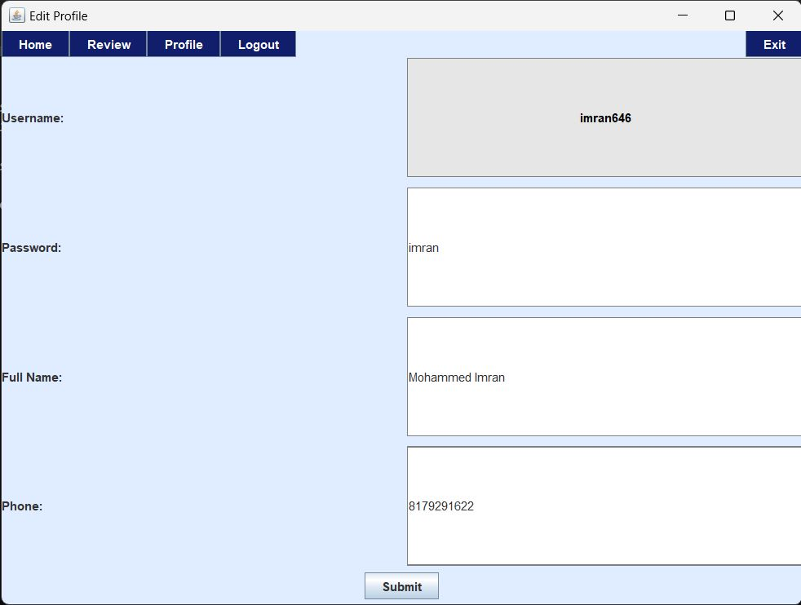
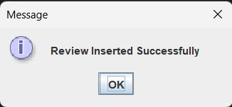

Slide 57
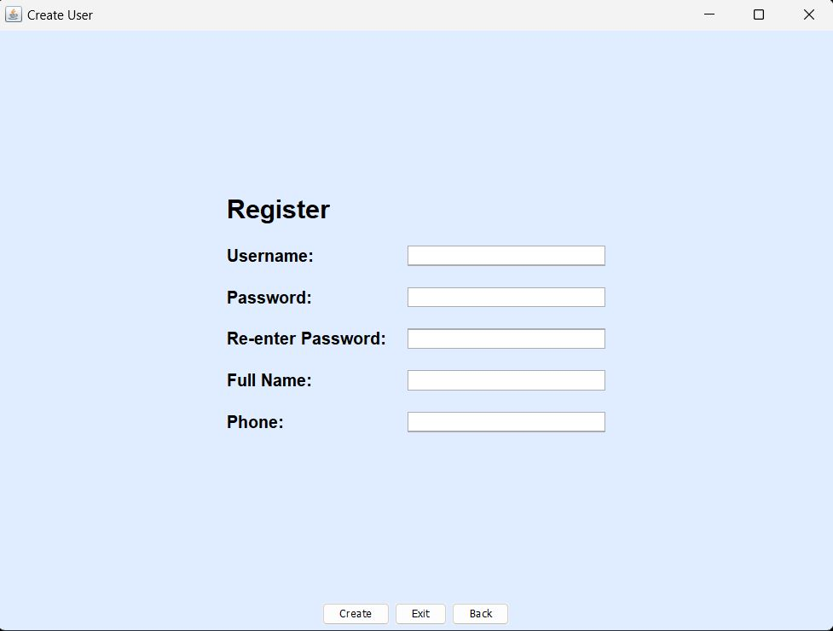

Slide 58
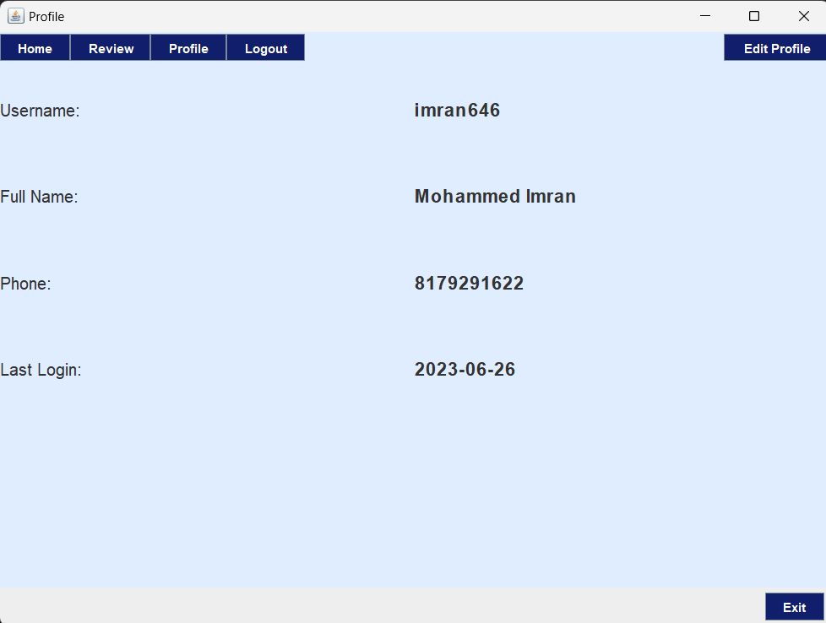
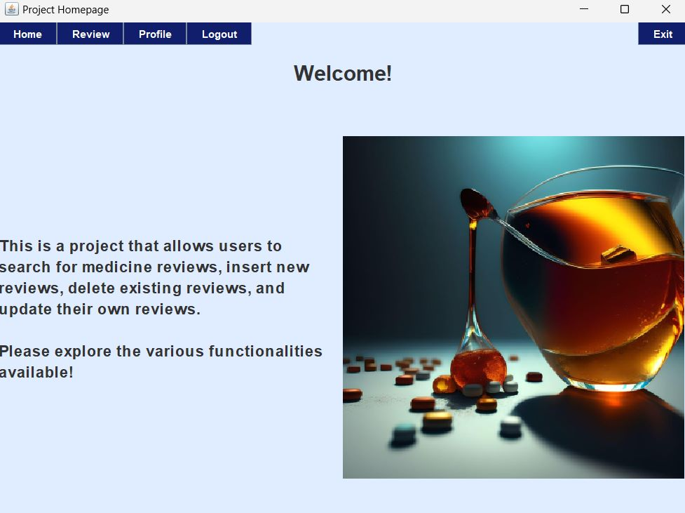

Slide 59
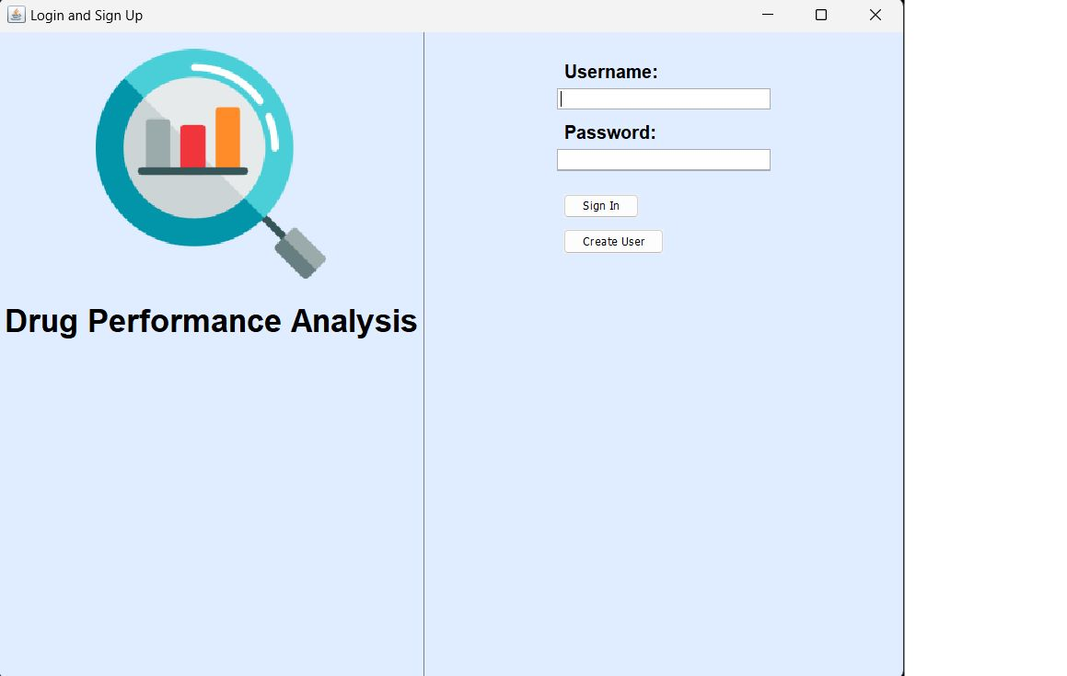
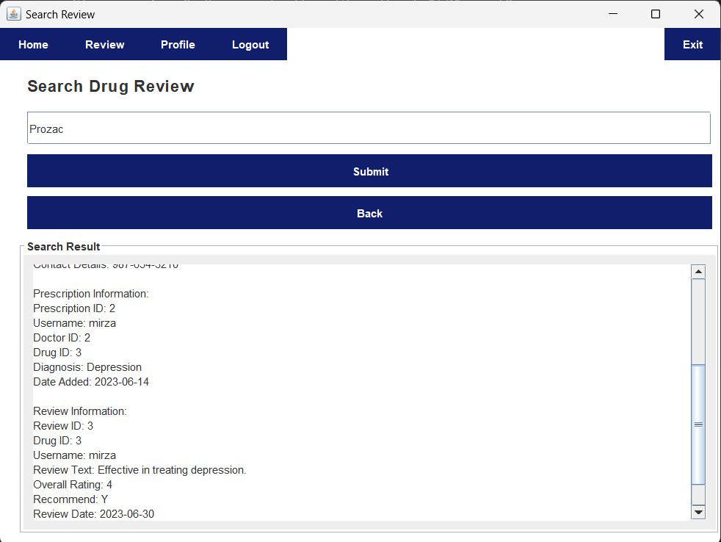

Slide 60
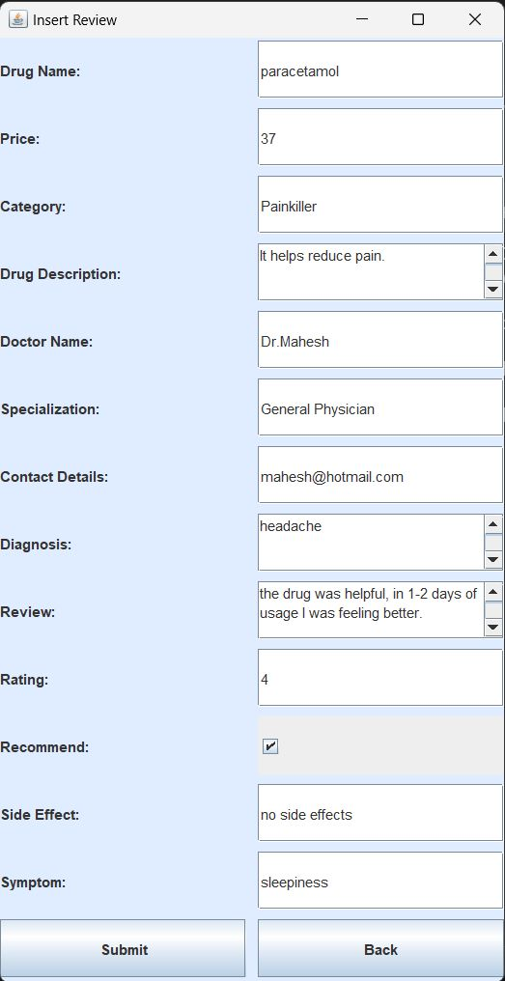

Slide 61
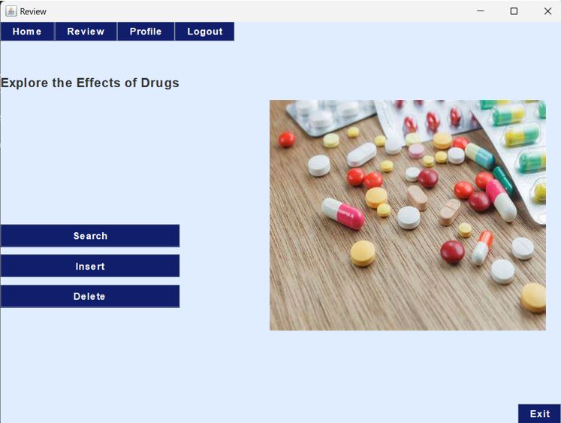
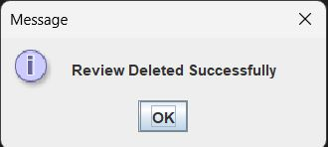

Slide 62
CONCLUSION :
In conclusion, drug performance analysis plays a crucial role in evaluating the effectiveness and safety of pharmaceutical products. By assessing various factors such as efficacy, side effects, dosing, and overall patient outcomes, drug performance analysis provides valuable insights into the real-world effectiveness of medications.
Additionally, drug performance analysis contributes to evidence-based medicine, facilitating the development of treatment guidelines and clinical protocols. It enhances our understanding of how drugs interact with specific patient populations, allowing for personalized medicine approaches and targeted interventions.
Overall, drug performance analysis is a vital component of the drug development and healthcare delivery process. It provides valuable information to healthcare professionals, regulators, and researchers, helping them make informed decisions and ultimately improving patient care and treatment outcomes.

Slide 63
FUTURE SCOPE OF THE PROJECT :
Real-world evidence (RWE) integration: Real-world data, collected from diverse patient populations and healthcare settings, can provide valuable insights into drug performance in real-life scenarios.
Artificial intelligence and machine learning: Advancements in artificial intelligence (AI) and machine learning (ML) techniques have the potential to revolutionize drug performance analysis.
Pharmacogenomics: Pharmacogenomics explores how an individual's genetic makeup influences their response to drugs.
Long-term safety monitoring: While clinical trials provide essential initial safety data, long-term safety monitoring is crucial to identify rare or delayed adverse events.
Comparative effectiveness research: Comparative effectiveness research compares the benefits and risks of different treatment options to inform clinical decision-making.

Slide 64
REFERENCES
Drugs & Medications A to Z - Drugs.com
Drug Performance Evaluation | Kaggle
Analytical techniques in pharmaceutical analysis: A review – ScienceDirect
UCI ML Drug Review dataset | Kaggle

