Slide 1
VASAVI COLLEGE OF ENGINEERING
Department of Information Technology
MINI PROJECT
REVIEW -1
Title | College Admission System Project
Team Members :
Hall Ticket No. | Name
1602-21-737-097 | Mohammed Imran
1602-21-737-095 1602-21-737-066 | Mirza Rafiq Ahmed Aatmika Abhiram
Date
Notes:
1

Slide 2
CONTENTS
Abstract
Introduction
Hardware and Software Requirements
Design
Implementation
Conclusion
References
Notes:
2

Slide 3
ABSTRACT
This project aims to manage the applications of incoming students at a college.
Generally this process involves a lot of paperwork and hectic processes hence this project reduces the complexity and saves time.
It makes it easier for students and management to know the criterions and the relevant information required to complete the admission process conveniently.
This system is accessible anywhere and available to everyone.
Notes:
3

Slide 4
2.INTRODUCTION
The project starts by popping up a login window, prompting the user to enter the login credentials.
There are two main parts in this system namely admin (college) and user (students).
Admin can add college details and cut off list, they can select students, register and view the final database of all the students registered. We can generate the cut off marks for all the streams respectively.
Notes:
4

Slide 5
Users (Students) can login, register, view the college details, and can apply by entering the student details.
They are also permitted to create a new account and register for the first time.
Students are expected to register on the website and apply with required student information. They also have the option to view the college details and past records,and add or view reviews.
College can register admissions of new students. College can make a final list after comparing the entered scores and the cut off.

Slide 6
3.HARDWARE & SOFTWARE REQUIREMENTS
FRONT END – GUI Tkinter
BACK END - mySQL
SOFTWARE REQUIRED – Python IDE and internet connection.
Notes:
6

Slide 7
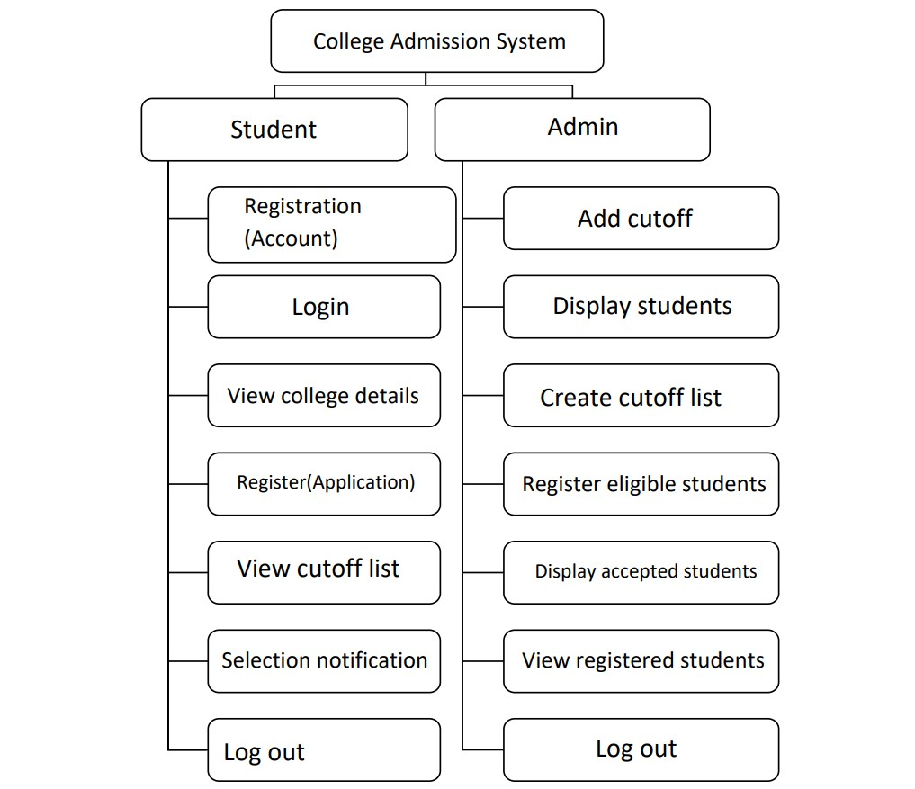
4. DESIGN
Flowchart:
Reviews
Notes:
7

Slide 8
5. IMPLEMENTATION
Notes:
8

Slide 9
6. CONCLUSION
This project successfully bridges the gap between the students and college management by providing a medium to communicate and complete the procedure of admission conveniently and precisely.
The management may use this project to store the details of incoming students for admission and filter out the students who match the criteria.
Notes:
9

Slide 10
REFERENCES
https://nevonprojects.com/online-college-admission-management-system-project/
https://www.youtube.com/watch?v=PPXhqYkKCDw
https://www.geeksforgeeks.org/python-tkinter-tutorial/
https://www.w3schools.com/python/python_mysql_getstarted.asp
https://pythongeeks.org/gui-programming-in-python/
Notes:
10

Slide 11

Notes:
11

