Slide 1
Mini Project
REVIEW - 1
TITLE : SPACE SHOOTER GAME
NAME :
ROLL NUMBER :
MATHARI LAZARUS
MOHAMMED FAHAD KHAN
MITTUKOLU SHARATH
1602–21–737-092
1602–21–737-096
1602–21–737-112

Slide 2
CONTENTS
ABSTRACT
INTRODUCTION
IN-BUILT FUNCTIONS
HARDWARE AND SOFTWARE REQUIREMENTS
CONCLUSION

Slide 3
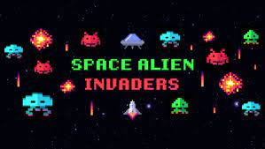
ABSTRACT IDEA
EVERYONE LOVES VIDEO GAMES.IT IS ONE OF THE MAIN FORMSOF ENTERTAIMENT.
Space Invaders was the first fixed shooter and set the template for the
shoot 'em up genre. The goal is to defeat wave after wave of descending aliens with a horizontally moving laser to earn as many points as possible.
The player has to constantly shoot and dodge to save themselves from a constant oncoming barrage of attacks from enemies.

Slide 4
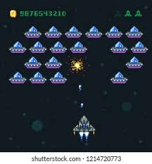

INTRODUCTION
SPACE SHOOTER is a popular arcade and a video game.The player has to constantly shoot and dodge to save themselves from a constant oncoming barrage of attacks from enemies.
The project basically uses the PYGAME module which is useful for creating video games .It consists of computer graphics and sound libraries designed to be
used with the Python programming language.
There would be apllicatiion of many In-Built functions of pygame module.

Slide 5

IN-BUILT FUNCTIONS IN PYGAME
pygame._sdl2.touch
pygame.camera
pygame.cdrom
pygame.cursors
pygame.display
pygame.draw
pygame.event
pygame.examples
pygame.fastevent
pygame.font
pygame.freetype
pygame.gfxdraw
pygame.image
pygame.joystick
pygame.key
pygame.locals
pygame.math
pygame.mask
pygame.mixer
pygame.mouse
pygame.pixelcopy
pygame.scrap
pygame.sndarray
pygame.sprite
pygame.surfarray
pygame.tests
pygame.time
pygame.transform
pygame.version
pygame.key
pygame.locals
pygame.midi

Slide 6

HARDWARE AND SOFTWARE REQUIREMENTS
SOFTWARE :
PYTHON
HARDWARE :
KEYBOARD
MOUSE

Slide 7
CONCLUSION
The game would most likely be created like an actual arcade game.
The main module used would be Pygame in python.
Hope the project would be helpful and enjoyable.

Slide 8
Thank You …

